Slide 1
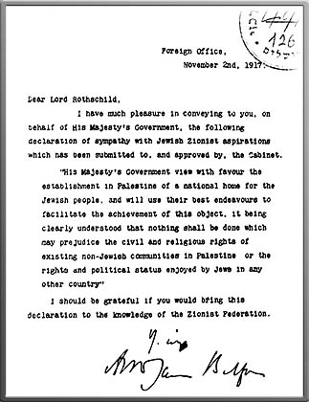
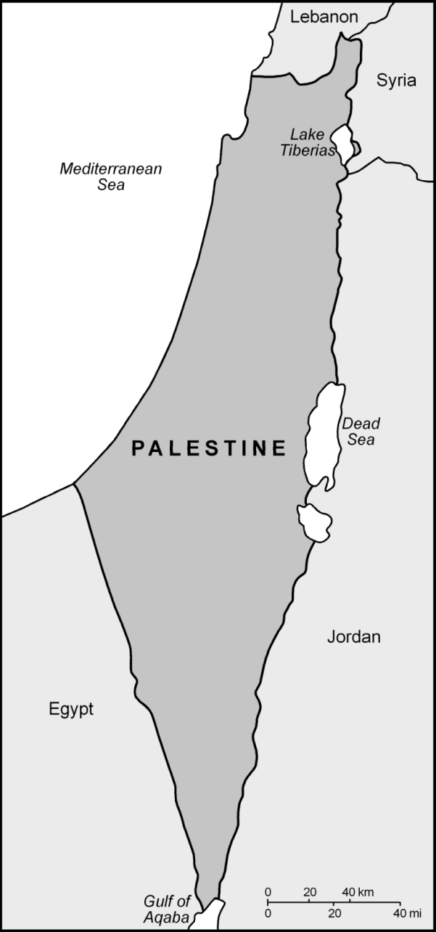
Who promised Palestine to the Jews in 1917? God or Britain?
In 1917 Britain issued the Balfour Declaration (promising Arab Palestine to world Jewry) and began a 30-year military occupation of Palestine to fulfill the promise through what British Colonel Charles Churchill envisioned in 1841 as a simultaneous and Europe-wide Jewish “agitation.”
Arthur Balfour said: The Zionist movement would “mitigate the age-long miseries created for Western civilization by the presence in its midst of a Body which it too long regarded as alien and even hostile, but which it was equally unable to expel or to absorb.” Forward, 11/1/2017, https://forward.com/opinion/386480/its-time-to-admit-that-arthur-balfour-was-a-white-supremacist-and-an-anti-s/
Read this Balfour Declaration to see that the British government (Not God) promised Palestine to the Jews in 1917 and occupied Palestine for 30 years to fulfill the promise
Watch George Galloway
(long-time British Member of Parliament) discuss how “the Balfour Declaration, made by Arthur Balfour, the British Foreign Secretary, promised on behalf of one people [the British] to a second people [the Jews] the land that belongs to a third people [the Palestinians]”, 6/4/2015: https://www.youtube.com/watch?v=KZvmOQhcObw
Watch Alison Weir discuss “The Hidden history of how the U.S. was used to create Israel,” If Americans Knew, 5/5/2015, https://www.youtube.com/watch?v=k4cNrbo15ME
Existence of Israel contrary to Torah teachings: Rabbi Weiss, 4/3/2014, https://www.youtube.com/watch?v=WuAy2xkeniY
The Rothschild Jewish family in 1906
http://www.jewishencyclopedia.com/articles/12909-rothschild
https://www.britannica.com/topic/Rothschild-family
Prince Charles, heir to British Throne, wrote in 1986: "Surely some U.S. president has to have the courage to stand up and take on the Jewish lobby in U.S.? I must be naive, I suppose!" Israel Hayom, 11/12/2017, http://www.israelhayom.com/2017/11/12/1986-prince-charles-letter-reveals-shocking-thoughts-on-jews/
In 1943, President Roosevelt’s special envoy to the Middle East US Army Lt. Col. Harold Hoskins warned: “Only by force can a Jewish state in Palestine be established or maintained” See PPT 9
In 1946, Albert Einstein warned that
a Jewish state in Palestine where a majority of the population is Arab would be “unjust and impractical.” Forward, 11/22/2015, http://forward.com/news/325189/what-was-einsteins-relationship-to-judaism-and-zionism/
http://www.valentinosghost.com/#anchorSummery
Israel Ministry of Foreign Affairs, 10/30/2015,
http://mfa.gov.il/MFA/ForeignPolicy/Peace/Guide/Pages/The%20Balfour%20Declaration.aspx
Arthur James Balfour

Slide 2
The British government promised Arab Palestine to world Jewry on 11/2/1917 and occupied Jerusalem on 12/11/1917
This British promise was expressed in a letter (dated 11/2/1917) by British Foreign Secretary Arthur James Balfour to Lord Rothschild, a leading member a Jewish banking family in London. But the promise was not a personal letter from Balfour to Rothschild. It was debated by the British Cabinet “comma by comma” through the whole of 1917, approved by US President Wilson and the US Congress, and adhered to by France and Italy. It was also approved at the San Remo Conference held by the Allies in 1920 and incorporated into the Palestine Mandate of the League of Nations in 1922 which was actually an implementation document for the promise (known as the Balfour Declaration). L. Wolf, 1919; B. Tuchman, 1984; H. Cattan, 1969; Y. Hazony, 2000.
The following are two DIFFERENT versions of the British promise: the one on the left was adopted, the other was not. What’s the difference between the two, and why it’s significant?
“His Majesty's Government view with favour the establishment in Palestine of a National Home for the Jewish people, and will use their best endeavours to facilitate the achievement of this object, it being clearly understood that nothing shall be done which may prejudice the civil and religious rights of existing non-Jewish communities in Palestine, or the rights and political status enjoyed by Jews in any other country.”
“His Majesty's Government view with favour the establishment in Palestine of the National Home for the Jewish people, and will use their best endeavours to facilitate the achievement of this object, it being clearly understood that nothing shall be done which may prejudice the civil and religious rights of existing non-Jewish communities in Palestine, or the rights and political status enjoyed by Jews in any other country.”
Napoleon promised Arab Palestine to world Jewry in 1799
"Rightful heirs of Palestine! … Arise!… Hasten!..." France “offers to you [the Jews] at this very time, and contrary to expectations, Israel’s patrimony! France calls on you not indeed to conquer your patrimony, nay, only to take over that which has been conquered and, with that nation’s warranty and support, to maintain it against all comers.” Napoleon Bonaparte, 1799, quoted in F. Kobler, 1975.

Slide 3
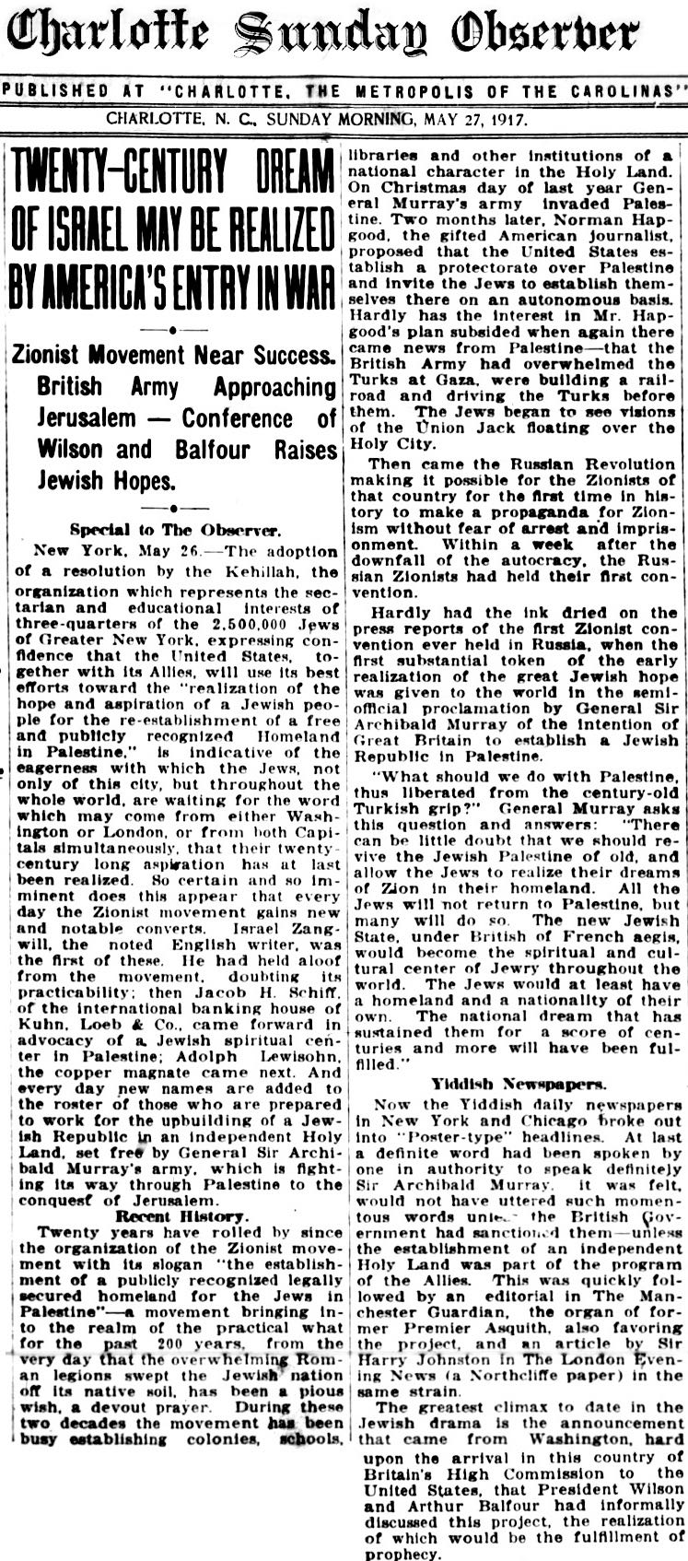
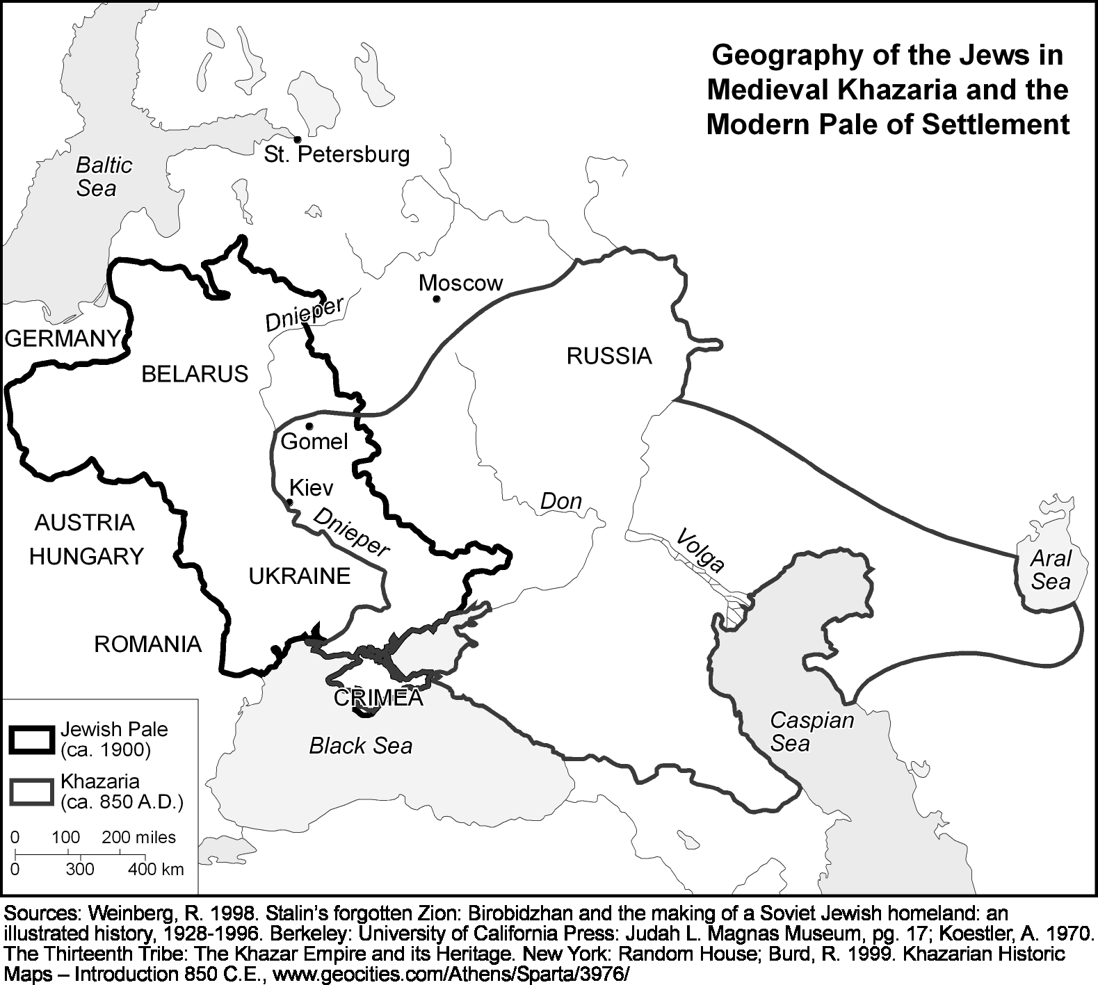
https://upload.wikimedia.org/wikipedia/commons/9/97/Charlotte_Sunday_Observer_front_page_May_27_1917%2C_Twenty-Century_Dream_of_Israel_May_Be_Realized_by_America%27s_Entry_into_War.jpg
http://www.bbc.co.uk/history/worldwars/wwone/battle_somme.shtml
Did Brits Kill New York City Cops to Get U.S. into WWII? The Daily Beast, 7/16/2017, http://www.thedailybeast.com/did-brits-kill-new-york-city-cops-to-get-us-into-wwii
Overview of World War I, http://www.digitalhistory.uh.edu/era.cfm?eraid=12&smtid=1

Slide 4
Geography of Russia’s Jews by Provinces and Regions in 1897
Provinces and Regions Jewish Population Percent of Total Population
Grodno Province 276,874 17.28
Kovno 212,230 13.71
Minsk 338,657 15.77
Mohilev 201,301 11.92
Vilna 205,261 12.80
Vitebsk 175,678 11.80
Kiev 427,863 12.03
Podolia 306,597 12.15
Poltava 111,417 4.02
Tchernigov 114,630 4.99
Volhynia 397,772 13.31
Bessarabia 225,637 11.65
Ekatrinoslav 100,736 4.77
Kherson 337,282 12.32
Tauride 66,125 4.57
Kalisz 72,339 8.59
Kielce 82,427 10.82
Lomza 90,912 15.69
Lublin 153,728 13.26
Piotrkow 222,299 15.83
Plock 50,473 9.13
Radom 113,277 13.89
Siedle 122,370 15.84
Suwalki 58,808 10.09
Warsaw 349,943 18.12
Caucasus Region 58,471 0.63
Siberia Region 34,477 0.60
Central Asia Region 12,729 0.16
Other Provinces/Regions 269,088
All Provinces/Regions 5,189,401 4.13
Source: Compiled from: Jewish Colonization Association, Recueil de matériaux sur la situation économique des Israélites de Russie, d'après l'enquête de la Jewish Colonization Association, Tome II: La Grande Industrie, Misère et Bienfaisance, Instruction, Paris: F. Alcan, 1908, Appendice, Tableau 1, 2, 3, and Carte (Note: the names of some provinces retain their French spelling). See also Jewish Colonization Association, Recueil de matériaux sur la situation économique des Israélites de Russie, d'après l'enquête de la Jewish Colonization Association, Tome I: Introduction, Agriculture, Artisans et Manoeuvres, Paris: F. Alcan, 1908, pages 21-23.
Population figures published by the Berman Jewish DataBank of the Jewish Federations of North America indicate that in 2016, US Jewish population was 6.8 million, and the world's Jewish population was 14.4 million.
http://www.jewishdatabank.org/
How Fall Of Steven M. Cohen [President of the Berman Jewish Policy Archive, a database of Jewish communal policy research at Stanford University] Could Change The Field Of Counting Jews, Forward, 8/3/2018, https://forward.com/news/407361/how-fall-of-steven-m-cohen-could-change-the-field-of-counting-jews/

Slide 5
Original names and countries of the new* children of Abraham
Israeli Name Original Name Original Country Top Services to the State of Israel
David Ben-Gurion Grün Poland Prime Minister 1948-53 & 1955-63
Moshe Sharett Shertok Ukraine Prime Minister 1954-55
Levi Eshkol Shkolnik Ukraine Prime Minister 1963-69
Golda Meir Mabovitch Ukraine Prime Minister 1969-74
Yitzhak Rabin Rubitzov Ukraine Prime Minister 1974-77 & 1992-95
Menachem Begin Begin Belarus Prime Minister 1977-83
Yitzhak Shamir Yzernitzky Poland Prime Minister 1983-84 & 1992-95
Benjamin Netanyahu Milikowsky Lithuania Prime Minister 1996-99/2009-present
Ehud Barak Brug Belarus Prime Minister 1999-01
Ariel Sharon Sheinerman Belarus Prime Minister 2001-06
Ehud Olmert Olmert Ukraine Prime Minister 2006-2009
Chaim Weizmann Weizmann Belarus President 1949-52
Itzhak Ben-Zvi Shimshelevitz Ukraine President 1952-63
Zalman Shazar Rubashov Belarus President 1963-73
Yitzhak Navon Navon Spain President 1978-83
Chaim Herzog Herzog Poland President 1983-93
Ezer Weizman Weizman Belarus President 1993-00
Moshe Katsav Qassab Iran President 2000-07
Shimon Peres Perski Belarus President 2007-2014
Reuven Rivlin Rivlin Austria President 2014-present
Source: Israel Ministry of Foreign Affairs, “Personalities: The Presidents of the State of Israel and The Prime Ministers of the State of Israel,” 19 August 2006, http://www.israel-mfa.gov.il/mfa. A couple of the biographies were updated from the website of Wikepedia Free Encyclopedia, 11 February 2008, http://en.wikipedia.org
*The “Semitic” ancestry and inheritance claimed by Zionism and Israel in the name of contemporary Jews have been rejected and exposed by many scholars, including (1) Hungarian Ashkenazi Jew Arthur Koestler in his book The Thirteenth Tribe: The Khazar Empire and its Heritage; (2) British archaeologist Michael Rice in his book False Inheritance: Israel in Palestine and the Search for a Solution, (3) Tel Aviv University Professor Paul Wexler in his four books (a) The Ashkenazic Jews: A Slavo-Turkic People in Search of a Jewish Identity, (b) The Non-Jewish Origins of the Sephardic Jews, (c) Two-tiered Relexification in Yiddish: Jews, Sorbs, Khazars, and the Kiev-Polessian Dialect; (d) Jewish and Non-Jewish Creators of “Jewish” Languages, and (4) Tel Aviv University Professor Shlomo Sand in his two books (a) The Invention of the Jewish People and (b) The Invention of the Land of Israel.
Ibn Fadlan visited the Khazar city [Astrakhan, Russia] on the Itil [Volga] River in 921 AD and wrote: “The Khazars and their king are all Jews” , Ibn Fadlan and the Land of Darkness, translated with an introduction by Paul Lunde and Caroline Stone, Pinguin Books, London, 2012, p. 58.
Ibn al-Faqih’s kitab al-buldan of the tenth century AD noted with a spontaneous precision that “the Khazars are all Jews, but Judaized (only) recently” (من قريب).
Ibn Rusta on the Khazars 903-913 AD: “Their supreme authority [Khaqan] is Jewish, and so is the Isha [king] and those commanding officers and important men who support him. The rest of them follow a religion like the religion of the Turks” p 117

Slide 6
Soviet Government Plans Jewish Republic in Siberia, Kalenin Says
Jewish Telegraphic Agency, January 3, 1923, http://archive.jta.org/article/1926/08/16/2762918/soviet-government-plans-jewish-republic-in-siberia-kalenin-says
The establishment of a Jewish republic in Siberia, under the auspices of the Union of Socialist Soviet Republics, is the latest plan of the Soviet Government, according to an article published in the New York "Herald-Tribune" by Elias Tobenkin, American Jewish writer and author of the novel "The God of Might", who spent five months in Soviet Russia as correspondent for the "Herald-Tribune."
Mr. Tobenkin reproduces in his article an interview with Michael Kalenin, President of the Soviet Republic, on this matter.
"'I would like to see a Jewish republic established in Russia, in Siberia. It need not be a very big republic--half a million people would do. Nor need the whole of this half million population be exclusively landworkers. Such a Jewish republic could very well consist of a combination of peasants, with home artisans and skilled mechanics,' Kalenin stated….
"The President of the Soviet Republic at this point found himself discussing Zionism. M. Kalenin did not seem familiar with the word 'Palestine' and regularly substituted the word 'Mesopotamia' for it.
"'I understand,' he said, 'that there is a movement on foot in certain countries of Europe and in America to settle Jews on land in Mesopotamia [Palestine]. Of course, we are not going to hinder any one who wishes to leave the country to expatriate himself. But it is an insult to us to say that Jews need to go away from Russia to engage in agriculture or in any other pursuit. There is not the slightest juridical discrimination among nationalities in our country. There is not a trace of a Jewish question in law or in fact anywhere in the Soviet Union.‘… "The Jews, by reason of their not being permitted to take root in the soil, had, before the revolution, a merchant class running up to 42 per cent of the total Jewish inhabitants in Russia. The revolution, with its ban on private trade, left this class economically helpless…"'It is the plan of the Jewish spokesmen in Soviet Russia to give their people a natural footing in the country by converting 20 per cent of the Jewish population into farmers.”

Slide 7
Text of Kalinin’s Statement on Jewish Question in Russia
Jewish Telegraphic Agency, July 30, 1926 http://www.jta.org/1926/07/30/archive/text-of-kalinins-statement-on-jewish-question-in-russia
The statement of M. Kalinin, chairman of the Central Executive Committee of the Soviets, dealing with the Jewish question in Soviet Russia and particularly with the Jewish Colonization question and the opposition manifested against it by some peasant elements….
“The first stages of the revolution fell most severely upon the small traders and the artisans, upon just that section of the population which consisted almost exclusively of Jews... The small nationalities feel that the Soviet Government is a real mother, not a step-mother. We have discovered among us peoples of whose existence no one knew and today they are equals among equals. All of them enjoy national autonomy. Only the Jews dispersed among the other nationalities could not obtain territorial autonomy, although their numbers, from two-and-a-half to three million people in the Soviet Union, gives them the right to autonomy... So the Jews have asked the Soviet Governments to provide them with land. The Government of the Soviet Union realized that the greatest part of the Jewish masses can be saved from ruin and destruction only by settling them on the land and for this reason a committee was formed for settling the Jewish toiling masses on the land... The Jews have by fate been made accustomed to life in a temperate Southern climate. They live in the Ukraine, Poland and South Russia. Czarism did not allow them to go northward and Siberia was closed to them... So the Government seeks to settle them in places where the climate and other conditions are not dissimilar from those to which they are accustomed. During the Czarist regime, a great number of Jews emigrated to America and of late there is the idea of settling most of the Jews in Palestine, an idea supported by foreign Jewish capitalists. This movement is still very strong. The Zionists wage a campaign against the Soviet Government, enticing the Jewish impoverished masses to Palestine where they fall into slavery to British and Jewish capital. The Soviet Government cannot sit by and see not the rich man but the beguiled Jewish poor learning its territory. The Jewish communists, not those communists who occupy important positions with us who are only Jews by descent, but those Jewish communists who live among the Jewish masses have approached the Government asking it to settle in the Soviet Union those emigrants who would go to Palestine and for this purpose to raise the funds which are being collected abroad for the settling of the Jews on the land in Russia."

Slide 8
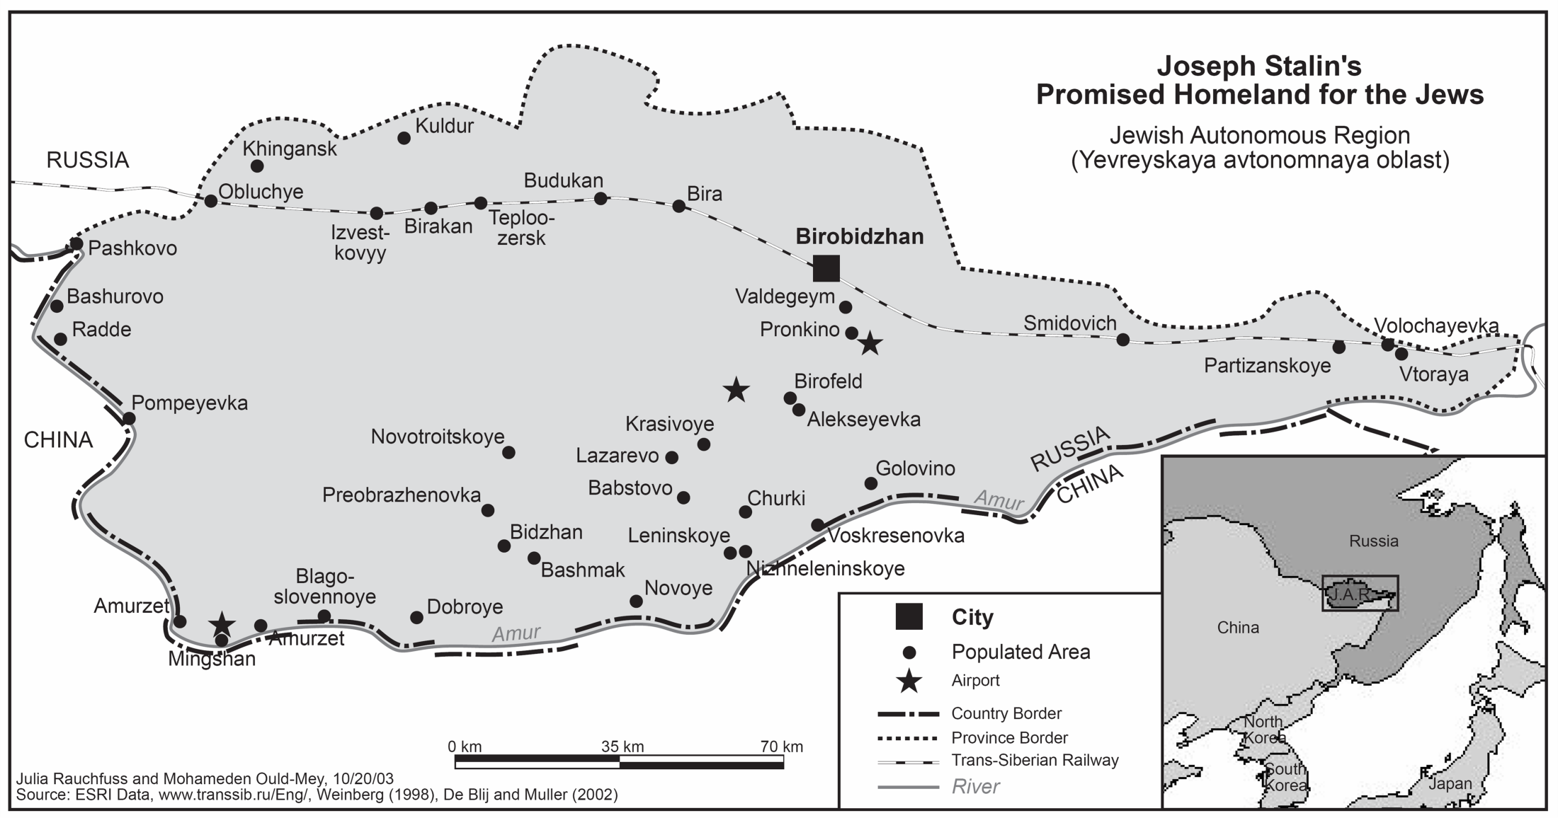
Soviet Joseph Stalin’s Promised Homeland for the Jews (1928)

Slide 9
In 1943, US Army Colonel Hoskins warned President Roosevelt against the creation of a Jewish state in Palestine
In a 1943 secret memo to President Franklin D. Roosevelt, special envoy to the Middle East US Army Lt. Col. Harold Hoskins, warned against the creation of a Jewish state in Palestine: “… Not only you as President but the American people as a whole should realize that, if the American government decides to support the establishment of a Jewish state in Palestine… they are committing the American people to the use of force in that area, since only by force can a Jewish state in Palestine be established or maintained.”----Ben Bradley, “The secret files: Washington, Israel and the Gulf,” videocassette (60 min.), Washington, D.C.: WETA, 1991.
“Even in 1946, when the horrors of the Holocaust were still raw, [Albert] Einstein’s views were unchanged. In an interview with the Forverts, Einstein warned that a “Jewish commonwealth” where a majority of the population is Arab would be “unjust and impractical.” Testifying in Washington that same year to an international committee examining the Palestine question, Einstein said, “The state idea is not in my heart.” If Einstein’s opposition to a Jewish state was disappointing for Zionists, then his religious views disappointed religious Jews as well as atheists.” Forward, 11/22/2015, http://forward.com/news/325189/what-was-einsteins-relationship-to-judaism-and-zionism/

Slide 10
The Palestine question was the main concern during the historic encounter between President Roosevelt and King Ibn Saud in 1945
“President Roosevelt took the initiative of inviting Ibn Saud to meet with him for the first time in February 1945 on board of the USS Quincy on Great Bitter Lake in the Suez Canal. At the meeting, following warm pleasantries and evidence of mutual goodwill (including Roosevelt's gift to the king of one of his wheelchairs), the entire meeting became a vigorous exchange on the Palestine question. This had been the central theme of earlier correspondence between the two leaders, beginning with a letter from Ibn Saud to the president dated November 29, 1938, and the president’s reply of January 2, 1939. In July 1943, Roosevelt had ordered Harold Hoskins, the son of American missionaries and a speaker of Arabic, to Saudi Arabia to determine by personal contact with Ibn Saud whether the king would be willing to meet with Chaim Weizman or other representatives of the Jewish Agency. The purpose would be to seek a ‘solution of basic problems affecting Palestine acceptable to both Arabs and Jews.’ Hoskins was personally well received. His report to Roosevelt recounted a weeklong visit to Riyadh, where he held frequent sessions alone with Ibn Saud. The king was appreciative of the opportunity Hoskins offered to speak frankly on many sensitive topics without an interpreter. The subject dealt with were many, but Palestine was the main concern. The king chose his words to the president with the utmost care. He said he could neither enter into such talks himself nor authorize a representative to do so. He feared a stage-by-stage wipeout of the Palestinian Arab population; also, he revealed a personal hatred of Weizman, based on Weizman’s alleged attempt to bribe him with 20 million pounds sterling, to be ‘guaranteed’ by President Roosevelt. The king later told me that Weizman’s proposed intermediary was H. St. John Philby.” Hoskins made his report to Roosevelt in person in a one-hour breakfast talk on September 27, 1943, only a few days before the scheduled arrival in Washington of Princes Faisal and Khalid. To Hoskins, Roosevelt expressed full understanding of the reason for the king’s refusal to meet with Weizman, and the president also showed irritation that his name had been mentioned as a guarantor, for which, he said, there was no basis in fact. The nearest he ever came to bordering on a discussion of this subject, Roosevelt said, was a suggestion he made several years earlier to Stephen Wise, chairman of the American Zionist Emergency Council, that if the Jews wanted to get more land in Palestine, they might well think of buying arable land outside of Palestine and assisting Arabs financially to move from Palestine to such areas. Roosevelt also told Hoskins that he favored an international trusteeship for Palestine, as recommended by the Department of State.”
Source: Parker Hart, Saudi Arabia and the United States: Birth of a Security Partnership, Indiana University Press, 1998, pp. 38-39
See also William Eddy’s memorandum of the conversation printed in Foreign Relations of the United States, 1945, vol. 8, pp. 1-3 and 7-9 , and in Eddy’s personal account, F.D.R. Meets Ibn Sa’ud, published in 1954.

Slide 11

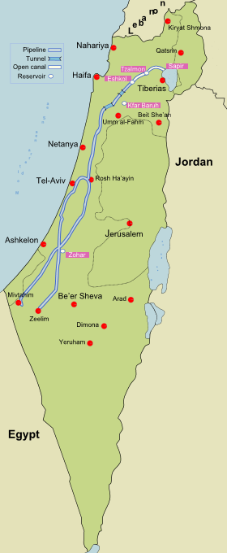
Ethnic cleansing & River Diversion
* Israeli historian and political scientist Ilan Pappe describes and documents the planning and execution of the ethnic cleansing of Palestine by 11 Jewish settlers sitting in a room beneath Marxist-style posters that carried slogans such as ‘Brothers in Arms:’
* “In this building [the Red House in the Jewish settlement of Tel-Aviv], on a cold Wednesday afternoon, 10 March 1948, a group of eleven men, veteran Zionist leaders together with young military Jewish officers, put the final touches to a plan [Plan Dalet] for the ethnic cleansing of Palestine.”
* “The orders came with a detailed description of the methods to be employed to forcibly evict the people: large-scale intimidation; laying siege to and bombarding villages and population centres; setting fire to homes, properties and goods; expulsion; demolition; and, finally, planting mines among the rubble to prevent any of the expelled inhabitants from returning. Each unit was issued with its own list of villages and neighbourhoods as the targets of this master plan.”
Ilan Pappe, The Ethnic Cleansing of Palestine, Oxford: Oneworld, 2006, p. xii-xiii.
Diversion of the only river (The Jordan River) in an arid country away from its 20 million-year-old natural course.
The 1948 ethnic cleansing of native Palestinian Muslims and Christians by incoming Jewish settlers is known in Arabic as the Alnakba or the Catastrophe:
Alnakba English P1, https://www.youtube.com/watch?v=bm7dMhE80dw
Alnakba English P2, https://www.youtube.com/watch?v=jYvimRnlTqE#t=6117
The 70th Anniversary of the Palestinian Nakba (Catastrophe)
http://www.almayadeen.net/episodes/877023/كلمة-حرة_الذكرى-الـ-70-للنكبة-الفلسطينية/
CC
National Water Carrier of Israel, by AdamHej, 15 March 2015, https://commons.wikimedia.org/wiki/File:National_Water_Carrier_of_Israel_-en.svg

Slide 12
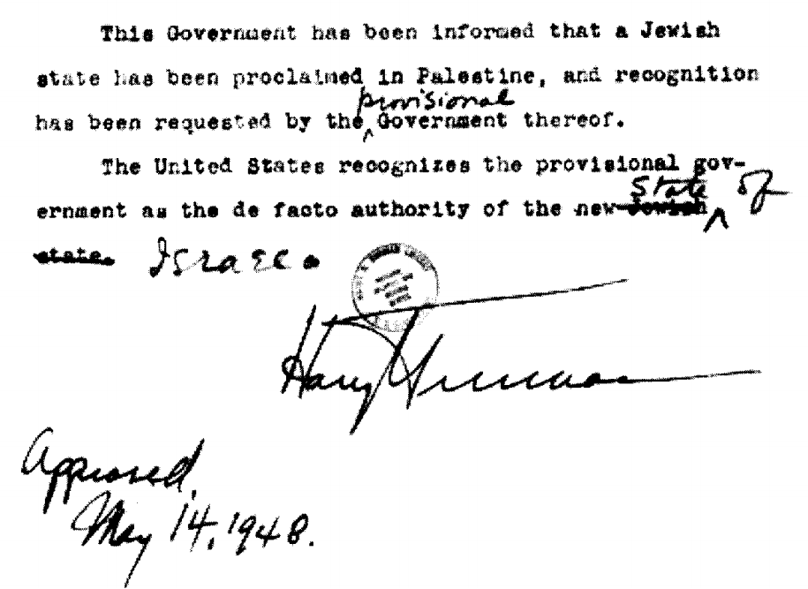
U.S. President Harry Truman recognized Israel 11 minutes after its proclamation,
but he recognized it as a “provisional” government and a “non-Jewish” state
Source: Jeff Gates, Guilt by Association, page 180
“Sometime in the late 1950s, that world-class gossip and occasional historian, John F. Kennedy, told me how, in 1948, Harry S. Truman had been pretty much abandoned by everyone when he came to run for president. Then an American Zionist brought him two million dollars in cash, in a suitcase, aboard his whistle-stop campaign train. ‘That’s why our recognition of Israel was rushed through so fast.’”---Gore Vidal, Quoted in Grant F. Smith, Spy Trade: How Israel’s Lobby Undermines America’s Economy, Institute for Research: Middle Eastern Policy, Inc., Washington, DC, 2008, page 27

Slide 13
Palestine Refugees Hearings before the Committee on Foreign Affairs , House of Representative , Eighty-First Congress on Senate Joint Resolution 153
A Joint Resolution for the Authorization of a Contribution by the United States to the United Nations Relief and Works Agency for Palestine Refugees in the Near East
Washington, DC, February 16 and 17, 1950
Mr. [John M.] Vorys [House Committee on Foreign Affairs]. Looking at the Path of Immigration it would appear that 800,000 Jews came in , and 750,000 Arabs went out. Would that be a statement, nearly, of the cause and effect?
Mr. [George C.] McGhee [Assistant Secretary of State for Near Eastern, South Asian, and African Affairs]. No, sir, I do not think you can say there is a direct cause and effect relationship. Of course there was a considerable movement into Palestine, starting in 1919. One might reason that there is an indirect cause and effect.
Mr. Vorys [Ohio]. I have no further questions.
Chairman John Kee [West Virginia]. Mr. Battle?
Mr. [Laurie C.] Battle [Alabama]. I have no further questions.
Chairman Kee . Mr. Merrow?
Mr. [Chester E.] Merrow [New Hampshire]. I have no further questions.
Trump and Allies Seek End to Refugee Status for Millions of Palestinians: Jared Kushner, U.S. President Donald Trump’s son-in-law and senior advisor, has quietly been trying to do away with the U.N. relief agency that has provided food and essential services to millions of Palestinian refugees for decades, according to internal emails obtained by Foreign Policy. Foreign Policy, 8/3/2018, https://foreignpolicy.com/2018/08/03/trump-palestinians-israel-refugees-unrwaand-allies-seek-end-to-refugee-status-for-millions-of-palestinians-united-nations-relief-and-works-agency-unrwa-israel-palestine-peace-plan-jared-kushner-greenb/

Slide 14
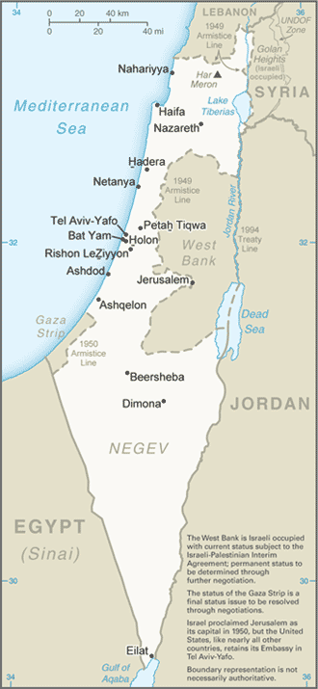
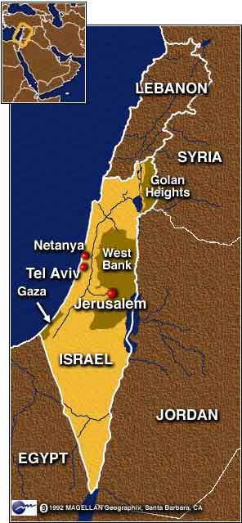
Jewish settlers dispossessed and displaced most native Muslim/Christian Palestinians
Jewish Settlers in Palestine/Israel 1919-1999
About 3,237,000 Jewish settlers/immigrants arrived in Palestine/Israel between 1919 and 1999: Euro-American (71.2%) and Afro-Asian (28.8%). Source: Goldscheider, C. (2002), Israel's Changing Society: Population, Ethnicity, and Development. Colorado: Westview Press. Page 51.
At the end of 2017, the estimated Jewish population in Palestine-Israel was 6.5 million, Israel's Central Bureau of Statistics, Israel’s Central Bureau of Statistics, 1/10/2018 http://cbs.gov.il/reader/?MIval=cw_usr_view_SHTML&ID=705
Palestinian Dispossession and Dispersal 1948-2000
Palestine/Israel (4,715,000), Jordan (2,540,000), Lebanon (500,000), Syria (443,000), Saudi Arabia (334,000), Iraq (87,000), Egypt (72,000), Kuwait (35,000), Libya (31,000), Other Arab States (570,000). Source: De Blij, H.J. and Muller, P. O. (2002), Geography: Realms, Regions, and Concepts, 10th Edition. New York: John Wiley & Sons. Page 314.
At the end of 2016, the estimated number of Palestinians in the world was 12.70 million, of whom 6.41 million in Palestine-Israel and 6.28 million in foreign countries, Palestinian Central Bureau of Statistics,
الجهاز المركزي للإحصاء الفلسطيني، الفلسطينيون في نهاية عام 2016
http://www.pcbs.gov.ps/Downloads/book2242.pdf
CNN

Slide 15
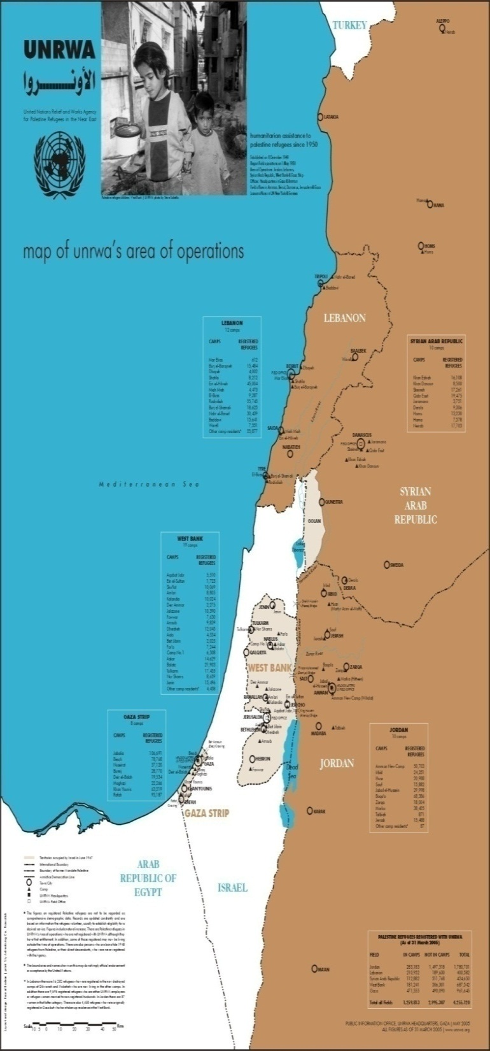
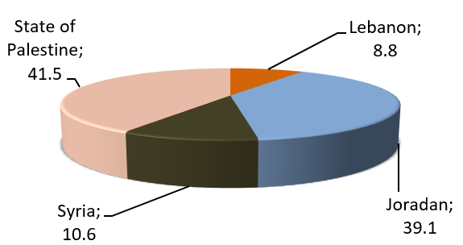
At the end of 2016 there were 6.4 million Jewish settlers or Jewish Israelis who came from over 100 countries and who live in Palestine-Israel. There were also 12.70 million Muslim and Christian Palestinians who are the native of Palestine and who live inside and outside Palestine-Israel (millions of them living in 58 UN registered Palestinian refugee camps in Palestine-Israel, Jordan, Syria, and Lebanon for more than six decades). The Palestinian refugees continue to struggle to return to the homes from which they were expelled or fled in 1948 and thereafter. Israel continues to deny the Palestinian refugees the right to return to their country because they are not Jewish. This is the core of the Palestine-Israel conflict. Review carefully the geography of the Palestine refugees and refugee camps as mapped by the United Nations Relief and Work Agency (UNRWA) at: http://www.unrwa.org/userfiles/2011011352710.pdf/
The Core of the Palestine-Israel Conflict
Percentage Distribution of [5.9 million] Palestinian Refugees by the Residential Country 2016, (According to the data of UNRWA on the Palestinian Refugees))
PCBS, 6/20/2017, http://www.pcbs.gov.ps/portals/_pcbs/PressRelease/Press_En_IDRef2017En.pdf

Slide 16
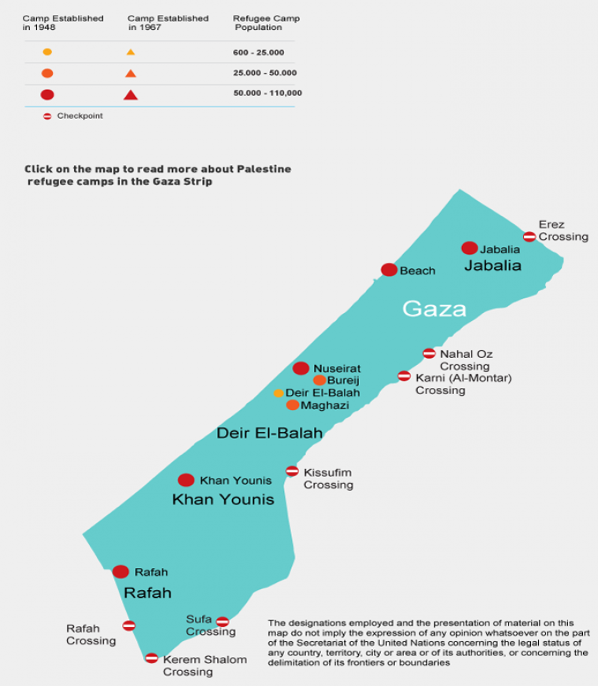
Geography of UNRWA-registered Palestine refugees in Gaza Strip
The United Nations Relief and Works Agency for Palestine Refugees (UNRWA) provides assistance and protection for millions of registered Palestine refugees.
The Gaza Strip is home to a population of approximately 1.9 million people, including 1.3 million Palestine refugees
Facts & Figures
•1.3 million registered refugees out of 1.9 million total population (approximately 70%)
•8 refugee camps
•Almost 12,500 staff
•267 schools for over 262,000 students
•21 health centres
•16 relief and social services offices
•3 micro-finance offices
•12 food distribution centres for almost one million beneficiaries
Figures as of 31 October 2016,
https://www.unrwa.org/where-we-work/gaza-strip

Slide 17
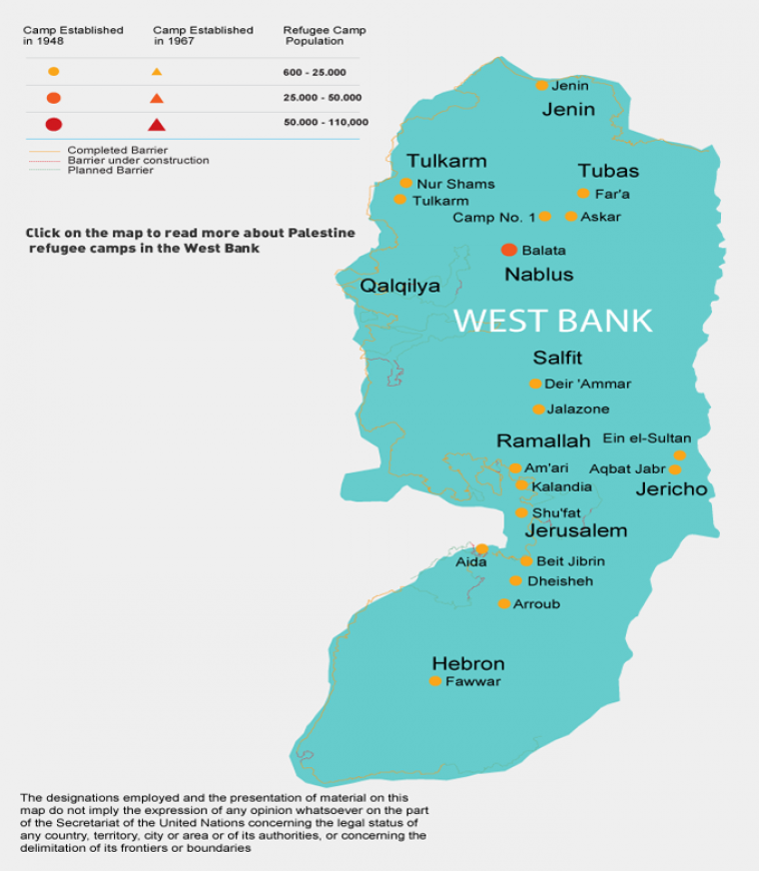
Geography of UNRWA-registered Palestine refugees in West Bank
While the West Bank has the largest number of recognized Palestine refugee camps in the five UNWRA fields, the largest of them, Balata, has a population similar to that of the smallest camp in Gaza.
Facts & figures
809,738 registered Palestine refugees
•19 camps
•96 schools, with 48,956​ pupils
•2 vocational and technical training centres
•43 primary health centres
•15 community rehabilitation centres
•19 women’s programme centres
Figures as of 31 December 2016, UNRWA, https://www.unrwa.org/where-we-work/west-bank

Slide 18
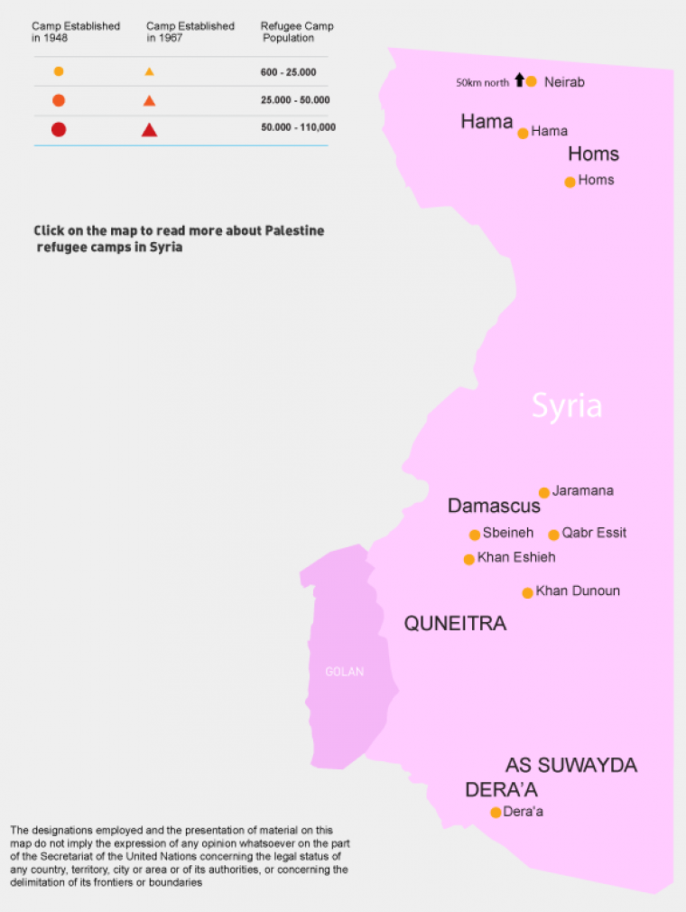
Geography of UNRWA-registered Palestine refugees in Syria
Facts & figures
•526,744 registered Palestine refugees
•Nine camps
•42 schools(76 schools are unusable due to damage, inaccessibility or because they are housing IDPs. 43 alternative school buildings are used in afternoon shifts)
•46,385 tsudents (An estimated 10,000 UNRWA students in Syria are not currently in school and an estimated 10,000 Palestine refugees from Syria are attending UNRWA schools in Lebanon and Jordan)
•Damascus Training Centre
•23 primary health centres (Nine health centres are unusable; UNRWA has established an additional 12 health points)
•Eight community rehabilitation centres
•16 women's programme centres
Figures as of 1 January 2011.
UNRWA, https://www.unrwa.org/where-we-work/syria

Slide 19
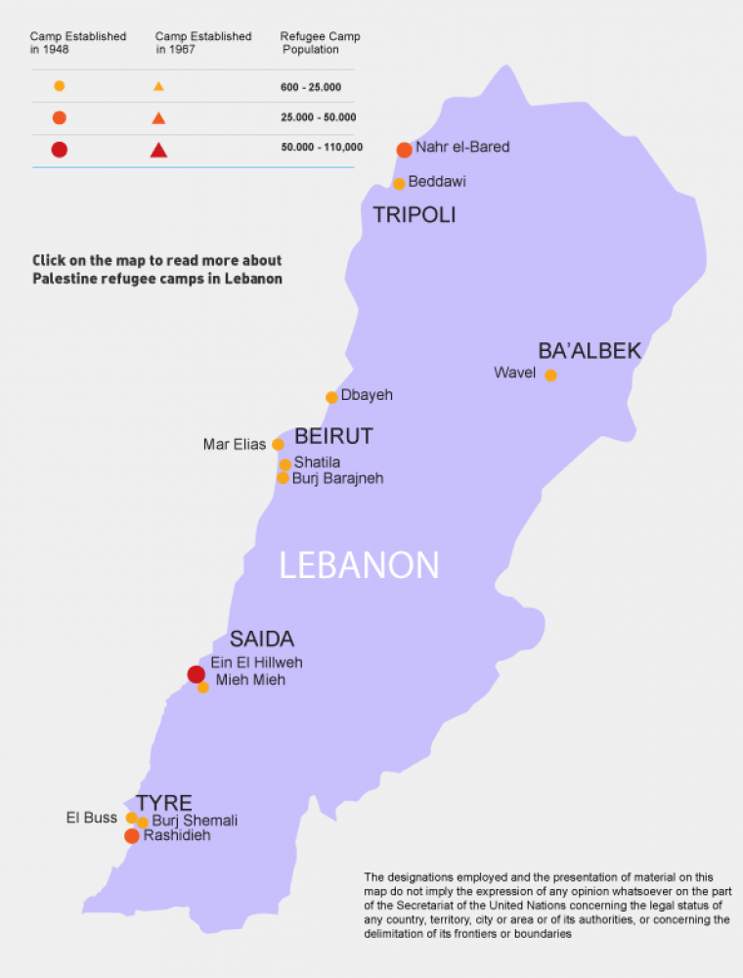
Geography of UNRWA-registered Palestine refugees in Lebanon
The United Nations Relief and Works Agency for Palestine Refugees (UNRWA) provides assistance and protection for millions of registered Palestine refugees. Some 450,000 refugees are registered with UNRWA in Lebanon, with many living in the country’s 12 refugee camps.
Facts & figures
449,957 registered Palestine refugees
12 camps
69 schools, with 32,350 pupils
Two vocational and technical training centres
27 primary health centres
One community rehabilitation centre
Nine women’s programme centres
Figures as of 1 July 2014
UNRWA, https://www.unrwa.org/where-we-work/lebanon

Slide 20
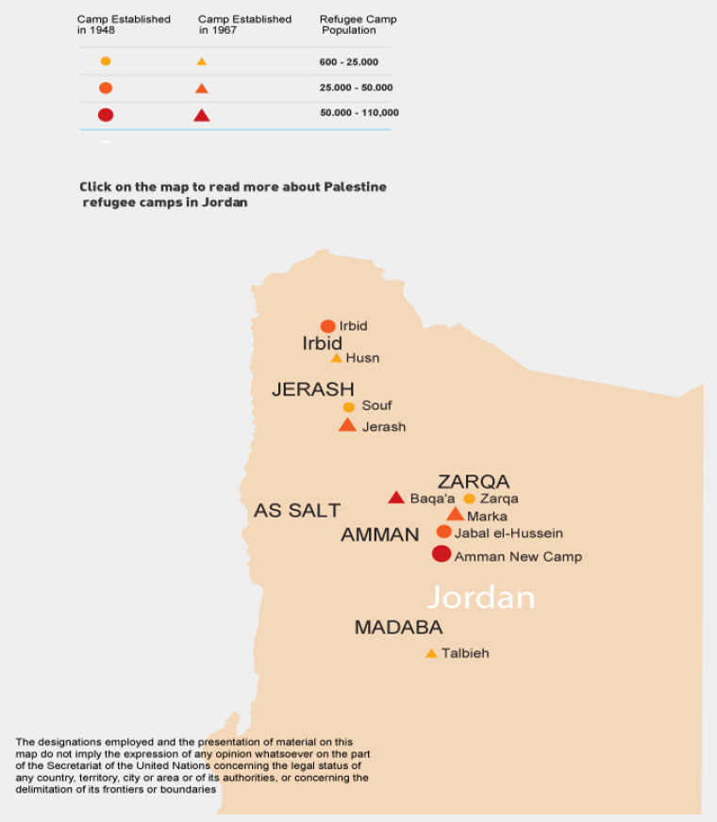
Geography of UNRWA-registered Palestine refugees in Jordan
More than 2 million registered Palestine refugees live in Jordan.
Facts & figures
•2,175,491 registered Palestine refugees
Ten official camps
•171 schools, with 121,368 students
One Faculty of Science and Educational Arts
•Two vocational and technical training centres
25 primary health centres
Ten community-based rehabilitation centres
14 women’s programme centres
Figures as of 1 December 2016
UNRWA, https://www.unrwa.org/where-we-work/jordan
Munther J. Haddadin, a senior negotiator in Jordan’s delegation to the Middle East Peace Process, once suggested that “the Kingdom of Jordan should perform a detailed assessment of the costs it has incurred in housing the waves of people it has received since 1948, along with the natural growth this has caused, including the increased cost of providing utilities. It should seek compensation for its expenses when the issues of refugees are addressed in the context of Middle Eastern peace.” Munther J. Haddadin, “Conclusions,” in Water Resources in Jordan, edited by Munther J. Haddadin, Resources for the Future, Washington, DC, USA, 2006, pp. 264-284, p. 268.

Slide 21
“The Israeli Knesset passed The Law for Safeguarding the Rejection of the Right of Return, 2001”---Israeli historian and political scientist Ilan Pappe, The Ethnic Cleansing of Palestine (2006), page 244
In 2003, the Israeli Knesset passed a law prohibiting Palestinians from obtaining citizenship, permanent residency or even temporary residency when they marry Israeli citizens”---Pappe, page 249
“No refugee can enter Israel as part of the peace process.”--- Israeli Foreign Minister Tzipi Livni told the Conference of Presidents of Major American Jewish organizations, 2/16/2009, http://www.israelnationalnews.com/News/News.aspx/129979
The refugee problem must be solved outside of Israeli borders. Their return goes against the principle of Israel as a Jewish state.—Israeli Prime Minister Benjamin Netanyahu, BBC, 6/14/2009, http://news.bbc.co.uk/2/hi/middle_east/8099757.stm
“It was not as if there was a Palestinian people in Palestine and we came and threw them out and took their country away from them. They did not exist.”—Israeli Prime Minister Golda Meir (1969), Sunday Times, 6/15/1969. The Guardian, 6/6/2003 2003Ghada Karmi, “The map must show a way home: The Middle East plan will fail unless it allows the right of return,” http://www.guardian.co.uk/comment/story/0,3604,971664,00.html
“What are we doing in the villages that were abandoned… by friends without a battle…? Are we ready to protect these villages so that their residents may return, or do we want to erase all evidence that a village ever existed at the site?—Golda Meyerson (Meir) before the central committee of the Mapai (Land of Israel Workers Party), May 11, 1948. Source: Quoted in The Invention of the Land of Israel: From Holy Land to Homeland, Shlomo Sand, Translated by Geremy Forman, Verso, 2102, page 257.
Hannah Arendt was horrified by Zionism when Golda Meir told her, “I do not believe in God, I believe in the Jewish people.” Book Reviews, "A Shared Debt: The Correspondence of Hannah Arendt and Gershom Scholem," by Adam Kirsch, Tablet, February 5, 2018, http://www.tabletmag.com/jewish-arts-and-culture/books/254461/hannah-arendt-and-gershom-scholem
“I worked with David Ben-Gurion [first prime minister of Israel] and was at his side for eighteen consecutive years, including the War of Independence. Not only was Ben-Gurion against the Arabs leaving Israel, he did everything he could to keep them from departing and prevent them from feeling discriminated against.”-- Israeli President Shimon Peres (2008), An Interview with Shimon Peres,” In Israel on Israel, 2008, edited by Michael Korinman and John Laughland, London: Vallentine Mitchell, 2008, pages 10-14, page 10.
[Israel Defense Minister] Liberman: World should forget about Israeli-Palestinian conflict,
Defense Minister Avigdor Liberman on Tuesday called on the entire international community to “forget about” the Israeli-Palestinian conflict, arguing that the world’s “over-involvement” does nothing to help achieve peace. “What I propose to everyone — to the Europeans, the Americans, the Russians — is first of all not to deal with the Israeli-Palestinian conflict. Forget about it,” he told a conference of the Israeli Institute for National Security Studies in Tel Aviv." Times of Israel, 1/24/2017, http://www.timesofisrael.com/liberman-world-should-forget-about-israeli-palestinian-conflict/

Slide 22
Universal Declaration of Human Rights
December 10, 1948
Article 13:
Everyone has the right to freedom of movement and residence within the borders of each State.
Everyone has the right to leave any country, including his own, and to return to his country.
Article 2: Everyone is entitled to all the rights and freedoms set forth in this Declaration, without distinction of any kind, such as race, color, sex, language, religion, political or other opinion, national or social origin, property, birth or other status. Furthermore, no distinction shall be made on the basis of the political, jurisdictional or international status of the country or territory to which a person belongs, whether it be independent, trust, non-self-governing or under any other limitation of sovereignty.

Slide 23
United Nations Resolution 194 of December 11, 1948 Backs the Right of Return for the Palestinians
The UN General Assembly Resolution 194:
11. Resolves that the refugees wishing to return to their homes and live at peace with their neighbours should be permitted to do so at the earliest practicable date, and that compensation should be paid for the property of those choosing not to return and for loss of or damage to property which, under principles of international law or in equity, should be made good by the Governments or authorities responsible;
Instructs the Conciliation Commission to facilitate the repatriation, resettlement and economic and social rehabilitation of the refugees and the payment of compensation, and to maintain close relations with the Director of the United Nations Relief for Palestine Refugees and, through him, with the appropriate organs and agencies of the United Nations.
At the end of 2015, the number of Palestinians in the world was 12.37 million, of whom 4.75 million were in State of Palestine, 1.47 million in Israel, 5.46 million in Arab countries, and around 0.685 million in foreign countries. Palestinian Central Bureau of Statistics, http://www.pcbs.gov.ps/

Slide 24
The Israeli Law of Return July 5, 1950
1. “Every Jew has the right to come to this country as an oleh [a Jew immigrating]”
4. Every Jew who has immigrated into this country before the coming into force of this Law, and every Jew who was born in this country, whether before or after the coming into force of this Law, shall be deemed to be a person who has come to this country as an oleh under this Law.
“Palestinians saw through the euphemisms that emerged between 1950 and 1952: the Law of Return blocked Palestinian return, the Law of Entry blocked Palestinian entry, and the Law of Nationality blocked Palestinian nationality. These “laws” deleted Palestinian rights. While Jews from anywhere in the world could enter and gain citizenship as a right under the Law of Return, today close to ten million Palestinians are denied that right and need a permit to enter, a permit to reside, a permit to work, a permit to move, a permit to exist, and so on.” Nadia Abu-Zahra and Adah Kay, Unfree in Palestine: Registration, Documentation and Movement Restriction, PlutoPress, 2013.
The Israeli Law of Return (Amendment of 1970):
4A. (a) The rights of a Jew under this Law and the rights of an oleh under the Nationality Law, 5712-1952***, as well as the rights of an oleh under any other enactment, are also vested in a child and a grandchild of a Jew, the spouse of a Jew, the spouse of a child of a Jew and the spouse of a grandchild of a Jew, except for a person who has been a Jew and has voluntarily changed his religion.
4B. For the purposes of this Law, "Jew" means a person who was born of a Jewish mother or has become converted to Judaism and who is not a member of another religion.

Slide 25
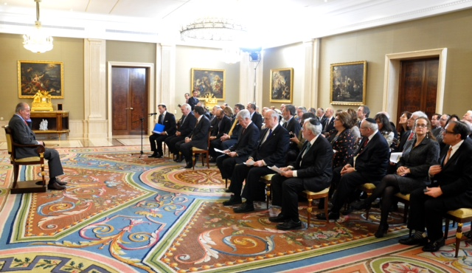
King Juan Carlos I of Spain Receives Leaders of the Conference of Presidents of Major American Jewish Organizations at Zarzuela Palace
Conference of President of Major American Jewish Organizations,
http://www.conferenceofpresidents.org//content/king-juan-carlos-i-spain-receives-leaders-conference-presidents-major-american-jewish
His Majesty King Juan Carlos I welcomes delegation of American Jewish Leaders on Conference of Presidents Leadership Mission
In 2014 [Israeli] President Shimon Peres awards [German Chancellor Angela] Merkel the Presidential Medal, Israel’s highest civilian honor, recognizing exceptional service to the Jewish state. http://www.jta.org/2015/05/07/news-opinion/israel-middle-east/its-complicated-germany-and-israel-mark-golden-anniversary-as-friends
The Presidents Conference goes to Madrid, JTA, 2/17/2014, http://www.jta.org/2014/02/17/news-opinion/world/the-cop-goes-to-madrid
Spanish cabinet approves draft bill for Sephardic return, JTA, June 6, 2014 9:05am, http://www.jta.org/2014/06/06/news-opinion/world/spanish-cabinet-approves-draft-bill-for-sephardic-return
Portuguese citizenship law attracts 250 Jewish applicants, primarily from Turkey, Haaretz, 6/24/2015, http://www.haaretz.com/jewish-world/jewish-world-news/.premium-1.662701
Spain grants citizenship to 4,302 descendants of Sephardic Jews, JTA, 10/4/2015, http://www.jta.org/2015/10/04/news-opinion/world/spain-grants-citizenship-to-4302-descendants-of-sephardic-jews
Portugal and Spain have given 10,000 passports to people claiming Sephardic roots, JTA, 11/23/2018, https://www.jta.org/2018/11/23/news-opinion/portugal-spain-gave-10000-passports-sephardic-new-citizens-since-2015

Slide 26
American Jewish Joint Distribution Committee finances legal and illegal Jewish emigration from Eastern Europe
At the end of World War II, an agreement was reached between David Ben-Gurion, then chairman of the Jewish Agency Executive, and Joseph Schwartz, chairman of the [American Jewish] Joint Distribution Committee’s European Executive Committee (AJJDC), stipulating that the AJJDC “would finance legal and illegal Jewish emigration from Eastern Europe.”
Michael Beizer, Translated from Russian by I. Michael Aronson, “American Jewish Joint Distribution Committee,” The YIVO Encyclopedia of Jews in Eastern Europe, http://www.yivoencyclopedia.org/article.aspx/American_Jewish_Joint_Distribution_Committee

Slide 27
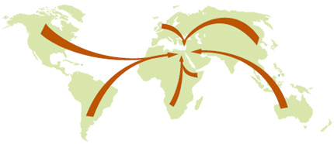
Immigrants to [Israel] by Continent 1948-1996
Europe 58%
Africa 18%
Asia 15%
America & Oceania 8%
Unknown 1%
Immigrants by Year of Immigration 1948-1996 1948-51 688,000
1952-59 272,000
1960-69 374,000
1970-79 346,000
1980-89 154,000
1990-96 737,000
Source: Israel Ministry of Foreign Affairs, http://mfa.gov.il/MFA/MFA-Archive/2002/Pages/Aliyah.aspx
Between 1989 to 2009, 1,274,574 people immigrated to Israel from the Former Soviet Union (996,059), Latin America (39,669), U.S.A & Canada (54,633), UK (11,205), France (39,505), Ethiopia (68,862), and Other countries (64,641). Source: Knesset Research and Information Center (February 2011), Israel Ministry of Foreign Affairs, http://mfa.gov.il/MFA/AboutIsrael/People/Pages/SOCIETY-%20Jewish%20Society.aspx
This Zionist flow to Palestine after 1948 is comparable to Jihadist flow to Afghanistan after 1979
Israel Bares 200,000 Documents in Yemeni Baby-Kidnapping Scandal
JERUSALEM (JTA) — Israel inaugurated an online database of some 200,000 pages of declassified documents about the long-controversial “Yemenite children affair” in a ceremony in this city.
By making the documents public Wednesday, the state hopes to end the controversy, which has persisted in Israel for decades.
Since the 1950, more than 1,000 Israelis families have alleged their children were systematically kidnapped from Israeli hospitals and put up for adoption in the country and abroad. The claims of the families, mostly immigrants from Yemen, were generally dismissed by authorities... Three government-appointed committees have looked into the Yemenite children affair, and each concluded that the majority of the children died in the hospital and were buried without the families being informed...
Nurit Koren, a Knesset member for the ruling Likud party who chairs the Knesset panel tasked with researching the affair and whose cousin disappeared, welcomed the release of the documents but said it was “just the beginning of the path,” in a radio interview. Koren said the database included just half of the 400,000 documents generated by the three investigative committee. She also pointed out that one committee found the Yemenite children affair continued until 1966, while the database only includes documents from 1948 to 1954. Forward, 12/28/2016, http://forward.com/news/breaking-news/358520/israel-bares-200-000-documents-in-yemeni-baby-kidnapping-scandal/
The Dark Secret of Israel’s Stolen Babies, Washington Post on Middle East Affairs, August-September 2018, https://www.wrmea.org/2018-august-september/the-dark-secret-of-israels-stolen-babies.html

Slide 28
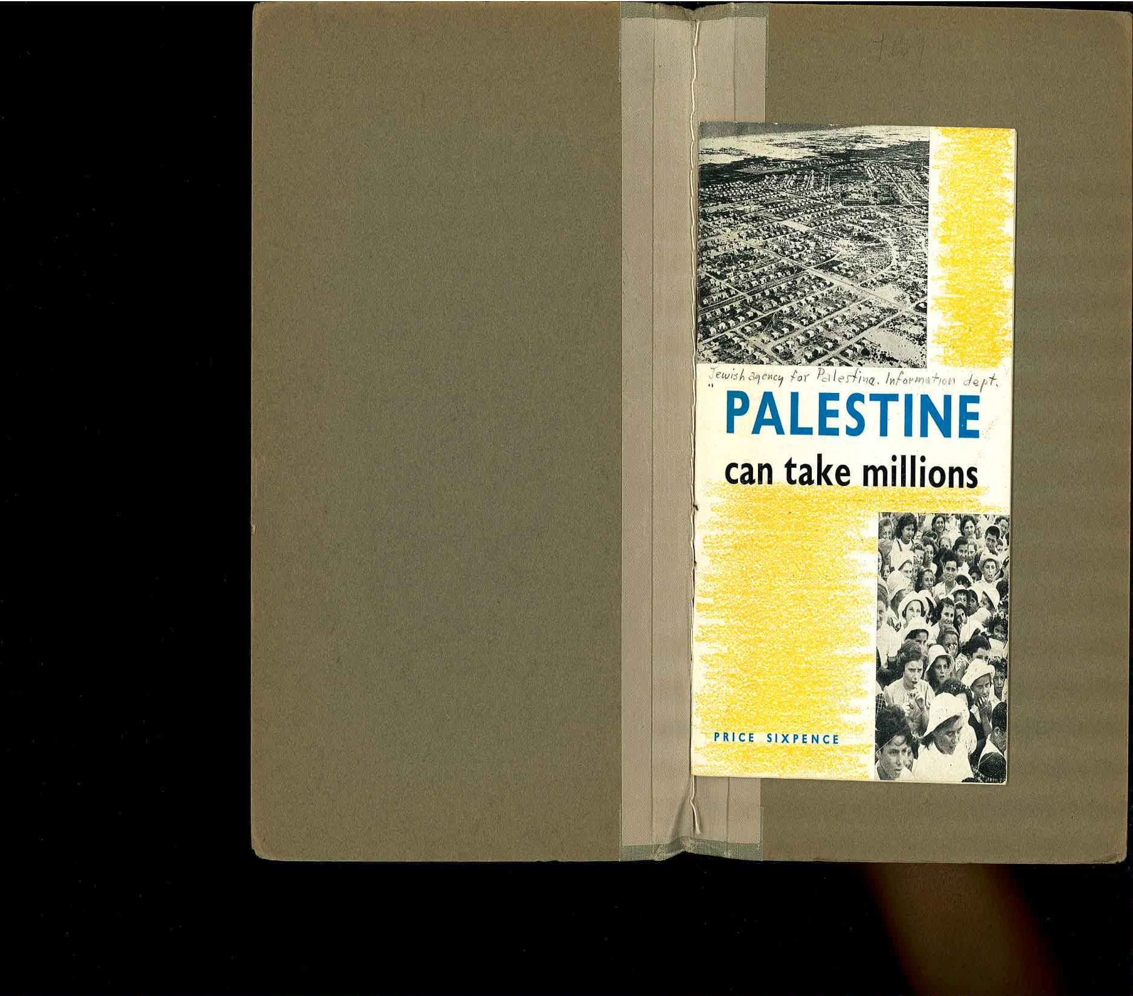
“Jewish experience with Palestinian colonisation has proved that for every family settled on the land, four additional families can be settled in towns and villages, to live from industry, commerce, maritime trades, transportation, the professions, etc. … Thus the total absorptive capacity of Palestine, even within present mandate frontiers, can easily reach 5 millions[sic]. Abraham Revusky [American Jewish journalist], “The absorptive capacity of Palestine,” In Palestine can take millions, Issued by the Information Department, The Jewish Agency for Palestine, November 1944, page 8.
“The region of the Jordan Valley offers an opportunity for the construction of one of the most striking and unique power and irrigation projects in the world. I propose the name Jordan Valley Authority, of the United States, to include all the drainage of the Jordan River and the maritime slope of Palestine.” Walter Clay Lowdermilk [American soil expert], “Palestine’s prospects and the Jordan Valley Plan,” In In Palestine can take millions, Issued by the Information Department, The Jewish Agency for Palestine, November 1944, page 19.

Slide 29
Israel Marks First-Ever National Day Remembering Jewish Exodus from Arab Lands
850,000 Refugees Forgotten No More
(Haaretz) — For Meir Kahlon, chairman of the World Organization of Jews from Arab Countries, this is a historic week. For the first time, Israel has officially recognized his suffering, that of his family and some 850,000 other Jews who left, were expelled or fled from their homes in Syria, Libya, Morocco, Algeria, Tunisia, Iran, Iraq, Yemen, Egypt, Lebanon and other Arab and Muslim countries around the time of the founding of the State of Israel and afterwards.
“Until now, they spoke about the Arab refugees and not the Jewish refugees. Today we are marking the remembrance day commemorating the expulsion of the Jews of Arab lands,” shouted Kahlon emotionally into the microphone at Bar-Ilan University, where a seminar on the topic was held last Thursday with the title “Exodus, Emigration, Expulsion and Uprooting.”
November 30 is the official day the State of Israel marks for the first time as the national day of commemoration for Jewish refugees from Arab lands and Iran, based on a law sponsored by MK Shimon Ohayon (Yisrael Beiteinu) and passed this summer by the Knesset. The date has a special meaning – it is the day after November 29, the day in 1947 that the United Nations General Assembly approved the partition plan for the Palestine Mandate and the creation of a Jewish state. November 30, the day after the decision, is the day the Arabs started their concerted attacks on the Jews.
“The Arab nations did not accept the UN partition plan, and the riots against the Jews started. We want to remember this day as the Nakba [catastrophe in Arabic, used to refer by Palestinians to Israel’s Independence Day] Day of the Jews of Arab lands,” Kahlon told Haaretz. “It is not just the Nakba of the Palestinians – it is also our Nakba, Jews of Arab lands who were expelled and slaughtered.”
Almost a million Jews lived in Arab and Muslim countries in 1948 when Israel was founded. The largest Jewish community was in Morocco, with 250,000 Jews. Today are only a few tens of thousands of Jews left in all the Arab countries together...
“Every time the world talks about refugees from the Middle East [they] only emphasize the Palestinian refugees. The fact is there were two populations of refugees,” says Dr. Stanley Urman. Urman, a founder of JJAC, its current executive vice president and former executive director, lives in Montreal. The organization’s goal is make sure that the narrative of the suffering and rights of the Jews from Arab lands are also on the negotiating table, since they were also refugees as part of the same struggle, at the same time and in similar numbers, he says.
In recent years, Urman has been researching the UN’s activities concerning the refugees, and points out the lack of equality in the UN’s treatment of Palestinian and Jewish refugees. He counted 197 UN General Assembly and Security Council decisions between 1946 and 2014 concerning Palestinian refugees. Yet there is not a single UN resolution that emphasizes the suffering and rights of the Jews from Arab lands, he points out.
The exception is the famous Security Council Resolution 242 passed in November 1967 after the Six-Day War. “Achieving a just settlement of the refugee problem,” states section 2(b) of the resolution, without providing any details of which refugees it is talking about. Representatives of Britain and the United States said afterwards that they used this wording intentionally so as to also recognize the rights of the Jewish refugees, says Urman.
Ofer Aderet, "Israel Marks First-Ever National Day Remembering Jewish Exodus from Arab Lands," Forward, December 01, 2014, http://forward.com/articles/210138/israel-marks-first-ever-national-day-remembering
Israel secretly working to redeem Jewish property in Arab world and Iran, Arutz Shiva, 7/17/2016,, http://www.israelnationalnews.com/News/News.aspx/215067

Slide 30
Ministry grants citizenship to gay spouse of immigrant
“The Interior Ministry [of the State of Israel] recently granted citizenship to a non-Jewish gay man married to a Jew, for the first time applying the Law of Return [emphasis added] to a spouse in same-sex marriage… The case of Bayardo Alvarez, who is not Jewish, and Joshua Goldberg, both U.S. citizens who married in Canada four years ago, made headlines earlier this year, after the couple threatened to sue the ministry for refusing Alvarez citizenship. According to the Law of Return, every Jew and his or her spouse have the right to immigrate to Israel as citizens, but until the ruling, this had only applied to heterosexual couples… With same-sex marriage being recently being legalized in New York State, the ministry may soon see many more cases like Alvarez's, according to Rabbi Seth Farber, whose Itim organization helps immigrants. "There is a significant Jewish homosexual population in New York, many of them very strongly identify with the State of Israel.” Haaretz, 9/2/2011, http://www.haaretz.com/weekend/anglo-file/ministry-grants-citizenship-to-gay-spouse-of-immigrant-1.382066
Gay Jews have “higher souls” than gentiles, says [Israeli] deputy minister [Rabbi Eli Ben-Dahan] ----Haaretz, 12/29/2013, http://www.haaretz.com/news/national/1.566021

Slide 31
Pictures: 38 Members of 'Lost Tribe' Make Aliyah From India
“Tears flowed freely as a group of 38 Bnei Menashe, descendants of a Lost Tribe of Israel, were greeted by relatives at Ben Gurion Airport after making Aliyah yesterday from India.
The immigrants, who hail from the northeastern Indian state of Mizoram, were brought to Israel by the organization, which recently received permission from the Israeli government to bring 900 Bnei Menashe to the Jewish state over the next 15 months.
The Bnei Menashe are descendants of the tribe of Menashe (or Manasseh), one of the Ten Lost Tribes of Israel which were exiled by the Assyrian empire after the death of King Solomon more than 2,700 years ago.” Israel National News, 12/27/2013,
http://www.israelnationalnews.com/News/News.aspx/175620#.Ut7YYbYo5LM
10 Indian-Jewish ‘lost tribe’ couples remarried in Israel, Jewish Telegraphic Agency, 4/4/2017,
http://www.jta.org/2017/04/04/news-opinion/israel-middle-east/10-indian-jewish-lost-tribe-couples-remarried-in-israel

Slide 32
France largest source of immigration to Israel so far in 2014
Jewish Telegraphic Agenct, 9/5/2014 http://www.jta.org/2014/09/05/news-opinion/israel-middle-east/france-largest-source-of-immigration-to-israel-so-far-in-2014
“(JTA) – Reaching a 25-year high, immigration to Israel from France has become the largest single source of newcomers to Israel so far this year.
Some 4,566 French immigrants arrived in Israel from January through Sept. 1, surpassing Russia, with 2,632 immigrants, and Ukraine, with 3,252 immigrants. The United States, whose Jewish population is more than 10 times that of France, has sent 2,218 new immigrants to Israel so far this year.”
France agrees Holocaust SNCF rail payout with US
“France and the US have agreed a compensation package for Holocaust victims deported by a French rail company during World War Two.
The two sides announced a $60m (£40m) compensation fund, paid for by the French government, on Friday.
Reparations will be paid to those transported by state rail company SNCF to Nazi concentration camps.
US lawmakers have previously attempted to bar SNCF from rail contracts due to its actions in WW2.
The rail company moved 76,000 Jews to Nazi camps during the Holocaust.
However, the company, and some historians, have argued that SNCF was forced to assist the deportations by the occupying German army.
In 2010, the SNCF chief executive expressed "profound sorrow and regret" for the consequences of the company's actions.
Under the deal, both Holocaust survivors and their spouses or descendants will receive compensation. Officials say thousands could be eligible.
The agreement still needs to be voted on by the French parliament.
SNCF is currently bidding on US rail contracts, including in the state of Maryland, where lawmakers have pushed for reparations for survivors.”
BBC, 12/5/2014, http://www.bbc.com/news/world-europe-30351196

Slide 33
NBA star Amar'e Stoudemire heads to Israel after discovering Jewish roots
“U.S. Basketball star Amar'e Stoudemire is apparently on his way to Israel for a voyage of discovery after learning he has Jewish roots… According to an Army Radio report, Stoudemire plans to spend time in Israel learning Hebrew, having recently learned he has a Jewish mother”-- Reuters, Haaretz, 7/28/2010, http://www.haaretz.com/jewish-world/nba-star-amar-e-stoudemire-heads-to-israel-after-discovering-jewish-roots-1.304552
“Stoudemire seeking Israeli citizenship”, JTA, August 2, 2013, http://www.jta.org/2013/08/02/arts-entertainment/stoudemire-seeks-israeli-citizenship
Israel to ramp up Birthright investment
NEW YORK (JTA) -- Israel's government will more than double its investment in the popular Birthright Israel program. Prime Minister Benjamin Netanyahu made the announcement Thursday night before 3,000 program participants in Jerusalem, The Jerusalem Post reported.
"My government will give more than double its investment in Birthright, and over the next few years we will invest more than $100 million in Birthright," said Netanyahu, according to the Post. "Together with private donations we can increase the number of people to 50,000 a year."
Considered one of the most successful initiatives in the Jewish world, Birthright Israel provides free 10-day trips to Israel for Jewish young adults aged 18-26. Some 30,000 people participate in the program each year; more than a quarter-million have participated since its inception in 2000.
http://www.jta.org/news/article/2011/01/06/2742445/israel-to-ramp-up-birthright-investment
[Israel’s] Cabinet agrees last Ethiopian Jews can move to Israel
The remaining members of the Ethiopian Jewish community are to move to Israel.
After years of wrangling, Israel’s cabinet voted in favour of giving the more than 7,800 Falash Mura Jews citizenship. The Jewish Chronicle,
http://www.thejc.com/news/israel-news/41254/cabinet-agrees-last-ethiopian-jews-can-move-israel
Israel Approves Aliyah for 899 Bnei Menashe from India,
http://www.israelnationalnews.com/News/Flash.aspx/278396
'Hidden' Polish Jews Embrace Their Heritage in Israel,
http://www.israelnationalnews.com/News/News.aspx/170948
“All together, 16,465 people around the world moved [as Jewish settlers] to Israel in 2010, 16 per cent higher than the previous year. The number of North American Jews rose from 3,767 in 2009 to 3,980 in 2010”—Jewish Chronicle, 12/29/2010,
http://www.thejc.com/news/uk-news/43060/aliyah-figures-uk-drop
After years of deliberations, the Israeli Interior Ministry has resolved not to grant recognition to the Jewish community of Uganda, Haaretz, 5/31/2018, https://www.haaretz.com/israel-news/.premium-exclusive-israel-rules-not-to-recognize-ugandan-jewish-community-1.6137079

Slide 34
Ethiopian-Israeli lawmaker’s rejection as blood donor has Knesset seeing red
“Ethiopian-Israeli lawmaker’s rejection as blood donor has Knesset seeing red
JERUSALEM (JTA) — Israeli lawmakers called for an examination of Magen David Adom blood donation policies after an Ethiopia-born Knesset member was rejected as a donor.
Pnina Tamano-Shata of the Yesh Atid party tried to donate during a special blood drive Wednesday at the Knesset but was told she could not because she had “the special kind of Jewish-Ethiopian blood,” according to Ynet, which first broke the story.
Tamano-Shata was told subsequently that she could donate but the blood would be frozen and never used.
“I am good enough to serve the state and in the Knesset,” Tamano-Shata told Ynet. “But for some reason to give blood I am not good enough. This is insulting.”
The Knesset’s Labor, Welfare and Health Committee will meet in emergency session on Monday to discuss the issue.
Tamano-Shata has lived in Israel since she was 3 years old and served in the Israel Defense Forces. As a youth she protested the MDA practice of discarding Ethiopian blood donations, according to Ynet.”
Jewish Telegraphic Agency, 12/11/2013,
http://www.jta.org/2013/12/11/news-opinion/israel-middle-east/controversy-erupts-over-mda-refusal-to-take-ethiopian-israeli-lawmakers-blood

Slide 35
The New Jewish Diaspora?
Israeli-American Michael Freund told an Israeli Ministry of Diaspora Affairs committee: “We are on the verge of a tidal wave of return,” Forward, 4/28/2016, http://forward.com/news/339682/the-new-jewish-diaspora/?attribution=articles-hero-item-text-1

Slide 36
Vatican memo: Mideast conflict driving Christians out of region
By The Associated Press
Haaretz, 1/20/2010, http://www.haaretz.com/hasen/spages/1143691.html
“A Vatican document released Tuesday [1/19/2010] blamed the Israeli-Palestinian conflict and the occupying of lands for fomenting most of the conflicts in the Middle East, driving Christians out and making life difficult for those who remain.”
“Political conflicts in the region have a direct influence on the lives of Christians, both as citizens and as Christians. The Israeli occupation of the Palestinian Territories makes daily life difficult with regard to freedom of movement, the economy and religious life (access to the Holy Places is dependent on military permission which is granted to some and denied to others on security grounds).” SYNOD OF BISHOPS, SPECIAL ASSEMBLY FOR THE MIDDLE EAST, THE CATHOLIC CHURCH IN THE MIDDLE EAST: COMMUNION AND WITNESS. http://www.vatican.va/roman_curia/synod/documents/rc_synod_doc_20091208_lineamenta-mo_en.html

Slide 37
Defining 'Jewish state': For many, term has different meanings
By Glenn Kessler, Washington Post Staff Writer, Saturday, October 2, 2010 http://www.washingtonpost.com/wp-dyn/content/article/2010/10/01/AR2010100104177.html
Nine years ago, then-Secretary of State Colin L. Powell delivered a speech on the Middle East in which he briefly called on Palestinians to recognize Israel as a "Jewish state." Powell doesn't recall how the phrase ended up in his speech, but David Ivry, then the Israeli ambassador to the United States, says he persuaded an aide to Powell to slip it in…
President George W. Bush picked up the "Jewish state" concept in his speeches and used it in a controversial exchange of letters with Israeli Prime Minister Ariel Sharon in 2004. Obama has also adopted the phrase, most recently in a speech last month before the U.N. General Assembly…
For the Israeli government of Prime Minister Binyamin Netanyahu, Palestinian recognition of Israel as a "Jewish state" would mean acceptance that the Jews have existed in the Middle East for thousands of years - and that Palestinian refugees have no claim to return to property they fled or were forced to flee when Israel was founded six decades ago.
Palestinians see their "right of return" as a sacred tenet. They regard a "Jewish state" as a trap, a new demand that did not come up during years of negotiations in the 1990s or in peace treaties reached with Egypt and Jordan. The Palestine Liberation Organization recognized the State of Israel as part of the Oslo Accords in 1993…
Obama, when he was running for president in 2008, told the American Israel Public Affairs Committee that "any agreement with the Palestinian people must preserve Israel's identity as a Jewish state." …
In the eyes of Israelis, Obama stumbled when he delivered his 2009 speech to the Arab world in Cairo because he appeared to link the creation of Israel to the Holocaust, which goes against the Zionist narrative that Jews have always been a part of the Middle East.
In his U.N. General Assembly speech last month, Obama tried to address that concern. He referred to "the Jewish state" and added: "After thousands of years, Jews and Arabs are not strangers in a strange land. . . .Israel is a sovereign state and the historic homeland of the Jewish people."

Slide 38
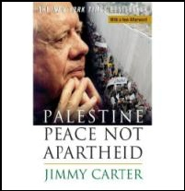
President Jimmy Carter’s book describes the situation in the Palestinian occupied territories:
“Utilizing their political and military dominance,” the Israelis “are imposing a system of partial withdrawal, encapsulation, and apartheid on the Muslim and Christian citizens of the occupied territories.”
Israel “has 150 nuclear weapons”
President Jimmy Carter, BBC, 5/26/2008, http://news.bbc.co.uk/2/hi/middle_east/7420573.stm
[Former US Secretary of State] Colin Powell leaked emails: Israel has “200 nukes all pointed at Iran,” former US secretary of state says, The Independent, 9/16/2016, http://www.independent.co.uk/news/world/americas/colin-powell-leaked-emails-nuclear-weapons-israel-iran-obama-deal-a7311626.html

Slide 39
The Iranian Revolution and the Palestine-Israel Conflict
Under the Shah monarchy, Iran had close ties with Israel. Iran was the second Muslim-majority country to recognize Israel after Turkey.
January 1979: The Shah was forced out of Iran
February 1979: Khomeini returned from exile to Iran
Iran ended its alliance with Israel, severed all diplomatic and commercial ties with Israel, expelled the Israelis from Iran, and considered Israel an illegitimate state.
Iran began its support for the Palestinians by turning over the Israeli embassy in Tehran to the Palestine Liberation Organization
Khomeini was quoted (5/10/1979): “Moses would have nothing to do with these pharaoh-like Zionists who run Israel... We recognize our [Iranian] Jews as separate from those godless, bloodsucking Zionists.” Tablet, 12/30/2014, http://tabletmag.com/jewish-news-and-politics/187519/how-iran-kept-its-jews
"Our concerns with Iran extend far beyond the nuclear issue... We will not relent in our efforts to confront Iran’s destabilizing behavior... That is exactly why Secretary Kerry was in the UAE yesterday, and it is exactly why the President will visit Saudi Arabia next month." U.S. Deputy Secretary of State William J. Burns, Washington, DC, February 19, 2014, http://www.state.gov/s/d/2014/221809.htm
Iran's allies, not atoms, preoccupy Israeli generals
http://www.reuters.com/article/2015/05/05/us-iran-nuclear-israel-allies-idUSKBN0NQ1CC20150505
Tamir Pardo (chief of Israel’s elite, feared and revered Mossad, from 2011 to 2016)’s view would be that Iran’s conventional weapons threaten Israel more than its nuclear program (at least as things currently stand.), The Jerusalem Post, 8/17/2018, https://www.jpost.com/Israel-News/Former-Mossad-chief-reveals-revolutionary-plan-for-defeating-Hezbollah-565086
Iranian President Ahmadinejad Greeted by Anti-Zionist Jews in New York in 2007
https://www.youtube.com/watch?v=q_XAeqtY7Sk
Larry King asks Iranian President Ahmadinejad about the Holocaust, Zionism and Israel - 22 Sept. 2010, https://www.youtube.com/watch?v=O_MegAmVPSE
Iranian President Ahmadinejad on Jews, Larry King,
https://www.youtube.com/watch?v=_vYXcna8Pxw
FlashPoint Interview: Jeff Blankfort (part 1: 7mn; part 2: 6mn), https://www.youtube.com/watch?v=CNf2SntA3pk
Rare Video: Nelson Mandela Speaking on Palestine [Extracts] (12 mn), https://www.youtube.com/watch?v=i5TiUhhm7cQ
From Friends to Foes: How Israel and Iran Turned Into Arch-enemies
The two countries enjoyed good relations for 30 years, but since the Islamic Revolution of 1979, Israel and Iran have been a study in enmity – despite not sharing a border or having any territorial disputes, Haaretz, 5/8/2018, https://www.haaretz.com/middle-east-news/iran/MAGAZINE-how-israel-and-iran-went-from-allies-to-enemies-1.6049884
Saban Forum 2013: A Conversation with President Barack Obama, http://www.youtube.com/watch?v=hVRZOazaWKQ
[Former US Secretary of State] Colin Powell leaked emails: Israel has '200 nukes all pointed at Iran', former US secretary of state says, The Independent, 9/16/2016, http://www.independent.co.uk/news/world/americas/colin-powell-leaked-emails-nuclear-weapons-israel-iran-obama-deal-a7311626.html
Therefore Iran’s main “problem” with Israel is Iran’s support for Palestine, NOT Iran’s nuclear program. Iran’s main “problem” with the United States is Iran’s main “problem” with Israel. Iran’s main “problem” with Saudi Arabia is Iran’s main “problem” with the United States.

Slide 40
Revealed: how Israel offered to sell South Africa nuclear weapons
Exclusive: Secret apartheid-era papers give first official evidence of Israeli nuclear weapons
…“The "top secret" minutes of meetings between senior officials from the two countries in 1975 show that South Africa's defence minister, PW Botha, asked for the warheads and Shimon Peres, then Israel's defence minister and now its president, responded by offering them "in three sizes". The two men also signed a broad-ranging agreement governing military ties between the two countries that included a clause declaring that "the very existence of this agreement" was to remain secret.” The Guardian, 5/24/2010, http://www.guardian.co.uk/world/2010/may/23/israel-south-africa-nuclear-weapons

Slide 41
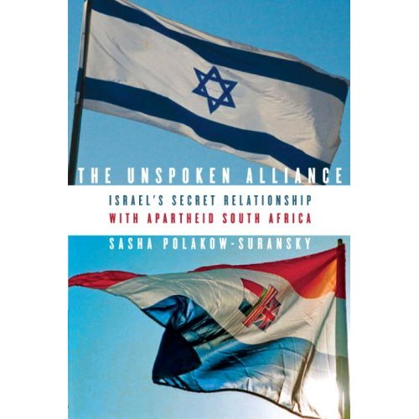
In 1961, South African prime minister Hendrik Verwoerd declared to the U.N. General Assembly that “Israel, like South Africa, is an apartheid state”-Sasha Polakow-Suransky, The Unspoken Alliance: Israel's Secret Relationship with Apartheid South Africa, New York: Pantheon Books, 2010, page 241. See photos on pages 82, 91, and 92.

Slide 42
Similarities between Zionist Israel and Apartheid South Africa
Both were founded on exclusive ethnic foundations
Both developed exclusive ethno-national political systems
Both exercised exclusive ‘democracy’ or restricted ‘democracy’ for the ethnic group in power
Both continuously regenerate their respective ideologies—apartheid and Zionism
  Membership is based on belonging to the exclusive ethnicity of the Volk, or on being a Jew
  Claiming rights to land is based on settlement, biblical texts and historical connections
  There is a felt need to have power and control over their own destiny
  Both developed national identities in light of past trauma
  Both held convictions and/or feelings of superiority (being God’s chosen people, and being culturally superior)
Both political systems developed to become highly centralized, i.e. strong states vis-a-vis their societies
Both cases fit with Gramsci’s argument on state-society and state-civil society relations , where hegemony of the political elite is achieved in a sophisticated manner, leading to voluntary consent
Both systems continue/d to exert almost total control over the moral order of their respective societies
Both political systems developed similar strategies towards the dominated side, adopting policies of discrimination and oppression
  Discrimination by law has been widely used (in Israel, discriminatory laws included the ethnic-based citizenship or naturalization law (1952), the law of return (1950) and the state’s arrangements for land distribution (early 1950s). There are many more examples in the South African case, including the Native Act of 1913 for land distribution and the Population Registration Act of 1950
  Policies of discrimination against the indigenous people were also translated by enforcing the settler society’s ethnic-national symbols while diminishing those of the natives
Both political systems which represented ethnic-national ideologies (have) also developed into highly militarized ones
Both political systems developed indoctrinated societies both before and after they had come to power in 1948 Education policies and the media contributed heavily to this task. They promoted the national ideological aims of the state, stressed the rightness of self-ethnic goals, prioritized security, de-legitimized the opponent, and projected a positive image and perception of themselves as being simultaneously heroes and victims.
Both political systems also adopted the vision of ‘separation’ as the prime option for reaching a settlement of the existing conflicts with the Other.
The author concludes that Zionist Israel represents another form of apartheid (more sophisticated, more subtle in some aspects, and more vicious)
Amneh Daoud Badran, Zionist Israel and Apartheid South Africa: Civil Society and Peace Building in Ethnic-National States, New York: Routledge, 2010, p 175-176.
Richard Boyd Barrett TD (Irish Parliament)--- Israel is not a normal state and should not be treated as such, https://www.youtube.com/watch?v=3RYBV1X7_CM

Slide 43
French pied noir settlers in Algeria
Shortly after the conquest of Algeria by France in 1830, one French general observed (in 1834) that “nearly all the Arabs can read and write; in each village, there are two schools.” p. 29
French Marshal Bugeaud said before France’s National Assembly in 1841: “Whenever there is fresh water and fertile land, there one must locate colons [settlers], without concerning oneself to whom these lands belong” p. 30
In 1847 de Tocqeville observed that “we [the French] have rendered Muslim society much more miserable and much more barbaric than it was before it beccame acquainted with us.” p. 29
“In the outer world, the most obvious kinsmen to the pied noir are the whites of South Africa, Rhodesia and the “Deep South” of the United States” p. 54
The pied noir would habitually tutoyer any Muslim—a form of speech reserved for inmates, domestics or animals—and was outraged were it ever suggested that this might be a manifestation of racism. Commenting on this, Pierre Nora (admittedly a Frenchman often unduly harsh in his criticism of the pieds noirs) adds an illustration of a judge asking in court:
“Are there any other witnesses?”
“Yes, five; two men and three Arabs.” p. 55
When the Algerian National Liberation won the eight year-war (1954-1962) against the pieds noirs settlers and 600,000 French troops [p. 506], French settlers began to exit Algeria. “When the exodus was all over it was estimated that 50,000 pieds noirs had gone to Spain; 12,000 to Canada; 10,000 to Israel; and 1,550 to Argentina. But the huge mass, 1,380,000 strong (which included the luckier Muslim refugees)—equivalent then to the combined population of the two biggest French cities after Paris—had flooded into France. Only 30,000 stayed bravely, or hopelessly, behind.” P. 533
“Algeria adopts the round figure of one million as representing her war dead” p. 538
Source: Alistair Horne, A Savage War of Peace: Algeria 1954-1962, New York: The Viking Press, 1977.
“Il était rare que les prisonniers interrogés la nuit se trouvent encore vivants au petit matin. Qu’ils aient parlé ou pas, il étaient généralement neutralisés. Il était impossible de les remettre dans le circuit judiciaire. Ils étaient trop nombreux et les rouages de la machine se seraient grippés… Plus de vingt mille personnes son passées par ce camp: trois pour cent de la population de l’agglomération d’Alger. Comment confier tous ces gens à la Justice?”--- Paul Aussaresses, Services Spéciaux: Algérie 1955-1957, Saint-Amant-Montrond: Perrin, Mai 2001, pages 153-154
Paul Aussaresses, ancient de la France libre, général de la brigade de l’armée française, engagé dans les services spéciaux, est envoyé par le général de Gaulle dans les opérations secrètes les plus délicates. Après avoir participé à la guerre d’Indochine et à la formation du Sdece [Service de documentation extérieure et de contre-espionnage], il exerce des responsabilités importantes au Service Action. Mais c’est en Algérie que Paul Aussaresses, qui deviendra ensuite instructeur des forces spéciales américaines, a dû accomplir sa mission la plus douloureuse.

Slide 44
Human Right Watch Report: Separate and Unequal: Israel’s Discriminatory Treatment of Palestinians in the Occupied Palestinian Territories, December 19, 2010
"Palestinians face systematic discrimination merely because of their race, ethnicity, and national origin, depriving them of electricity, water, schools, and access to roads, while nearby Jewish settlers enjoy all of these state-provided benefits. While Israeli settlements flourish, Palestinians under Israeli control live in a time warp - not just separate, not just unequal, but sometimes even pushed off their lands and out of their homes."---Carroll Bogert, deputy executive director for external relations at Human Rights Watch.
"This report shows that Israel operates a two-tier system for the two populations of the West Bank in the large areas where it exercises exclusive control. The report is based on case studies comparing Israel’s starkly different treatment of settlements and next-door Palestinian communities in these areas. It calls on the US and EU member states and on businesses with operations in settlement areas to avoid supporting Israeli settlement policies that are inherently discriminatory and that violate international law."
"The case studies in this report show that discriminatory Israeli policies control many aspects of the day-to-day life of Palestinians who live in areas under exclusive Israeli control and that those policies often have no conceivable security justification. For example, Jubbet al-Dhib is a 160-person Palestinian village to the southeast of Bethlehem that is often accessible only by foot because its only connection to a paved road is a rough, 1.5 kilometer-long dirt track. Children from Jubbet al-Dhib must walk to schools in other villages several kilometers away because their own village has no school. Jubbet al-Dhib lacks electricity despite numerous requests to be connected to the Israeli electric grid, which Israeli authorities have rejected; Israeli authorities also rejected an internationally donor-funded project that would have provided the village with solar-powered streetlights. Any meat or milk in the village must be eaten the same day due to lack of refrigeration; residents often resort to eating preserved foods instead. Villagers depend for light on candles, kerosene lanterns, and, when they can afford to fill it with gasoline, a small generator.
Approximately 350 meters away is the Jewish community of Sde Bar. It has a paved access road for its population of around 50 people and is connected to Jerusalem by a new, multimillion dollar highway—the “Lieberman Road”—which bypasses Palestinian cities, towns, and villages like Jubbet al-Dhib. Sde Bar operates a high school, but Jubbet al-Dhib students are ineligible to attend; for Palestinians, settlements are closed military areas that may be entered only with special military permits. Residents of Sde Bar have the amenities common to any Israeli town, such as refrigerators and electric lights, which Jubbet al-Dhib villagers can see from their homes at night." Human Right Watch Report, December 19, 2010, http://www.hrw.org/node/95061
“Is Judaism a race? Ask Israelis--Can Israeli racism be eliminated through law, trial and punishment, or is it already part of the Israeli identity? The recent demonstrations in Bat Yam, Tel Aviv's Hatikva Quarter and Zion Square, in Jerusalem, featured a motley medley of paradoxical partners in racist positions: ultra-Orthodox rabbis and "liberal" rabbis standing together against the rental and sale of apartments to Arabs; working-class folk demanding that foreigners be deported; members of the middle class who "fear for our daughters' welfare" and male chauvinists carrying signs that say "Jewish women for Jewish men." This demographic array poses an impossible burden on the law: Using legal means to stifle the trend would be tantamount to putting Israeli identity on trial.” Zvi Bar’el, Haaretz, 12/26/2010, http://www.haaretz.com/print-edition/opinion/is-judaism-a-race-ask-israelis-1.332977
Supreme Court rejects citizens' request to change nationality from 'Jewish' to 'Israeli‘, Haaretz, 10/2/2103, http://www.haaretz.com/news/national/.premium-1.550241
Israel's Supreme Court upholds open-fire rules on Gaza border, Rules of engagement came under international fire after Israeli forces shot dead at least 62 Gazans on May 14, i24news, 5/25/2018, https://www.i24news.tv/en/news/international/middle-east/175557-180525-israel-s-supreme-court-upholds-open-fire-rules-on-gaza-border

Slide 45
Palestine/Israel-relevant sections of The Platform for the Movement for Black Lives [2016] https://policy.m4bl.org/platform/
"The US military accounts for over 50 percent of discretionary federal spending, a total of 598.5 Billion dollars spent annually, as compared to 70 billion spent on education, 66 billion spent on healthcare, $63.2 billion spent on housing and 29.1 billion spent on social security and unemployment. In addition, approximately 3 billion dollars in US aid is allocated to Israel, a state that practices systematic discrimination and has maintained a military occupation of Palestine for decades. Together with aid to Egypt — Israel’s most important regional ally — this figure represents nearly 75 percent of all US aid dollars. As these figures demonstrate, resources and funds needed for reparations and for building a just and equitable society domestically are instead used to wage war against a majority of the world’s communities...
The US justifies and advances the global war on terror via its alliance with Israel and is complicit in the genocide taking place against the Palestinian people. The US requires Israel to use 75 percent of all the military aid it receives to buy US-made arms. Consequently, every year billions of dollars are funneled from US taxpayers to hundreds of arms corporations, who then wage lobbying campaigns pushing for even more foreign military aid. The results of this policy are twofold: it not only diverts much needed funding from domestic education and social programs, but it makes US citizens complicit in the abuses committed by the Israeli government. Israel is an apartheid state with over 50 laws on the books that sanction discrimination against the Palestinian people. Palestinian homes and land are routinely bulldozed to make way for illegal Israeli settlements. Israeli soldiers also regularly arrest and detain Palestinians as young as 4 years old without due process. Everyday, Palestinians are forced to walk through military checkpoints along the US-funded apartheid wall...
Federal Action: Build invest/divestment campaigns that ends US Aid to Israel’s military industrial complex and any government with human rights violations...
State Action: Fight the expanding number of Anti-BDS bills being passed in states around the country. This type of legislation not only harms the movement to end the Israeli occupation of Palestine, but is a threat to the constitutional right to free speech and protest. Platform of The Movement for Black Lives [2016], https://policy.m4bl.org/invest-divest/
Israel Lobby Smears Black Lawmaker for Meeting Palestinians, IMEMC News, 8/25/2016, http://imemc.org/article/israel-lobby-smears-black-lawmaker-for-meeting-palestinians/

Slide 46
Compare how Bin Laden and Israeli Prime Minister Netanyahu view American power
Omar bin Laden had asked [his father Osama] why not attack Israel before America, given that Israel was a “small country near to us,” while America was a “huge country far away from our shores.”
My father paused before explaining it this way. “Omar, try to imagine a two-wheeled bicycle. One wheel is made of steel. The other wheel is made of wood. Now, my son, if you wanted to destroy the bicycle, would you destroy the wooded or the steel wheel? “The wooded wheel of course,” I replied. “You are correct my son. Remember this: America and Israel are one bicycle with two wheels. The wooden wheel represents the United States. The steel wheel represents Israel. Omar, Israel is the stronger power of the two. Does a general attack the strongest line when in battle? No, he concentrates on the weakest part of the line. The Americans are weak. It is best to attack the weakest point first. Once we take out the weak wooden wheel, the steel wheel will automatically fail. Who can ride a bicycle with only one wheel? He patted my knee with his hand. “First we obliterate America. By that I don’t mean militarily. We can destroy America from within by making it economically weak, until its markets collapse. When that happens, they will have no interest in supplying Israel with arms, for they will not have extra funds to do so. At that time, the steel wheel will corrode and be destroyed by lack of attention.” Michael Scheuer, Osama Bin Laden, Oxford University Press, 2011, p. 111-112. [Michael Scheuer was the chief of the CIA’s bin Laden unit]
What Do Israelis Think About Americans? Start With Disdain--View Ally as Naive, Especially on Middle East Issues……
“I know what America is,” Netanyahu, then on political hiatus after an election defeat, told the settlers when one asked whether his proposal for a “large scale” attack on the Palestinians would be met with global condemnation. “America is a thing that can be easily moved, moved in the right direction. They will not bother us… Let’s suppose they [the Bush administration] will say something. So they say it — so what? Eighty per cent of the Americans support us. It’s absurd! We have such [great] support there! And we say… what shall we do with this [support]?” ‘What Do Israelis Think About Americans? Start With Disdain,’ The Jewish Daily Forward, 3/8/2015, http://forward.com/articles/216074/what-do-israelis-think-about-americans-start-with/
Israeli Prime Minister Benjamin Netanyahu gets 29 standing ovations from Congress, https://www.youtube.com/watch?v=asGvjbfIASA

Slide 47
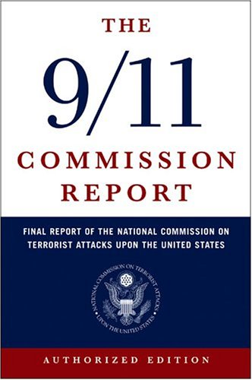
“By his own account, KSM [Khalid Sheikh Mohammed, the principal architect of the 9/11 attacks]'s animus toward the United States stemmed not from his experience there as a student, but rather from his violent disagreement with U.S. policy favoring Israel” p.147
When someone asked why he and Atta [one of the 9/11 hijackers] never laughed, Shehhi [one of the 9/11 hijackers] retorted, “How can you laugh when people are dying in Palestine” page 162, The 9/11 Commission Report (2004), http://www.9-11commission.gov/report/911Report.pdf
Full text: bin Laden's 'letter to America' (Q1) Why are we fighting and opposing you? (Q2) What are we calling you to, and what do we want from you? As for the first question: Why are we fighting and opposing you? The answer is very simple: (1) Because you attacked us and continue to attack us. a) You attacked us in Palestine: The Guardian, 11/24/2002, ttp://www.theguardian.com/world/2002/nov/24/theobserver
Thomas Kean and Lee Hamilton (co-chairs of the 9/11 Commission) wrote: “Commissioners who argued that al Qaeda was motivated primarily by a religious ideology—and not by opposition to American policies—rejected mentioning the Israeli-Palestinian conflict in the report. In their view, listing U.S. support for Israel as a root cause of al Qaeda’s opposition to the United States indicated that the United States should reassess that policy… Since neither U.S. policy in the Israel-Palestinian conflict nor U.S. policy in Iraq was covered in our mandate, we were not required to discuss the issues at length. Had that been the case, reaching consensus would have been difficult.” Thomas H. Kean and Lee H. Hamilton with Benjamin Rhodes, Without Precedent: The Inside Story of the 9/11 Commission, Alfred A. Knopf, New York, 2006, p. 284.

Slide 48
A passage from Bin Laden's 'letter to America'
“As for the first question: Why are we fighting and opposing you? The answer is very simple:
(1) Because you attacked us and continue to attack us.
a) You attacked us in Palestine:
(i) Palestine, which has sunk under military occupation for more than 80 years. The British handed over Palestine, with your help and your support, to the Jews, who have occupied it for more than 50 years; years overflowing with oppression, tyranny, crimes, killing, expulsion, destruction and devastation. The creation and continuation of Israel is one of the greatest crimes, and you are the leaders of its criminals. And of course there is no need to explain and prove the degree of American support for Israel. The creation of Israel is a crime which must be erased. Each and every person whose hands have become polluted in the contribution towards this crime must pay its*price, and pay for it heavily.
(ii) It brings us both laughter and tears to see that you have not yet tired of repeating your fabricated lies that the Jews have a historical right to Palestine, as it was promised to them in the Torah. Anyone who disputes with them on this alleged fact is accused of anti-semitism. This is one of the most fallacious, widely-circulated fabrications in history. The people of Palestine are pure Arabs and original Semites. It is the Muslims who are the inheritors of Moses (peace be upon him) and the inheritors of the real Torah that has not been changed. Muslims believe in all of the Prophets, including Abraham, Moses, Jesus and Muhammad, peace and blessings of Allah be upon them all. If the followers of Moses have been promised a right to Palestine in the Torah, then the Muslims are the most worthy nation of this.
When the Muslims conquered Palestine and drove out the Romans, Palestine and Jerusalem returned to Islaam, the religion of all the Prophets peace be upon them. Therefore, the call to a historical right to Palestine cannot be raised against the Islamic Ummah that believes in all the Prophets of Allah (peace and blessings be upon them) - and we make no distinction between them.
(iii) The blood pouring out of Palestine must be equally revenged. You must know that the Palestinians do not cry alone; their women are not widowed alone; their sons are not orphaned alone.”
The Guardian, 11/24/2002, http://www.theguardian.com/world/2002/nov/24/theobserver

Slide 49
Five Guantánamo detainees claim responsibility for September 11 attacks
The Guardian, 10 March 2009, http://www.guardian.co.uk/world/2009/mar/10/guantanamo-detainees-september-11-2001
Khalid Sheikh Mohammed, Walid Bin Attash, Ramzi Binalshibh, Ali Abdul Aziz Ali and Mustafa Ahmed Al-Hawsawi, say the terrorist killings were a response to US support for Israel

Slide 50
U.S. policy in the Israeli-Palestinian conflict feed anti-Americanism
“perceptions of U.S. policy in the Israeli-Palestinian conflict feed anti-Americanism. A 2003 Pew Global Attitudes poll found that enormous majorities in Arab and Muslim countries (at least 90% in Jordan, the Palestinian Authority, Morocco, and Lebanon) believed the U.S. favors Israel too much. Although our most recent survey did not ask this same question, it did find strongly negative views towards Jews in the Arab world. For example, no respondents in either Lebanon or Jordan had a favorable view of Jews (on the other hand, 91% of Lebanese and 58% of Jordanians had a favorable view of Christians)”--Testimony of Andrew Kohut, United States House of Representatives, International Relations Committee Subcommittee on Oversight and Investigations November 10, 2005, http://www.au.af.mil/au/awc/awcgate/congress/koh111005.pdf
One example of how U.S. Middle East Policy feed anti-Americanism:
1. Congressmen Joe Walsh (R-IL) and Joseph Crowley (D-NY) sent Secretary of State Hillary Clinton a bi-partisan letter urging her and U.N. Ambassador Susan Rice to veto the upcoming Security Council resolution condemning Israel (110 Democrat and Republican members co-signed the letter), Congressional Documents and Publications, Feb 18, 2011.
2. U.S. vetoes U.N. resolution declaring Israeli settlements illegal, CNN, 2/18/11.
3. US Veto on Settlements Undermines International Law, Human Rights Watch, 2/18/11.
4. Israel 'deeply appreciates' U.S. veto on UN resolution condemning settlements, Haaretz, 2/19/11.
5. Palestinians plan 'Day of Rage' to protest U.S. veto on UN settlement resolution, Haaretz, 2/19/11.
“Not a day goes by -- not one -- when my colleagues and I do not work hard to defend Israel's security and legitimacy at the United Nations”—Obama's Ambassador to the United Nations, Susan Rice, http://www.huffingtonpost.com/2012/03/06/aipac-susan-rice-obama-israel_n_1323398.html
President Obama’s national security adviser, Susan Rice: "we have spent seven and a half years of the Obama administration fighting and defeating efforts to delegitimize or otherwise single out Israel unfairly. I spent four and a half years of my life doing that at the U.N., and Ambassador [Samantha] Power is doing the same — all at President Obama’s direction." Forward, 6/6/2016, http://forward.com/news/342068/susan-rice-says-foolish-to-rule-out-backing-un-resolution-on-israel/

Slide 51
The Palestine-Israel Conflict and America’s image problem
Undersecretary of State for Public Diplomacy Charlotte Beers resigned in March 2003 after acknowledging before a Senate Foreign Relations Committee hearing that “the gap between who we are and how we wish to be seen, and how we are in fact seen, is frighteningly wide.”
CNN.com, “Bush's Muslim propaganda chief quits,” March 4, 2003.

Slide 52
The Palestine-Israel Conflict and America’s image problem
From 2005 to 2007 Undersecretary of State for Public Diplomacy and Public Affairs Karen Hughes made substantial efforts to
(1) increase the public diplomacy budget to nearly $900 million,
(2) energize the government-funded/Arabic language Radio Sawa, Alhurra satellite television, and Hi magazine,
(3) focus on winning the hearts and minds of Arabs and Muslims for the sake of the war on terrorism, and
(4) spend some time touring key Middle Eastern countries and speaking directly to the people.
CBS News, “Karen Hughes To Leave State Department:,” October 31, 2007.

Slide 53
The Palestine-Israel Conflict and America’s image problem
Karen Hughes said the Iraq war was usually the second issue that Muslims and Arabs around the world raised with her, after the Palestine-Israel conflict.
Hughes said she advised Mr. Bush and Rice two years ago that U.S. help in ending the six-decade old fight over Israel would probably do more than anything else to improve the U.S. standing worldwide. CBS News 10/31/07, http://www.cbsnews.com/stories/2007/10/31/politics/main3436792.shtml
George Mitchell stepping down as Middle East envoy, CNN, 5/13/2011, http://www.cnn.com/2011/POLITICS/05/13/mitchell.mideast.envoy/index.html?hpt=T1&iref=BN1

Slide 54
Moran steps down from leadership post
Lawmaker under fire for saying Jews push war with Iraq
CNN, March 14, 2003. http://www.cnn.com/2003/ALLPOLITICS/03/14/moran.remarks/index.html
Lawmaker under fire for saying Jews support Iraq war
Moran apologizes; White House blasts comments
CNN, March 11, 2003, http://www.cnn.com/2003/ALLPOLITICS/03/11/moran.jews/index.html
Watch [Former US Congresswoman] Cynthia McKinney: US Lawmakers FORCED to Support Israel!
https://www.youtube.com/watch?v=w_VNOk7Wv5A

Slide 55
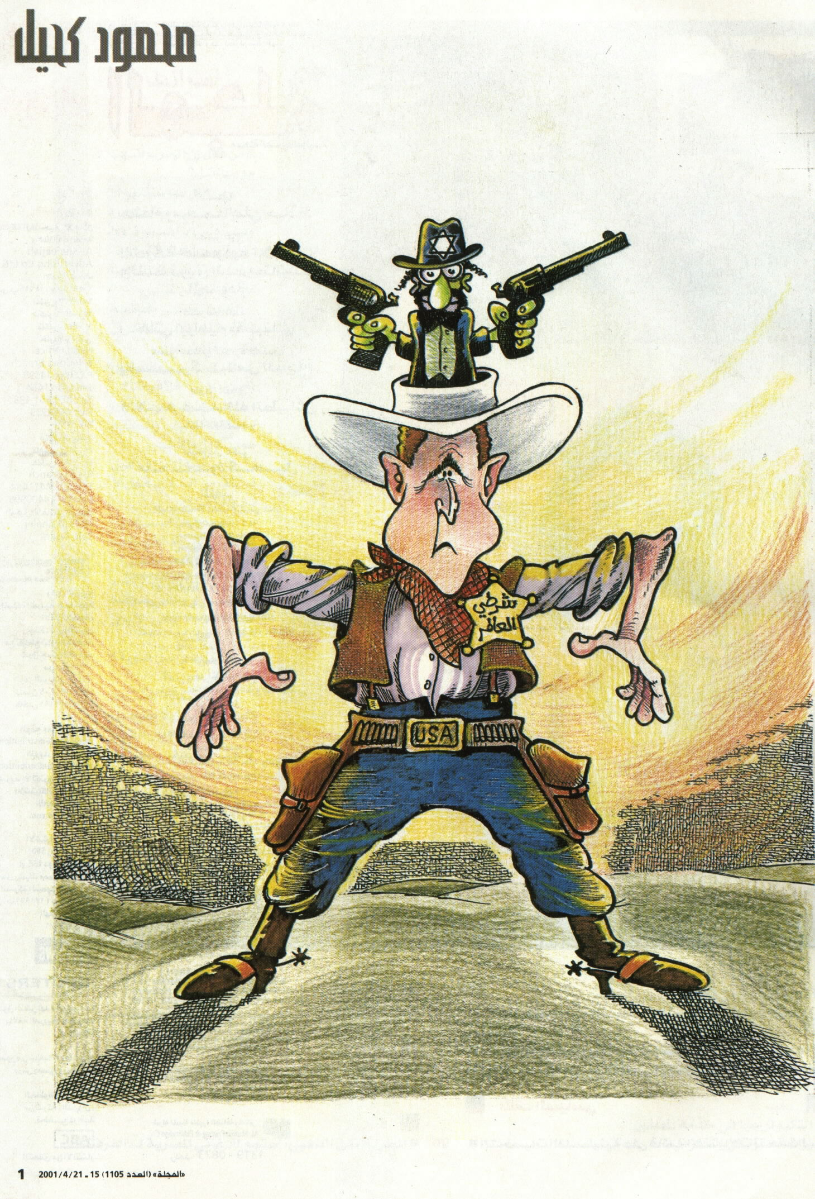
Karen Hughes, Undersecretary of State for Public Diplomacy and Public Affairs , said she was tired of seeing the president presented as a “caricature.”
The New York Times, 10/31/2007
President Bush told the AEI neoconservatives: “You are some of the best brains in our country and my government employs about 20 of you.” …"Employs" is too weak a verb,” wrote James Atlas.
The New York Times, May 4, 2003
A representation of the stereotypical view of US-Israel relations
Israel
USA
Al-Majalla , 4/21/2001, http://www.al-majalla.com/ar/

Slide 56

“There’s no question in my mind that months before 9/11, some ranking leaders at the top of the government already anticipated this strike scenario, and decided that Iraq would pay the ultimate price if and when this 9/11 style of attack occurred. They were already prepping parts of the Intelligence Community to accept the inevitability of War with Iraq in the aftermath….
In mid June [2001], an Al Qaeda video became public, in which Osama bin Laden announced, “Your brothers in Palestine are waiting for you. It’s time to penetrate America and Israel, and hit them where it hurts the most”—[“U.S. Asset”] Susan Lindauer, Extreme Prejudice: The Terrifying Story of the Patriot Act and the Cover Ups of 9/11 and Iraq , 2010, Made in the USA, Lexington, Kentucky, May 3, 2011, pages 21, 24.
A representation of the stereotypical view of US-Israel relations
“I know what America is.. America is a thing you can move very easily, move it in the right direction.”--Benjamin Netanyahu, Israeli Prime Minister, 1996-99 & 2009-present, “Fibi Netanyahu, In 2001, PM boasted of manipulating Oslo accords,” Tablet: A New Read on Jewish Life, http://www.tabletmag.com/scroll/39692/fibi-netanyahu
Israel
Adapted from Work by Ian Antonio, http://www.creative-holidays-spain.com/painting.html
America
Benjamin Netanyahu, Israeli Prime Minister, 1996-99 & 2009-present, when asked what 9/11 would mean for American-Israeli relations, responded: "It's very good." Realizing his maladroit gaffe, he then added: "Well, it's not good, but it will generate immediate sympathy" for Israel from the United States: http://www.counterpunch.org/sugg10252005.html
Palestine
Iraq
Afghanistan
Pakistan
Libya
Lebanon
Syria
Sudan
Yemen
Iran
Islam
Etcetera
‘a minnow swallowing a whale’ ‘the tail wagging the dog’
“Of course, while Israel employs many proxies in the service of its security interests, the proxy of choice, and by far the most powerful and capable of these proxies, is the United States… America, in the eyes of those who formulate Israeli security policy, is but a tool to be wielded in support of the larger Israeli interest” --- Scott Ritter, Target Iran: the Truth about the White House’s Plans for Regime Change, New York: Nation Books, 2006. page 33-34.
"only by force can a Jewish state in Palestine be established or maintained"--US Army Lt. Col. Harold Hoskins, 1943
“The U.S. can no longer afford $725 billion each year for defense, much of it borrowed. Given the poor return on our investment, it’s clear we need another strategy, one free of Zionist goals that advance behind serial conflicts and the debt incurred to fund them. We know what to do. What’s required is the leadership to do it.” Jeff Gates, 12/29/2010, http://criminalstate.com/2010/12/a-commonsense-solar-defense/
Attorney Brian Shaughnessy wrote, “Ms. Lindauer was always competent to stand trial, only the Justice Department wanted to avoid embarrassing revelations from her case”, page vii

Slide 57
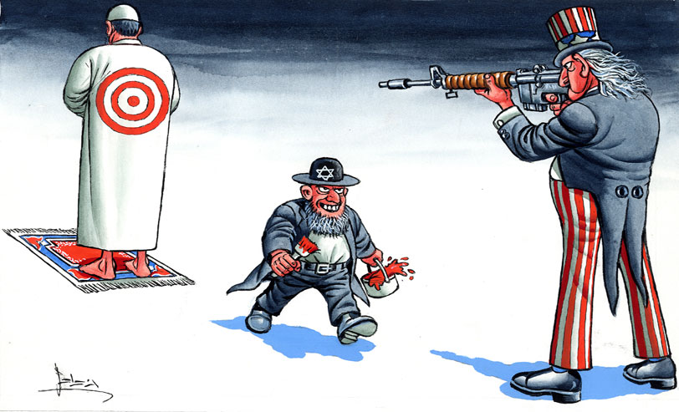
A representation of the stereotypical view of US-Israel relations
Islamic world
Israel
USA
alabonline, http://www.alarab.co.uk/

Slide 58
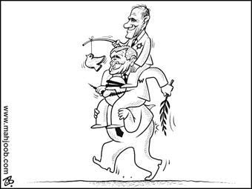
A representation of the stereotypical view of US-Israel relations
The Israelis
The Americans
The Arabs
President Bush Middle East Tour

Slide 59
What Do Israelis Think About Americans? Start With Disdain
View Ally as Naive, Especially on Middle East Issues
…… “I know what America is,” Netanyahu, then on political hiatus after an election defeat, told the settlers when one asked whether his proposal for a “large scale” attack on the Palestinians would be met with global condemnation. “America is a thing that can be easily moved, moved in the right direction. They will not bother us… Let’s suppose they [the Bush administration] will say something. So they say it — so what? Eighty per cent of the Americans support us. It’s absurd! We have such [great] support there! And we say… what shall we do with this [support]?” The Jewish Daily Forward, 3/8/2015, http://forward.com/articles/216074/what-do-israelis-think-about-americans-start-with/
Mueller Finally Starts to Target Trump’s Israel Ties: “Trump’s links to Moscow are visible but remain somewhat obscure. His ties to Israel, however, are much plainer to see. Based on the available evidence to date, Team Trump’s 2016 links to shadowy Israelis appear just as troubling as those to dodgy Russians—indeed, in some cases they are the very same people. As a veteran counterspy in our Intelligence Community whom I’ve known for years recently asked me with a wry smile, 'What if the real secret of the Trump campaign isn’t that it’s a Kremlin operation, rather an Israeli operation masquerading as a Russian one?' That’s a provocative question, but it merits consideration beyond counterintelligence circles." Observer, 6/5/2018, http://observer.com/2018/06/muellers-investigation-into-trump-russia-turns-focus-on-israel/
Citing anti-Israel bias, U.S. to withdraw from UNESCO [United Nations’ Paris-based cultural, scientific, and educational organization], Politico, 10/12/2017, https://www.politico.com/story/2017/10/12/united-states-withdraws-unesco-243708
"One by one, 14 members of the U.N. Security Council spoke out against President Donald Trump's decision to recognize Jerusalem as the capital of Israel [the UN Security Council has only 15 members, including the US], Fox News, 12/9/2017, http://www.foxnews.com/world/2017/12/09/14-security-council-members-criticize-us-action-on-jerusalem.html
"U.S. vetoes U.N. resolution rejecting Trump’s decision on Jerusalem... All 14 other members supported the resolution, underscoring the U.S. isolation on the issue." The Washington Post, 12/18/2017, https://www.washingtonpost.com/world/national-security/us-vetoes-un-resolution-rejecting-trumps-decision-on-jerusalem/2017/12/18/4e683732-e421-11e7-ab50-621fe0588340_story.html?utm_term=.684214f9ebce
“Most Israelis think Americans are pro-Israel and we can sell them anything, especially mud from the Dead Sea. Or — just regular mud with a ‘Dead Sea’ sticker on it.”
Israeli Embassy Official Caught on Camera Discussing 'Taking Down' British Lawmakers, Haaretz, 1/8/2017, http://www.haaretz.com/israel-news/1.763613
The 193-member United Nations General Assembly has overwhelmingly voted [128 in favor; 9 against: Guatemala, Honduras, Israel, Marshall Islands, Micronesia, Nauru, Palau, Togo, and United States; with 35 abstentions and 21 absences] to declare US recognition of Jerusalem as the capital of Israel "null and void" and must be cancelled. BBC, 12/21/2017, http://www.bbc.com/news/world-middle-east-42446027

Slide 60
The Christian Zionist Branch of the Israel Lobby
Former Congressman Paul Findley notes the paradox: “Mainline Christians who accept the legitimacy of the Jewish faith but question some policies of the Jewish state are branded anti-Semitic, while evangelical Christians who back Israel but doubt the theological validity of Judaism are welcome as allies.” The Christian Science Monitor, August 2, 1985, http://www.csmonitor.com/1985/0802/bfindl-f.html
The Evangelical-Jewish Alliance, The Christian Century, June 28, 2003, http://www.religion-online.org/article/the-evangelical-jewish-alliance/
Evangelicals Declare Trump A Friend Of The Jews, Forward, 12/12/2017, https://forward.com/fast-forward/389860/evangelicals-declare-trump-a-friend-of-the-jews/
(1) provides financial support to the Jewish settler movement
(2) opposes any territorial concession to the Palestinians
(3) contributes to tourism in Israel, a lucrative economic sector generating $2.8 billion in 2004 p138 and 400
(4) Yet the influence of the Christian Zionists should not be overstated
(5) In sharp contrast to the groups like AIPAC, Christian Zionists lack the organizational capacity to analyze national security topic
(6) They lack the organizational capacity to offer specific legislation guidance on concrete foreign policy issues
(7) They also lack the financial power of the major pro-Israel groups
(8) They do not have the same media presence when it comes to the Middle East issues
(9) Therefore Christian Zionists “are best seen as a significant adjunct to the Jewish elements of the lobby, but not its most important part”---Source: John Mearsheimer and Stephen Walt, The Israel lobby and U.S. foreign policy (2007), p. 132-139
[Israeli Prime Minister Binyamin Netanyahu] Bibi: Christian Zionists our top friends, Jerusalem Post, 4/7/2008, http://www.jpost.com/Israel/Bibi-Christian-Zionists-our-top-friends
Stephen Bannon [executive chairman of Breitbart News]: “I’m a Proud Christian Zionist”, VT, 11/15/2017, https://www.veteranstoday.com/2017/11/15/stephen-bannon-im-a-proud-christian-zionist/
Allies for Armageddon: The Rise of Christian Zionism, VT, 11/28/2017, https://www.amazon.com/Allies-Armageddon-Rise-Christian-Zionism/dp/0300116985?tag=veteranstoday-20
Leader of Christian Zionists Named Head of Campus Anti-BDS Group, Forward, 7/8/2015, http://forward.com/news/311662/leader-of-christian-zionists-named-head-of-adelson-campus-anti-bds-group/
Jonathan Farrell: Why I'm a Christian Zionist, The Global Jewish Channel (GJC), 9/10/2017, https://www.youtube.com/watch?v=e0w06Ro5pcY&list=PLEVTqoofQtWO7topNOIO8EDp1c3PNwCxi&index=10
Noor Dahri: I'm a Muslim Zionist. Here's why… Thankfully, the Arab countries of the Gulf are slowly realizing that Israel is not an enemy, GJC, 11/5/2017, https://www.youtube.com/watch?v=BC9GlA55sCI&list=PLEVTqoofQtWO7topNOIO8EDp1c3PNwCxi&index=2
Dr Shadman Zaman: I am the first Bangladeshi to visit Israel, GJC, 8/29/2017, https://www.youtube.com/watch?v=nGEFL9MNaXw
US Senator Biden: “I am a Zionist …You don't have to be a Jew to be a Zionist”, Shalom TV, 3/27/2007
Mike Pence's message to Jerusalem rally, https://www.youtube.com/watch?v=p9cRk10AZWg
‘Christian Zionism’ Grabs Spotlight As Mike Pence Addresses CUFI-
Forward, 7/18/2017, http://forward.com/news/377223/christian-zionism-grabs-spotlight-as-mike-pence-addresses-cufi/
Evangelicals Led Drive To Name Jerusalem As Capital, AIPAC Stayed On Sidelines... Vice President Mike Pence, has served as Christian Zionists’ main channel to the White House, Forward, 12/6/2017, https://forward.com/news/national/389233/evangelicals-led-drive-to-name-jerusalem-as-capital-aipac-stayed-on-sidelin/
This Jewish Group [Israel365, https://www.israel365.com/] Uses ‘Biblical Prophecy’ To Grow Christian Support For Israel, Forward, 9/8/2018, https://forward.com/news/israel/403254/israeli-evangelical-news-website-mixes-current-events-with-biblical/
[US Vice President Michael] Pence will be the first sitting vice president or president to speak to the Christian Zionist organization in its 11-year history, The Washington Post, 7/17/2017, https://www.washingtonpost.com/news/made-by-history/wp/2017/07/17/what-you-need-to-know-about-mike-pences-speech-to-christians-united-for-israel/?utm_term=.cb4e4e2efa51
The Scofield Bible—The Book That Made Zionists of America’s Evangelical Christians, https://www.wrmea.org/2015-october/the-scofield-bible-the-book-that-made-zionists-of-americas-evangelical-christians.html

Slide 61
Palestinians and Israelis killed since 9/29/2000
9,510 Palestinians (including 2,167 children) and 1,242 Israelis (including 134 children) have been killed since September 29, 2000 [as of 9/22/2017, If Americans Knew]
Heated Debate: Norman Finkelstein vs Ken Spiro - Is Israel held to double standards? The Global Jewish Channel, Published on Nov 14, 2016, https://www.youtube.com/watch?v=tWlxH7dypZs
During Fiscal Year 2016, the U.S. is providing Israel with at least $10.1 million per day in military aid and $0 in military aid to the Palestinians. Source: If Americans Knew (IAK), http://www.ifamericansknew.org/ http://www.ifamericansknew.org/stat/usaid.html#source http://israelpalestinetimeline.org/charts/
Some Israelis see $38 billion U.S. military aid offer as a failure, The Washington Post, 9/19/2016, https://www.washingtonpost.com/world/some-israelis-see-38-billion-us-military-aid-offer-as-a-failure/2016/09/19/2a2c298c-f878-4213-8e65-fcde59032f4c_story.html
"Palestinian women and children fight off Israeli soldier with boy in chokehold," https://www.youtube.com/watch?v=CrrbyGtNfEg
'Resistance continues', says Palestinian teen released from Israel jail, Reuters, 7/29/2018, https://www.reuters.com/article/us-israel-palestinians-teen/resistance-continues-says-palestinian-teen-released-from-israel-jail-idUSKBN1KJ04E
Ahed Tamimi to be honored by Nelson Mandela’s grandson, The Jerusalem Post, 7/30/2018, https://www.jpost.com/Arab-Israeli-Conflict/Ahed-Tamimi-to-be-honored-by-Nelson-Mandelas-grandson-563800
Israel “has received far more US aid, both military and economic, than all 42 Latin American and Caribbean countries combined,” Kirk Beattie, Congress and the Shaping of the Middle East, Seven Stories Press, 2015, page 393

Slide 62
Palestinians and Israelis injured since 9/29/2000
95,299 Palestinians and 11,895 Israelis have been injured since September 29, 2000 [as of 7/22/2017, If Americans Knew]
Israel has been targeted by at least 77 UN resolutions and the Palestinians have been targeted by 1 between 1955 and 1992
Source: If Americans Knew, http://www.ifamericansknew.org/

Slide 63
Causes of Deaths of Israeli Soldiers in 2005
Committed Suicide 30
Illness 14
Accidents 26
Terror Incidents 6
Source: Israeli newspaper Ma’ariv, Oct. 10, 2005, p. 6.
Note: The paper also reported that since 1992, 459 Israeli soldiers have committed suicide.
Source: If Americans Knew, http://www.ifamericansknew.org/

Slide 64
Palestinians and Israelis currently imprisoned
'Shin Bet tortures prisoners and denies access to lawyers'
As many as 90% of Palestinian prisoners are denied this basic right despite civilian and military legislation, says study produced by Public Committee Against Torture and Palestinian Prisoners' Society. Haaretz, 12/28/2010,
http://www.haaretz.com/news/diplomacy-defense/shin-bet-tortures-prisoners-and-denies-access-to-lawyers-1.333450
6,279 Palestinians are currently [9/22/2017] imprisoned by Israel, while 0 Israelis are being held prisoner by Palestinians.
“Since the Israeli occupation of Palestinian territory in 1967, more than 800,000 Palestinians have been detained under Israeli military orders in the occupied Palestinian territory (oPt). This number constitutes approximately 20 percent of the total Palestinian population in the oPt and as much as 40 percent of the total male Palestinian population… 8,000 Palestinian children have been arrested since 2000.”Source: If Americans Knew, http://www.ifamericansknew.org/
Gaza's first 'prison baby' on way after jailed Palestinian smuggles out sperm
Boy named Hassan to join three infants delivered in West Bank following IVF treatment for mothers with husbands held by Israel
Hana al-Za'anin and her husband, Tamer, have not set eyes on each other, let alone had physical contact, for almost seven years. But the young Palestinian couple are delighted to be expecting their first child in January.
The baby – a boy already named Hassan – is not a modern-day miracle but the result of medical science combined with old-fashioned subterfuge. He was conceived after Tamer's sperm was smuggled out of an Israeli prison, across a stringent military checkpoint into Gaza, and impregnated into an egg harvested from Hana at a fertility clinic in Gaza City. The resulting embryo was transplanted into her uterus. http://www.theguardian.com/world/2013/oct/13/gaza-first-prison-baby-palestinian-smuggles-sperm
A classified report by the Israel Bar Association obtained by Haaretz provides a glimpse into the harrowing conditions prisoners separated from the main jail population must endure. According to the document, which is the first external review of the Prison Service, the isolation wings at the Ayalon and Shikma prisons are not fit for human habitation and "look more like a dungeon," while most solitary cells in prisons across the country are "crammed, rancid with smells of sewer and mold, and infested with insects." "It's difficult to ignore the feeling that isolation as practiced today serves a function of punishment rather than imprisonment," wrote the authors of the report, Michael Atia - chairman of the prison service committee at the Israel Bar Association, and Moran Kabalo - chief of criminal law for the IBA... The report noted that prolonged stay isolated from the general prison population has profound psychological impacts. "Many isolated inmates testified to have developed paranoia, a tendency for uncontrollable fits of rage, and eyesight problems because of the lack of natural light through most hours of the day," the lawyers wrote...The report provides a rare insight into life in isolation wings. "Most such cells are windowless and are lit by cold fluorescent lights," the report says. "The meals are brought on trays and are inserted through a latch that is shut immediately afterwards, to prevent poisoning." Haaretz, 12/27/2010, http://www.haaretz.com/print-edition/news/groundbreaking-report-details-israel-s-inhumane-conditions-for-isolated-prisoners-1.333107
Legal barbarism: Israel's moral suicide
In Israel 2014, if you're a Palestinian, you're not even allowed to commit suicide in protest. That’s the significance of a bill that will allow force-feeding of hunger-striking prisoners, which is being pushed toward its second and third readings in a marathon debate in the Knesset. Haaretz, 6/18/2014, http://www.haaretz.com/opinion/.premium-1.599505

Slide 65
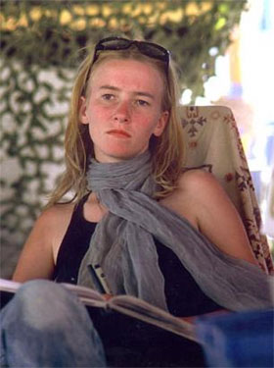
Palestinian and Israeli homes demolished
48,488 Palestinian homes have been demolished by Israel and 0 Israeli homes have been demolished by Palestinians since 1967
"It is impossible to know how many homes exactly because the Israeli authorities only report on the demolition of 'structures,' which may be homes or may be other structures. When a seven-story apartment building is demolished containing more than 20 housing units, that is considered only one demolition.“
In addition to the homes demolished by Israel, thousands of Palestinian homes have been destroyed or significantly damaged by Israeli bombing and shelling. Perhaps over 20,000 in the Dec 2008/Jan 2009 assault on Gaza. Americans Knew
On the 16 March, 2003, 23-year-old American Rachel Corrie was crushed to death by an Israeli military bulldozer, while she stood between the Israeli bulldozer and a to-be-demolished Palestinian house
“The [Israeli] High Court of Justice ruled on Wednesday that the West Bank Bedouin herding village of Khan al-Ahmar can be demolished after a week... Located right off of Route 1, below the Kfar Adumim settlement the encampment of shacks and tents is home to some 180 Bedouins, who were relocated to the area from the Negev in the early 1950s. The international community, including the European Union and European countries had heavily lobbied the Israeli government to prevent the community’s demolition.” The Jerusalem Post, 9/5/2018, https://www.jpost.com/Arab-Israeli-Conflict/High-Court-gives-final-okay-to-demolish-long-disputed-Bedouin-village-566531
According to the most recent United Nations OCHA report on home demolitions by Israeli forces, in the West Bank during the first two months of 2016: At least 320 structures, including 88 homes, were destroyed. IMEMC News, 7/27/2016, http://imemc.org/article/israeli-troops-demolish-12-homes-near-jerusalem-attack-locals-trying-to-block-the-demolitions/

Slide 66
Palestinians and Israelis killed in Gaza Strip 12/27/2008-1/18/2009
As of 1/31/2009, Israeli air/land/sea raids on the blockaded Gaza Strip (12/27/2008-1/18/2009) killed 1,380 Palestinians, of whom 431 are children. The number of injuries stands at 5,380, of whom 1,872 are children.
Three Israelis have been killed and 183 injured by rocket and mortar fire outside the Gaza Strip. Eleven Israeli soldiers have been killed and 340 wounded.
Source: If Americans Knew, http://www.ifamericansknew.org/
The UN Office for the Coordination of Humanitarian Affairs
The Israeli Ministry of Foreign Affairs

Slide 67
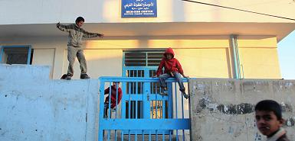
Jordanian suicide bomber who killed CIA agents ‘was triple agent’
TimesOnline, 1/6/2010
http://www.timesonline.co.uk/tol/news/world/Afghanistan/article6977047.ece
He vowed to “take up arms, and to wear an explosive belt, to avenge the killing of children and women in the Gaza War”.
Al-Balawi practised medicine at this UN clinic in the Hittin Palestinian refugee camp in Jordan
“The Jordanian suicide bomber who killed several CIA agents in Afghanistan last week fooled Amman’s intelligence agency into believing that he was a reliable informant spying on the al-Qaeda leadership.
But Humam Khalil Abu-Mulal al-Balawi was a triple-agent leading an extraordinary life on the front line of America’s war against militant Islam. An investigation by The Times has revealed that the trainee doctor became an open and public supporter of al-Qaeda, secretly pretended to work for Jordanian intelligence but ultimately sacrificed his life for the cause of jihad.
On December 30 al-Balawi infiltra-ted Forward Operating Base Chapman in Khost province near the Pakistan border. He detonated explosives strapped to his body and killed seven CIA agents and his Jordanian handler, Ali bin Zaid, an army captain and distant cousin of King Abdullah II. The Hashemite monarch, his wife, and other Royal Family members attended bin Zaid’s funeral on Friday.”

Slide 68
Israel’s Estimated Costs of the 3-Week Gaza War 12/27/2008-1/18/2009
“War costs take into account ammunition, reserves soldiers’ salaries, direct and indirect damage to towns and property, losses to businesses, and more. Total costs of the war are roughly estimated at 5.5 billion shekels ($1.43 billion).”
Source: Israel National News, 1/19/2009, http://www.israelnationalnews.com/News/News.aspx/129502

Slide 69
Gaza economic losses estimated at 1.9 billion dollars
Preliminary estimates by Dr. Loai Shabana (the head of the Palestinian central bureau of statistics) indicated that the Israeli assault led to the complete and partial destruction of over 14 percent of the 147,437 buildings and facilities in the Gaza Strip [that would be over 20,600 buildings and facilities]
Source: The Palestinian Information Center, 1/19/2009
http://www.palestine-info.co.uk/en/default.aspx?xyz=U6Qq7k%2bcOd87MDI46m9rUxJEpMO%2bi1s7y2gM99H%2bLE0HpdGNrBjOgAeW6NbBC2iKkBjQoXWjiHsgesZ0cEJxP3zBHHGB2UByaXglnhD%2bqM%2fLFQbqNWUNgNYklve5lKRuN1rv00VyPYY%3d

Slide 70
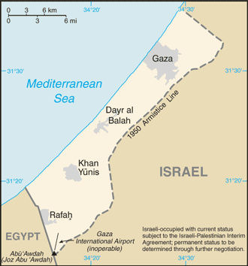
Gaza Strip
Population: 1.5 million
Area: 360 sq km
Population density: 4,166/sq km
Unemployment rate: 41.3%
Land boundaries: Israel 51 km
Egypt 11 km
Mediterranean coastline: 40 km
Refugee Registered
Camps Refugees
Jabalia 106,691
Beach 78,768
Nuseirat 57,120
Bureij 28,770
Deir al-Balah 19,534
Maghazi 22,226
Khan Younis 63,219
Rafah 95,187
Source: UN (May 2005) and CIA (July 2008)

Slide 71
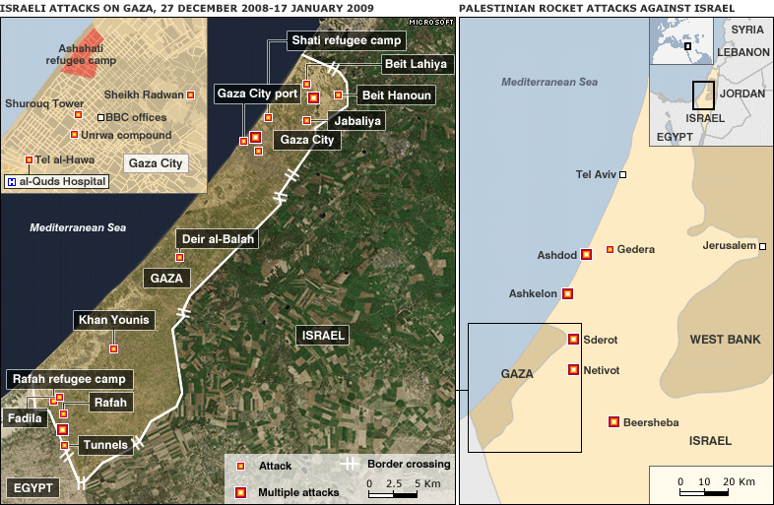
The map shows the main areas attacked in the three weeks of violence, BBC, http://news.bbc.co.uk/2/hi/middle_east/7812136.stm

Slide 72
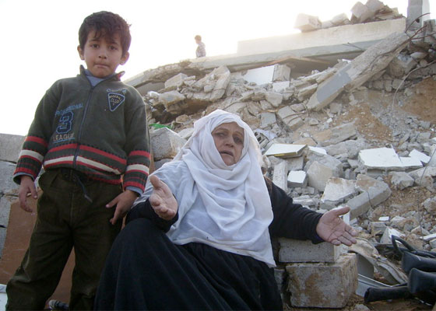
Impunity for War Crimes in Gaza and Southern Israel a Recipe for Further Civilian Suffering, 2 July 2009, http://www.amnesty.org/en/news-and-updates/report/impunity-war-crimes-gaza-southern-israel-recipe-further-civilian-suffering-20090702
“Israeli forces killed hundreds of unarmed Palestinian civilians and destroyed thousands of homes in Gaza in attacks which breached the laws of war, Amnesty International concluded in a new report published on Thursday. Operation 'Cast Lead': 22 days of death and destruction, is the first comprehensive report to be published on the conflict, which took place earlier this year.”
A woman and a child made homeless after the destruction of their home, Gaza, January 2009
© Amnesty International
'Most Cast Lead damage not repaired‘--UNDP: Small-scale repairs done using rubble, smuggled materials. As an eight-ship 'Freedom Flotilla' began to make its way from various Mediterranean ports toward Gaza Sunday morning, a UN agency said about three-quarters of the damage inflicted by Operation Cast Lead more than a year ago had not been repaired. Israel continues to bar construction material from entering Hamas-ruled Gaza as part of an overall blockade of the territory. The UN Development Program (UNDP) said in a report Sunday that Gazans have carried out small-scale repairs worth $173 million with recycled rubble or material smuggled through border tunnels. Jerusalem Post, 5/23/2010, http://www.jpost.com/MiddleEast/Article.aspx?ID=176184
Israel rejects Qatar bid to restore diplomatic ties
In exchange for renewed ties, Qatar demanded it be allowed to carry out a series of reconstruction projects in Gaza. Israel has rejected two proposals from Qatar to restore diplomatic relations and let Israel reopen its office in the capital of Doha. A senior source in Jerusalem said that in return for renewed diplomatic relations, the Qataris demanded that they be allowed to carry out a series of reconstruction projects in the Gaza Strip and to import the necessary construction materials. Prime Minister Benjamin Netanyahu and Foreign Minister Avigdor Lieberman were unwilling to agree to this, he said. Haaretz, 5/18/2010, http://www.haaretz.com/print-edition/news/israel-rejects-qatar-bid-to-restore-diplomatic-ties-1.290866

Slide 73
Rights group: IDF killed Gazans waving 'white flags' during war
Haaretz, 8/13/2009 http://www.haaretz.com/hasen/spages/1107286.html
“Human Rights Watch called on Israel on Thursday [8/13/2009] to investigate seven incidents in which it said Israeli troops shot and killed Palestinian civilians who were flying white flags during the war in the Gaza Strip in January.”

Slide 74
UN urges Israel to investigate alleged torture
“Israel should investigate the secret detention facility known as 1391, halt punitive housing demolitions, investigate Operation Cast Lead and improve its treatment of security detainees, the United Nations Committee Against Torture said on Friday [5/15/2009] in Geneva.”
Jerusalem Post, 5/17/2009 http://www.jpost.com/servlet/Satellite?pagename=JPost/JPArticle/ShowFull&cid=1242212388431 http://www.aljazeera.com/news/articles/34/UN_Calls_on_Israel_to_Reveal_Secret_Torture_Center.html

Slide 75
Sweden denies Israel request to condemn IDF organ harvest article
The Associated Press and Haaretz Service, 8/20/2009 http://www.haaretz.com/hasen/spages/1109008.html
“Swedish Foreign Minister Carl Bildt has rejected Israeli calls for an official condemnation of a recent article by a top Swedish newspaper that alleged that Israel Defense Forces soldiers kill Palestinian civilians in order to harvest their organs.
Israel's Foreign Minister Avigdor Lieberman had asked Bildt to print a a state rebuttal to the piece, which was published earlier this week in Sweden's top newspaper Aftonbladet. Israel's Ambassador to Sweden Benny Dagan was expected to make a similar request during a meeting Friday with Sweden's Deputy Foreign Minister.”
Police smash Israeli organ-trafficking ring--A retired army brigadier general is among six suspects arrested by Israeli police investigating an organ-trafficking ring, police say. The organisation offered as much as $100,000 (£65,600) for kidneys, which were transplanted by doctors in poor countries, a sting operation uncovered. Police said they had been "shocked" by the extent of the smuggling ring. Retired Gen Meir Zamir, arrested in connection with the trafficking, won a medal of valour in the Yom Kippur War. http://news.bbc.co.uk/2/hi/middle_east/8608053.stm
Israeli Organ Harvesting--Last week Sweden’s largest daily newspaper published an article containing shocking material: testimony and circumstantial evidence indicating that Israelis may have been harvesting internal organs from Palestinian prisoners without consent for many years. Worse yet, some of the information reported in the article suggests that in some instances Palestinians may have been captured with this macabre purpose in mind. http://www.counterpunch.org/weir08282009.html

Slide 76
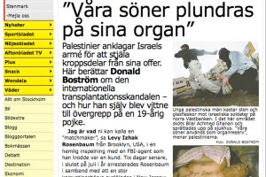
The organ harvesting controversy: Did Sweden fumble or Israel overreact?
JTA, August 24, 2009, http://jta.org/news/article/2009/08/24/1007429/did-israel-overreact-in-swedish-newspaper-controversy
“A Swedish newspaper is pushing forward with its far-fetched claims that the Israeli army harvested body organs from Palestinians. But for many Israel watchers the debate has shifted to whether the Swedish government fumbled the controversy or the Israeli government went overboard with its incensed reaction.”

Slide 77
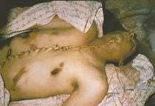
“Our sons are plundered of their organs” aftonbladet, 8/26/2009 http://www.aftonbladet.se/kultur/article5691805.ab
Bilal Achmed Ghanan, 19, was shot and taken away by Israeli soldiers. The body was returned stitched together from the belly to the neck.
Foto: Donald Boström
“Palestinians accuse the Israel Defense Forces of taking organs from their victims.
Donald Boström writes about an international organ trafficking scandal – and about the time he saw the cut-up dead body of a nineteen-year old Palestinian.
You could call me a ”matchmaker”, said Levy Izhak Rosenbaum, from Brooklyn, USA, in a secret recording with an FBI-agent whom he believed to be a client. Ten days later, at the end of July this year, Rosenbaum was arrested and a vast, Sopranos-like, imbroglio of money-laundering and illegal organ-trade was revealed in New Jersey: Rabbis, politicians and trusted civil servants had for years bin involved in money laundering and illegal organ-trade.
Rosenbaum’s matchmaking had nothing to do with romance. It was all about buying and selling kidneys from Israel on the black market. Rosenbaum says that he buys the kidneys for 10 000 dollars, from poor people. He then proceeds to sell the organs to desperate patients in the States for 160 000 dollars.
The accusations have shaken the American transplantation business. If they are true it means that organ trafficking is documented for the first time in the US, experts tell the New Jersey Real-Time News………………..”

Slide 78
U.S. Congress members to EU: Condemn IDF organ harvesting article
Haaretz, 9/4/2009 http://www.haaretz.com/hasen/spages/1112191.html
“Members of the U.S. Congress on Friday urged European foreign ministers to denounce an article published in the Swedish daily Aftonbladet alleging that Israel Defense Forces soldiers kill Palestinians in order to harvest their organs.”
Jenny Tonge stripped of Lords role
Liberal Democrat leader Nick Clegg has sacked controversial peer Jenny Tonge as the party’s health spokesperson in the Lords over her demands for an investigation into allegations of body parts harvesting by the Israeli Defence force in Haiti. The Jewish Chronicle, http://www.thejc.com/news/uk-news/27160/jenny-tonge-stripped-lords-role

Slide 79
Israeli doctors, patients accused of involvement in trafficking kidneys
Jewish Telegraphic Agency, June 24, 2013 http://www.jta.org/2013/06/24/news-opinion/israel-middle-east/israeli-doctors-patients-accused-of-involvement-in-trafficking-kidneys
JERUSALEM (JTA) — An international organ trafficking ring that sold kidneys to patients in Israel and Eastern Europe was broken up by Costa Rica police and Interpol.
The ring also worked with Israeli doctors who have not yet been named, according to Haaretz. Israel’s Health Ministry denied any knowledge of the organ trafficking ring.
The Costa Rican Attorney General’s Office said last week that Israeli doctors had performed kidney-removal operations on some Costa Ricans who sold their organs, according to Haaretz.
Israeli patients have paid up to $20,000 for a black market kidney.

Slide 80
UN rights body adopts Goldstone Gaza Report
Haaretz, 10/16/2009, http://www.haaretz.com/hasen/spages/1121610.html
The UN Human Rights Council on Friday endorsed a Gaza report that accused both Israel and the Palestinian militant group Hamas of committing war crimes in their December-January conflict.
In a special session, 25 of the body's members voted in favor of the resolution that chastised Israel for failing to cooperate with the UN mission led by South African jurist Richard Goldstone [who is Jewish]. Another 6 voted against and 11 abstained.
U.S. Senate unanimously calls on U.N. to rescind Goldstone
Haaretz, 4/15/2011, http://www.jta.org/news/article/2011/04/15/3086892/senate-unanimously-calls-for-goldstone-rescinsion
WASHINGTON (JTA) -- The U.S. Senate unanimously approved a resolution calling on the United Nations to rescind the Goldstone report... Similar legislation is now circulating in the U.S. House of Representatives. Unlike the non-binding Senate resolution, those bills would tie U.N. funding to rescinsion of the Goldstone report".

Slide 81
Israel rations Palestinians to trickle of water
Amnesty International has accused Israel of denying Palestinians the right to access adequate water by maintaining total control over the shared water resources and pursuing discriminatory policies…
“Israel allows the Palestinians access to only a fraction of the shared water resources, which lie mostly in the occupied West Bank, while the unlawful Israeli settlements there receive virtually unlimited supplies. In Gaza the Israeli blockade has made an already dire situation worse,” said Donatella Rovera, Amnesty International’s researcher on Israel and the OPT [Occupied Palestinian Territories]. ..
In a new extensive report, Amnesty International revealed the extent to which Israel’s discriminatory water policies and practices are denying Palestinians their right to access to water. Israel uses more than 80 per cent of the water from the Mountain Aquifer, the main source of underground water in Israel and the OPT, while restricting Palestinian access to a mere 20 per cent. The Mountain Aquifer is the only source for water for Palestinians in the West Bank, but only one of several for Israel, which also takes for itself all the water available from the Jordan River. While Palestinian daily water consumption barely reaches 70 litres a day per person, Israeli daily consumption is more than 300 litres per day, four times as much. In some rural communities Palestinians survive on barely 20 litres per day, the minimum amount recommended for domestic use in emergency situations. Some 180,000-200,000 Palestinians living in rural communities have no access to running water and the Israeli army often prevents them from even collecting rainwater. In contrast, Israeli settlers, who live in the West Bank in violation of international law, have intensive-irrigation farms, lush gardens and swimming pools. Numbering about 450,000, the settlers use as much or more water than the Palestinian population of some 2.3 million. In the Gaza Strip, 90 to 95 per cent of the water from its only water resource, the Coastal Aquifer, is contaminated and unfit for human consumption. Yet, Israel does not allow the transfer of water from the Mountain Aquifer in the West Bank to Gaza. ….“Over more than 40 years of occupation, restrictions imposed by Israel on the Palestinians’ access to water have prevented the development of water infrastructure and facilities in the OPT, consequently denying hundreds of thousand of Palestinians the right to live a normal life, to have adequate food, housing, or health, and to economic development,” said Donatella Rovera. Israel has appropriated large areas of the water-rich Palestinian land it occupies and barred Palestinians from accessing them.
Source: Amnesty International, 10/27/2009, http://www.amnesty.org/en/news-and-updates/report/israel-rations-palestinians-trickle-water-20091027

Slide 82
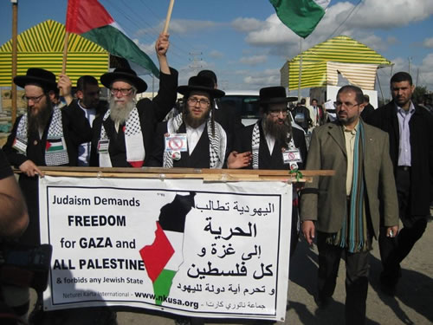
Viva Palestina Aid Convoy to Gaza moves on in 2010
Jan 1 2010: A delegation of Religious Orthodox Jews who joined British MP George Galloway in another Viva Palestina convoy to deliver aid to the citizens of Gaza report on their journey into Egypt, Jordan, Turkey and Palestine. http://www.nkusa.org/
“Neturei Karta [a group of Orthodox Jews who refused to recognize Israel] is always committed to voice the traditional Religious Jewish opposition to the philosophy of Zionism and the existence of the state of "Israel". According to the Torah teachings, Jews are in exile by divine decree. They are forbidden to leave exile and create their own state by physical means. Secondly, Jewish law forbids Jews to rebel against any other nations. Jews are required to be loyal citizens in the countries in which they reside. Hence, the state of "Israel" is forbidden.” http://www.nkusa.org/activities/Statements/20080123.cfm

Slide 83
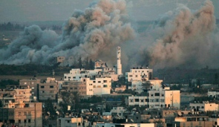
Amnesty: U.S., Europe shielding Israel over Gaza war crimes
In its annual report, the rights group accuses Israel of continually violating human rights in Gaza with its ongoing economic siege.
Amnesty International complained in its annual report released Thursday that the U.S. and members of the European Union had obstructed international justice by using their positions on the UN Security Council to shield Israel from accountability for war crimes allegedly committed during last year's Gaza war.
The rights group also accused Israel of continually violating human rights in the Gaza Strip. It cited Israel's ongoing economic blockade as violating international law, leaving Gaza residents without adequate food or water supplies . Haaretz, 5/27/2010, http://www.haaretz.com/news/diplomacy-defense/amnesty-u-s-europe-shielding-israel-over-gaza-war-crimes-1.292505
A cloud of smoke billows over Gaza after an Israel Defense Forces strike during the 2009 war.
Photo by: AP / Archive
'Israel is a Lunatic State' - Finkelstein on Gaza Flotilla Attack
http://www.youtube.com/watch?v=eB_CKL5h2_8

Slide 84
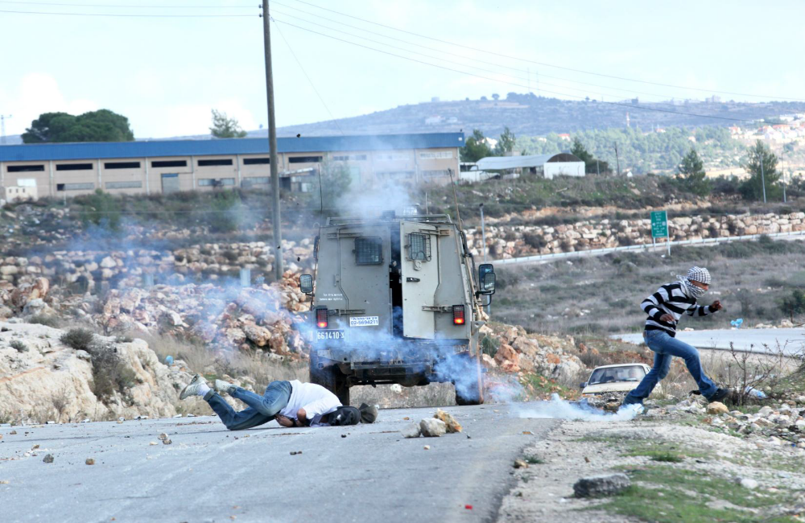
Trigger-Happy
Israel’s use of excessive force in the West Bank
Report by Amnesty International
February 2014,
http://www.amnesty.org/en/library/asset/MDE15/002/2014/en/349188ef-e14a-418f-ac20-6c9e5c8d9f88/mde150022014en.pdf
Amnesty International Report, February 2014: Trigger-Happy, Israel’s use of excessive force in the West Bank
“Out of nowhere many soldiers jumped out and ambushed Samir. They shot him first in the leg, yet he managed to run away towards the village. But how far can an injured child run? Twenty, maybe 30, metres? They could have easily arrested him, especially when he was injured, but instead they shot him in the back with live ammunition… To me this is premeditated murder... [Samir Awad was just 16 years old when Israeli soldiers shot and killed him],” page 5....
Israeli soldiers have repeatedly committed serious human rights and humanitarian law violations, including unlawful killings, in response to Palestinian opposition and protests in the West Bank, including East Jerusalem. The cases documented in this report represent only a minority of the cases that have occurred over recent years and which follow a general pattern, in which Israeli forces use excessive, often lethal, force against Palestinians who pose no threat to their lives or the lives of others. Soldiers are permitted to do so effectively with impunity – inasmuch as the official system established to investigate alleged human rights violations or other abuses by Israeli soldiers is neither independent nor impartial. This creates a situation of absolute absence of justice and the growing environment of impunity which the Israeli army and police enjoy. As the occupying power in the West Bank, including East Jerusalem, Israel is responsible for the welfare of the inhabitants of the occupied
territories, all of whom are protected persons. It must respect and protect the rights of Palestinians. Instead, Israeli forces routinely violate their obligations under international human rights law and the law of occupation by unlawfully killing and injuring civilians, including children, who are posing no threat to their lives or those of others. This has carried on for decades with the full knowledge of the Israeli government and military command," page 70.
Report by Amnesty International, February 2014, http://www.amnesty.org/en/library/asset/MDE15/002/2014/en/349188ef-e14a-418f-ac20-6c9e5c8d9f88/mde150022014en.pdf

Slide 85
Examples of Systematic Bias and Distorted Media Coverage of the Palestine-Israel Conflict in the United States
In the next 3 slides, compare and contrast:
Children’s Deaths Reported and Omitted in Headline or First Paragraph by The New York Times, First Year of Intifada 9/29/2000-9/28/2001
Percentage of Deaths Reported by ABC, CBS, and NBC evening news, First Year of Intifada 9/29/2000-9/28/2001
Percentage of Children’s Deaths Reported in Headline or First Paragraph by Associated Press newswire, 2004
Source: If Americans Knew

Slide 86
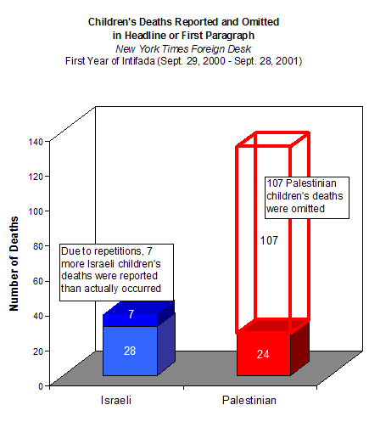
Source: If Americans Knew, http://www.ifamericansknew.org

Slide 87
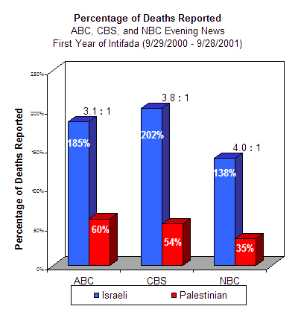
Source: If Americans Knew, http://www.ifamericansknew.org

Slide 88
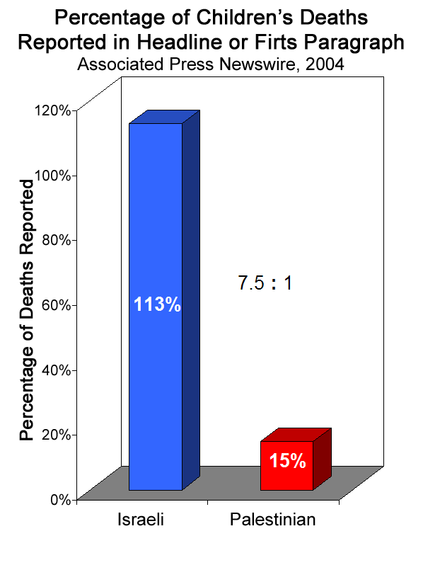
Source: If Americans Knew, http://www.ifamericansknew.org

Slide 89
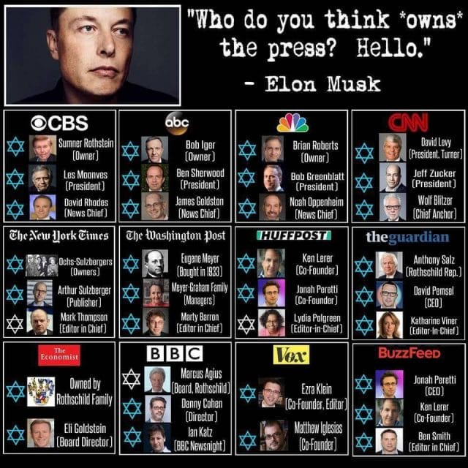
We're being molded by our information environment
In his book The Shallows: What the Internet Is Doing to Our Brains [2010], Nicholas Carr argues that we are losing our capacity for concentration and contemplation because of the impact of the Internet on our cognition. He stresses that the technologies we use to find, store, and share information can literally REROUTE our neural pathways. He concludes that "we're being molded by our new information environment" and "as we come to rely on computers to mediate our understanding of the world, it is our own intelligence that flattens into artificial intelligence” (page 224) .
The Occupation of the American Mind, Veterans Today, 8/1/2018,
https://www.veteranstoday.com/2018/08/01/israels-public-relations-and-propaganda-war-machine-against-palestine-and-our-world-of-sanity/

Slide 90
CNN “The Situation Room”
Anchor Wolf Blitzer
News program and politics
Monday-Friday 5-7 pm ET, Saturday 6-7 pm ET http://www.cnn.com/CNN/Programs/situation.room/
In his book Myths and Facts 1978: A Concise Record of the Arab-Israeli Conflict, Wolf Blitzer wrote:
“Myth: Arabs were displaced by Jewish settlements. Fact: British inquiry showed that these complaints were groundless.” page 8.
Wolf Blitzer: From AIPAC Lobbyist to CNN's Chief News Anchor
http://www.youtube.com/watch?v=7xatMfqa_C0

Slide 91
Reel Bad Arabs: How Hollywood Vilifies a People
See the video/book “Reel Bad Arabs: How Hollywood Vilifies a People.”
“Reel Bad Arabs takes a devastating tour of the American cinematic landscape, moving from the earliest days of silent film to today's biggest Hollywood blockbusters to reveal an astonishing and persistent pattern of slanderous Arab stereotyping. Featuring acclaimed author and Hollywood film consultant Dr. Jack Shaheen, the documentary exposes American cinema's long love affair with Arab villainy and buffoonery, from over-sexed Bedouin bandits and submissive maidens to sinister sheiks and blood-thirsty terrorists.”
Egypt bans 'inaccurate' Exodus film
Egypt has banned a Hollywood film based on the Biblical book of Exodus because of what censors described as "historical inaccuracies". The head of the censorship board said these included the film's depiction of Jews as having built the Pyramids. BBC, 12/26/2014, http://www.bbc.com/news/world-middle-east-30605059
Mark Green and Wendy Campbell noted that since Ashkanazi Jewish immigrants created Hollywood’s studio system nearly a century ago, “business there still retains a Yiddish accent.” For example, Hollywood distribution moguls Bob and Harvey Weinstein brothers did elect to distribute Michael Moore’s “much ballyhooed” Fahrenheit 9/11 because the film “actually managed to sidestep mentioning Israel, Zionism or neoconservatism throughout the entire film!”…. Michael Medved was quoted saying “It makes no sense at all to try to deny the reality of Jewish power and prominence in popular culture. … Any Martian monitoring American television … would view Seinfeld, Friends, The Nanny, Northern Exposure, Mad About You, and other shows and be surprised to learn that fewer than 1 in 40 Americans is Jewish.” ⁻⁻Mark Green and Wendy Campbell, “What about Mel? Hollywood’s Passionate Attachment,” In Mark Green, ed., Persecution, Privilege & Power: Reconsidering the Zionist Narrative in American Life, Thirty Essential Articles on the Most Pressing Issue of our Time, 2007, pp 93-100, page 93, 98. Edmund Connelly, “The Jews of Prime Time,” In Mark Green, ed., Persecution, Privilege & Power: Reconsidering the Zionist Narrative in American Life, Thirty Essential Articles on the Most Pressing Issue of our Time, 2007, pp 101-126, page 101.

Slide 92
Journalists and Diplomats Under Fire For Israel-Related Remarks
Helen Thomas: Bitter end for 'dean' of press corps
She is the only reporter to have had her name engraved on a chair in the White House press briefing room.
But after five decades of covering the White House, Helen Thomas, 89, retired under a cloud on Monday - caught on camera saying Israeli Jews should "get the hell out of Palestine" and "go home" to Germany, Poland and America.
BBC, 6/8/2010, http://news.bbc.co.uk/2/hi/world/us_and_canada/10260512.stm
CNN sacks editor over Muslim cleric Twitter remark:
CNN has sacked a veteran Middle East editor after she wrote on Twitter that she "respected" a late senior Lebanese cleric said to have inspired Hezbollah.
BBC, 7/8/2010, http://news.bbc.co.uk/2/hi/world/us_and_canada/10549106.stm
UK envoy's praise for Lebanon cleric draws Israel anger:
Israel has criticised Britain's ambassador to Lebanon for eulogising a recently deceased Lebanese cleric said to have inspired Hezbollah. Frances Guy wrote on her personal blog that Grand Ayatollah Mohammed Hussein Fadlallah was a "decent man" who rated among the people she most admired ["When you visited him you could be sure of a real debate, a respectful argument and you knew you would leave his presence feeling a better person"--Frances Guy, British ambassador to Lebanon]...The UK foreign office says it has taken down the blog after "mature consideration".
BBC, 7/9/2010,
http://news.bbc.co.uk/2/hi/world/middle_east/10572025.stm

Slide 93
CNN sacks Sanchez after dig at Jews
CNN fired anchorman Rick Sanchez after he suggested that Jews run the news business
WASHINGTON (JTA) -- CNN fired anchorman Rick Sanchez after he suggested that Jews run the news business.
Sanchez made his remarks in a freewheeling exchange Sept. 30 with Pete Dominick, a Latino stand-up comedian and radio show host who is friends with Jon Stewart, the faux-news Comedy Central star who has made Sanchez' robust style the butt of many jokes.
Sanchez, a native of Cuba, alleged that Stewart singled him out because of white bigotry.
Dominick pushed back, saying that Stewart, because he is Jewish, is himself a member of a minority.
"I’m telling you that everybody who runs CNN is a lot like Stewart, and a lot of people who run all the other networks are a lot like Stewart, and to imply that somehow they, the people in this country who are Jewish, are an oppressed minority? Yeah," he said.
On Oct. 1, Sanchez's 3 p.m. broadcast did not appear. At 6 p.m., in a short statement, CNN said he no longer worked for the network.
JTA, October 2, 2010 , http://www.jta.org/news/article/2010/10/02/2741092/cnn-sacks-sanchez-after-dig-at-jews

Slide 94
Ex-mayor of London suspended from Labour for saying Hitler was Zionist
Zionism Should be on Trial, Not Ken Livingstone
What is Zionism? This is the question that millions of people across the United Kingdom will undoubtedly have been asking themselves over recent days in light of the political crisis and media firestorm that’s been whipped up over allegations that the Jeremy Corbyn-led Labour Party has a problem with antisemitism. It is a crisis that has seen Labour MP Naz Shah suspended by the party, along with former mayor of London and Labour Party veteran Ken Livingstone – the former over Facebook comments that came to light, the latter over comments made in an interview he gave defending Shah during which he brought up the existence of the Haavara Agreement between the Nazis and Zionists in Germany to arrange the transfer of Jews from Germany to Palestine…
In taking things this far, however, in subjecting Ken Livingstone to trial-by-media over his comments on Zionism, his detractors have also unwittingly placed Zionism itself on trial, with the question of Zionism, as mentioned, undoubtedly now being pondered by millions of people who previously would have had zero interest in the subject. And what most of those people will inarguably find if they delve deep enough into that question, despite the determined efforts of Israel’s supporters to conflate Zionism with Judaism, is that this is a political doctrine and ideology responsible for crimes against humanity on a grand scale. By John Wight, Counterpounch, 5/3/2016, http://www.counterpunch.org/2016/05/03/zionism-should-be-on-trial-not-ken-livingstone/
(JTA) -- Britain’s Labour Party suspended former London Mayor Ken Livingstone on Thursday for saying Adolf Hitler was a Zionist... In a radio interview with the BBC on Thursday, Livingstone said, “Let’s remember when Hitler won his election in 1932 his policy then was that Jews should be moved to Israel. He was supporting Zionism.” He made the remarks in defense of Labour lawmaker Naz Shah, who was suspended a day earlier over a Facebook post in 2014 suggesting Israelis should be moved en masse to the United States. JTA, 4/28/2016, http://www.jta.org/2016/04/28/news-opinion/world/labours-ex-mayor-of-london-hitler-was-a-zionist
Anti-Semitic Campaign in Basel is Traced to a Jewish Student, JTA, 3/8/1983, https://www.jta.org/1983/03/08/archive/anti-semitic-campaign-in-basel-is-traced-to-a-jewish-student
Jewish Center Bomb Threat Suspect Is Arrested in Israel, The New York Times, 3/23/2017, https://www.nytimes.com/2017/03/23/us/jcc-bomb-threats.html
Why Did Adolf Hitler Hate the Jews? Haaretz, 4/11/2016, https://www.haaretz.com/jewish/holocaust-remembrance-day/why-did-adolf-hitler-hate-the-jews-1.5088390
DNA Tests Reveal Hitler's Jewish and African Roots, Haaretz, 8/24/2010, https://www.haaretz.com/jewish/1.5104559
Hitler May Have Married a Jew, DNA Evidence Shows, Haaretz, 4/5/2014, https://www.haaretz.com/jewish/hitler-may-have-married-a-jew-1.5244043

Slide 95
Leno will make first visit to Israel to emcee Genesis Prize ceremony
GTA, May 1, 2014 12:51pm, http://www.jta.org/2014/05/01/news-opinion/israel-middle-east/leno-will-make-first-visit-to-israel-to-present-genesis-prize-2
JERUSALEM (JTA) — Former “Tonight Show” host Jay Leno will visit Israel to host the presentation of the inaugural Genesis Prize.
The May 22 ceremony in Jerusalem will honor former New York City Mayor Michael Bloomberg with the $1 million award.
“Jay Leno is a comedic icon who has entertained millions of people around the world for over 20 years,” said Stan Polovets, board chairman of the Genesis Prize Foundation. “What many don’t know, however, is that he is also a great friend to Israel.”

Slide 96
Facebook IPO: Good for the Jews?
“…On the eve of Facebook’s initial public offering, scheduled for Friday, Jews -- like everyone else -- are still figuring out how Facebook can serve their personal or professional needs.
What started out in a college dorm room in 2003 as a way for Harvard students to rate women’s comparative “hotness” (it was then called Facemash.com) has morphed into a medium for more than 900 million people worldwide to communicate with each other, rally support or opposition, publicize news, make money, flirt and fulminate in ways both profound and mundane about the million and one things happening at any given moment…”
Jewish Telegraphic Agency, May 15, 2012, http://www.jta.org/news/article/2012/05/15/3095541/facebook-ipo-good-for-the-jews

Slide 97
Caricature of Mark Zuckerberg in German paper called anti-Semitic
“BERLIN (JTA) — A caricature of Facebook founder Mark Zuckerberg in a German newspaper has drawn charges of anti-Semitism against the artist and newspaper.
The Simon Wiesenthal Center protested the depiction of Zuckerberg by artist Burkhard Mohr in the Suddeutsche Zeitungas daily Feb. 21 featuring the 29-year-old Jewish entrepreneur as an octopus reaching with its tentacles to control social media — a comment on Facebook’s acquisition of WhatsApp announced last week... Rabbi Abraham Cooper, associate dean of the Wiesenthal Center, told the Algemeiner newspaper that the cartoon was “an outrage” that proves the artist is anti-Semitic.”
http://www.jta.org/2014/02/25/news-opinion/world/caricature-of-mark-zuckerberg-in-german-newspaper-called-anti-semitic
http://www.dailymail.co.uk/news/article-2567167/Cartoon-German-newspaper-depicting-Mark-Zuckerberg-octopus-taking-world-starkly-reminiscent-Nazi-anti-Semitic-propaganda.html
Mark Zuckerberg Sues to Make His $100M Hawaii Estate Even More Private:
“Mark Zuckberg might have started the world’s premier social network, but he’s not in the mood for new friends when’s he on holiday at his 700-acre estate on Kauai. He’s now suing hundreds of Native Hawaiian families who own small plots in the middle of his estate, giving them the right to traverse his lands, reported the Honolulu Star Advertiser. If the legal action succeeds, the families will be forced to sell their property — inherited over the generations in some cases — to the highest bidder (presumably Zuckerberg) at a public auction... Zuckerberg bought the estate in 2014, paying $100 million in total. He is worth a total of $44.6 billion." Forward, 1/19/2017, http://forward.com/fast-forward/360470/mark-zuckerberg-sues-to-make-his-100m-hawaii-estate-even-more-private/

Slide 98
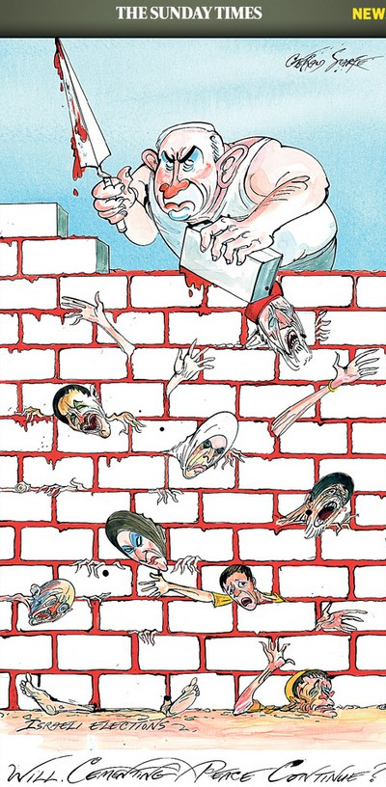
UK paper posts anti-Israel cartoon on Holocaust day [2013]--On Holocaust Memorial Day, 'Sunday Times' publishes cartoon depicting [Israeli] PM [Netanyahu] paving wall with Palestinian blood. The Jerusalem Post, 1/27/2013, http://www.jpost.com/JewishWorld/JewishNews/Article.aspx?id=301128
Holocaust denier ordered to visit concentration camps and write about them: A court in Brussels has ordered a former Belgian lawmaker to visit five Nazi concentration camps and write about his experiences as punishment for publicly denying the Holocaust, a crime in Belgium, The Washington Post, 9/25/2017, https://www.washingtonpost.com/news/morning-mix/wp/2017/09/25/holocaust-denier-ordered-to-visit-concentration-camps-and-write-about-them/?hpid=hp_hp-morning-mix_mm-denier%3Ahomepage%2Fstory&utm_term=.1407690b9873
Polish President Andrzej Duda signed a bill on Tuesday that authorizes jail time for people convicted of suggesting the country was complicit in the Holocaust. NPR, 2/6/2018, https://www.npr.org/sections/thetwo-way/2018/02/06/583765527/polish-president-signs-bill-giving-jail-time-for-implicating-poland-in-the-holoc
Cartoonist fired from Israeli mag for drawing Netanyahu as an Orwellian pig. RT, 7/26/2018, https://www.rt.com/news/434374-cartoonist-fired-netanyahu-pig-israel/
Haaretz Published a Cartoon 38 Years Ago Depicting Israeli Leaders as Pigs. Nobody Got Fired. Haaretz published a similar cartoon in 1980, Haaretz, 7/26/2018, https://www.haaretz.com/israel-news/a-1980-haaretz-cartoon-depicted-leaders-as-pigs-nobody-got-fired-1.6316410
“Will cementing peace continue?”
http://www.jpost.com/HttpHandlers/ShowImage.ashx?ID=21

Slide 99
Israeli "skunk" fouls West Bank protests http://www.reuters.com/article/2012/09/03/us-israel-palestinians-skunk-idUSBRE88208W20120903
(Reuters) - Imagine taking a chunk of rotting corpse from a stagnant sewer, placing it in a blender and spraying the filthy liquid in your face. Your gag reflex goes off the charts and you can't escape, because the nauseating stench persists for days.
This is "skunk", a fearsome but non-lethal tool in Israel's arsenal of weapons for crowd control. It comes in armored tanker trucks fitted with a cannon that can spray a jet of stinking fluid over crowds who know how to cope with plain old tear gas.
While the army calls skunk an attempt to minimize casualties, rights groups dismiss it as a fig-leaf for the use of deadlier force against protesters in the occupied West Bank.

Slide 100
IDF legal adviser: Detention of 5-year-old Palestinian boy was legitimate
The Israel Defense Forces' detention of a five-year-old Palestinian boy in Hebron earlier this month was a legitimate step in order to “thwart the threat posed by the activities of a minor,” the IDF’s legal adviser in the West Bank has ruled. Haaretz, July 31, 2013, http://www.haaretz.com/news/diplomacy-defense/.premium-1.538995

Slide 101
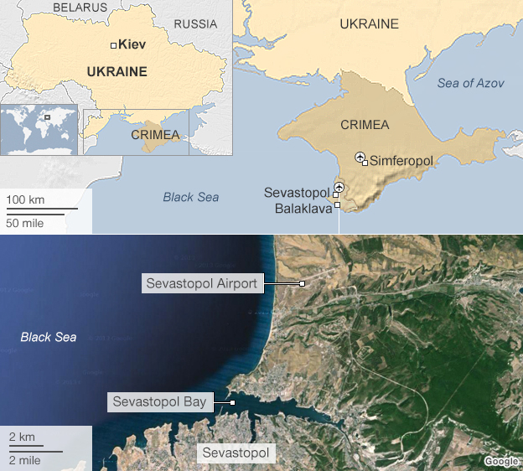
Israel’s connection to Ukraine crisis
[Ukraine and surrounding countries are the original homeland countries of the overwhelming majority of contemporary Jews, including almost all Israeli prime ministers and presidents]
The ex-Israeli soldier who led a Kiev fighting unit
'Delta' has headed 'the Blue Helmets of Maidan' of 40 men and women - including several IDF veterans - in violent clashes with government forces--- Haaretz, 2/28/2014, http://www.haaretz.com/news/world/1.577114
http://www.bbc.com/news/world-europe-27308526
Russia's Black Sea Fleet has its historic base at Sevastopol
Ukrainian president taps Jewish politician to be next prime minister
Jerusalem Post, 4/13/2016, http://m.jpost.com/Diaspora/Ukrainian-president-taps-Jewish-politician-to-be-next-prime-minister-451215#article=6017QzE5NEI0OTNDRDk0QThBN0Q3NjYxQTM3NkIyNzFFQ0E=
Delta, the nom de guerre of the Jewish commander of a Ukrainian street-fighting unit, is pictured in Kiev earlier this month. Photo by Courtesy
Crimea
Autonomous republic within Ukraine
Transferred from Russia in 1954
Ethnic Russians - 58.5%*
Ethnic Ukrainians - 24.4%*
Crimean Tatars - 12.1%*
****************************************
Russia supplies discounted natural gas to Ukraine and Ukraine allows Russia to station:
161 aircraft at Kasha and Gvardeyska airbases
388 warships and other vessels in Ukraine’s waters
25,000 officers and sailors at Sevastopol and Feodosia
BBC, http://www.bbc.com/news/world-europe-26387353
Jewish mogul Vadim Rabinovich running for Ukraine presidency
http://www.jta.org/2014/03/25/news-opinion/world/ukrainian-business-mogul-rabinovich-announces-presidential-bid
‘Go home!’ Ukrainian President Poroshenko calls for Russian Orthodox Church to be purged, RT, 11/8/2018, https://www.rt.com/news/443400-ukraine-poroshenko-orthodox-church/
‘Death to Jews’ graffiti sprayed on Crimean synagogue -- JTA, 2/28/2014, http://www.jta.org/2014/02/28/news-opinion/world/death-to-jews-graffiti-sprayed-on-crimean-synagogue
The So Very Jewish War on Russia, VT, 6/6/2018, https://www.veteranstoday.com/2018/06/06/the-so-very-jewish-war-on-russia/
John McCain addresses Ukrainian protesters in Kiev:
http://www.youtube.com/watch?v=93eyhO8VTdg
http://www.youtube.com/watch?v=MlbN2GEYW9w
Bernard Henri Levy en Ukraine en 2014 -VS- Brzezinski en Afghanistan en 1970. Similitude?
http://www.youtube.com/wa
tch?v=jsupx5c9Kok

Slide 102
The Jews who said 'no’ to Putin
In Ukraine they categorically deny the Russian propaganda that they are under threat, and directly address Putin and his credibility as a protector of the Jews and other minorities.
By Anshel Pfeffer, Haaretz, 3/14/2014, http://www.haaretz.com/weekend/jerusalem-babylon/.premium-1.579733
“Ukrainian Jews have got to be the most frustrating Jewish community to cover as a journalist, and that’s saying a lot. No one knows how many of them there really are; their numbers range from 70,000 in official censuses to anywhere around 500,000 or more according to unofficial assessments. At least three men claim to be the chief rabbi of Ukraine and at least four national organizations claim to represent and speak on behalf of the country’s Jews. Their identities are complex: Ukrainian citizens, Russian speakers, holders of Israeli and American passports and owners of homes in Geneva and London. And that’s before we get to the many Ukrainians who are rumored to be at least part Jewish but would never identify themselves as such.”

Slide 103

Wounded Ukrainian protesters airlifted to Israel for medical treatment
TEL AVIV (JTA) – For 17-year-old Bolodimir Bedyuk, a Ukrainian who was severely wounded in clashes with Ukrainian police on Feb. 18, Israeli medical care may be his only hope.
After a pitched battle with Ukrainian police forces on Institutskaya Street in Kiev, Bedyuk suffered chest wounds and extensive liver damage — his brother Aleksei said Bolodimir’s liver “was torn practically in half.” In that confrontation, Ukrainian police forces advanced with automatic weapons on protesters, leaving dozens dead. Jewish Telegraphic Agency, 3/7/2014, http://www.jta.org/2014/03/07/news-opinion/israel-middle-east/wounded-ukrainian-protesters-airlifted-to-israel-for-medical-treatment
A wounded individual is transported to a waiting plane, where he will be flown to Israel to receive medical care. (Shimon Briman)

Slide 104
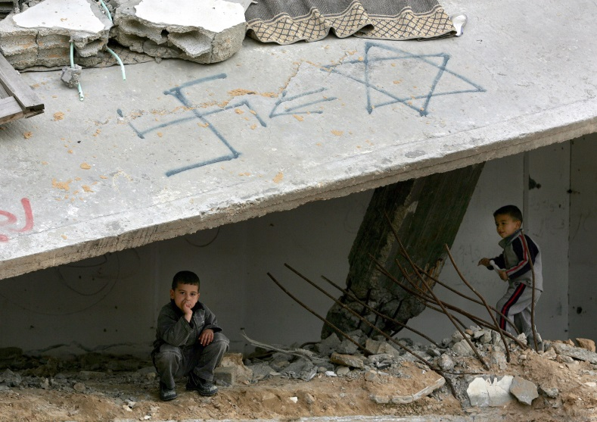
ADL survey: More than a quarter of the world is anti-Semitic
JTA, By Uriel Heilman, 5/13/2014, http://www.jta.org/2014/05/13/news-opinion/world/survey-more-than-a-quarter-of-the-world-hates-jews
NEW YORK (JTA) – A lot of people around the world hate the Jews.
That’s the main finding of the Anti-Defamation League’s largest-ever worldwide survey of anti-Semitic attitudes.
The survey, released Tuesday, found that 26 percent of those polled — representing approximately 1.1 billion adults worldwide — harbor deeply anti-Semitic views. More than 53,000 people were surveyed in 102 countries and territories covering approximately 86 percent of the world’s population.
“Our findings are sobering but, sadly, not surprising,” ADL National Director Abraham Foxman said at a news conference Tuesday morning at ADL’s national headquarters in New York. “The data clearly indicates that classic anti-Semitic canards defy national, cultural, religious and economic boundaries.”
Among the survey’s key findings:
• Some 70 percent of those considered anti-Semitic said they have never met a Jew. Overall, 74 percent of respondents said they had never met a Jew…
• Thirty-five percent of those surveyed had never heard of the Holocaust. Of those who had, roughly one-third said it is either a myth or greatly exaggerated.
• The most anti-Semitic region in the world is the Middle East and North Africa, with 74 percent harboring anti-Semitic views. Eastern Europe was second at 34 percent. The least anti-Semitic region was Oceania (Australia and New Zealand) at 14 percent.
• The three countries outside the Middle East with the highest rates of anti-Semitic attitudes were Greece, at 69 percent, Malaysia at 61 percent and Armenia at 58 percent.
• About 49 percent of Muslims worldwide harbor anti-Semitic views, compared to 24 percent of Christians.
• The West Bank and Gaza were the most anti-Semitic places surveyed, with 93 percent of respondents expressing anti-Semitic views. The Arab country with the lowest level of anti-Semitic views was Morocco, at 80 percent. Iran ranked as the least anti-Semitic country in the Middle East, at 56 percent.
• The least anti-Semitic country overall was Laos, where 0.2 percent of the population holds anti-Semitic views. The Philippines, Sweden, the Netherlands and Vietnam all came in at 6 percent or lower.
• Approximately 9 percent of Americans and 14 percent of Canadians harbor anti-Semitic attitudes.
• Thirty-four percent of respondents older than 65 were deemed anti-Semitic, compared to 25 percent of those younger than 65. Men polled were slightly more anti-Semitic than women.
“The ADL’s Global 100 index will serve as a baseline,” Foxman said. “For the first time we have a real sense of how pervasive and persistent anti-Semitism is today around the world.”
The survey gauged anti-Semitism by asking whether respondents agreed with an index of 11 statements that the ADL believes suggest anti-Jewish bias: Jews talk too much about what happened to them during the Holocaust; Jews are more loyal to Israel than to the countries they live in; Jews think they are better than other people; Jews have too much power in international financial markets; Jews have too much power in the business world; Jews have too much control over global affairs; people hate Jews because of the way Jews behave; Jews have too much control over the U.S. government; Jews have too much control over global media; Jews are responsible for most of the world’s wars; Jews don’t care about what happens to anyone but their own kind.
Respondents who agreed that a majority of the statements are “probably true” were deemed anti-Semitic.
Over the years, the ADL has been criticized for overstating what qualifies as anti-Semitism, with critics suggesting that some of the statements used to measure bias actually are more indicative of admiration for Jews than anti-Jewish hostility.
Palestinian children play in a damaged building with a swastika and the Star of David painted on it in a Gaza refugee camp in 2005. (Abid Katib/Getty Images)

Slide 105
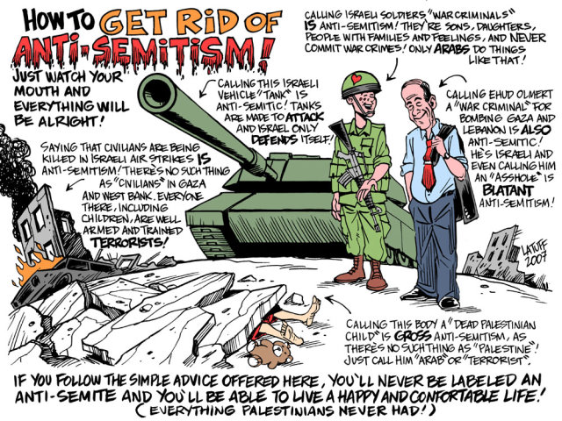
http://www.veteranstoday.com/wp-content/uploads/2010/12/latuff-criticism-of-Israel1.jpg
http://www.ifamericansknew.org/download/HelenThomas.pdf

Slide 106
The Jewish Question of integration (assimilation) versus separation (Zionism*) continues to persist despite:
Over 100 years of Jewish emancipation in Europe
Nearly 100 years of Jewish emancipation in Russia
Over 100 of effective Jewish lobbying in America
Over 60 years of Jewish statehood in the Arab world
*Zionism refers more specifically to the international colonial movement designed to make Palestine an extraterritorial nation-state for world Jewry.

Slide 107
The Jewish Question continues to haunt and preoccupy the Jews themselves, the Europeans, the Russians, the Arabs and the Americans
Jewish integration
Jewish separation
Jewish assimilation
Jewish emigration
Anti-Semitism
The State of Israel
The Israel lobby

Slide 108
The Essence of the Jewish Question
Integration versus separation
  Israel defines itself as the Jewish State
  Israel defines itself as the State of the Jews
  Israel regards itself as the work of the whole Jewish people
  Israel speaks and acts on behalf of world Jewry
  Israel considers itself the center of Jewish loyalty
  Israel treats its friends and enemies on behalf of the Jews
  Israel prosecutes Nazis & collects reparations on behalf of Jews
  Israel gets tremendous support from world Jewry
  Israel imports Jews from almost all countries around the world
  Israel’s Law of “Return” is taken for granted by most Jews
  Israel relies heavily on Jewish foreign lobbies and sayanim
  Israel does not consider its non-Jewish citizens as nationals
  Israel is designed specifically for Jews living in it and in other countries
  The fine line between criticizing Israel and anti-Semitism: Only Jews are allowed to speak of the effect lobbying and political donations have on U.S. policy in the Middle East; all others are dabbling in anti-Semitism, says former Knesset Member Einat Wilf. Haaretz, 10/31/2013, http://www.haaretz.com/jewish-world/jewish-world-features/.premium-1.555468
  Think critically about how one can/should talk about the State of Israel without talking about the Jews or without being open to the charge of anti-Semitism
Currently there is a political debate about ‘granting’ all the Jews in the world the right to vote in Israeli elections.
Haaretz, 7/10/2010, http://www.haaretz.com/print-edition/features/moshe-kantor-s-house-of-lords-1.238607

Slide 109
The Essence of the Jewish Question
Integration versus separation
  The Israeli Knesset enacted the Zionist Organization Status Law (5 December 1952) which declares that “The State of Israel regards itself as the work of the whole Jewish people…Under this law, the job of the State of Israel and the Zionist movement “calls for continuous efforts by the Jewish people in the countries of the Diaspora.”--David Ben-Gurion, Israel: a personal history, New York: Funk & Wagnalls, 1971, page 409.
  David Ben Gurion wrote: “I believe that every Jew belongs to the Jewish people, and only to the Jewish people.”…“the moral greatness of Zionism in Germany and the other countries of Western Europe lay in the fact that by the force of the Zionist ideology it succeeded in uprooting many Jews from the German, French, or Italian worlds in which they had been immersed since the Emancipation.” --David Ben Gurion, “Zionism and Pseudo-Zionism,” in Carol Diament, ed., Zionism: The Sequel, New York: Hadessa, The Women’s Zionist Organization of America, Inc., 1998, pp. 45-49, pages 46-47.
  With the outbreak of the Second World War, Jewish Zionist leader Chaim Weizmann wrote a letter to the British prime minister in which he declared that the Jews [implying clearly all Jews] will "stand by" Great Britain in the war:
  “Dear Prime Minister, In this hour of supreme crisis, the consciousness that the Jews have a contribution to make to the defence of sacred values impels me to write this letter. I wish to confirm, in the most explicit manner, the declarations which I and my colleagues have made during the last months, and especially in the last week: that the Jews ‘stand by Great Britain and will fight on the side of the democracies.’ Our urgent desire is to give effect to these declarations. We wish to do so in a way entirely consonant with the general scheme of British action, and therefore would place ourselves, in matters big and small, under the co-ordinating direction of His Majesty’s Government. The Jewish Agency is ready to enter into immediate arrangements for utilizing Jewish manpower, technical ability, resources, etc. The Jewish Agency has recently had differences in the political field with the Mandatory Power. We would like these differences to give way before the greater and more pressing necessities of the time. We ask you to accept this declaration in the spirit in which it is made.” Mrs Edgar Dugdale, The Balfour Declaration: Origins and Background, Published by the Jewish Agency for Palestine, 77, Great Russell Street, London, W.C.1. March, 1940, page 31.

Slide 110
The “American Jewish Question”
Editorial Page Editor Saul Singer carefully reported that an American Jewish Committee panel “distilled” what he called the “Jewish predicament” or the “American Jewish Question” in these terms:
“We as a people remain ensconced in exile like a bug trapped in sap and may not survive if we cannot extricate ourselves”---Saul Singer
The Jerusalem Post (5/12/2006) and The Jewish News Weekly of Northern California (5/19/2006)
In November 2013, the State of Israel continues to combat rising Jewish assimilation---Sam Sokol, "Israel enters battle against assimilation at American Jewry conference," The Jerusalem Post, 11/10/2013, http://www.jpost.com/Diplomacy-and-Politics/Israel-enters-battle-against-assimilation-at-American-Jewry-conference-331194
‘Up, Up and Away’ for North American Jews
American and Canadian Jews resumed their annual one-way trek to Israel Wednesday morning, with 232 new immigrants arriving on the first of nearly a dozen flights that will bring 2,500 Jews to their new home this summer [2010]. IsraelNationalNews.com, http://www.israelnationalnews.com/News/News.aspx/138476
What’s your idea to save U.S. Jewry?
The recent Pew survey showing American Jews assimilating in droves has prompted deep concern for the future of our community. But maybe we’re just a few good ideas away from reversing those negative trends. We want to hear your strategies for stemming the tide of American Jewish disengagement. Jewish Telegraphic Agency, 10/10/2013, http://www.jta.org/2013/10/10/news-opinion/united-states/whats-your-idea-to-save-u-s-jewry

Slide 111
Netanyahu halts distribution of 'loyalty' poll to U.S. Jews, Israeli expats
Haaretz, 10/27/2013, http://www.haaretz.com/news/diplomacy-defense/.premium-1.554651
Netanyahu halts distribution of 'loyalty' poll to U.S. Jews, Israeli expats
Prime minister's order follows Haaretz report of questionnaire being distributed in America asking respondents to indicate where their allegiance would lie in case of Israeli-U.S. crisis. Prime Minister Benjamin Netanyahu on Sunday ordered Israel’s immigrant absorption and foreign ministries to cease distribution of a controversial questionnaire already sent to tens of thousands of Israelis living in the United States and Jewish Americans, asking them to indicate where their allegiance would lie in the...
Israel suspends plan for building database of US Jewish students---"The idea is to set up a database of all Jewish students in the United States (some 350,000 students) and to map daily all the Jewish/Israel events taking place on campuses", i24News, 10/16/2017, https://www.i24news.tv/en/news/israel/157830-171016-israel-suspends-plan-for-building-database-of-us-jewish-students
Israel asks U.S. Jews, Israelis: Where do your loyalties lie?
PM orders ministries to stop distributing the survey, which asks questions about dual allegiance and the Jewish lobby in America. Two sensitive and potentially explosive issues have always clouded the relationship between the Jewish community in the United States and the State of Israel. The first relates to claims of “dual allegiance” to both Israel and the United States; the other concerns the pro-Israel, American “Jewish lobby.” Haaretz, 10/27/2013, http://www.haaretz.com/news/diplomacy-defense/.premium-1.554541
Israeli-American Council Opens Vegas Office for Growing Israeli Population
The Israeli-American Council has established an office in Las Vegas as part of a drive to expand from its Los Angeles base to U.S. cities with major concentrations of Israeli expatriates. Miriam Adelson, born in Haifa and wife of billionaire casino owner Sheldon Adelson, is chair of the new IAC Las Vegas regional council established this week. Inauguration of the Las Vegas office follows on the heels of similar openings in Miami and Boston... Estimates of the number of Israelis and their children in the United States vary widely, from a likely 500,000 to IAC’s figure of 800,000. http://forward.com/articles/195938/israeli-american-council-opens-vegas-office-for-gr/?

Slide 112
Where does ‘Russian’ tycoon Viatcheslav Moshe Kantor’s loyalty really lie?
  Viatcheslav Moshe Kantor:
  Is President of the European Jewish Congress
  Is President of the Russian Jewish Congress
  Is President of Russia's largest fertilizer company (Acron agrochemical company)
  Is President of the World Holocaust Forum Foundation
  Is Chairman of the European Jewish Fund
  Is Co-Chairman of the European Council on Tolerance and Reconciliation
  Holds Israeli citizenship and splits his time between Israel and Switzerland
  Holds Honorary Doctorate from Tel-Aviv University
  Compares his position in Russia to Joseph's in Egypt & Esther's in Persia
  Grant Slater, “Kantor: European Jewry has bigger problems than Russian Jewry,” Jewish Telegraphic Agency, 2/12/2009, http://jta.org/news/article/2009/02/12/1002981/russian-jewry-chief-stepping-down-to-focus-on-europes-woes
  President [Kantor]’s Page, European Jewish Congress, 1/16/2009, http://www.eurojewcong.org/ejc/section.php?id_rubrique=97
  Amiram Barkat, “Putin ally is frontrunner to head European Jewish Congress ,” Haaretz, 6/23/2007, http://www.haaretz.com/hasen/spages/873804.html

Slide 113
Some polls indicate that 82 to 85 percent of American Jews support Israel
According to a poll commissioned by The Israel Project (a pro-Israel public advocacy group) and conducted by pollster Frank Luntz, among the 800 American Jews that took part in the survey, 82% said they support Israel---Jerusalem Post, 1 December 2005.
According to a survey, commissioned by Stand for Israel, a project of the International Fellowship of Christians and Jews, polled 1200 Americans, with an oversampling of Jews and Evangelicals, and found that 85 percent of Jews expressed support for Israel, as did 62 percent of "conservative church-going Christians“----Carl Schrag, “American Jews and Evangelical Christians: Anatomy of a Changing Relationship,” Jewish Political Studies Review 17:1-2 (Spring 2005)
According to Reuven Firestone, “most observant Jews now support Zionism and the State of Israel with great enthusiasm… the Orthodox see the secular Zionists as unknowingly doing God’s will by beginning the process of ultimate redemption”---- Reuven Firestone, Children of Abraham: An Introduction to Judaism for Muslims, A publication of the Harriet and Robert Heilbrunn Institute for International Interreligious Understanding of the American Jewish Committee in association with Ktav Publishing House, Inc., 2001, page 141.

Slide 114
Europe's Jews get a political lobby
THE JERUSALEM POST, 10/18/2009 http://www.jpost.com/servlet/Satellite?cid=1255694829571&pagename=JPost%2FJPArticle%2FPrinter
BRUSSELS - Europe once had 80 to 90 percent of the world's Jews, until the 20th century's calamities brutally cut that figure down to the current estimate of 10%. Two very different societies - Israel and the United States - have replaced Europe as home of the major centers of Jewish life.
But Europe's Jews are apparently no longer satisfied with accepting this verdict of history. They are increasingly organized and increasingly vocal. And now they have a lobby.
The inauguration in Brussels of a new branch office of the European Jewish Congress last week marks a dramatic development in European Jewish political activism, believes EJC president Moshe Kantor.
"In Europe we see both too much tolerance" - for example, toward the Iranian regime's genocidal ambitions - "and too little" when it comes to Europe's religious and ethnic minorities, Kantor says.
The office in Brussels will be charged with "triggering important processes in legislation, legal issues and research to advance tolerance. The goal is not to talk about tolerance, but to [engage] in a wide spectrum of real action," he adds.
According to Raya Kalenova, the director of the new office, it will also focus on "educating against anti-Semitism and for reconciliation between the three great monotheistic religions."
The message of the new Jewish presence in the heartland of European government "is that Europe's Jews are European citizens with European values," Kalenova explains.
The opening of the Brussels office on Wednesday seemed to suggest the organization already possessed the ability to reach the highest echelons of European politics. In attendance at the celebratory cocktail reception and dinner were Europe's most senior officials, including European Parliament President Jerzy Buzek, European Commission President José Manuel Barroso, Commission Vice President for Justice, Freedom and Security Jacques Barrot, and some 50 MEPs.
Israel also sent a high-ranking representative, in the person of National Infrastructures Minister Uzi Landau.
According to observers, however, it is too early to tell whether the new office will be influential or significant.
A comparison with the United States may be instructive, some argued. Mainstream American Jewish organizations maintain lobbies in Washington, but rarely are they influential if they don't represent the broad consensus of American Jews.
Among the most powerful of the Jewish advocacy lobbies is the Washington office of the Jewish Federations of North America, which is focused almost exclusively on making US tax policy favorable to charitable giving. This is because American Jewish life does not exist outside its non-profit institutions, which include all its synagogues, schools, old-age homes and charities.
Also in keeping with the wide consensus of the American Jewish community, Jewish groups in Washington have been instrumental in developing civil rights legislation and in advocating in broad terms for American support for Israeli security. But they shy away from dealing with issues that lack an overwhelming Jewish consensus, such as the Afghan deployment, sex education or international trade policy.
What, one might ask, are the consensus issues of European Jewry?
Asked about the European Jewish "constituency," Yossi Lempkowicz, founder of the European Jewish Press, a pan-European news agency based in Belgium, noted that it is not easy to pin down such issues of consensus.
"Europe's Jews are citizens of Europe," he says. "They care about many different issues as Europeans," not in clearly defined Jewish blocs.
"For example, there is disagreement on the question of the expansion of Europe, or on [the rights of states to limit the wearing of] the Muslim veil," he says.
Furthermore, domestic issues affecting the daily life of Europe's Jews - taxation, law enforcement, regulations on religious life - are not handled at the European level, but in each country's national institutions.
An even greater obstacle to European Jews' ability to conduct political advocacy is their extreme diversity. One may fairly ask if Jewish Latvians, Belgians and Italians can really share an overarching agenda that can be represented in pan-European institutions.
In a sense, this question of a Jewish agenda for Europe is a microcosm of the larger question of European identity.
What does it mean to be "European?" asked one attendee at the reception. Is this an authentic popular identity or, as some complain, an invention by activist bureaucrats?
Another layer of complexity lies in the EJC's own structure, which is also the umbrella for many communities outside the EU, including Russia, Macedonia and Norway. Can EJC Brussels have a position on EU-Russian energy spats? Or can it oppose Russia's Iran policy within EU institutions without harming the political situation of the Russian Jewish organizations ostensibly represented in the Brussels office?
All these issues will have to be resolved in the new office's first months of operation. It is not likely to be an easy task, and there are no guarantees of success.
Yet, according to many participants, the mere existence of the new office is a telling symbol of a nascent European Jewish consciousness that is emerging alongside the development of a broader European identity.

Slide 115
New European Jewish parliament riles existing European Jewish leaders
BERLIN (JTA) -- A new European Jewish parliament is set to open in Brussels this week, the brainchild of two businessmen philanthropists on a mission to shake up the status quo.
Igor Kolomoisky and Vadim Rabinovich, the Ukrainian Jewish moguls behind the body, founded the European Jewish Union last spring and will fete their new parliament in ceremonies at the EU Parliament on Thursday. According to their invitation, 120 Jewish members of parliament have been chosen by 403,810 voters from all over Europe.
But who are these representatives? And what exactly will they do? That remains a mystery.
Among the candidates in the elections were soccer star David Beckham, filmmaker Roman Polanski, comic actor Sacha Baron Cohen and fashion designer Diane von Furstenburg, as well as other famous and less-famous European Jews -- many of whom never expressed an interest in running and didn’t know anything about the planned parliament.
Toby Axelrod, “New European Jewish parliament riles existing European Jewish leaders,” JTA, February 14, 2012, http://www.jta.org/news/article/2012/02/14/3091671/new-european-jewish-parliament-riles-existing-european-jewish-leaders

Slide 116
European Jewish Parliament Convenes for Second Day: European Parliament Holds Panel Discussions http://www.youtube.com/watch?v=sQdqI5uC3C4
May 17, 2012 In the command center of pan-European politics, the European Jewish Parliament convened for a second day... At the European Parliament, panel discussions were held on the economic crisis in Europe and its impact on extremism, populism and anti-semitism... Dr. Antonyia Parvanova, a member of the European Parliament from Bulgaria, moderated... Parvanova says she and her colleagues are aware that baseless hatred for Jews is rearing its ugly head again in violent acts, in anti-Israeli sentiment and in politics...
Igor Kolomoisky, the President of the European Jewish Union, was the guiding light behind the first-ever Parliament for Jews and forging ties with other European leaders is one of its priorities. The European Jewish Parliament was modeled in some ways after the European Parliament. Its members are elected osein contrast to how other Jewish leaders in Europe are chosen which is usually by those inside existing organizations. The European Jewish Parliament hopes its system can attract young, unaffiliated Jews with fresh ideas.
A Jewish woman from Washington joined the EJP's meetings...but she's not an American working for President Obama or Republican candidate Mitt Romney...Her boss is King Hamad bin Isa Al Khalifa of Bahrain... Hoodah Nunu is the Bahraini Ambassador to the US, a Jewish woman who represents her Muslim country. EJP members also expressed hope that they can help build bridges between Jews and Muslims wherever they clash. Nunu's colleague -- the Bahraini Ambassador to the EU -- attended the panel discussions. Tomorrow these new Jewish reps of Europe will head back to their home countries after two days of sharing ideas, solutions and meeting like-minded politicians.
Jordana Miller, JN1, Brussels
British scholar and political analyst Dr. Rodney Shakespeare: Zionists control British government’s policy http://www.presstv.com/Detail/2016/08/03/478345/Israel-UK-Zionism-Daesh-Saudi-Arabia-Saddam

Slide 117
Historical Background:
Theological and commercial interest in European Jews began to emerge with the Reformation and Mercantilism
The Protestants were interested in the Jews
  as ammunition against the Catholics
  as leaders of the interest-based economy
  Source: Mohameden Ould-Mey, “The Non-Jewish Origin of Zionism,” International Journal of the Humanities 1(1):591-610, 2005, http://faculty.isuad.indstate.edu/mouldmey/The%20Non-Jewish%20Origin%20of%20Zionism2.pdf
  Hannah Arendt states in The Origins of Totalitarianism (1951) that the key to understanding “the rise and fall of the Jews” is “the relationship between Jews and the state.” Historically, in response to the hostile attitudes and actions of their neighbors, Jews frequently sought the protection of the state. As Ginsberg argues in The Fatal Embrace: Jews and the State, for their own purposes, rulers often were happy to accommodate the Jews in exchange for their services, resulting in “the rise to great power by Jewish elites, but creating conditions for their subsequent fall.” Eric Walberg, Geopolitics and the Great Games, Clarity Press, 2011, pages 161-162.

Slide 118
Theological and commercial interest in European Jews began to emerge with the Reformation and Mercantilism
Martin Luther’s Jewish-friendly writings
Oliver Cromwell’s readmission of the Jews
The quasi-Judaization of the Puritans
  Source: Mohameden Ould-Mey, “The Non-Jewish Origin of Zionism,” International Journal of the Humanities 1(1):591-610, 2005, http://faculty.isuad.indstate.edu/mouldmey/The%20Non-Jewish%20Origin%20of%20Zionism2.pdf

Slide 119
German Martin Luther’s Jewish-friendly pamphlet:
“That Jesus Christ Was Born a Jew”
1523
“I will cite from Scripture the reasons that move me to believe that Christ was a Jew born of a virgin, that I might perhaps also win some Jews to the Christian faith... Accordingly, I beg my dear papists, should they be growing weary of denouncing me as a heretic, to seize the opportunity of denouncing me as a Jew.”
Source: Luther, Martin., The Christian in Society II, ed. Walther Sherman.Vol. 45 of Luther’s Works, ed. Helmut T. Lehmann. Philadelphia: Muhlenberg Press, 1971, pp. 200-201.

Slide 120
English-Dutch trade wars and Cromwell’s invitation of Amsterdam Jewish merchants (1650s)
  Oliver Cromwell invited Amsterdam Jewish merchants to London in order to strengthen England in its trade war against Portugal, Spain, and the Netherlands, whose Jewish communities were known for their wealth, commercial skills, and business contacts abroad.
  Source: Mohameden Ould-Mey, “The Non-Jewish Origin of Zionism,” International Journal of the Humanities 1(1):591-610, 2005, http://faculty.isuad.indstate.edu/mouldmey/The%20Non-Jewish%20Origin%20of%20Zionism2.pdf

Slide 121
French Zionism & Napoleon’s Attempt to Estrange the Jews from their European & Ottoman Rulers
French National Assembly boosted Jewish emancipation (12/24/1789)
Napoleon Bonaparte’s Jewish “Proclamation” promised Palestine to the Jews (1799)
Emperor Napoleon I summoned representatives to the Jewish Great Sanhedrin in Paris (1807)
  Source: Mohameden Ould-Mey, “The Non-Jewish Origin of Zionism,” International Journal of the Humanities 1(1):591-610, 2005, http://faculty.isuad.indstate.edu/mouldmey/The%20Non-Jewish%20Origin%20of%20Zionism2.pdf

Slide 122
  In reaction to Napoleon’s Great Sanhedrin in Paris (1807), the British established the London Society for Promoting Christianity among the Jews (1809)
  Source: Mohameden Ould-Mey, “The Non-Jewish Origin of Zionism,” International Journal of the Humanities 1(1):591-610, 2005, http://faculty.isuad.indstate.edu/mouldmey/The%20Non-Jewish%20Origin%20of%20Zionism2.pdf

Slide 123
The British reinvented Napoleon’s Zionist idea and linked the Eastern Question and the Jewish Question
“That which Napoleon designed in his violence and ambition, thinking “to destroy nations not a few,” we may wisely and legitimately undertake for the maintenance of our Empire”
Alexander Crawford Lindsay (Lord Lindsay), “Letters on Egypt, Edom, and the Holy Land,” The Quarterly Review 125 (Dec.):166–92, 1838, pages 188-190.

Slide 124
Britain Stations a Vice-Consul in Jerusalem (1838)
“…his residence will be fixed at Jerusalem, but his jurisdiction will extend to the whole country within the ancient limits of the Holy Land; he is thus accredited, as it were, to the former kingdom of David and the Twelve Tribes.”---Quarterly Review of 1838

Slide 125
“The soil and climate of Palestine are singularly adapted to the growth of produce required for the exigencies of Great Britain”
“The soil and climate of Palestine are singularly adapted to the growth of produce required for the exigencies of Great Britain; the finest cotton may be obtained in almost unlimited abundance; silk and madder are the staple of the country, and oil-olive is now, as it ever was, the very fatness of the land. Capital and skill are alone required: the presence of a British officer, and the increased security of property which his presence will confer, may invite them [the Jews] from these islands to the cultivation of Palestine” Alexander Crawford Lindsay (Lord Lindsay), “Letters on Egypt, Edom, and the Holy Land,” The Quarterly Review 125 (Dec.):166–92, 1838, pages 188-190.

Slide 126
British Zionism opposed assimilation and preached separation for the Jews
An article in The Times of 24 January 1839 attacked the idea of assimilation and naturalization (“amalgamation”) of the Jews, of whom Numbers 23:9 says: “the people shall dwell alone, and shall not be reckoned among the nations”
In 1972, Israeli Prime Minister Golda Meir declared that in her view when a Jew marries a non-Jewess he joins the six million victims of Nazism--Shlomo Sand, Comment le people juif fut inventé, Paris: Fayard, 2008, page 402.
Jewish assimilation is referred to in today’s Israeli media as “la bombe a retardement de l’assimilation” [the time-bomb of assimilation] Sand, p 402

Slide 127
The London Memorandum on the Restoration of the Jews (1839)
The Memorandum “urges upon the consideration of the powers addressed what may be the probable line of duty on the part of Protestant Christendom to the Jewish people in the present controversy in the East.”
  Source: Mohameden Ould-Mey, “The Non-Jewish Origin of Zionism,” International Journal of the Humanities 1(1):591-610, 2005, http://faculty.isuad.indstate.edu/mouldmey/The%20Non-Jewish%20Origin%20of%20Zionism2.pdf

Slide 128
British Colonel Charles Churchill’s letter to Moses Montefiore and Western Jewry (1841)
“MY DEAR SIR MOSES…I cannot conceal from you my most anxious desire to see your countrymen endeavour once more to resume their existence as a people. I consider the object to be perfectly attainable. But, two things are indispensably necessary. Firstly, that the Jews will themselves take up the matter universally and unanimously. Secondly, that the European Powers will aid them in their views. It is for the Jews to make a commencement. Let the principal persons of their community place themselves at the head of the movement. Let them meet, concert and petition. In fact the agitation must be simultaneously throughout Europe.
  Source: Mohameden Ould-Mey, “The Non-Jewish Origin of Zionism,” International Journal of the Humanities 1(1):591-610, 2005, http://faculty.isuad.indstate.edu/mouldmey/The%20Non-Jewish%20Origin%20of%20Zionism2.pdf

Slide 129
[British] Lieutenant-Colonel Gawler's Tranquilization of Syria and the East: Observations and practical suggestions, in furtherance of the establishment of Jewish Colonies in Palestine, the most sober and sensible remedy for the miseries of Asiatic Turkey
(1845)
“Reduced to its practical form the question [of the tranquillization of Syria] becomes one of colonization [of Palestine]. There is a fertile country, nine-tenths of which lies desolate. Elsewhere, are civilized men, for whom it is desired to make of that almost forsaken country, an established home. For successful colonization three things are, in the highest degree, indispensable. The probability of safe settlement in the colony—the facility of transit to it—and the will, or the obligation to embrace these opportunities. … On any other principle, the will of the proposed settler would be wanting. No members of the Jewish persuasion, worth sending to Palestine, would accept the boon so tauntingly proffered. We cannot, if we would, force them into colonization as convicts, under the moving agency of compulsory obligation, and must therefore carefully consult their feelings as well as our own desires”
Source: Mohameden Ould-Mey, “The Non-Jewish Origin of Zionism,” International Journal of the Humanities 1(1):591-610, 2005, http://faculty.isuad.indstate.edu/mouldmey/The%20Non-Jewish%20Origin%20of%20Zionism2.p

Slide 130
Thomas Clarke’s India and Palestine: or, the Restoration of the Jews, viewed in relation to the nearest route to India (1861)
Thomas Clarke attempted to prove that the restoration of the Jews to Palestine “was not only a Prophetical but Political necessity.” With such a project, “England need have no fear of her darling Indian possessions.” Like his Zionist predecessors, he believed that planting Jews in Palestine would be inexpensive for the British, would serve British imperial interests, and would deny access to Britain’s rival powers.
Source: T. Clarke, India and Palestine, or the Restoration of the Jews viewed in Relation to the Nearest Route to India: In two parts, with a map, Manchester: William Bremner & CO., 11, Market Street; London: F. Pitman, 20 Paternoster Row, 1861, pages 1-2.

Slide 131
The Zionist novel Daniel Deronda (1876)
By George Eliot (the pen name of Mary Ann Evans)
Daniel Deronda tries to pull out the “Semite” Jew from the “German” and the “Sclave” of Europe as one pulls a hair out of dough. This novel raised awareness about a new racial realignment and could indeed be viewed as another major milestone on the road to the anti-Jewish “agitation” of the late nineteenth century in Europe and Russia

Slide 132
The Jews Did Not Invent Zionism. Rather Zionism Invented the Jews
“During the Reformation and mercantilist era, Protestants were interested in the Jews as ammunition against the Catholics and as leaders of the interest-based rising capitalist sector. Martin Luther’s Jewish-friendly writings in 1523, Oliver Cromwell’s readmission of the Jews to England in 1655, and the quasi-Judaization of the Puritans are graphic examples. With the Industrial Revolution and the European Enlightenment, Napoleon boosted the emancipation of the Jews in an attempt to estrange them from their European and Ottoman rulers as part of his unsuccessful plans to destroy the power of England and Russia and dominate Europe. After Napoleon, the British articulated a complex set of imperialist and religious motives designed to make the Eastern Question fit the Jewish Question. Obviously all of this took place before the alleged founder of Zionism (Theodor Herzl) was born in 1860, as well as before anti-Semitism was encouraged as a propelling machine for Zionism.” Source: Mohameden Ould-Mey, “The Non-Jewish Origin of Zionism,” International Journal of the Humanities 1(1):591-610, 2005, http://faculty.isuad.indstate.edu/mouldmey/The%20Non-Jewish%20Origin%20of%20Zionism2.p
"Great exertions will hardly be necessary to spur on the movement. Anti-Semites provide the requisite impetus. They need only do what they did before, and then they will create a desire to emigrate where it did not previously exist, and strengthen it where it existed before." Source: Theodor Herzl, The Jewish State, 1896, http://www.jewishvirtuallibrary.org/quot-the-jewish-state-quot-theodor-herzl

Slide 133
“You can’t build a cultural heritage on a lie”
Hebrew University Professor of History Yehoshua Porath was quoted: “You can’t build a cultural heritage on a lie. Because when young people discover the truth, they can become cynical” ---Fletcher E R (1995) ‘New’ Israeli History Gets Reviewed in the U.S. Press. Middle East Labor Bulletin (Spring):16
The Genealogical Science: The Search for Jewish Origins and the Politics of Epistemology
Anonymous. Arab Studies Quarterly; London35.3 (Summer 2013): 333-334.
The Genealogical Science: The Search for Jewish Origins and the Politics of Epistemology by Nadia Abu El-Haj is reviewed.
This work critically explores the genomic practices that increasingly inform and reconfigure the past focusing primarily on analyzing the construction of genomic past in researching the Jewish origin... Abu El-Haj analyzes the implications of the work and its cultural and political effects. It is also richly perceptive about the epistemological, political, and cultural presuppositions of the scientific work itself. It discusses how human population genetics not only reproduces existing concepts of race and creates new ones, but also how it biologizes notions of human diversity... Abu El-Haj 's book examines three distinct moments in science and politics: race science, circa 1900, population genetics, circa 1950, and genetic history starting in the 1990s. Abu Al-Haj "analyzes studies undertaken by European and American Jewish scientists at the turn of twentieth century on the racial composition of the Jews." This, she argues, "fashioned a particular and ultimately enduring understanding of Jewish peoplehood, which articulated fundamental hurdles to be overcome for a new Hebrew nation and individual to be born" (4). Next, Abu El-Haj analyzes the work of Israeli population genetics in the 1950s and 1960s after the establishment of the state. Abu El-Haj reads this work "as expressing a desire - indeed, a need - to find 'content' for the a priori nationalist belief in the fact of Jewish peoplehood." Finally, and the central quest of the book, Abu El-Haj explores genetic history projects "to identify the origins of contemporary Jewry that have been carried out, by and large, by self identified Jewish scientists." In this section, she pays special attention to the "nexus of epistemological commitments, epistemic objects, the commerce in ancestry testing, and the making of genetic historical selves" (4)... The final and concluding part, "The Things We Carry: History through the Molecular Optics" (2 1 9-247), goes beyond the earlier arguments about "epistemological politics of contemporary studies in genetic history" and considers the implications of "treating the DNA as a 'history book' for our understandings of both 'history' and of its relationship to the self."
Bennett Greenspan: Your Jewish Identity (July 13, 2012) , https://www.youtube.com/watch?v=O42hXF6RB3U
Crowd Sourced Genealogy and Direct-to-Consumer DNA Testing: Implications for the Jewish People, http://jppi.org.il/uploads/Crowd_Sourced_Genealogy_and_Direct-to-Consumer_DNA_Testing-Implications_for_the_Jewish_People.pdf
How DNA Testing Can Reveal Jewish Ancestry, Bolster Zionist Narrative, Breaking Israel News, 10/15/2017, https://www.breakingisraelnews.com/22424/dna-testing-can-reveal-jewish-ancestry-bolster-zionist-narrative/

Slide 134

In Search of the Origin of the Jews
For a long time, the biblical narrative held sway. Now scholars seek to distinguish historical fact from religious myth—if it is possible to do so.
Can we grasp the essence of something by laying bare its origins? “An origin is not just a beginning,” Steven Weitzman writes, “it is a ‘beginning that explains.’ ” In “The Origin of the Jews,” Mr. Weitzman, a professor at the University of Pennsylvania, aims to find one nation’s elusive starting point. “The Jews have one of the longest and most intensively studied histories of any population on earth,” he notes, “but the beginning of their history, how it is that the Jews came to be, remains surprisingly unsettled.” WSJ, 7/10/2017, https://www.wsj.com/articles/in-search-of-the-origin-of-the-jews-1499726881
At the outset of this nearly 400-page book, the author asked the core question about “the origin that connects all Jews into a single people, religion, or community; the very beginning of their collective story” p. 1
Towards the end of the book, the author came full circle and asked: “Is there a way for scholars and scientists to truly progress in the search to understand the origin of the Jews when there is more than one way to think about the question and no possibility of reconciling the different perspectives [anthropologists versus geneticists].” p. 316
2017

Slide 135
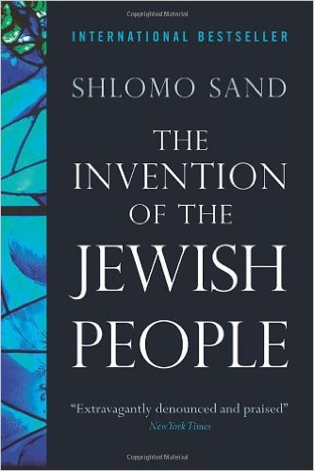
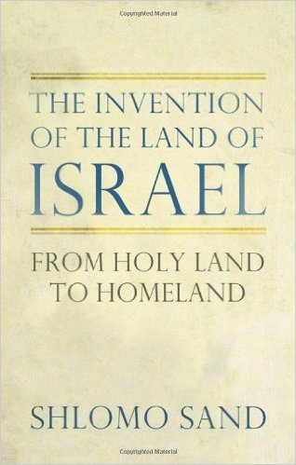
Exploding the myth that there was a forced Jewish exile in the first century at the hands of the Romans, Israeli historian Shlomo Sand argues that most modern Jews descend from converts, whose native lands were scattered across the Middle East and Eastern Europe. Amazom.com
2010
2012
Sand's account dissects the concept of 'historical right' and tracks the invention of the modern geopolitical concept of the 'Land of Israel' by nineteenth century Evangelical Protestants and Jewish Zionists. This invention, he argues, not only facilitated the colonization of the Middle East and the establishment of the State of Israel; it is also what is threatening the existence of the Jewish state today. Amazon.com

Slide 136
The Non-Semitic Origins of Contemporary Jews
The “Semitic” ancestry and “inheritance” claimed by Zionism and Israel in the name of contemporary Jews have been questioned, rejected, and exposed by many scholars, including:
Hungarian Ashkenazi Jew Arthur Koestler in his book The Thirteenth Tribe: The Khazar Empire and its Heritage
Egyptian writer Abd Errahman Shakir in his book Dawlat al-Khazar al-jadidah aw Isra’il (The New Khazar State Or Israel)
British archaeologist Michael Rice in his book False Inheritance: Israel in Palestine and the Search for a Solution
Tel Aviv University Professor Paul Wexler in his four books (a) The Ashkenazic Jews: A Slavo-Turkic People in Search of a Jewish Identity, (b) The Non-Jewish Origins of the Sephardic Jews, (c) Two-tiered Relexification in Yiddish: Jews, Sorbs, Khazars, and the Kiev-Polessian Dialect; (d) Jewish and Non-Jewish Creators of “Jewish” Languages
Lebanese writer Farajullah Salih Deeb in his two books (a) Ettawrat Elarabiya wa Urshleem Elyemeniya (The Arabic Tawrah and the Yemenite Jerusalem) and (b) Kithbat Essamiya wa Haqiqat Elfiniqiya (The Semitic Lie and the Phoenician Truth)
American University of Beirut Professor Kamal Salibi in his book The Bible Came from Arabia
Tel Aviv University Professor Shlomo Sand in his two books: Comment le peuple juif fut inventé: de la Bible au sionisme (How Was the Jewish People Invented), and The Invention of the Land of Israel
The “Semitic” claim was essentially invented and used to ultimately ‘justify’ the dispossession, displacement, and impersonation of the native Muslim/Christian/Arab Palestinians by Jewish settlers in one of the most blatant and arrogant form of ethnic identity theft.
See also “The Non-Semitic Origins of Contemporary Jews” manuscript: http://faculty.indstate.edu/melyassini/NSOCJ.PDF

Slide 137
The Non-Semitic Origins of Contemporary Hebrew
“Eight conclusions follow from this study:
Modern Hebrew is a Slavic language.
Language revival is an impossibility.
The Ashkenazic Jews have a tradition of cyclical partial language shift.
The diglossic relationship between Yiddish and Yiddish whole Hebrew both resembled and differed from other instances of diglossia in Europe
Modern Hebrew is a fusion language in the sense that its Hebrew lexicon comes from two genetic stocks: Semitic and Slavic
The external history of a language provides indispensable clues for the interpretation of the internal history of a language.
The role of children in the development of Modern Hebrew differs from that in other speech communities.
The partial language shift from Yiddish lexicon (of all etymological components, including many hebraisms-aramaisms) to Biblical /Mishnaic Hebrew lexicon has altered the position of Yiddish within the Sprachbund of European languages.”
Paul Wexler, The Schizoid Nature of Modern Hebrew: A Slavic Language in Search of a Semitic Past, Wiesbaden: Otto Harrassowitz, 1990, page 99.

Slide 138
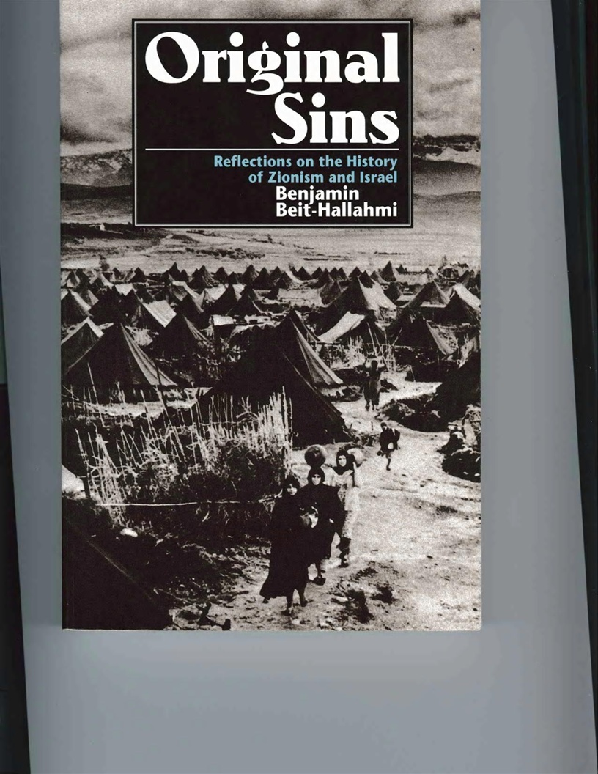
“Justifications for the injustice involved in Zionism have been many and varied. Sometimes what we get are excuses, not justifications. The excuses, which are encountered often enough in our daily lives, usually take the following forms:
Denial— “I didn't do it.”
Reduction— “It wasn’t so bad.”
“Yes, but …” Page 167
Benjamin Beit-Hallahmi, Original Sins: Reflections on the History of Zionism and Israel (New York: Olive Branch Press, 1993)
Israeli scholar Benjamin Beit-Hallahmi observed: “Israel looks like a place that more often than not replicates the Diaspora malaise through a pervasive feeling of existential insecurity. If Diaspora Jews were insecure, tense and nervous, being in their own homeland was supposed to cure all that. Today, Israelis are recognized as being an extremely tense people, leading a nervous existence. Tourists in Israel note the nervousness of Israelis and the serenity of Arabs, as do Israelis themselves. Most Jews in the world today are still subject to the Jewish condition, and their existence is still abnormal. The Israeli condition, offered as an alternative, is still abnormal, and likely to remain that way. In reaching for its main goal of creating a normal nation-state for the Jewish people, Zionism faced two major political problems. The first was that of redefining and creating the Jews. The second was that of removing the natives of Palestine, so that a new nation-state could be created there. The problem of the natives has led to colonialism and to permanent war” page 213.
“Israel is now a [world] problem and a trap as the Israeli question is heir to the Jewish question.” page 220.

Slide 139
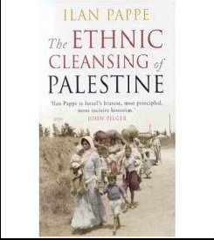
The Ethnic Cleansing of Palestine (2006)
by
Israeli historian and
political scientist
Ilan Pappe
http://ilanpappe.com/

Slide 140
Israeli historian and political scientist Ilan Pappe describes and documents the planning and execution of the ethnic cleansing of Palestine by 11 Jewish settlers sitting in a room beneath Marxist-style posters that carried slogans such as ‘Brothers in Arms:’
“In this building [the Red House in the Jewish settlement of Tel-Aviv], on a cold Wednesday afternoon, 10 March 1948, a group of eleven men, veteran Zionist leaders together with young military Jewish officers, put the final touches to a plan [Plan Dalet] for the ethnic cleansing of Palestine.”
“The orders came with a detailed description of the methods to be employed to forcibly evict the people: large-scale intimidation; laying siege to and bombarding villages and population centres; setting fire to homes, properties and goods; expulsion; demolition; and, finally, planting mines among the rubble to prevent any of the expelled inhabitants from returning. Each unit was issued with its own list of villages and neighbourhoods as the targets of this master plan.”

Slide 141
“The Faculty Club of Tel-Aviv University is called the Green House. Originally this was the house of the mukhtar of the village of Shaykh Muwannis, but you would never be able to tell that if you were ever invited there to have dinner, or to take part in a workshop on the history of the country or even on the city of Tel-Aviv itself. The menu card of the Faculty Club’s restaurant mentions that the place was built in the nineteenth century and used to belong to a rich man called ‘Shaykh Munis’ –a fictious and faceless person imagined in a fitious, placeless location, as are all the other ‘faceless’ people who once lived in the destroyed village of shaykh Muwannis, on whose ruins Tel-Aviv University built its campus. In other words, the Green House is the epitome of the denial of the Zionists’ master plan for the ethnic cleansing of Palestine that was finalized not far away along the beach, in Yarkon Street, on the third floor of the Red House. Had the campus of Tel-Aviv University been dedicated to proper academic research, you would have thought that its economists, for example, would have assessed by now the extent of the Palestinian properties lost in the 1948 destruction, providing and inventory that could enable future negotiatiors to start working towards peace and reconciliation.” p. 257

Slide 142
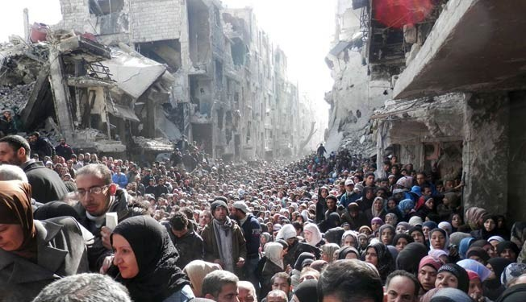
Residents of Syria's besieged Yarmouk Palestinian refugee camp, south of Damascus, crowded a destroyed street during a food distribution led by the UNRWA, on January 31, 2014.
http://en.alalam.ir/news/1579967
Many of the survivors of the massacre committed by Jewish militias at the Palestinian village of Tantura on May 22, 1948 are among the current residents of the Yarmouk Palestinian refugee camp in Damascus. Pappe, The Ethnic cleansing of Palestine, p. 133-137

Slide 143
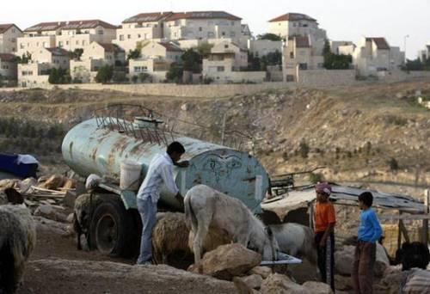
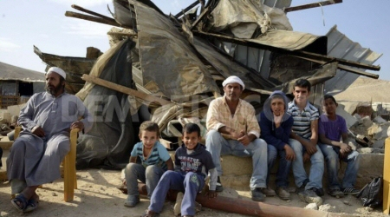
Israel's bulldozers vs the Bedouin Arabs
At the top of an unmarked track leading into the small village of Alsra, in the Negev desert, somebody has placed a triangular road sign barring the entry of bulldozers. They will come, nevertheless, for every family in this village has been served with a demolition order by the Israeli authorities
The indigenous Bedouin Arabs have eked out an existence in the desert for generations, but despite being citizens of Israel, their communities do not exist officially. Alsra, and others like it, does not appear on any official map; does not connect to any roads, and does not receive basic services from the state, such as electricity or sewage treatment.
By contrast, Jewish families have been encouraged to settle in this part of the country to make the desert "bloom" and small, gated farming communities – fully serviced with water and electricity – have sprung up close to the Bedouin villages. Belfast Telegraph, 11/4/2011, http://www.belfasttelegraph.co.uk/news/world-news/israels-bulldozers-vs-the-bedouin-arabs-28676938.html
Palestinian Bedouin feed their animals near the Maale Adumimm Jewish settlement in the occupied West Bank
As Jewish settlers move into the desert to make it 'bloom', an ancient way of life is under threat. In Alsra, Catrina Stewart speaks to Arab families on the fault line
As Israeli bulldozers circle, a tiny village takes center stage in Palestinian struggle, The Washington Post, 7/11/2018, https://www.washingtonpost.com/world/middle_east/as-israeli-bulldozers-circle-a-tiny-village-takes-center-stage-in-palestinian-struggle/2018/07/10/528ad6c8-83ac-11e8-9e06-4db52ac42e05_story.html?utm_term=.8a00f50dc554
Negev: Bedouin-owned Properties Demolished by Israeli Forces, IMEMC News, 8/19/2016, http://imemc.org/article/negev-bedouin-owned-properties-demolished-by-israeli-forces/
A Southern Israeli Village's Fate: Bedouin Out, Jews In, Haaretz, 9/8/2017, http://www.haaretz.com/israel-news/.premium-1.811082

Slide 144


'This is our land': Protests at plan to remove Bedouins from ancestral villages
The so-called 'Prawer plan' is being fought in and outside Israel
Stun grenades, tear gas, flying rocks and a dispute over land – the scene might be familiar, but the players are less so. Used to running battles with Palestinians over territory, Israel is now facing opposition from another group of people who do not want to leave their homes: the Bedouin. In northern Israel, a plan to remove tens of thousands of Bedouins from their ancestral villages and resettle them in specially designed towns is meeting resistance. Israel’s Bedouin do not want to move. And that is increasingly becoming a problem, not only for the Bedouin themselves, but also for the Israeli government, which is behind the unpopular plan. The protests are getting bigger, and they are attracting more attention. Last Thursday, more than 1,000 largely Arab protesters, many of them bused in from towns and cities across the country, held demonstrations against the so-called “Prawer plan”, which, if implemented, will lead to the removal of between 40,000 and 70,000 – depending on who you ask – Bedouin from 35 of their traditional villages. The Independent, 8/7/2013, http://www.independent.co.uk/news/world/middle-east/this-is-our-land-protests-at-plan-to-remove-bedouins-from-ancestral-villages-8748966.html
/
Palestinian village demolished for the ‘100th time since 2010’
Israel has demolished the Arab village of Al-Araqeeb in the Negev “for the 100th time since July 2010” and the second time since the beginning of Ramadan, locals and activists say. “A large number of Israeli police accompanied with bulldozers stormed the village [on Wednesday] at dawn and demolished all the houses, tents and other facilities,” local activist Aziz Al-Touri told The Middle East Monitor media outlet. Israeli authorities claimed that they leveled the village because it was constructed on state land and didn’t have the necessary building permits… The residents of these villages are full Israeli citizens, but the state doesn’t provide them with water, electricity, infrastructure, or sewage systems. RT, 7/4/2016, https://www.rt.com/news/349419-israel-palestinian-village-demolishion
Bedouins attend Friday prayer under a tent in the Al-Araqib village, located between Beersheba and Rahat in the Israeli Negev desert. © Hazem Bader / AFP
Israel okays 800 new homes in East Jerusalem, West Bank, Times of Israel, 7/4/2016, http://www.timesofisrael.com/israel-okays-800-new-housing-units-in-east-jerusalem-surrounding-area/

Slide 145

They came, they razed, they left: A visit to a destroyed Palestinian village
The tiny village of Homsa was the latest victims of Israel's systematic policy of destruction of Palestinian homes in the Jordan Rift. Haaretz, 4/12/2014, http://www.haaretz.com/weekend/twilight-zone/.premium-1.585009
Israel is continuing to destroy systematically the villages of shepherds who live in the Jordan Rift. Last week, the Civil Administration demolished Homsa, another tiny Palestinian village. In January, 160 residents of the valley were made homeless; last year, twice as many were left homeless as in the year before.
Israel steps up pace of Bedouin home demolitions
The targeted area, east of Jerusalem, is slated for an expansion of the settlement of Ma’aleh Adumim.
The Civil Administration in the West Bank has stepped up demolitions of Bedouin buildings in the E-1 area east of Jerusalem since April. The area is slated for an expansion of the settlement of Ma’aleh Adumim. Haaretz, 9/24/2014, http://www.haaretz.com/news/diplomacy-defense/.premium-1.617537
Report: 75,000 Bedouin in Negev have limited or no running water----Health Ministry does not supervise water quality in the Bedouin villages, yet they pay a higher water rate, report claims. Tens of thousands of Bedouin living in rural Negev communities that the government does not recognize as legal have no running water. Many others have restricted access to water and pay much more for it than other communities, a recent report finds.
Haaretz, 7/6/2014, http://www.haaretz.com/news/national/.premium-1.603248

Slide 146

Israel has 101 different types of permits governing Palestinian movement
Over the decades permit regimen grows into vast, triple-digit bureaucracy
Haaretz, 12/23/2011, http://www.haaretz.com/print-edition/news/israel-has-101-different-types-of-permits-governing-palestinian-movement-1.403039
Palestinians waiting to cross through the Hawara checkpoint near Nablus. Photo by Nir Kafri. February 11, 2011

Slide 147

Amnesty International warns Israel against use of force in 'Land Day' demonstrations
Child throws stone during Land Day protest Photo: Marc Israel Sellem
Amnesty International made a public statement on Saturday strictly warning, "Israel must not use violence to quash Land Day demonstrations on Sunday." The press release made open the organization's fear that Israeli security forces plan to "launch a violent crackdown on planned Palestinian protests."
Israeli Arabs will mark the annual Land Day on Sunday, with protests planned across the country.
The annual event commemorates six Israeli Arabs killed by security forces during riots on March 30, 1976, which were held to protest the state appropriation of Arab land in the Galilee.
Last year protesters around the country numbered in the thousands with many carrying Palestinian flags and chanting “from the river to the sea, Palestine will be free” and “with blood and fire, we will liberate al-Aksa,” among other chants.
The Jerusalem Post, 3/30/2014, http://www.jpost.com/National-News/Amnesty-International-warns-Israel-against-use-of-force-in-Land-Day-demonstrations-346859

Slide 148

The 1967 Six-Day War:
http://www.washingtonreport.me/a-pre-planned-war-of-choice.html
http://www.washingtonreport.me/six-days-in-june.html
http://www.washingtonreport.me/uss-liberty.html
http://www.washingtonreport.me/the-golan-heights.html
http://www.washingtonreport.me/50-years-later.html
Land Day
A Palestinian woman touches her face after an Israeli border police officer sprayed her with pepper spray during confrontations at a Land Day protest outside Jerusalem's Old City March 30, 2014. REUTERS/Baz Ratner, http://blogs.reuters.com/fullfocus/2014/04/03/editors-choice-34/#a=6

Slide 149

Stages of Ethnic Cleansing of Muslims and Christians from Palestine by Jewish Settlers:
1948 war: (1) creation of Israel, (2) the ethnic cleansing of the Palestinians from 13 cities and 600 villages (i.e.., Deir Yassin massacre 4/9-11/1948), and (3) the birth of Palestinian refugees
1967 war: (1) Israel occupied all of Palestine and (2) continued the ethnic cleansing
After 1967: the Israeli government and Jewish settlers built settlements in the conquered territories of the West Bank and the Gaza Strip & continued the ethnic cleansing of the Palestinians through (1) eviction, (2) expropriation, (3) border closures, (4) abuse at checkpoints, (5) house demolitions, (6) olive tree uprooting, (7) sanctions, (8) assassination of military and political activists, (9) large military operations (in the West Bank in 4/3-11/2002 and in the Gaza Strip in 2008/2009 and 2014); (10) mass arrests, (11) walls of separation, (12) discriminatory legislation, (13) denial of right to return, and (14) other means (see the headline story below):
3,000 trees to be planted in Israel to memorialize Newtown victims: NEW YORK (JTA) – More than 2,000 people have donated funds to plant a grove of more than 3,000 trees in Israel in memory of the victims of the Newtown shooting... The idea for the Newtown grove grew from a request made by Veronique Pozner, whose son, Noah, was the only Jewish victim of the shooting at the Connecticut school. --Jewish Telegraphic Agency, December 31, 2012, http://www.jta.org/news/article/2012/12/31/3115736/3000-trees-to-be-planted-in-israel-to-memorialize-newtown-victims

Slide 150
Arab-Israeli Wars and other conflicts have cost the Middle East trillions of dollars
Six major Arab-Israeli wars
1948
1956
1967
1973
1982
2006
A January 2009 study by India’s Strategic Foresight Group concluded that 20 years of conflict has cost the Middle East $12 trillion.
Reuters, 1/23/2009, http://in.reuters.com/article/domesticNews/idINLN69708120090123

Slide 151







“a passionate attachment of one nation for another produces a variety of evils.” President George Washington’s Farewell Address, 1796
“Why Do They Hate Us?” President George W. Bush
“Let him [Bush] tell us why we did not strike Sweden, for example”--- Bin Laden
Top Left: President Clinton appears to pause while drinking from a cup with an Israeli flag printed on it--Al-Majalla Magazine’s cover-page photo, 11/2000
Top Right: President Bush offers chocolates wrapped in Israeli flags to Israeli Prime Minister Sharon during their meeting at Bush's ranch in Crawford, Texas, 4/11/2005, Palestine Report, http://www.palestinereport.ps/article.php?article=733 4/11/2005,, http://raedinthemiddle.blogspot.com/2005/04/bush-and-sharon.html
“For these reasons America does not like us”
“It is critical that we send a message around the world we will stand with Israel, we want them around not just for 60 years, but for 600 years. ” --- Democratic presidential candidate Barack Obama (CNN.com, 5/8/2008)
“[Israel is] the most cruel and racist regime… Wasn’t the military action against Iraq planned by the Zionists and their allies”? ---Iranian President Mahmoud Ahmadinejad, UN anti-racism conference, Geneva, Switzerland, 4/20/2009
“Palestine is Arab” were the final words of Iraq’s President Saddam Hussein
“We swore that America wouldn't live in security until we live it truly in Palestine” ---Al-Qaeda leader Osama Bin Laden “So [you believers], say, ‘We believe in God and in what was sent down to us and what was sent down to Abraham, Ishmael, Isaac, Jacob, and the Tribes, and what was given to Moses, Jesus, and all the prophets by their Lord. We make no distinction between any of them, and we devote ourselves to Him’” Quran 2:136
أوباما يصلي أمام ما يسميه اليهود حائط المبكى في القدس المحتلة
“Obama prays facing what the Jews call the Wailing Wall in occupied Jerusalem” Aljazeera.net, 7/21/1429 AH

Slide 152

Presidential candidate John McCain views the Iraq war in light of Israel’s security
“If you believe that the State of Israel will be more secure if the United States fails in Iraq, you and I have a disagreement.” ---
Republican presidential candidate John McCain (JTA, 10/30/2007) in Jerusalem
“The threats to Israel's security are large and growing and America's commitment must grow as well.”--McCain, Haaretz, 10/29/2008 http://haaretz.com/hasen/spages/1032258.html
Google, http://www.ccun.org/images/2008/July/24%20p/john%20mccain%20at%20the%20Western%20Wall%2019mar8ap.jpg
http://www.youtube.com/watch?v=kRx7naNRs5w
UNESCO votes to condemn Israel’s sovereignty in Jerusalem, Jewish Telegraphic Agency, 5/2/2017, http://www.jta.org/2017/05/02/news-opinion/israel-middle-east/unesco-votes-to-condemn-israels-presence-in-jerusalem
Trump 'seriously considering' moving U.S. embassy to Jerusalem, VP Pence says, i24 news, 3/27, 2017, https://www.i24news.tv/en/news/israel/diplomacy-defense/141158-170327-u-s-stands-without-apology-for-israel-vp-pence-says
UNESCO declares Hebron's Old City Palestinian World Heritage site, BBC, 7/7/2017, http://www.bbc.com/news/world-middle-east-40530396

Slide 153

Senator Biden speaks his mind and makes no gaffe
“I am a Zionist …You don't have to be a Jew to be a Zionist” ---Biden, Shalom TV, 3/27/2007
“With all the change you will hear about, there is one enduring, essential principle that will not change; and that is our commitment to the peace and security of the state of Israel.”--Vice President Joseph Biden, 5/5/2009 http://www.aipac.org/Publications/SpeechesByPolicymakers/VicePresidentBidenPC09.pdf
“There is no space between the United States and Israel when it comes to Israel’s security, and for that reason and many others addressing Iran’s nuclear program has been one of our administration’s priorities” –Vice President Joseph Biden, 3/9/2010, JTA, http://jta.org/news/article/2010/03/09/1010996/biden-no-space-between-us-israel
Vice President Joseph Biden was a Senator from Delaware for 36 years—The White House

Slide 154
UN votes for new sanctions on Iran over nuclear issue
The UN Security Council has voted in favour of fresh sanctions against Iran over its nuclear programme. The council voted 12 to two, with one abstention, in favour of a fourth round of sanctions, including tighter finance curbs and an expanded arms embargo. US President Barack Obama said the sanctions were an unmistakable message on stopping the spread of nuclear arms. Iran's President Mahmoud Ahmadinejad said the sanctions should be thrown in the dustbin like a "used handkerchief". The US and its allies fear Iran is secretly trying to build a nuclear bomb, but Tehran insists its programme is aimed solely at peaceful energy use. BBC, 6/9/2010, http://news.bbc.co.uk/2/hi/middle_east/10276276.stm
Israel Makes Case to China for Iran Sanctions
“JERUSALEM — During the many months China has wavered over whether to join the American-led effort to impose sanctions on Iran, Israeli officials have been waging their own quiet campaign to convince the Chinese that Iran should be punished for its renegade nuclear program... 'The Chinese didn’t seem too surprised by the evidence we showed them, but they really sat up in their chairs when we described what a pre-emptive attack would do to the region and on oil supplies they have come to depend on, said an Israeli official with knowledge of the meeting and who asked for anonymity so as not to upset his Chinese counterparts... Israel’s outsized allure also stemmed from China’s regard for the country’s military prowess and a deeply held affection for Karl Marx and Albert Einstein, cornerstones of a Chinese fascination with Jews." The New York Times, 6/8/2010

Slide 155
“They hate us because of things they see us doing to their part of the world that they definitely do not like”
“So we will mercilessly, viciously, effectively attack and destroy all kinds of symptoms. When the rubble has settled and the dust is gone, the disease is still going to be out there untouched. Because we don't want to look at why, why it is that all of these people hate us. It's not because of freedom. It's not because Britney Spears has a belly button or because we export hamburgers. They hate us because of things they see us doing to their part of the world that they definitely do not like.” ---Edward Peck, former chief of mission at the American embassy in Iraq, former ambassador to Mauritania, deputy director of covert intelligence programs at the State Department and deputy director of the White House Task Force on Terrorism in the Reagan Administration, in a CNN interview on October 11, 2001.
Leonard Fein, “If We Judge a Man by His Words,” Forward, New York, 4/4/2008 (Vol. 111, Iss. 31699; pg. 14, 1 pgs).

Slide 156


Hillary Clinton's rival defends handshake with Arafat
NEW YORK (AP) -- First the kiss, now the handshake. Hillary Rodham Clinton's rival for New York's open senate seat found himself under fire after a photograph of him shaking Palestinian leader Yasser Arafat's hand two years ago resurfaced. he photograph, which appeared in Sunday's New York Post, was taken by a White House photographer in 1998 when Rep. Rick Lazio visited the Mideast with President Clinton and other U.S. officials. Source: CNN, 9/11/2000, http://archives.cnn.com/2000/ALLPOLITICS/stories/09/11/lazio.arafat.ap/
http://news.bbc.co.uk/2/hi/americas/923248.stm
Lazio's controversial handshake with Arafat
“Hillary Clinton kissing Suha Arafat [wife of Palestinian President Arafat], a November 1999 political mistake that she recovered from”
Source: Wikipedia, 3/20/2008, http://en.wikipedia.org/wiki/United_States_Senate_election_in_New_York%2C_2000
http://en.wikipedia.org/wiki/Image:Hillaryandsuha.jpg
The flashpoint in the area of foreign policy in the New York Senate race can be summed up in one word: Israel
Rick Lazio and Hillary Rodham Clinton disagree more sharply about other foreign-policy issues - such as whether the United States should be isolationist or try to be the world's policeman - but the Mideast, and the quest for the Jewish vote, has gotten most of the attention. New York Post, 10/31/2000, http://www.nypost.com/p/news/item_UufpsL70tsPX9r8UBXCOxO

Slide 157

“I’ve proudly stood with the State of Israel for my entire career, making sure it always has the resources it needs to maintain its qualitative military edge”—Hillary Clinton, JTA, 4/18/2016, http://www.jta.org/2016/04/18/news-opinion/united-states/ahead-of-ny-primary-hillary-clinton-links-her-policies-to-ancient-lessons-of-passover
“Haim Saban, who’s a friend, a colleague, a mentor, an inspiration to so many of us here tonight. He certainly has always challenged me to make the most of America’s place in the world and especially our close friendship with Israel... President Obama and I stood before the international community and supported Israel’s right to defend itself from a threat no country would tolerate. The Iron Dome system – invented by Israel, underwritten by America – knocked rockets out of the sky like never before.” U.S. Secretary of State, November 30, 2012, http://www.state.gov/secretary/rm/2012/11/201343.htm
During 2000 Senate campaign, Hillary Clinton "once took a Yiddish lesson” as a way to relate to her Jewish supporters, Jewish Telegraphic Agency, 12/24/2015, http://www.kveller.com/hillary-clinton-learned-how-to-say-kvell-during-2000-ny-sen-campaign/ , CPAN, 11/8/2001, http://www.c-span.org/video/?c4569711/2000-senate-campaign-hillary-clinton-took-yiddish-lesson
Senator Hillary Rodham Clinton visits the Western Wall—11/14/2005, http://gatewaypundit.blogspot.com/2005/11/no-kisses-for-suha-as-hillary-condemns.html

Slide 158
EXCERPTS from Secretary of State Hillary Clinton speech to AIPAC Policy Conference 2010
"Given the shared challenges we face, the relationship between the United States and Israel has never been more important. The United States has long recognized that a strong and secure Israel is vital to our own strategic interests. We know that the forces that threaten Israel also threatened the United States. And we firmly believe that when we strengthen Israel's security, we strengthen America's security."
"We know that to make progress in this region, there must be no gap between the United States and Israel on security. And there will not be. For President Obama, for me, and for this entire administration, our commitment to Israel's security and Israel's future is rock solid."
"Guaranteeing Israel's security is more than a policy position for me. It is a personal commitment that will never waiver."
"This administration will always stand up for Israel's right to defend itself."
"The Iranian leadership funds and arms terrorists who have murdered Americans and Israelis alike.
"The United States is determined to prevent Iran from acquiring nuclear weapons."
"Our aim is not incremental sanctions, but sanctions that will bite."
"We will not compromise our commitment to preventing Iran from acquiring these weapons."
"It is true that heightened security measures have reduced the number of suicide bombings"
"Hizballah has amazed tens of thousands of rockets on Israel's northern border. Hamas has a substantial number in Gaza."
"Our message to Hamas is clear: renounce violence, recognize Israel, and abide by previous signed agreements. And I will repeat today what I have said many times before: Gilad Shalit must be released immediately and reunited with his family."
"A comprehensive peace that is real and not a slogan, that is rooted in genuine recognition of Israel's right to exist in peace and security, and that offers the best way to ensure Israel's enduring survival and well-being."
Regarding Israel's Arab neighbors and the peace process, "their rhetoric must now be backed up by action."
"We commend Prime Minister Netanyahu for embracing the vision of the two-state solution and for acting to lift road-blocks and east movement throughout the West Bank."
"From addressing climate change and energy to hunger, poverty and disease, Israel has so much to offer. Look at the spread of high-tech start-ups, the influx of venture capital, the number of Nobel laureates."
AIPAC, http://www.aipac.org/PC2010/webPlayer/mon_clinton10.asp

Slide 159
EXCERPTS from Secretary of State Hillary Clinton speech to AIPAC Policy Conference 2010
And let me assure you, as I have assured you on previous occasions with large groups like this and small intimate settings, for President Obama and for me, and for this entire Administration, our commitment to Israel's security and Israel's future is rock solid, unwavering, enduring, and forever. (Applause.)
And why is that? Why is that? Is it because AIPAC can put 7,500 people into a room in the Convention Center? I don't think so. Is it because some of the most active Americans in politics and who care about our government also care about Israel? That's not the explanation. Our countries and our peoples are bound together by our shared values of freedom, equality, democracy, the right to live free from fear, and our common aspirations for a future of peace, security and prosperity, where we can see our children and our children's children, should we be so lucky - and as a future mother of the bride [emphasis added], I'm certainly hoping for that - (applause) - to see those children, those generations come of age in peace, with the opportunity to fulfill their own God-given potentials.
Americans honor Israel as a homeland for a people too long oppressed and a democracy that has had to defend itself at every turn, a dream nurtured for generations and made real by men and women who refused to bow to the toughest of odds. In Israel's story, we see our own. We see, in fact, the story of all people who struggle for freedom and the right to chart their own destinies.
That's why it took President Harry Truman only 11 minutes to recognize the new nation of Israel - (applause) - and ever since, our two countries have stood in solidarity. So guaranteeing Israel's security is more than a policy position for me; it is a personal commitment that will never waver. (Applause.). AIPAC, http://www.aipac.org/PC2010/webPlayer/mon_clinton10.asp

Slide 160
It's official - Chelsea Clinton to wed Jewish boyfriend
By Haaretz Service and The Associated Press, 12/1/2009
“Chelsea Clinton, the daughter of America's most powerful political couple will soon wed a "member of the tribe," according to various media reports.
Clinton is set to marry her Jewish boyfriend Marc Mezvinsky, ABC News reported on Monday.
Clinton, the daughter of former President Bill Clinton and current Secretary of State Hillary Clinton, met Mezvinsky when both were teenagers in Washington, according to reports. They also both attended Stanford University in California.”

Slide 161
“Let me be clear. Israel's security is sacrosanct. It is non-negotiable.”--- Presidential candidate Obama, 6/4/2008, http://edition.cnn.com/2008/POLITICS/06/27/obama.aipac/index.html
"Obama pushes ahead with plan to rejuvenate black-Jewish alliance"—JTA, January 13, 2009, http://www.jta.org/2009/01/13/news-opinion/politics/obama-pushes-ahead-with-plan-to-rejuvenate-black-jewish-alliance
“It is critical that we send a message around the world we will stand with Israel, we want them around not just for 60 years, but for 600 years. And when I am president of the United States they will have an unwavering ally in me.” --- Democratic presidential candidate Barack Obama (CNN.com, 5/8/2008)
“I think when this is all over, people are going to say that Barack Obama is the first Jewish president.”–--Abner Mikva, former Congressman, Federal Judge, and White House Counsel to President Bill Clinton, Pauline Dubkin Yearwood , “Obama and the Jews,” Chicago Jewish News, 10/24/2008, http://www.chicagojewishnews.com/story.htm?sid=212226&id=252218
“I've got a Chief of Staff named Rahm Israel Emmanuel. My top political advisor is somebody who is a descendent of Holocaust survivors. My closeness to the Jewish American community was probably what propelled me to the U.S. Senate”---President Obama, Haaretz, 7/10/2010, http://www.haaretz.com/news/diplomacy-defense/obama-israelis-suspicious-of-me-because-my-middle-name-is-hussein-1.300793
“Obama to pick Jew for Supreme Court”--Jerusalem Post, 5/10/2010, http://www.jpost.com/JewishWorld/JewishNews/Article.aspx?id=175155
"U.S. President Barack Obama on Tuesday picked Jacob Lew, an Orthodox Jew, as the new White House budget chief"--Haaretz, 7/13/2010, http://www.haaretz.com/jewish-world/news/obama-nominates-jacob-lew-for-white-house-budget-chief-post-1.301772
“I have shown repeatedly my commitment to Israel’s security and I feel it deeply.... I believe it would be a moral betrayal for the world not to protect and secure a homeland for the Jewish people.”---US President Obama, Forward, 1/12/2017, http://forward.com/news/359744/barack-obama-s-2-farewells-urging-americans-and-israelis-to-defend-their-va/?attribution=articles-hero-item-text-1
“Close to 70 percent of American Jews who voted in the 2012 presidential election cast their ballots for Barack Obama, an expression of the resiliency of the black-Jewish alliance"---Forward, 1/25/2013, http://forward.com/articles/169571/dr-kings-memory-and-the-jewish-conscience/
“Jews made him. Wherever you look, there is a Jewish presence” – Chicago Jewish News , 10/24/2008
http://www.chicagojewishnews.com/story.htm?sid=212226&id=252218
President Obama’s approval rating among U.S. Jews was 60 percent in June 2011, an average of 14 percentage points above the general public. Jewish Telegraphic Agency,
http://www.jta.org/2011/07/05/news-opinion/politics/jewish-approval-of-obama-unaffected-by-israel-tensions-poll-shows
“I first became familiar with the story of Israel when I was 11 years old”-- Obama, NPR, 6/4/2008
أوباما يصلي أمام ما يسميه اليهود حائط المبكى في القدس المحتلة
“Obama prays facing what the Jews call the Wailing Wall in occupied Jerusalem” [my translation]--Aljazeera.net, 7/21/1429 AH هـ

Slide 162


"The evidence points to a purely political appointment... Elena Kagan’s appointment certainly was not based on “diversity”… Prima facie evidence strongly suggests that Kagan’s ties to the staunchly Zionist faculty at both Chicago and Harvard Law Schools (and not her intellectual prowess) account for her meteoric promotions to tenure, deanship and now the US Supreme Court, over the heads of hundreds of other highly qualified candidates with far superior academic publication records and broader practical judicial experience... Elena Kagan joins a long list of key Obama appointees who have long-standing ties to the pro-Israel power configuration. Like Barack Obama, Elena Kagan started her legal apprenticeship with the Chicago Judge Abner Mitva, an ardent Zionist, who hailed the newly elected President Obama as “America’s first Jewish President”, probably his soundest judgment." Bartle Professor (Emeritus) of Sociology at Binghamton University James Petras, "Elena Kagan and the Supreme Court: A Barnyard Smell in Chicago, Harvard and Washington," 05.13.2010, http://lahaine.org/petras/articulo.php?p=1806&more=1&c=1
Jewish groups file Jerusalem brief with U.S. high court: (JTA, August 7, 2011) -- American Jewish groups asked the U.S. Supreme Court to allow Jerusalem-born American citizens to have their birthplace listed as Israel on their birth certificates and passports. http://www.jta.org/news/article/2011/08/07/3088875/jewish-groups-file-jerusalem-brief-with-high-court
“Obama to pick Jew for Supreme Court” By ASSOCIATED PRESS, 5/10/2010 , The Jerusalem Post, 5/10/2010, http://www.jpost.com/JewishWorld/JewishNews/Article.aspx?id=175155
“A superb day for the Jewish people”: U.S. Senate approves Kagan as Supreme Court judge—Haaretz, 8/7/2010, http://www.haaretz.com/jewish-world/a-superb-day-for-the-jewish-people-u-s-senate-approves-kagan-as-supreme-court-judge-1.306278
Photo by: Associated Press
[If confirmed] She would be the third Jewish justice along with six Catholics. With [Justice John Paul] Stevens' retirement, the court will have no Protestants, the most prevalent denomination in the US. The Jerusalem Post, 5/10/2010, http://www.jpost.com/JewishWorld/JewishNews/Article.aspx?id=175155
Pat Buchanan suggests: Too many Jews on U.S. Supreme Court bench
American conservative political commentator decries Obama nomination of Elena Kagan, laments absence of Protestants in Supreme Court.
Haaretz, 5/16/2010, http://www.haaretz.com/news/international/pat-buchanan-suggests-too-many-jews-on-u-s-supreme-court-bench-1.290692
U.S. political commentator Pat Buchanan on the campaign trail in 1999.
Photo by: Elise Amendola

Slide 163


Supreme Court Judges Laud 'Wonder' of 3 Jewish Justices at Federation G.A.
Oxon Hill, Maryland — Supreme Court justices Stephen Breyer and Elana Kagan talked about their Jewish identities at the opening plenary of the 2014 General Assembly conference of the Jewish Federations of North America. Speaking before a crowd of more than 2,000 at the conference center just outside Washington, Breyer said the most remarkable thing about there being three Jews among the nine Supreme Court justices is how unremarkable it is in America today. Forward, 11/10/2014, http://forward.com/articles/208941/supreme-court-judges-laud-wonder-of--jewish-justi/
Supreme Court justices Stephen Breyer and Elena Kagan speak at the 2014 General Assembly conference of the Jewish Federations of North America
Could Merrick Garland Become the Fourth Jewish Supreme?
Merrick Garland grew up Jewish in the Chicago suburbs, worked his way to Harvard Law School and investigated the Oklahoma City bombing as a federal prosecutor… After twice being passed over for the Supreme Court, he is now aiming to become an unprecedented fourth Jew on the nine-member top court… Forward, 3/16/2016, http://forward.com/news/336091/merrick-garland-offers-poignant-story-about-anti-semitism-as-supreme-court
Obama nominates Jewish judge, Merrick Garland, to Supreme Court, Jewish Telegraphic Agency, 3/16/2016, http://www.jta.org/2016/03/16/news-opinion/united-states/obama-to-name-jewish-federal-judge-to-supreme-court
Schumer Asks Trump To Nominate Merrick Garland To Supreme Court, Forward, 7/5/2018, https://forward.com/fast-forward/404849/chuck-schumer-asks-trump-to-nominate-merrick-garland-to-supreme-court/

Slide 164
Supreme Court strikes down aggregate campaign donation caps
Supreme Court strikes down aggregate campaign donation caps: (Reuters) - The U.S. Supreme Court on Wednesday struck down a key pillar of campaign finance law by allowing wealthy donors to give money to as many political candidates, parties and committees as they wish. On a 5-4 vote, the court struck down the overall limits on how much individuals can donate during the federal two-year election cycle. Before the ruling, donors could not exceed a $123,200 overall limit during the two-year period. The ruling allows donors to contribute nearly $6 million in the same period, according to public advocacy groups. Reuters, 4/2/2014, http://www.reuters.com/article/2014/04/02/us-usa-court-election-idUSBREA3116V20140402
In politics, money is speech: "In American democracy, this free speech plays two vital roles. The first is well recognized. It is to shape public opinion and to influence elections that, in turn, determine the social climate and steer government... Free speech’s second function is less understood. It buttresses the political system’s legitimacy. It helps losers in the struggle for public opinion and electoral success accept their fates. It helps keep them loyal to the system, even though it has disappointed them.” The Washington Post, 4/6/2014, http://www.washingtonpost.com/opinions/robert-j-samuelson-in-politics-money-is-speech/2014/04/04/075df4ec-bc18-11e3-9a05-c739f29ccb08_story.html?hpid=z2
‘Ex-U.K. FM: Jewish money biggest obstacle to Mideast peace’: Jack Straw, a British lawmaker and former foreign secretary, said “unlimited” funds available to U.S. Jewish groups are used to control American policy in the Middle East. Haaretz, 10/27/2013, http://www.haaretz.com/jewish-world/jewish-world-news/1.554717
A Republican attack ad in a congressional race in Minnesota accused the Democratic candidate of being “owned” by Jewish billionaire financier George Soros, leading some to accuse the GOP of anti-Semitism. Forward, 10/18/2018, https://forward.com/fast-forward/412278/gop-ad-accuses-jewish-billionaire-george-soros-of-owning-democratic/

Slide 165





Hypocrisy & Deception
“Only 6% of Israelis see US gov't as pro-Israel” according to a Jerusalem Post-sponsored Smith Research poll.---Jerusalem Post, 6/19/2009 http://www.jpost.com/servlet/Satellite?cid=1245184872947&pagename=JPost%2FJPArticle%2FShowFull
Conservative movement ordains first openly gay rabbi--(Jewish Telegraphic Agency) – The Conservative movement ordained its first openly gay rabbi during ceremonies at the Jewish Theological Seminary in New York. GTA, May 29, 2011 http://www.jta.org/news/article/2011/05/29/3087914/conservative-movement-ordains-first-openly-gay-rabbi
Israel is hypocritical when it comes to Iran nuclear sanctions--The Israeli industrialists, the Ofer Brothers, did business with Iran, defying United Nations sanctions that Israel pressed for.
Haaretz, 5/30/2011, http://www.haaretz.com/print-edition/news/israel-is-hypocritical-when-it-comes-to-iran-nuclear-sanctions-1.364852
Breakdown of the Jewish vote in the 2008 U.S. presidential election, according to initial exit polling data—Jewish Telegraphic Agency, 11/5/2008
Campaign finance law and money can win lawmakers/policymakers as easily as the media can mislead the public
يهود في مظاهرة منددة بباراك أوباما في تل أبيب الشهر الماضي ---الجريرة---7/14/2009

Slide 166


Cruzing for Jewish support
President Barack Obama signs the United States-Israel Enhanced Security Cooperation Act, Friday, July 27, 2012, in the Oval Office of the White House in Washington. Photo by Natasha Mozgovaya, https://www.youtube.com/watch?v=TJPZTo2JSxk
“Obama signed the bill using five pens, at his desk, flanked by Senator Barbara Boxer, sponsor of the Senate version of the bill, Rep. Howard Berman, the House version author, Lee Rosenberg, chairman of the board of AIPAC and Howard Friedman, the former Chair, as well as Richard Stone, chairman of the Conference of Presidents of Major American Jewish Organizations [these are American Jewish leaders working for Israel; apparently no “Israeli” needs to be present at this important bilateral agreement]” http://www.haaretz.com/news/diplomacy-defense/obama-announces-new-military-assistance-to-israel-on-eve-of-romney-trip-1.454118
Sen. Ted Cruz and casino magnate Sheldon Adelson at annual ZOA dinner. (Credit: ZOA), JTA, 11/26/2014, http://www.jta.org/2014/11/26/news-opinion/the-telegraph/cruzing-for-jewish-support
Top Republican Party donor Sheldon Adelson said on Friday he met presidential candidate Donald Trump earlier this week and that the two American billionaires broached the issue at the heart of Adelson’s political agenda: support for Israel... On the subject of Israel, Trump added, “Sheldon knows that nobody will be more loyal to Israel than Donald Trump.” Forward, 12/18/2015, http://forward.com/news/327512/sheldon-adelson-upbeat-on-very-charming-donald-trump/?attribution=articles-hero-item-text-5
"The Zionist Organization of America has largely embraced Bannon [President Donald Trump's former chief strategist]", Haaretz, 11/13/2017, https://www.haaretz.com/us-news/1.822455
Why Not a Probe of “Israel-Gate”? Israeli Meddling… The other day, I asked a longtime Democratic Party insider who is working on the Russia-gate investigation which country interfered more in U.S. politics, Russia or Israel. Without a moment’s hesitation, he replied, “Israel, of course.” Global Research, 4/2/4/2017, http://www.globalresearch.ca/why-not-a-probe-of-israel-gate/5586601

Slide 167
Obama announces new military assistance to Israel on eve of Romney trip
One day before Mitt Romney's visit to Jerusalem, U.S. president signs bill expanding military and civilian cooperation with Israel.
U.S. President Barack Obama announced on Friday that he will be releasing an additional $70 million in military assistance to Israel, a previously announced move that appeared timed to upstage Republican rival Mitt Romney's trip to Jerusalem this weekend.
Haaretz, July 27, 2012, http://www.haaretz.com/news/diplomacy-defense/obama-announces-new-military-assistance-to-israel-on-eve-of-romney-trip-1.454118
http://thehill.com/images/stories/blogs/flooraction/jan2012/hr4133.pdf
President Barack Obama signs the United States-Israel Enhanced Security Cooperation Act, Friday, July 27, 2012, in the Oval Office of the White House in Washington. Photo by Natasha Mozgovaya
https://www.youtube.com/watch?v=TJPZTo2JSxk
“Obama signed the bill using five pens, at his desk, flanked by Senator Barbara Boxer, sponsor of the Senate version of the bill, Rep. Howard Berman, the House version author, Lee Rosenberg, chairman of the board of AIPAC and Howard Friedman, the former Chair, as well as Richard Stone, chairman of the Conference of Presidents of Major American Jewish Organizations [these are American Jewish leaders working for Israel; apparently no “Israeli” needs to be present at this important bilateral agreement]” http://www.haaretz.com/news/diplomacy-defense/obama-announces-new-military-assistance-to-israel-on-eve-of-romney-trip-1.454118
Right and Left React to the Donald Trump Jr. Email Scandal, The New York Times, 7/12/2017, https://www.nytimes.com/2017/07/12/us/politics/right-and-left-donald-trump-jr-email-scandal.html
Clinton Campaign Colluded With Ukraine To Try And Sink Trump, Published 7/12/2017, https://www.youtube.com/watch?v=7quC0touaqw
“On eve of Romney visit, U.S. Jews continue to favor Obama by 68%-25%, new poll shows”—Jerusalem Post, July 27, 2012, http://www.haaretz.com/news/diplomacy-defense/on-eve-of-romney-visit-u-s-jews-continue-to-favor-obama-by-68-25-new-poll-shows.premium-1.454126
Why Not a Probe of “Israel-Gate”? Israeli Meddling… The other day, I asked a longtime Democratic Party insider who is working on the Russia-gate investigation which country interfered more in U.S. politics, Russia or Israel. Without a moment’s hesitation, he replied, “Israel, of course.” Global Research, 4/2/4/2017, http://www.globalresearch.ca/why-not-a-probe-of-israel-gate/5586601

Slide 168




Romney raises more than $1 million at end of Israel trip
Reuters, July 29, 2012,
http://www.reuters.com/article/2012/07/30/us-usa-campaign-romney-idUSBRE86Q1DO20120730
U.S. Republican presidential candidate Mitt Romney places a note in the Western Wall, Judaism's holiest prayer site, in Jerusalem's Old City July 29, 2012. Romney would respect an Israeli decision to use military force to stop Iran from developing a nuclear weapon, a senior aide said on Sunday. REUTERS/Baz Ratner
Reuters, July 29, 2012,
http://www.reuters.com/news/pictures/slideshow?articleId=USBRE86Q1DO20120730&slide=7#a=7
Mitt Romney has angered Palestinians with his hint that he will recognise Jerusalem as Israel's capital should he win November's presidential election.
JC, July 30, 2012, http://www.thejc.com/news/uk-news/70618/romney-upsets-palestinians-jerusalem-embassy-remark
“In Jerusalem speech, it was Romney's voice but Netanyahu's words”, Haaretz, July 30, 2012,
http://www.haaretz.com/blogs/diplomania/in-jerusalem-speech-it-was-romney-s-voice-but-netanyahu-s-words.premium-1.454521
Veterans Today, 1/9/2017 http://www.veteranstoday.com/wp-content/uploads/2017/01/Trump-Israel.jpg
Trump Family Gets the Jewish Orthodox Experience at Western Wall in Jerusalem’s Old City on May 22, 2017, Haaretz, http://www.haaretz.com/israel-news/1.791011
President Donald Trump election promise Fulfilled, https://www.youtube.com/watch?v=wXSJGmST_Uc
Washington Report on Middle East Affairs,
http://www.wrmea.org/archives/519-washington-report-archives-2011-2015/october-2012/11410-two-views-mitt-romney-election-year-in-jerusalem.html

Slide 169
Petraeus denies saying Israel endangers lives of U.S. troops:
Gen. David Petraeus, commander of the U.S. Military's Central Command, telephoned Chief of Staff Gabi Ashkenazi Wednesday to deny the reports he had blamed Israeli policy for the failure to reach a regional solution and for endangering the lives of U.S. soldiers in the Middle East. … Earlier this month, Petraeus warned the Pentagon that "America's relationship with Israel is important, but not as important as the lives of America's soldiers," in a posting on the Foreign Policy Web site. In a 56-page report, the Central Command had written: "The enduring hostilities between Israel and some of its neighbors present distinct challenges to our ability to advance our interests....apparently it was important for the general not to be seen as hostile to Israel, for Israeli consumption but also for the American public...there is talk of him as a candidate for the presidency... ”
Haaretz, 3/28/2010, http://www.haaretz.com/hasen/spages/1159295.html
‘Israel made world better’
WASHINGTON – The Holocaust survivors who helped build Israel "made our world better," US Gen. David Petraeus said Thursday. "The men and women who walked or were carried out of the death camps, and their descendents, have enriched our world immeasurably in the sciences and in the arts, in literature and in philanthropy," said Petraeus, the key note speaker at the US Holocaust Memorial Museum commemoration in the Capitol Rotunda. "They have made extraordinary contributions in academia, in business, and in government. And, they have, of course, helped build a nation that stands as one of our great allies. The survivors have, in short, made our country and our world better, leaving lasting achievements wherever they settled.”
Jerusalem Post, 4/17/2010 (by JTA, 4/16/2010), http://www.jpost.com/International/Article.aspx?id=173335

Slide 170

Indiana Governor Mitch Daniels receives the Man of Achievement Award from the [pro-Israel] Anti-Defamation League, November 23, 2009
“I got there, our class got there, right on the heels of the Six Day War. Everybody was thrilled with what Israel had accomplished on its own behalf… But now what one writer has called “the oldest hatred” is back again, in new forms and from very new and strange quarters. We didn't get a chance to hear the speech that Mr. Foxman [National Director of ADL] prepared for tonight, but I'm going to go get it and you should too, because I bet it catalogues, as so many folks have recently, th astonishing virulence and widespread nature of anti-Semitism in this world. It is a matter of both surprise and also enormous alarm to me, aend I hope to you. How strange to me that sectors and people who I once thought of as allies of the Jewish people in the fight against anti-Semitism have changed uniforms and changed sides, completely… the UN today… is a hotbed of animosity, lies, and hatred for the state of Israel and the people that created it… I have some great news for you, some proud news, and I have permission to share it. I stumbled onto it as I was thinking about tonight, reading and re-reading some things I’d saved about the new anti-Semitism. I called Dr. Alvin Rosenfeld down at Indiana University, who’d given two speeches that I had in my file, just to see if he had any thoughts about the topic. And he gave me the greatest news, and I’m so pleased that President McRobbie of Indiana University is here. By his leave and Dr. Rosenfeld’s, I share it with you. Very, very soon on the campus of Indiana University, will be born a new institute: The Institute for the Study of Contemporary Anti-Semitism. I am so proud that that is happening, and happening here in our state. Michael, thank you very, very much. [Applause] I just look forward to the work that is done there, the scholarship that occurs, and I hope the frontal response to a would-be new wave of terror, so that we don’t have to ask “What if?” in our later days and our children never have to ask it of us… Thank you for this recognition, but mostly for your commitment to this most urgent of causes.”---Indiana Governor Mitch Daniels
“Anti-Defamation League Remarks”: Indiana Governor Mitch Daniels receives the Man of Achievement Award from the Anti-Defamation League, November 23, 2009, : http://www.youtube.com/watch?v=6-UlDOGWZVY
Indiana Governor Mitch Daniels “has been a strong friend of the State of Israel and the Indianapolis Jewish community and he has spoken to our forums and been available to counsel with us on issues of concern.” --Remarks by Abraham H. Foxman, ADL National Director, November 23, 2009, http://www.adl.org/main_Anti_Semitism_Domestic/Indiana_Achievement_Address.htm
The Conference of Presidents of Major American Jewish Organizations: It is time to permanently delete Item 7 from the [UN Human Rights] Council’s agenda---Call for action: The Jewish community and friends of Israel are called upon to demand an end to the lopsided verbal condemnation and anti-Israel resolutions throughout the United Nations, from the General Assembly, to the Human Rights Council, to UNESCO, and the World Health Organization. http://www.conferenceofpresidents.org/content/conference-presidents-un-declaration-against-anti-israel-bias

Slide 171

UN Resolutions Targeting Israel and the Palestinians, 1955 - 1992
Israel has been targeted by at least 77 UN resolutions and the Palestinians have been targeted by 1. IfAmericansKnew

Slide 172
New PAC hopes to unseat Burke
“TERRE HAUTE — A group of Vigo County Democrats on Monday announced they are throwing their support to a Republican in hopes of unseating Mayor Kevin D. Burke in November’s general election. “Democrats-for-Duke” is a political action committee formed on July 18, with Eva Kor serving as its chairwoman. Burke, a Democrat, is being opposed in the general election by Republican Duke Bennett, director of operations at Hamilton Center Inc. Kor, founding director of the CANDLES Holocaust Museum and a Terre Haute Realtor, said she feels Terre Haute residents do not have a voice in city government. “I am backing Duke Bennett for whom I have known for about five years. He was instrumental in rebuilding CANDLES Holocaust Museum.” Howard Greninger, “New PAC hopes to unseat Burke,” The Tribune-Star, August 13, 2007, http://www.tribstar.com/news/local_story_225235708.html
Bennett Wins '07
“Duke Bennett edges past Kevin Burke to become first Republican mayor since 1971
Duke Bennett defeated incumbent Kevin Burke in the election for Terre Haute mayor Tuesday, making him the first Republican elected in 40 years. Bennett defeated Burke by a mere 107 votes, securing approximately 50.4 percent” Indiana Statesman, “BENNETT WINS '07,” November 7, 2007, http://www.indianastatesman.com/2.3880/bennett-wins-07-1.457938
Ceremonies commemorates 65th anniversary of Auschwitz liberation
“OSWIECIEM, Poland — “That was wild – to my right, I had the president of Poland, and to my left, I had the prime minister of Israel,” said Eva Mozes Kor, Holocaust survivor and founder of the CANDLES Holocaust Museum and Education Center in Terre Haute. Kor, leading a group of 55 travelers from the United States, participated Wednesday in the official ceremonies commemorating the 65th anniversary of the liberation of Auschwitz in Poland… The group led by Kor included teachers, students and Terre Haute Mayor Duke Bennett.” Gerald Z. Slaughter, “Ceremonies commemorates 65th anniversary of Auschwitz liberation” Tribune Star, http://www.tribstar.com/archivesearch/local_story_027230242.html
Auschwitz Revisited: Krakow Life (Special Pt.3)
There were more lessons-of a much different kind--to take home from Poland. Terre Haute Mayor Duke Bennett was taking notes as we visited the thriving city of Krakow. WTWO, Mywabashvalley.com, http://mywabashvalley.com/content/video/?cid=104972

Slide 173


No Tolerance
For
Anti-Zionist
In Madrid
“Madrid- A top American Muslim leader and American Jewish groups formed an unlikely alliance this week against a fiercely anti-Zionist chasidic group at an interfaith conference in Madrid, spearheaded by Saudi Arabia's King Abdullah…
Dr. Sayyid Syeed, national director of the Islamic Society of North America, said he was upset by the planned participation in the conference, which opened this week, of Rabbi Yisrael Dovid Weiss, a representative of Neturei Karta from upstate Monsey. Rabbi Weiss was to be the only Jewish leader to address the gathering sponsored by the Saudi-affiliated Muslim World League.
Syeed said he immediately called Adel al-Jubeir, Saudi ambassador to the U.S., to complain about the Neturei Karta invitation. "I told the ambassador that we strongly protested the invitation, which was not only an affront to our friends in the Jewish community, but to us as well." Syeed's organization, considered one of the most influential Muslim groups in North America, has instituted joint programming in the past several years with Jewish groups like the Union for Reform Judaism and Foundation for Ethnic Understanding.” The New York Times, July 18, 2008
.

Slide 174
Prominent U.S. Muslims call for Shalit’s release
Jewish Telegraphic Agency, August 30, 2011 http://www.jta.org/news/article/2011/08/30/3089178/prominent-us-muslims-urge-hamas-to-release-shalit
NEW YORK (JTA) -- A group of prominent American Muslims issued a letter urging Hamas to immediately release captive Israeli soldier Gilad Shalit.
The Aug. 26 letter’s 11 signatories include the two Muslim members of Congress – Reps. Keith Ellison (D-MN) and Andre Carson (D-IN) -- as well as Muslim academics and communal figures.
“We believe Hamas’ harsh treatment and five-year detention of Shalit is wrong,” the Muslim leaders wrote in their letter, which was addressed to Khaled Mashal, the Syrian-based chairman of Hamas’ political bureau.
The letter said that Hamas has complained about the conditions under which Israel holds thousands of Palestinian prisoners. Citing the teachings of Muhammad, the letter’s signatories wrote that Muslims are “instructed to ‘repel the evil deed with one that is better.’”
“The struggle for Palestinian human rights and self-determination must be based on this ethical and moral code,” the letter said. “Hamas’ inhumane detention of Shalit undermines the Palestinian people’s legitimate aspirations for human rights and a state of their own, existing in peace and security beside Israel.”
Along with the two congressmen, the letter’s signatories include Imam Feisal Abdul Rauf, chairman of the Cordoba Initiative, who was involved initially in the controversial effort to build a Muslim community center near Ground Zero; Sayyid Syeed, national director of the Islamic Society of North America’s Office for Interfaith and Community Alliances; and Akbar Ahmed, a former Pakistani ambassador to the United Kingdom who now teaches at American University.
Indian Americans and American Jews: Advancing a trilateral alliance, The Jerusalem Post, 7/6/2017, http://www.jpost.com/Opinion/Indian-Americans-and-American-Jews-Advancing-a-trilateral-alliance-498989

Slide 175
Examples of political manipulation of ethnic identity http://ffeu.org/
Demographer Steven M. Cohen: “Anything that fosters ethnic identity in America actually helps Jewish continuity. It makes the culture more empathetic to perpetuation of ethnic group ties.” Forward, 6/19/2015, http://forward.com/news/breaking-news/310378/us-census-may-add-controversial-israeli-category/
Muslim group [CAIR] appoints Jew as Philadelphia director, JTA, 10/18/2013, http://www.jta.org/2013/10/18/news-opinion/united-states/muslim-group-appoints-jew-as-their-philadelphia-director
J Street U’s new Muslim president says she’s ‘culturally Jewish’, JTA, 9/3/2015, http://www.jta.org/2015/09/03/news-opinion/united-states/j-street-us-new-muslim-president-is-culturally-jewish
US Muslims raise money to mend vandalized Jewish cemetery, PressTV, 2/22/2017, http://www.presstv.com/Detail/2017/02/22/511633/US-Muslims-Jewish-cemetary
Jewish people give Muslims key to their synagogue after town's mosque burns down, The Independent, 2/1/2017, http://www.independent.co.uk/news/world/americas/victoria-islamic-centre-mosque-fire-texas-jews-give-key-synagogue-muslims-worship-gofundme-a7556331.html
Israel Lobby Initiates Hispanic Strategy, IRmep, 10/4/2006, http://www.irmep.org/hispanic.htm
Jews and Muslims ramp up alliances in wake of Trump’s election, Jewish Telegraphic Agency, 11/14/2016, http://www.jta.org/2016/11/14/news-opinion/united-states/jews-and-muslims-ramp-up-alliances-in-wake-of-trumps-election
Congressman floats conspiracy theory that George Soros organized Charlottesville rally, JTA, 10/6/2017, https://www.jta.org/2017/10/06/news-opinion/united-states/charlottesville-rally-was-secretly-organized-by-george-soros-congressman-says
Sadiq Khan: London's Muslim Zionist mayor, Middle East Eye, 24 May 2016, http://www.middleeasteye.net/columns/sadiq-khan-londons-very-exclusive-mayor-565273955
Zac Goldsmith and Sadiq Khan back Tel Aviv festival in London, Jewish News Online, 2/1/2016, http://jewishnews.timesofisrael.com/zac-goldsmith-and-sadiq-khan-back-tel-aviv-festival-in-london/
London’s Muslim mayor calls for complete ban on Hezbollah, Jewish Telegraphic Agency, 7/7/2017, http://www.jta.org/2017/07/07/news-opinion/world/londons-muslim-mayor-calls-for-complete-ban-on-hezbollah
Indian Americans and American Jews: Advancing a trilateral alliance, The Jerusalem Post, 7/6/2017, http://www.jpost.com/Opinion/Indian-Americans-and-American-Jews-Advancing-a-trilateral-alliance-498989
Obama pushes ahead with plan to rejuvenate black-Jewish alliance, Jewish Telegraphic Agency, 1/13/ 2009, http://www.jta.org/2009/01/13/news-opinion/politics/obama-pushes-ahead-with-plan-to-rejuvenate-black-jewish-alliance
Breitbart News Network: Born In The USA, Conceived In Israel, Breitbart, 11/17/2015, http://www.breitbart.com/big-journalism/2015/11/17/breitbart-news-network-born-in-the-usa-conceived-in-israel/
How Steve Bannon and Breitbart News Can Be Pro-Israel — and Anti-Semitic at the Same Time, Forward, 11/15/2016, http://forward.com/news/israel/354402/how-steve-bannon-and-breitbart-news-can-be-pro-israel-and-anti-semitic-at-t/
Jewish senator calls on Jewish Trump Cabinet members to resign, JTA, 8/20/2017, http://www.jta.org/2017/08/20/news-opinion/politics/jewish-senator-calls-on-jewish-trump-cabinet-members-to-resign
Religion is not asked about at all in US census because of ‘objections by American Jewry’, Forward, 6/19/2015, http://forward.com/news/breaking-news/310378/us-census-may-add-controversial-israeli-category/

Slide 176
Example of political manipulation of ethnic identity (identity politics)
Global Anti-Semitism Review Act of 2004
It is the sense of Congress that--
(1) the United States Government should continue to strongly support efforts to combat anti -Semitism worldwide through bilateral relationships and interaction with international organizations such as the OSCE, the European Union, and the United Nations; and
(2) the Department of State should thoroughly document acts of anti -Semitism that occur around the world. Jewish Virtual Library, October 16, 2004. http://www.jewishvirtuallibrary.org/jsource/US-Israel/globalantisemtext.html
This Global Anti-Semitism Review Act commits the United States to rate countries on their treatment of Jews, not their treatment of other American ethnic groups
[US Secretary of State Michael] Pompeo Promises Anti-Semitism Envoy Eventually, But Advocates Urge Quick Action, Forward, 6/1/2018, https://forward.com/news/national/402124/advocates-urge-sec-pompeo-to-quickly-appoint-anti-semitism-envoy-after/
NY Senate Passes $485 Million In CUNY Cuts, Citing Anti-Semitism
The New York State Senate has voted to slash $485 million in funding to senior colleges in the City University of New York system to “send a message” that they have not done enough to fight campus anti-Semitism.. Forward, 3/25/2016, http://forward.com/news/337014/ny-senate-passes-485-million-in-cuny-cuts-citing-anti-semitism/?attribution=articles-article-listing-1-headline
US vetoes UN resolution on protecting Palestinians, i24news, 6/1/2018, https://www.i24news.tv/en/news/international/176158-180601-us-vetoes-un-resolution-on-protecting-palestinians
Trump names Gary Bauer, an evangelical pro-Israel activist, to religious freedoms commission, JTA, 6/1/2018, https://www.jta.org/2018/06/01/news-opinion/united-states/trump-names-gary-bauer-christian-pro-israel-activist-religious-freedoms-commission

Slide 177

Example of political manipulation of ethnic identity
Haim Saban is an Egyptian-born Israeli-American and Chairman of Univision, the Hispanic television station
Israel Lobby Initiates Hispanic Strategy:
Grant Smith, Institute for Research: Middle East Policy, 10/4/2006
“The Israel lobby has recently begun strategizing how to influence the Hispanic vote in the United States. Already a $760 billion[i] powerhouse consumer market, the Hispanic share of US voters will reach 8.6% in 2006 according to the Pew Hispanic Center. Hispanics accounted for 50% of the US population growth between 2000 and 2004 but only 10% of the increase in the total votes cast.[ii] In the event of amnesty or other citizenship initiatives for undocumented immigrants, this segment of voters will become even more significant as population gains translate into voting power. Understanding and influencing the Hispanic vote will soon attract additional resources from many special interest groups. The Israel lobby clearly sees Hispanic voters as a new and largely untapped force in American politics in need of leadership harnessed to the American Israel Public Affairs Committee's (AIPAC) foreign policy issue framework.” http://www.irmep.org/hispanic.htm
“AS an Israeli-American who cares deeply about the survival of Israel and the future of the Jewish people, I will be voting for President Obama in November.” Haim Saban, New York Times, 9/4/2012
Haim Saban
Net Worth $3.4 billion as of September 2013
Haim Saban got his first big win with children's TV show Mighty Morphin Power Rangers in the early 1990s. Today he chairs Spanish-language TV giant Univision [the most-watched Spanish-language broadcast television network in the country, reaching 96 percent of U.S. Hispanic households]. http://www.forbes.com/profile/haim-saban/

Slide 178

Examples of political manipulation of ethnic identity
Rabbi Marc Schneier wrote: “I felt that the black community was no longer our friend and had sided with the Palestinians… So my objective became to meet as many African American leaders as possible to understand the community and size up the playing field: to figure out who was influential, who were the movers and shakers”-- Rabbi Marc Schneier and Imam Shamsi Ali, Sons of Abraham: A Candid Conversation about the Issues that Divide and Unite Jews and Muslims, Forward by President Bill Clinton, Introduction by Samuel G. Freedman, Beacon Press, Boston, 2013, page 34.
Rabbi Marc Schneier published a book (Shared Dreams) on Martin Luther King, Jr. and quoted Martin Luther King saying: “I see Israel, and never mind saying it, as one of the great outposts of democracy in the world and a marvelous example of what can be done, how desert land almost can be transformed into an oasis of brotherhood and democracy”---page 169
Rabbi Schneier also wrote: “Throughout his adult life, Martin Luther King, Jr., had Jewish friends: political advisers Stanley Levison and Harry Wachtel; literary agent Joan Daves; rabbis Abraham Joshua Heschel, Maurice Eisendrath, and Israel Dresner; attorneys William Kunstler, Jack Greenberg, and Morris Abram”---page 171. Rabbi Marc Schneier is chairman of the World Jewish Congress American Section, founder and president of the Jewish-Muslim Foundation for Ethnic Understanding, and author of Shared Dreams: Martin Luther King, Jr. and the Jewish Community
Rivlin addresses African-American leaders in New York visit
(JTA) — Israeli President Reuven Rivlin began his first visit to the United States as president with a speech to leaders of the African-American community. Speaking at the Christian Cultural Center in New York, Rivlin compared the establishment of Israel to the civil rights movement, and recalled the friendship of Martin Luther King, Jr. and Rabbi Abraham Joshua Heschel. He said the proximity of Martin Luther King, Jr. Day last week and International Holocaust Remembrance Day this week is “no coincidence.” http://www.jta.org/2015/01/26/news-opinion/united-states/auto-draft-30
Obama pushes ahead with plan to rejuvenate black-Jewish alliance, Jewish Telegraphic Agency, 1/13/ 2009, http://www.jta.org/2009/01/13/news-opinion/politics/obama-pushes-ahead-with-plan-to-rejuvenate-black-jewish-alliance
Republican candidate Carson says Muslims unfit to be U.S. president, Reuters, 9/21/2015, http://www.reuters.com/article/2015/09/21/us-usa-election-republicans-idUSKCN0RK0ND20150921
Donald Trump dons Jewish prayer shawl at black church in Detroit, JTA, 9/4/2016, http://www.jta.org/2016/09/04/news-opinion/politics/pastor-gifts-trump-a-tallit-during-visit-to-detroit-black-church
Was Martin Luther King sacrificed by Zion? VT, 4/3/2018, https://www.veteranstoday.com/2018/04/03/mlk-zion/

Slide 179

Example of political manipulation of ethnic identity
Rabbi Marc Schneier established The Foundation for Ethnic Understanding, led a campaign of twinning synagogues and mosques, and co-authored a book (Sons of Abraham) with a Muslim Imam.
Rabbi Schneier wrote in the book: “Certainly, Muslims as well as Jews are descendants of Abraham … if you are anti-Zionist, you are anti-Semitic”--- pages 71 and 176, respectively.
Imam Shamsi Ali, the Indonesian-born co-author of the book wrote: “When Hamas was holding the Israeli soldier Gilad shalit captive, I signed a letter with ten other prominent Muslims---Imams, professors, and the two Muslim members of the US Congress, Keith Ellison and André Carson---to ask for his release” –page 186. Rabbi Marc Schneier is chairman of the World Jewish Congress American Section, founder and president of the Jewish-Muslim Foundation for Ethnic Understanding, and author of Shared Dreams: Martin Luther King, Jr. and the Jewish Community
“The goal of Sharing the Well is to highlight what we share as Muslims and Jews in America today and to use this as a starting point for deeper learning and dialogue. To this end, we have chosen to omit discussion of the Israel-Palestine issue.” Introductions to Sharing the Well, From the Editors Kim Zeitman and Dr. Mohamed Elsanousi (page 4). SHARING THE WELL:A Resource Guide for Jewish-Muslim Engagement, A Project of The Jewish Theological Seminary, Hartford Seminary, and the Islamic Society of North America, Kim Zeitman and Dr. Mohamed Elsanousi, Editors, http://www.isna.net/uploads/1/5/7/4/15744382/sharing_the_well_final.pdf

Slide 180


Example of political manipulation of ethnic identity
Rabbi Marc Schneier is chairman of the World Jewish Congress American Section and founder and president of the Jewish-Muslim Foundation for Ethnic Understanding, http://www.ffeu.org/newsletters/newsletter_fall07.pdf
The Jewish Council for Public Affairs [whose mission includes dedication to the safety and security of the state of Israel] passed a “resolution that achieved wide backing of public-policy advocates from more than 100 community relations councils and 14 national organizations encouraged local communities to pursue Jewish-Muslim dialogue on common concerns such as civil liberties issues and fighting racism and prejudice” ---Eric Fingerhut, “Darfur still on the brain at JCPA gathering, The Times of Israel, 3/6/2009, http://jewishstandard.timesofisrael.com/darfur-still-on-the-brain-at-jcpa-gathering/
Schneier talking with US President Bush in Jerusalem, May 2008. WJC
Schneier has been honored by the United States Congress, the State of Israel, the NAACP, the Southern Christian Leadership Conference, and the American Civil Rights Education Services. Wkp

Slide 181

With Herzliya condo project, Schneier pitches Hamptons-style Zionism
JTA, 11/26/2014, http://www.jta.org/2014/11/26/news-opinion/united-states/with-herzliya-condo-project-east-end-rabbi-pitches-hamptons-style-zionism
The 34-unit building is the brainchild of Rabbi Marc Schneier of The Hampton Synagogue, an Orthodox congregation on Long Island’s posh East End. The synagogue has one of the most affluent memberships in the country and is also very generous toward Israel: In just two weekends last summer, congregants raised more than $1 million for an Israel emergency campaign and another $535,000 for United Hatzalah, the Israeli emergency rescue service.
But this project aims to get community members to go beyond opening their checkbooks for Israel.
“This is a campaign to challenge Jews in the Diaspora to raise their commitment from giving to Israel to owning a piece of Israel,” Schneier, who used to work in real estate, told JTA. “Owning only strengthens your commitment, it only intensifies your relationship, it only reinforces your dedication and devotion.”
A rendering of The Hamptons in Herzliya Pituach (Courtesy of The Hampton Synagogue)
Rabbi Marc Schneier expelled from rabbinic group over affair, Jewish News, 6/7/2015, http://www.crescentcityjewishnews.com/report-rabbi-marc-schneier-expelled-from-rabbinic-group-over-affair/

Slide 182

American Jewish organizations laud U.S. decision not to attend Durban 3
"The American Jewish Committee lauded the Obama administration for its decision not to take part in the upcoming United Nations’ Commemoration of the Durban World Conference Against Racism, set to take place in September in New York. The conference, referred to as "Durban 3", is to mark the 10-year anniversary of the contentious 2001 conference in the South African city of Durban... The U.S. and Israel walked out midway through the eight-day meeting over a draft resolution that singled out Israel for criticism and likened Zionism - the movement to establish and maintain a Jewish state - to racism." Haaretz, 6/2/2011, http://www.haaretz.com/jewish-world/american-jewish-organizations-laud-u-s-decision-not-to-attend-durban-3-1.365512
"The new anti-Semitism--From time immemorial, the Jew has been the hated "other." Though the term anti-Semitism was probably first coined in 1860, the phenomenon has existed since Jews first became a people in Egypt. Pagan Greeks and Romans singled out Jews because of their stubborn refusal to work on Shabbat or because they "defaced" their body with circumcision. With the rise of Christianity and Islam, Diaspora Jews were hated for rejecting Jesus and Muhammad. In its most murderous mutation, anti-Semitism was fueled by racism. For a time, Hitler, history's most conscientious anti-Semite, gave Jew-hatred a bad name. In the aftermath of the Shoah, anti-Semitism waned. But that inexplicable, ageless phenomenon is enjoying a new heyday.
The Stephen Roth Institute for the Study of Contemporary Anti-Semitism and Racism at Tel Aviv University, in a new report released in cooperation with the European Jewish Congress, establishes that 2009 was a record year for anti-Semitism. "The year in the wake of Operation Cast Lead was the worst since monitoring of anti- Semitic manifestations began two decades ago in terms of both major anti-Semitic violence and the hostile atmosphere generated worldwide by the mass demonstrations and verbal and visual expressions against Israel and the Jews," note the institute's scholars." The Jerusalem Post, April 13, 2010.
Anti-Semitism in Europe. (AP)
Political Science Professor Norman Finkelstein noted that “the new anti-Semitism pops up every 10 years” when pressure is put on Israel to negotiate with its neighbors (as in 1974, 982, and 2000). See the relevant publications by the [Jewish] Anti-Defamation League on anti-Semitism. Norman G. Finkelstein, Image and reality of the Israel-Palestine conflict [videorecording], C-SPAN, National Cable Satellite Corp., 2005.
"Although American Jews are keenly aware of anti-Semitism, there is no longer enough of it to hold the community together.” Harry Ostrer, Legacy: A Genetic History of the Jewish People, Oxford University Press, 2012, EBSCOhost, p. 205.

Slide 183
Near East: Office of International Religious Freedom Funds Middle East Media Research Institute Project
The Department of State’s Office of International Religious Freedom in the Bureau of Democracy, Human Rights and Labor awarded a $200,000 grant to the Middle East Media Research Institute (MEMRI) to conduct a project that documents anti-Semitism, Holocaust denial and Holocaust glorification in the Middle East. This grant will enable MEMRI to expand its efforts to monitor the media, translate materials into ten languages, analyze trends in anti-Semitism and Holocaust denial and glorification, and increase distribution of materials through its website and other outlets.
Through translations and research, MEMRI aims to inform and educate journalists, government leaders, academia, and the general public about trends in anti-Semitism and Holocaust denial in the Middle East and South Asia, thus generating awareness and response to these issues. MEMRI is a non-governmental organization based in Washington, DC, whose research is translated into ten languages: English, French, Spanish, German, Italian, Polish, Russian, Chinese, Japanese, and Hebrew.
The Office of the Special Envoy to Monitor and Combat Anti-Semitism (SEAS) advocates U.S. policy on anti-Semitism both in the U.S. and internationally, developing and implementing policies and projects to support efforts to combat anti-Semitism. The Special Envoy was created by the Global Anti-Semitism Review Act of 2004, and is a part of the Bureau of Democracy, Human Rights and Labor.
Source: US Department of State, Media Note Office of the Spokesperson, Washington, DC, August 11, 2011.

Slide 184

“Why Do They Hate Us?”
“[Israel Shahak wrote:]In dealing with political factors in our book, we did not specify many of the often petty forms of hatred of Christianity that are officially approved. One case in point is that “Israeli educational authorities removed the international plus sign from the textbooks of elementary arithmetic used in the first grade of Israeli schools. Allegedly, this plus sign, which is a cross, could religiously corrupt little Jewish children. Instead of the offending cross, the authorities substituted a capital ‘T’. This substitution was made some years after Israel became a state”; the influence of Jewish fundamentalism was responsible. If this substitution had been made by the Taliban in Afghanistan, by the Iranian regime or by China during the cultural revolution, it would probably have been discussed at length. In contrast, this easily discoverable fact has been omitted in English-language articles and books concerned with Israeli Jewish society and Judaism. This omission is one piece of the existent evidence that most books of this genre are unreliable.”---Israel Shahak and N. Mezvinsky, Jewish fundamentalism in Israel. London: Pluto Press, 1999, p. 154.
How Hasidic Jews 'celebrate' Christmas: On Nittel Nacht - otherwise known to the world as Christmas Eve - Hasidic Jews believe that evil inclinations are at full force. In order to prevent any damages that may be caused from such phenomena, they abstain from learning Torah. Haaretz, 12/25/2012, http://www.haaretz.com/jewish-world/jewish-world-features/how-hasidic-jews-celebrate-christmas.premium-1.489734
“Vatican irked by 'blasphemous' Virgin Mary TV spoof in Israel
The Vatican said Friday [2/20/2009] it has formally complained to the Israeli government about an Israeli TV show that ridiculed Jesus and Mary in an offensive act of intolerance… In the show, Mary is said to have become pregnant at 15, thanks to a schoolmate.” Jack Khoury and The Associated Press, “Vatican irked by 'blasphemous' Virgin Mary TV spoof in Israel,”Haaretz, 2/20/2009, http://www.haaretz.com/hasen/spages/1065809.html
Israel's top Reform rabbi: Israeli society falling into deep pit of racism---Rabbi Gilad Kariv condemns letter by 30 rabbis' wives calling on Jewish girls to stay away from Arab men.
The head of Israel's Reform Judaism movement on Tuesday harshly criticized a letter by 30 rabbis' wives calling on Jewish girls not to date Arabs, work with them or perform national service in the same places where they work. "Israeli society is falling into a deep, dark pit of racism and xenophobia," said Rabbi Gilad Kariv, who two weeks ago also vocally condemned a move by a number of leading rabbis who signed on a ruling to forbid the rental of homes to Arabs. Haaretz, 12/29/2010, http://www.haaretz.com/news/national/israel-s-top-reform-rabbi-israeli-society-falling-into-deep-pit-of-racism-1.333996
Israel’s Education Ministry has disqualified a novel that describes a love story between an Israeli woman and a Palestinian man from use by high schools, Haaretz, 12/31/2015, http://www.haaretz.com/israel-news/.premium-1.694620

Slide 185

Jerusalem church defaced in latest hate crime attack
'Price tag, King David is for the Jews, Jesus is garbage' graffiti found on wall adjacent to Roman Church, just a day after Vatican urges Israel to secure Christian sites. Haaretz, Nir Hasson | May 9, 2014 | 9:41 AM, http://www.haaretz.com/news/national/1.589744
'Price tag, King David is for the Jews, Jesus is garbage' graffiti on Jerusalem church, May 9, 2014. - Photo: AFP
Anti-Christian graffiti was found Friday morning on a wall adjacent to a Roman church on Hahoma Hashlishit Street in Jerusalem in another in a series of hate crimes. The graffiti read "Price tag, King David is for the Jews, Jesus is garbage." In addition, "Death to Arabs" graffiti was spotted on the door of a home and on an electrical box in the Old City of Jerusalem.
Palestinians to U.S., EU: Add Israeli hate crimes to terror lists
In a letter sent to foreign ministers and leaders, Palestinian Authority says so-called 'hilltop youth' and 'price tag' activists breed a culture of hate and racism. The Palestinian Authority has officially asked the United States, Canada, Russia, and the European Union to declare "price tag" perpetrators and "hilltop youth" activists as terrorist organizations, and include them on those countries' list of terror groups. Haaretz, 5/12/2014, http://www.haaretz.com/news/diplomacy-defense/.premium-1.590253

Slide 186
Jewish Hungarian journalist Theodor Herzl (the alleged founder of Zionism) reported that he presented the rationale of the British Zionist argument to the Pope in Rome during a 25 minute audience on 26 January 1903. But the Pope was not impressed by the idea of a Jewish state in Palestine. Herzl wrote that the Pope “answered sternly and resolutely” by saying:
“We cannot give approval to this movement. We cannot prevent the Jews from going to Jerusalem—but we could never sanction it. The soil of Jerusalem, if it was not always sacred, has been sanctified by the life of Jesus Christ. As the head of the Church I cannot tell you anything different. The Jews have not recognized our Lord, therefore we cannot recognize the Jewish people … The Jewish religion was the foundation of our own; but it was superseded by the teachings of Christ, and we cannot concede it any further validity. The Jews who ought to have been the first to acknowledge Jesus Christ, have not done so to this day.”
Source: Theodor Herzl, Complete diaries (New York: Herzl Press, 1960), pages 1602-1603.

Slide 187
US Military Commitment to Israel
"We will continue to shield Israel, militarily and diplomatically, U.S. official [U.S. ambassador to the United Nations Susan Rice] says"--Haaretz, 7/15/2010, http://www.haaretz.com/news/diplomacy-defense/we-will-continue-to-shield-israel-militarily-and-diplomatically-u-s-official-says-1.302208
The United States is currently involved in four major wars involving the security of Israel:
(1) the war in Palestine-Israel since the late 1940s
(2) the war in Afghanistan since the early 1980s
(3) the war in Iraq since the early 1990s
(4) the war on terrorism since September 11, 2001
The United States is also involved in other conflicts (in Iran, Pakistan, Syria, Sudan, Lebanon) involving the security of Israel
Without Israel’s security concerns and US commitment to Israel’s security, the United States would not be involved in all those wars and conflicts
In his book Breaking Ranks, Norman Podhoretz pinpoints the focus of the neoconservative branch of the Israel lobby: (1) “The inextricable connection between the survival of Israel and American military strength” (p. 351), and (2) therefore supporting Israel means supporting “the [U.S.] defense appropriations out of which aid to Israel had to come” (p. 357).--Norman Podhoretz, Breaking Ranks: A political Memoir (New York: Harper & Row Publishers, 1979), pp. 351, 357.
“The U.S. defense budget has more than doubled since the September 11, 2001, attacks on New York and Washington and the 2003 invasion of Iraq.” CNN, 5/10/2010, “Gates: Pentagon must cut overhead, restrain spending,” http://www.cnn.com/2010/POLITICS/05/09/gates.defense/index.html?hpt=T2
Obama authorizes $205 million for Iron Dome:
WASHINGTON (JTA) -- The Obama administration authorized $205 million to allow Israel to complete its Iron Dome short-range missile defense system… A senior administration official set the figure at $205 million and said it was over and above the $3 billion that the United States annually allocates to Israel in defense assistance… JTA, 5/13/2010, http://www.jta.org/news/article/2010/05/13/2394806/obama-authorizes-205-million-for-iron-dome
“By a 410-4 margin, the House of Representatives on Thursday overwhelmingly backed President Obama's request for $205 million for Israel's Iron Dome missile defense program.” AIPAC, 5/21/2010, http://www.aipac.org/

Slide 188

U.S. Deploys Radar, Troops To Israel
“U.S. European Command (EUCOM) has deployed to Israel a high-powered X-band radar and the supporting people and equipment needed for coordinated defense against Iranian missile attack, marking the first permanent U.S. military presence on Israeli soil. Gayle s. Putrich, “U.S. Deploys Radar, Troops To Israel,” Defense News, 9/26/2008, http://www.defensenews.com/story.php?i=3744319&c=MID&s=LAN
More than a dozen aircraft were required to transport an AN/TPY-2 X-band radar to Israel. (U.S. Missile Defense Agency)

Slide 189
Text of U.S.-Israel agreement to end Gaza arms smuggling
Haaretz, 1/17/2009, http://www.haaretz.com/hasen/spages/1056175.html
Recalling the steadfast commitment of the United States to Israel's security, including secure, defensible borders, and to preserve and strengthen Israel's capability to deter and defend itself, by itself, against any threat or possible combination of threats;
Reaffirming that such commitment is reflected in the security, military and intelligence cooperation between the United States and Israel, the Strategic Dialogue between them, and the level and kind of assistance provided by the United States to Israel;
Taking note of the efforts of Egyptian President Mubarak, particularly the recognition that securing Gaza's border is indispensable to realizing a durable and sustainable end to fighting in Gaza;
Unequivocally condemning all acts, methods, and practices of terrorism as unjustifiable, wherever and by whomever committed and whatever the motivation, in particular, the recent rocket and mortar attacks and other hostile activity perpetrated against Israel from Gaza by terrorist organizations;
Recognizing that suppression of acts of international terrorism, including denying the provision of arms and related materiel to terrorist organizations, is an essential element for the maintenance of international peace and security;
Recognizing that the acquisition and use of arms and related materiel by terrorists against Israel were the direct causes of recent hostilities;
Recognizing the threat to Israel of hostile and terrorist activity from Gaza, including weapons smuggling and the build-up of terrorist capabilities, weapons and infrastructure; and understanding that Israel, like all nations, enjoys the inherent right of self defense, including the right to defend itself against terrorism through appropriate action;
Desiring to improve bilateral, regional and multilateral efforts to prevent the provision of arms and related materiel to terrorist organizations, particularly those currently operating in the Gaza Strip, such as Hamas;
Recognizing that achieving and maintaining a durable and sustainable cessation of hostilities is dependent upon prevention of smuggling and re-supply of weapons into Gaza for Hamas, a terrorist organization, and other terrorist groups, and affirming that Gaza should not be used as a base from which Israel may be attacked;
Recognizing also that combating weapons and explosives supply to Gaza is a multi-dimensional, results-oriented effort with a regional focus and international components working in parallel, and that this is a priority of the United States? and Israel?s efforts, independently and with each other, to ensure a durable and sustainable end to hostilities;
Recognizing further the crucial need for the unimpeded, safe and secure provision of humanitarian assistance to the residents of Gaza;
Intending to work with international partners to ensure the enforcement of relevant United Nations Security Council Resolutions on counterterrorism in relation to terrorist activity in Gaza;
Have reached the following understandings:
1. The Parties will work cooperatively with neighbors and in parallel with others in the international community to prevent the supply of arms and related materiel to terrorist organizations that threaten either party, with a particular focus on the supply of arms, related materiel and explosives into Gaza to Hamas and other terrorist organizations.
2. The United States will work with regional and NATO partners to address the problem of the supply of arms and related materiel and weapons transfers and shipments to Hamas and other terrorist organizations in Gaza, including through the Mediterranean, Gulf of Aden, Red Sea and eastern Africa, through improvements in existing arrangements or the launching of new initiatives to increase the effectiveness of those arrangements as they relate to the prevention of weapons smuggling to Gaza. Among the tools that will be pursued are:
· Enhanced U.S. security and intelligence cooperation with regional governments on actions to prevent weapons and explosives flows to Gaza that originate in or transit their territories; including through the involvement of relevant components of the U.S. Government, such as U.S. Central Command, U.S. European Command, U.S. Africa Command, and U.S. Special Operations Command.
· Enhanced intelligence fusion with key international and coalition naval forces and other appropriate entities to address weapons supply to Gaza;
· Enhancement of the existing international sanctions and enforcement mechanisms against provision of material support to Hamas and other terrorist organizations, including through an international response to those states, such as Iran, who are determined to be sources of weapons and explosives supply to Gaza.
3. The United States and Israel will assist each other in these efforts through enhanced sharing of information and intelligence that would assist in identifying the origin and routing of weapons being supplied to terrorist organizations in Gaza.
4. The United States will accelerate its efforts to provide logistical and technical assistance and to train and equip regional security forces in counter-smuggling tactics, working towards augmenting its existing assistance programs.
5. The United States will consult and work with its regional partners on expanding international assistance programs to affected communities in order to provide an alternative income/employment to those formerly involved in smuggling.
6. The Parties will establish mechanisms as appropriate for military and intelligence cooperation to share intelligence information and to monitor implementation of the steps undertaken in the context of this Memorandum of Understanding and to recommend additional measures to advance the goals of this Memorandum of Understanding. In so far as military cooperation is concerned, the relevant mechanism will be the United States-Israel Joint Counterterrorism Group, the annual Military to Military discussion, and the Joint Political Military Group.
7. This Memorandum of Understanding of ongoing political commitments between the Parties will be subject to the laws and regulations of the respective parties, as applicable, including those governing the availability of funds and the sharing of information and intelligence
Gazans cut through Egypt's border barrier:
http://news.bbc.co.uk/2/hi/middle_east/8664316.stm

Slide 190
The Financial Cost of Israel to the United States
Thomas Stauffer, a consulting economist in Washington, estimates that between 1973 and 2002 Israel has cost the United States about $1.6 trillion.---David Francis, “Economist tallies swelling cost of Israel to US,” The Christian Science Monitor, 12/9/2002, http://www.csmonitor.com/2002/1209/p16s01-wmgn.html
“A Conservative Estimate of Total Direct U.S. Aid to Israel: Almost $114 Billion,” Washington Report on Middle East Affairs, November 2008, pages 10-11, [“It must be emphasized that this analysis is a conservative, defensible accounting of U.S. direct aid to Israel, NOT of Israel’s cost to the U.S. or the American taxpayer, nor of the benefits to Israel of U.S. aid.”], http://www.wrmea.com/archives/November_2008/0811010.html
“The engine that has run the Israeli economy for decades has been American aid…Israel is heavily in debt to the U.S. Treasury, its commercial banks, and its Jews and other citizens and organizations that have purchased millions of Israel bonds or donated money to Jewish causes.” Edward Tivnan, The Lobby: Jewish Political Power and American Foreign Policy, New York: Simon and Schuster, 1987, page 217.
In 2002, Hebrew University Professor of Economics and former Director General of Israel’s Ministry of Finance Avi Ben-Bassat edited the book “The Israeli Economy, 1985-1998,” without including a single word about “American aid” (the engine of the Israeli economy) in the Table of Contents or the Index of the 529-page book (published simultaneously by The MIT Press in the United States, Britain, and Israel).
Jeffrey Blankfort wrote: “While not officially part of the lobby, since the establishment of Israel in 1948, the AFL-CIO has been one of its most solid cornerstones. It has provided millions of dollars for pro-Israel Democrats; it has blocked all international efforts to punish Israel for its exploitation and abuse of Palestinian workers, and it has encouraged its member unions to invest millions of dollars of their pension funds in State of Israel Bonds, thereby linking their members’ retirement to the health of the Israeli economy. Over the past year, the lobby has cemented ties with the Christian evangelical right, which gives it clout in states where there are few Jews and access to hundreds of thousands of new donors to Israel cause. ” Jeff Blankfort : The Israel Lobby and the Left: Uneasy Questions , 4/30/2010, http://mycatbirdseat.com/2010/04/jeff-blankfort-the-israel-lobby-and-the-left-uneasy-questions/

Slide 191
Israel’s Major Source of Financing
Israel’s three major sources of financing have been world Jewry, the U.S. government, and the government of West Germany.
World Jewry (falling from 30-50% to about 25% in 1978)
    Funds raised by institutions connected to the World Zionist Organization and other smaller institutions
    Private transfers, including immigrants’ remittances
    The sale abroad of State of Israel Bonds
U.S. government (over half of all long-term and unilateral transfers)
      Grants and loans since 1949
      Agricultural surplus program
      Hard currency loans from different specialized agencies
German reparations (40% per long-term transfers in 1957-1961)
      Federal Republic of Germany provided Israel with $815 millions in the form of goods in 1953-1965
      In 1954 Israeli residents began receiving personal restitution in the form of lump-sum payments or pensions from the German government
      In 1963 Germany agreed to provide some loan capital as substitute continuation of aid
Source: Yoram Ben-Porath, ed., The Israeli Economy: Maturing through Crises, Harvard University Press, 1986, pages 257-258
Israel “depends on imports of crude oil, grains, raw materials, and military equipment. Cut diamonds, high-technology equipment, and agricultural products (fruits and vegetables) are the leading exports. Israel usually posts sizable trade deficits, which are covered by tourism and other service exports, as well as significant foreign investment inflows.” CIA Factbook, December 2012

Slide 192
Spy Trade: How Israel’s Lobby Undermines America’s Economy
According to former CIA analyst Michael F. Scheuer, this book exposes how Israel’s intelligence services have created a domestic espionage network in the United states whose operatives do the following:
(a) Steal secret business data that benefits Israel’s economy and costs America intellectual property, business revenues, and domestic jobs.
(b) Shield the American Israel Public Affairs Committee (AIPAC) from having to register as an agent of a foreign government. AIPAC mission is to coordinate with the Israeli government in order to push U.S. policies that economically benefit Israel at high costs to U.S. business and workers. This agency relationship has corrupted the U.S. legislative, electoral, and judicial processes, and guarantees that American—not Israeli—kids die fighting wars pushed by Israel and its lobby’s leaders.
(c) Purloin highly classified military technology that Israel then sells to the highest bidders, who use it to negate the technical superiority of U.S. weaponry, or even resell it to enemies intent on killing U.S. soldiers and Marines in the field.
(d) Run covert operations against a host of government agencies—from the Pentagon to the U.S. Trade Representative’s office—stealing and passing information to Israel that compromises U.S. foreign, economic, and defense policies.
(e) Gain preferential and corrupting access—via illegally coordinated campaign contributions, influence, and intimidation—to leading politicians in the Democratic and Republican parties, as well as serving presidents, congressmen, senior law enforcement officials, journalists, judges, bureaucrats, and even intelligence officers.
(f) Buy pardons from presidents to expunge the criminal records of the handful of operatives who have been convicted of theft and/or espionage-related activity.
Source: Grant F. Smith, Spy Trade: How Israel’s Lobby Undermines America’s Economy, Institute for Research: Middle Eastern Policy, Inc., Washington, DC, 2008, Forward by Michael Scheuer, pages 15-16.

Slide 193
U.S.-Israel Free Trade Agreement
(USIFTA)
Since 1990 USIFTA has generated a cumulative U.S. trade deficit of $71 billion, the equivalent of 100,000 American jobs for each of the last 10 years. It is the only bilateral trade deal consistently generating deficits, major market access complaints from U.S. industries, and ongoing disputes over misappropriated U.S. intellectual property…
The USIFTA is an anomaly among other bilateral intergovernmental managed trade pacts negotiated by the U.S. USIFTA offers benefits to only one party while presenting threats to major industries. The core drivers of USIFTA trade policies, which sacrifice U.S. worker income and wealth creation along with the nation’s competitiveness, have subsequently been imbedded in much larger multilateral treaties such as NAFTA.
The lack of coordination by U.S. enforcement and regulatory agencies places American firms at a disadvantage against “at risk” pharmaceutical launches that violate patents. The USTR refuses to treat Israeli espionage as an intellectual property or treaty violation issue, instead of referring it to agencies enforcing arms and other export controls.
At the regional level, the Israel lobby has used its influence to successfully undermine and thwart greater U.S. export access to the Arab market while financing illegal activity—from settlement construction to counterfeit pharmaceuticals—that is only possible due to Israel’s preferential access to U.S. consumer markets and proprietary American innovations.
“The fact is that the U.S.-Israel Free Trade Agreement served as a wedge that opened up the Congress to Free Trade Agreements throughout the world, including NAFTA agreement.” Martin Indyk, Brookings Institution Saban Center for Middle East Policy
The first such treaty between America and another nation, it [USIFTA] provides the impetus for explosive growth in trade and investment and sets a precedent for future agreements between the United States and other nations.” 1998 AIPAC “Fifty Years of Friendship” brochure
Source: Grant F. Smith, Spy Trade: How Israel’s Lobby Undermines America’s Economy, Institute for Research: Middle Eastern Policy, Inc., Washington, DC, 2008, pages 20, 110, 111.
A closer look at the currency war with China [author was wrong on "The modern term, currency war, was coined by then-Brazilian finance minister Guido Mantega in September 2010, at the height of the global economic crisis." He ignored Chinese economist Hongbing Song's book "Currency Wars," published in 2007], The Jerusalem Post, 8/3/2018, https://www.jpost.com/International/A-closer-look-at-the-currency-war-with-China-564069

Slide 194
1996 U.S. Defense Investigation Service Memo
Documented Incidents:
a) The most highly publicized incident involving Israeli espionage directed against the United Sates is the 1985 arrest of Navy Intelligence analyst Jonathan Pollard. Pollard conveyed vast quantities of classified information to Israel for ideological reasons and personal financial gain.
b) In 1986, Israeli agents stole property information from Chicago-based Recon Optical, Inc., an Illinois optics firm. Significant financial damages were incurred by Recon an[d] in 1993, the Israeli agreed to pay three million dollars in damage.
c) In the mid-eighties, a large DoD contractor hosting Israeli visitors experienced the loss of test equipment during filed testing relating to the manufacture of a radar system. Two years later, a request was received from Israel to repair the piece of missing equipment.
d) In 1994, a small firm utilizing a proprietary PC-based product to upgrade Israeli radar system sent an engineer to Israel with its product. Upon arrival, the PC-based equipment was malfunctioning. Examination by the engineer traveling to Israel revealed the proprietary chip had been tampered with.
e) Israel is suspected of furnishing the People’s Republic of China with U.S. export-controlled technology desired by the Chinese to upgrade their indigenous capability to develop a fighter aircraft.
f) Author Peter Schweizer maintains Israeli Air Force personnel have repeatedly gained access to top secret military research projects by paying off Pentagon employees.
Source: Grant F. Smith, Spy Trade: How Israel’s Lobby Undermines America’s Economy, Institute for Research: Middle Eastern Policy, Inc., Washington, DC, 2008, Forward by Michael Scheuer, pages 15-16
Report: Kerry offered to free Pollard as part of Palestinian prisoner release. Israeli officials however doubt the proposal to free the Israeli spy was cleared with Obama, says Channel 10, Haaretz, December 28, 2013, http://www.haaretz.com/news/diplomacy-defense/1.565880

Slide 195
The Israeli economy is interventionist and unique
“Based on the large role the government still plays in the economy, it [the Israeli economy] is interventionist and regulated. And based on the country’s high defense requirements, chronic trade deficits, and political economy, it can be described as distinctive or unique.” [CRS-1]
Table 8. The Largest Government Companies [in Israel] as of December 31, 1995 (in millions of U.S. dollars): Total Assets [TA] Total Revenues [TR] Percentage Direct and indirect Government Ownership [PDIGO]
The Israel Electric Corporation: TA 8,651; TR 2,452; PDIGO 100
Bezeq - The Israel Telecommunication Corporation: TA: 4,370; TR: 2,283; PDIGO: 77
Israel Chemicals: TA 2,614; TR 1,387; PDIGO 48
Mekorot - Water Corporation: TA 1,861; TR 427; PDIGO 100
Israel Aircraft Industries: TA 1,599; TR 1,394; PDIGO 100
Oil Refineries: TA 1,218; TR 1,909; PDIGO 74
El-Al Israel Airlines: TA 1,072; TR 1,235; PDIGO 100
Israel Military Industries: TA 496; TR 440; PDIGO 100
Source: IMF Staff Report, p. 34.
Compiled from: WikiLeaks Document Release, http://wikileaks.org/wiki/CRS-97-908, February 2, 2009Congressional Research Service Report 97-908, The Israeli Economy: Overview and Recent Developments [CRS-29], Raymond J. Ahearn, Foreign Affairs and National Defense Division, October 8, 1997, Accessed 4/29/2017, https://file.wikileaks.org/file/crs/97-908.pdf

Slide 196

Retiree Charged With Passing U.S. Documents to Israel in the 1980s Pleads Guilty—Washington Post, 12/31/2008, http://www.washingtonpost.com/wp-dyn/content/article/2008/12/30/AR2008123003099.html
A retired engineer from New Jersey whose clandestine activities went undetected for more than two decades pleaded guilty yesterday to a criminal charge accusing him of serving as an unregistered agent for Israel.
Ben-Ami Kadish passed classified documents to an Israeli handler between about 1980 and 1985, when he worked at a U.S. Army research and engineering center at the Picatinny Arsenal in Dover, N.J., authorities say.
Kadish, 85, will face a maximum term of five years in prison when he is sentenced by Manhattan U.S. District Judge William H. Pauley III in February. The retiree acted out of a desire to help Israel, receiving only nominal gifts and family dinners in exchange for the 50 to 100 documents he shared, according to court papers filed by the government.
Kadish, a U.S. citizen born in Connecticut, checked classified papers out of an Army research library and passed them to an Israel official, identified for the first time by prosecutors yesterday as Yossi Yagur. Yagur photographed materials related to nuclear weapons, the F-15 fighter jet program and the U.S. Patriot missile defense system, according to court papers.
Yagur first drew attention more than 20 years ago as the handler for former Navy intelligence analyst Jonathan Pollard. Pollard is serving a life sentence in a federal prison in Butner, N.C., after pleading guilty in 1986 to an espionage-related charge.
Retired engineer Ben-Ami Kadish said that he passed classified U.S. documents to an Israeli handler. (Frank Franklin Ii - AP)

Slide 197
Israel Has Received $104 billion from Congress since 1948
U.S. Aid to Israel ($USD Million):
Year Total Military Grant Economic Grant Immigrant ASHA* All Other
1949-1996 68030.9 29014.9 23122.4 868.9 2.1 14903.3
1997 3132.1 1800 1200 80 2.1 50
1998 3080 1800 1200 80 ? ?
1999 3010 1860 1080 70 ? ?
2000 4131.85 3120 949.1 60 2.75 ?
2001 2876.05 1975.6 838.2 60 2.25 ?
2002 2850.65 2040 720 60 2.65 28
2003 3745.15 3086.4 596.1 59.6 3.05 ?
2004 2687.25 2147.3 477.2 49.7 3.15 9.9
2005 2612.15 2202.2 357 50 2.95 ?
2006 2534.53 2257 237 40 ? 0.53
2007 2500.24 2340 120 40 ? 0.24
2008 2423.8 2380.6 0 39.7 3 0.5
Total 103614.67 56024 30897 1557.9 143.3 14992.47
This statistic does not represent the total cost of Israel to the United States (see Thomas Stauffer)
* American Schools and Hospitals Abroad multi-agency funding
Source: Grant F. Smith, Spy Trade: How Israel’s Lobby Undermines America’s Economy, Institute for Research: Middle Eastern Policy, Inc., Washington, DC, 2008, page 35

Slide 198

U.S. FY 2009 International Affairs Request for the State of Israel http://www.state.gov/documents/organization/100014.pdf
Signing of Memorandum of Understanding between Israel and the United States [$30 billion]
Haaretz, 8/16/2007
http://www.mfa.gov.il/MFA/About+the+Ministry/MFA+Spokesman/2007/Signing%20of%20Memorandum%20of%20Understanding%20between%20Israel%20and%20the%20United%20States%2016-Aug-2007
“As president, I [Obama] will implement a Memorandum of Understanding that provides $30 billion in assistance to Israel over the next decade — investments to Israel's security that will not be tied to any other nation. First, we must approve the foreign aid request for 2009.” NPR, “Transcript: Obama's Speech at AIPAC,” NPR, 4 June 2008
Israel is world's largest exporter of drones, study finds---In eight years, Israel exported $4.6 billion worth of UAVs to countries ranging from Britain to India and Uganda. Haaretz, 5/19/2013, http://www.haaretz.com/news/diplomacy-defense/israel-is-world-s-largest-exporter-of-drones-study-finds.premium-1.524771
Foreign Military Financing: $2,550,000,000
Migration and Refugee Assistance (including transportation to Israel, Hebrew language instruction, transitional housing, education, and vocational training): $30,000,000
FY2008 Department of Defense Appropriations Act, provides a total of $155.5 million for U.S.-Israeli missile defense programs ( out of which $98 million is allocated for the Arrow II missile program; $20 million for A High Altitude Missile Defense System; $37 million for David’s Sling, a short range missile defense program ).
To keep the piece with Israel, U.S. FY 2009 International Affairs Request for Egypt and Jordan amounted to $1,535,000,000
Multilateral Force and Observers: $21,750,000
The 1952 Mutual Defense Assistance Agreement and subsequent arms agreements between Israel and the United States limit the use of U.S. military equipment to defensive purposes.

Slide 199
AIPAC head testifies on Israel aid
Jewish Telegraphic Agency, By Eric Fingerhut · March 27, 2009, http://jta.org/news/article/2009/03/27/1004048/aipac-head-testifies-on-israel-aid
WASHINGTON (JTA) -- The head of a pro-Israel lobby group testified on Capitol Hill about the importance of U.S. aid to Israel.
Howard Kohr, executive director of the American Israel Public Affairs Committee, told the House Appropriations Foreign Operations subcommittee that "American assistance to Israel serves vital U.S. national security interests and advances critical U.S. foreign policy goals."
He requested that Israel receive $2.775 billion in military aid in fiscal year 2010, as called for in the 2007 Memorandum of Understanding between the U.S. and Israel that allocates $30 billion in aid for the Jewish state over 10 years.
Kohr noted that the military hardware Israel must purchase to face the increased threat of terrorism and Islamic radicalism is increasingly expensive, and that "windfall oil profits" have fuled the growth rate of military spending in countries such as Saudi Arabia and Iran in recent years.
He added that Israel will do its part by increasing its own defense spending. The Jewish state is slated to spend $150 billion on defense during the next decade, a 50 percent increase over the previous 10-year period, he said.

Slide 200

Daily U.S. Military Aid to Israel and the Palestinians, FY2014
During Fiscal Year 2014, the U.S. is providing Israel with at least $10.2 million per day in military aid and $0 in military aid to the Palestinians
Source: If Americans Knew, http://www.ifamericansknew.org/

Slide 201
Congress conditions Palestinian aid on dropping statehood bid
GTA, December 23, 2011, http://www.jta.org/news/article/2011/12/23/3090884/us-funds-for-palestinians-conditional-on-statehood-maneuvers
WASHINGTON (JTA) -- A newly passed congressional appropriations bill maintains the level of assistance for Israel while conditioning funds for the Palestinians on them dropping their statehood recognition bid.
An omnibus appropriations bill passed last week and awaiting President Obama's signature funds assistance to Israel at $3.075 billion, consistent with a 2007 memorandum of understanding that averages such aid at $3 billion annually over 10 years.
The funding was spared from across-the-board cuts toward slashing the deficit.
Funding for Palestinians is also approved by the legislation, but no amounts are specified. Instead, the president must submit specific requests to appropriators in both Houses, allowing Congress greater leverage over how the money is spent.
Furthermore, should the Palestinians gain statehood recognition through any international body in the absence of negotiations, the funding will be suspended, although the president is able to waive the provision.
The Israeli embassy in Washington welcomed the new conditions.

Slide 202
KIDS LIVING IN POVERTY IN VALLEY
Percent of area children ages 0-17 living in poverty in 2007 by county
Parke County 28.1 percent
Vigo County 22.9 percent
Sullivan County 19.4 percent
Greene County 19.0 percent
Clay County 16.4 percent
Vermillion County 15.0 percent
Statewide average 17 percent
National average 18 percent
Poverty is defined as a family of two adults and two children with an income less than $21,027 in 2007.
Source: Annie E. Casey Foundation, Quoted by The Tribune Star, 7/30/2009, http://links.tribstar.com/leaderboard/frontpage.pdf

Slide 203
Schools slated to get budgets cut in January [2010]
Associated Press
Tribune Star, 12/28/2009 http://www.tribstar.com/local/local_story_362214320.html
“INDIANAPOLIS — Gov. Mitch Daniels says Indiana will start cutting school funding starting in January.
Daniels previously announced the K-12 cuts of about $300 million. Schools will lose about 3.5 percent of current state funding in 2010, starting with their January payment. The State Board of Education had recommended that the cuts begin in January.
State Superintendent Tony Bennett says school districts can find 3 percent savings without laying off teachers.
Daniels says education is such a big part of the state budget that cuts were unavoidable to ensure Indiana doesn’t have a deficit when the budget ends in July 2011. The Republican governor has already ordered cuts at state agencies and universities.
In a news release, the governor’s office stated the reduction “will be applied evenly to all school corporations using the current funding formula. It represents 2.7 percent of the total $11 billion schools receive from all sources or 3.5 percent of current state funding.”
K-12 spending is half of the state’s budget or about $6.5 billion annually. Daniels has said repeatedly that education reductions were a last resort and that every other area would be trimmed first.
School corporation officials are still awaiting details to determine how much the cuts will affect them.
A cut of 3 to 3.5 percent for the Vigo County School Corp. would be about $3 million to $3.5 million, said Donna Wilson, the district’s chief financial officer.”

Slide 204
Year in review:
Indiana State University
By Sue Loughlin
The Tribune-Star [1/1/2010, http://www.tribstar.com/local/local_story_365223040.html]
“TERRE HAUTE — As a new year begins, Indiana State University faces the unpleasant task of cutting $10.5 million from its budget over the next 18 months as the result of the state’s revenue shortfalls.
“The reductions will result in an elimination of positions,” ISU President Dan Bradley told the campus community Dec. 23. “The majority of our operating budget is dedicated to personnel costs.”
Recently, Gov. Mitch Daniels ordered a $150 million cut in state higher education spending because tax revenues are far below previous projections.
Among the state’s seven public colleges and universities, ISU took the hardest hit in its proportional share of the cuts, which amounted to 6.64 percent, or $3.8 million in the current fiscal year with the remaining $6.7 million in 2010-11.”

Slide 205
U.S. poverty on track to be highest since '60s
Associated Press, July 23, 2012 http://tribstar.com/bigstory3/x228005597/U-S-poverty-on-track-to-be-highest-since-60s
“WASHINGTON — The ranks of America’s poor are on track to climb to levels unseen in nearly half a century, erasing gains from the war on poverty in the 1960s amid a weak economy and fraying government safety net.
Census figures for 2011 will be released this fall in the critical weeks ahead of the November elections.
The Associated Press surveyed more than a dozen economists, think tanks and academics, both nonpartisan and those with known liberal or conservative leanings, and found a broad consensus: The official poverty rate will rise from 15.1 percent in 2010, climbing as high as 15.7 percent. Several predicted a more modest gain, but even a 0.1 percentage point increase would put poverty at the highest level since 1965…
The 2010 poverty level was $22,314 for a family of four, and $11,139 for an individual, based on an official government calculation that includes only cash income, before tax deductions. It excludes capital gains or accumulated wealth, such as home ownership, as well as noncash aid such as food stamps and tax credits, which were expanded substantially under President Barack Obama’s stimulus package.
An additional 9 million people in 2010 would have been counted above the poverty line if food stamps and tax credits were taken into account.”
Poverty Overview (2015), United States Department of Agriculture, Economic Research Service, https://www.ers.usda.gov/topics/rural-economy-population/rural-poverty-well-being/

Slide 206





The Israel Lobby in the United States
The founder of the AIPAC (one of the main branches of the Israel lobby), I. L. “Si” Kenen, was head of the American Zionist Committee for Public Affairs in 1951, which was registered as a foreign lobbying group [required to register under the Foreign Agents Registration Act, http://www.law.cornell.edu/uscode/22/611.html]. Kenen reorganized it as a U.S. lobbying organization—the American Zionst Committee for Public Affairs—in 1953-54, and the new organization was renamed AIPAC in 1959. Kenen relied on psersonal contacts with key legislators rather than public campaigns or mass mobilization, and AIPAC generally followed “Kenen’s Rules” to advance Israel’s cause. Rule No. 1. was: “Get behind legislation; don’t step out in front of it (that is, keep a low profile)” ---Mearsheimer and Walt, The Israel Lobby, p. 118.
“A lobby is like a night flower: It thrives in the dark and dies in the sun.” Steve J. Rosen, AIPAC Director of Policy. Source: Grant F. Smith, Foreign Agents: The American Israel Public Affairs Committee from the 1963 Fulbright Hearings to the 2005 Espionage Scandal, Washington, DC: Institute for Research: Middle Eastern Policy, Inc., 2007, page [7].
The Shah of Iran, a friend of Israel, answers questions about the Israel lobby in a 1976 interview with Jewish journalist Mike Wallace. OccupyingTheMind, 7/27/2012, https://www.youtube.com/watch?v=jsTxfH6tnww
Paul Findley’s They dare to speak out (1985)
Edward Tivnan’s The Lobby (1987)
Jonathan Jeremy Goldberg’s Jewish power (1996)
James Petras’s The Power of Israel in the United States (2006)
Mearsheimer & Walt’s The Israel lobby and U.S. foreign policy (2007).
Mark Green (ed.)’s Persecution, Privilege & Power (2008)
Jeff Gates‟ Guilt by Association: How Deception and Self-Deceit Took America to War (2008)
The United States government is strongly involved in the Palestine-Israel conflict, which continues to define US relations with other countries and contributes to US isolation from the international community as indicated by the most recent United Nations General Assembly vote on the "right of the Palestinian people to self-determination': 177 countries in favor, 7 against (Canada, Federated States of Micronesia, Israel, Marshall Islands, Nauru, Palau, United States), with 4 abstentions (Cameroon, Côte d’Ivoire, South Sudan, Tonga). United Nations, 12/19/2016, https://www.un.org/press/en/2016/ga11879.doc.htm
“Steven Rosen, the former AIPAC official who has been indicted for allegedly passing classified documents to Israel, illustrated AIPAC’s power for the New Yorker’s Jeffrey Goldberg by putting a napkin in front of him and saying, “In twenty-four hours, we could have the signatures of seventy senators on this napkins.’ These are not idle boasts”—Mearsheimer and Walt, p. 10-11.
“76 senators sign AIPAC-backed letter seeking added pressure on Iran: WASHINGTON (JTA) — An AIPAC-backed letter urging President Obama to exert greater pressure on Iran to end its suspected nuclear weapons program garnered the signatures of 76 senators.”–-- Jewish Telegraphic Agency, August 4, 2013, http://www.jta.org/2013/08/04/news-opinion/politics/aipac-backed-letter-on-iran-garners-76-senate-signatures

Slide 207
How does the Jewish Anti-Defamation League Measure/Gauge anti-Semitism?
“The survey gauged anti-Semitism by asking whether respondents agreed with an index of 11 statements that the ADL believes suggest anti-Jewish bias. Respondents who agreed that a majority of the statements are “probably true” were deemed anti-Semitic:
1. Jews are more loyal to Israel than to [this country/the countries they live in]
2. Jews have too much power in international financial markets
3. Jews have too much control over global affairs
4. Jews think they are better than other people
5. Jews have too much control over the global media
6. Jews are responsible for most of the world's wars
7. Jews have too much power in the business world
8. Jews don't care what happens to anyone but their own kind
9. People hate Jews because of the way Jews behave
10. Jews have too much control over the United States government
11. Jews still talk too much about what happened to them in the Holocaust.”
Source: ADL survey: More than a quarter of the world is anti-Semitic, Jewish Telegraphic Agency, By Uriel Heilman, 5/13/2014, http://www.jta.org/2014/05/13/news-opinion/world/survey-more-than-a-quarter-of-the-world-hates-jews
Anti-Semitism and the anti-Semitic “charge” are often used to generate sympathy for Israel, intimidate the critics of Israel, and counter the de-legitimization of Israel
More Than 1,000 Religious Leaders Urge [US Secretary of State] Pompeo To Name Anti-Semitism Monitor... [US Secretary of State] Rex Tillerson, Pompeo’s predecessor, emptied the Office to Monitor and Combat Anti-Semitism of staff last summer [2017]. Forward, 5/18/2018, https://forward.com/fast-forward/401360/a-thousand-religious-leaders-urge-mike-pompeo-to-name-anti-semitism
Global Anti-Semitism Review Act of 2004
It is the sense of Congress that--
(1) the United States Government should continue to strongly support efforts to combat anti -Semitism worldwide through bilateral relationships and interaction with international organizations such as the OSCE, the European Union, and the United Nations; and
(2) the Department of State should thoroughly document acts of anti -Semitism that occur around the world. Jewish Virtual Library, October 16, 2004. http://www.jewishvirtuallibrary.org/jsource/US-Israel/globalantisemtext.html
This Global Anti-Semitism Review Act commits the United States to rate countries on their treatment of Jews, not their treatment of other American ethnic groups

Slide 208
Why Does the United States Support Israel?
University of Chicago Professor John Mearsheimer and Harvard University Professor Stephen Walt, the authors of the book THE ISRAEL LOBBY AND US FOREIGN POLICY, wrote: “The authors of this book are ‘pro-Israel,’ in the sense that we support its right to exist, admire its many achievements, want its citizens to enjoy secure and prosperous lives, and believe that the United States should come to Israel’s aid if its survival is in danger. But we are obviously not part of the Israel lobby.” John Mearsheimer and Stephen Walt, The Israel Lobby and U. S. Foreign Policy, New York: Farrar, Straus and Giroux, 2007, pages 113-114.
In this book, Professors Mearsheimer and Walt demonstrated that the US primarily supports Israel NOT because of moral values or strategic interests BUT because of the Israel Lobby which creates the support by focusing on:
influencing Congress
influencing the executive
manipulating the media
dominating think tanks
policing academia
misusing anti-Semitism
demonizing the Palestinians
---Mearsheimer & Walt
“In fact, a good case can be made that current U.S. policy conflicts with basic American values and that if the United States were to choose sides on the basis of moral considerations alone, it would back the Palestinians, not Israel” page 80
“We believe the activities of groups and individuals who make up the [Israel] lobby are the main reason why the United States pursues policies in the Middle East that make little sense on either strategic or moral ground” page 111
“AIPAC's success is due to its ability to reward legislators and congressional candidates who support its agenda and to punish those who challenge it. Money is critical to U.S. elections." Professors Mearsheimer and Walt, 2006, http://www.mepc.org/israel-lobby-and-us-foreign-policy-0
How Israel Controls American Election, No, It Wasn’t Russia, VT, 11/20/2018, https://www.veteranstoday.com/2018/11/20/how-israel-controls-american-election-no-it-wasnt-russia/
Not for nothing did Pat Buchanan once describe Congress as "Israeli-occupied territory", The Independent, 3/2/2013, http://www.independent.co.uk/voices/comment/so-just-how-powerful-is-the-israel-lobby-in-the-us-8478432.html
US lawmakers ‘bought and paid for’ by Israel lobby, VT, 1/3/2015, https://www.veteranstoday.com/2015/01/03/lobby/
Former Congresswoman Cynthia McKinney: US Lawmakers FORCED to Support Israel! 5/22/2011, https://www.youtube.com/watch?v=w_VNOk7Wv5A
In politics, money is speech, The Washington Post, 4/6/2014, http://www.washingtonpost.com/opinions/robert-j-samuelson-in-politics-money-is-speech/2014/04/04/075df4ec-bc18-11e3-9a05-c739f29ccb08_story.html?hpid=z2
Supreme Court strikes down aggregate campaign donation caps, Reuters, 4/2/2014, http://www.reuters.com/article/2014/04/02/us-usa-court-election-idUSBREA3116V20140402

Slide 209
https://www.youtube.com/watch?v=j1cIm2C1DWo What is the Israel lobby? https://www.youtube.com/watch?v=Kfrey4vzf3U&t=22s
“The lobby is a loose coalition of individuals and organizations that actively work to move U.S. foreign policy in a pro-Israel direction… The bulk of the lobby is comprised of Jewish Americans.” John Mearsheimer and Stephen Walt, The Israel Lobby and U. S. Foreign Policy, 2007, pages 5 and 115.
The Israel lobby is “a collection of American Jewish organizations, campaign contributors and think tanks -- aided by Christian conservatives and other non-Jewish supporters -- that arose over the second half of the 20th century and that sees as a principle goal the support and promotion of the interests of the state of Israel.” Glenn Frankel, “A Beautiful Friendship? In search of the truth about the Israel lobby's influence on Washington,” Washington Post, 7/16/2006
“The group that is really in charge that you don’t hear about very often is the Conference of Presidents of Major [American] Jewish Organizations… All of the synagogue groups, all of the fund-raising groups, all of the political groups, all of the influencing organizations, 53 people in one room control those groups… The Conference of Presidents, these 53 people are the board of AIPAC. It is in that body that these decisions are made and that all of this confluence comes together. The synagogues get their marching orders. The universities get their marching orders. The charities get their marching orders from those 53 people.” Seth Morrison, 4/10/2015, http://israellobbyus.org/transcripts/1.2Seth_MorrisonT.htm
"At the grass-roots you have hundreds of local Jewish federations and councils that cultivate the support of city councilors and supervisors and select the more promising among them to run for Congress, assured that they will be solid votes for Israel. While not officially part of the lobby, since the establishment of Israel in 1948, the AFL-CIO has been one of its most solid cornerstones." J. Blankfort, 5/2003, http://www.ifamericansknew.org/us_ints/pg-blankfort.html [AFL-CIO=American Federation of Labor & Congress of Industrial Organizations]
"Out of the 114 PACs only two (Women’s Pro-Israel National PAC and Jewish Republican PAC, both in the District of Columbia) are listed under names that indicate their pro-Israel affiliation. The remaining 112 are stealth PACs whose names vary from Hollywood Women’s Political Committee (California) and Desert Caucus (Arizona) to Tennesseans for a Better Government (Tennessee) and Delaware Valley (Pennsylvania)." Richard Curtiss, Stealth PACs: How Israel’s American Lobby Seeks to Control U.S. Middle East Policy, Washington, DC: American Educational Trust, 1990, pp 159-162. [PACs=Political action committees organized to elect or defeat political candidates]
The Israel lobby is “an overlapping matrix of organizations, some working in direct coordination with the Israeli government, that extract military, financial, and political resources from America through policy formulation, grassroots direct lobbying, pressure on media and elites in direction of reward and punishment”---Grant Smith, The Scott Horton Show, 4/10/2015, http://scotthorton.org/interviews/2014/07/23/072314-grant-f-smith/
“The Israel lobby, in terms of a nonprofit sector snapshot—and this is coming out of the database that was compiled for my book Big Israel—is an ecosystem of organizations that advance Israel at very many levels. This is on track to be a $6.3 billion industry in 2020. Nearly 500 separate medium-sized to major organizations—with, certainly, AIPAC and the American Jewish Committee and the Anti-Defamation League and many others at the top—but if you add it up, it’s almost 17,000 employees, half a million volunteers working in organizations that have the advancement of Israel as one of their primary objectives in the United States.” Grant Smith, Washington Report, March 2018, https://www.wrmea.org/018-may-june/an-overview-of-the-israel-lobby-agenda.html
"Any serious effort to understand the extraordinary influence of the Zionist power configuration over US foreign policy must examine the presence of key operatives in strategic positions in the government and the activities of local Zionist organizations affiliated with mainstream Jewish organizations and religious orders. There are at least 52 major American Jewish organizations actively engaged in promoting Israel’s foreign policy, economic and technological agenda in the US." James Petras, Bartle Professor (Emeritus) of Sociology at Binghamton University, New York, “The State and Local Bases of Zionist Power in America,” [September 2010], http://www.lahaine.org/petras/b2-img/petras_thest.pdf
"Some people will call it Zionism; I was not comfortable with that term, and I still do not know quite what it means... Trained as a lawyer, I just think of it as organized crime, very sophisticated and transgenerational... [we] open the book by explaining how the politics of it works, to explain the simple math of campaign finance… sort of group that sort of coalesces around a shared faith and tradition they don't really observe, and very good salesmen in persuading you that they are victims." Jeff Gates, citing his book "Guilt by Association," allmoderncons, 2/21/2015, https://www.youtube.com/watch?v=hUJx1dVX45s
Former Israeli Mossad Director Tamir Pardo described the Mossad [the legendary Israeli spy organization that works with sayanim collaborators in many countries] as a "licensed organized crime” [or “licensed crime organization”], Almayadeen 6/2/2018, http://www.almayadeen.net/reports/883668/
"I would prefer to call [it] a subset of the Jewish Lobby, which in itself is supported by something I would designate Jewish Power, an aggregate of Jewish money, control over key aspects of the media and entertainment industries plus easy access to corrupted politicians desirous of positive press and campaign donations." Understanding Jewish Power: Who has helped create a war-addicted America?, Philip Giraldi, VT, 6/13/2018, https://www.veteranstoday.com/2018/06/13/giraldi/

Slide 210
The Jews, the state, and the Jewish state
“Increasingly, I came to be convinced that Hannah Arendt was correct in her view that the key to understanding the rise and fall of the Jews was to be found in the relationship between Jews and the state. Historically, in response to the hostile attitudes and actions of their neighbors, Jews frequently sought the protection of the state. For their own purposes, rulers often were happy to accommodate the Jews in exchange for the services that the latter could provide. Much followed from the relationship between Jews and the states, and, as an outgrowth, some of the most important states in the modern world were built or strengthened.. Their relationship with the state, however, also exposed Jews to new hatreds and antagonisms. For the Jews, under some circumstances, the embrace of the state proved to be fatal [p. ix].” … The Jews: Social marginality and the fatal embrace of the state: “Today [1990s], though barely 2% of the nation’s population is Jewish, close to half its billionaires are Jews. The chief executive officers of the three major television networks and the four largest film studios are Jews, as are the owners of the nation’s largest newspaper chain and most influential single newspaper, the New York Times. In the late 1960s, Jews already constituted 20% of the faculty of elite universities and 40% of the professors of elite law schools; today, these percentages are doubtless higher… Jews are elected to public office in disproportionate numbers… One recent study [1988] found that in twenty-seven of thirty-six campaigns for the United States Senate, one or both candidates relied upon a Jewish campaign chairman or finance director. In the realm of lobbying and litigation, Jews organized what was for many years one of Washington’s most successful political action committees, the American Israel Public Affairs Committee (AIPAC), and they played leadership roles in such important public interest groups as the American Civil Liberties Union (ACLU) and Common Cause… The most obvious indicator of this [Jewish] influence is the $3 billion in direct military and economic aid provided to Israel by the United States each year and, for that matter, the like amount given to Egypt since it agreed to maintain peaceful relations with Israel [p.1]. That fully three-fourths of America’s foreign aid budget is devoted to Israel’s security interests is a tribute in considerable measure to the lobbying power of AIPAC and the importance of the Jewish community in American politics [p.2].” … “Their geographic dispersion and literacy combined to help Jews become important traders in medieval and early modern worlds… European monarchs , moreover, depended upon Jewish financiers to manage their fiscal affairs and relied heavily upon Jewish merchants and bankers for loans. In addition, because Jews remained outsiders to the societies in which they lived, sovereigns found them useful instruments for carrying out unpopular tasks, notably collecting taxes… This exchange of protection and opportunity for service was the foundation of a centuries-long relationship between the Jews and the state. Such alliances were responsible for the construction of some of the most powerful states of the Mediterranean and European worlds, including the Hapsburg, Hohenzollern, and Ottoman empires. These patterns persisted into the nineteenth and twentieth centuries [p. 9].” Source: Benjamin Ginsberg, The Fatal Embrace: Jews and the State, University of Chicago Press, 1993. See also Court Jews, http://www.jewishencyclopedia.com/articles/4709-court-jews
Werner Sombart (1863-1941), a German economist and sociologist, authored a leading study on “the influence of Jews on modern economic life.” His book, Die Juden und das Wirtschaftsleben (1911), is considered a pendant to Max Weber's study on the connection between Protestantism (especially Calvinism) and Capitalism, only that Sombart puts the Jews at the core of the development. Sombart even linked the shift of the center of gravity of mercantilist and capitalist economy since the sixteenth century to Jewish migrations. The causes Sombart assigned for Jewish economic success include dispersion over a wide area, treatment as strangers, semi-citizenship, wealth, Deutoronomy 23:20 [“You may charge a foreigner interest, but not a brother Israelite”], Ghetto life, and a long experience in money dealing. Source: Werner Sombart, The Jews and Modern Capitalism, Translated with notes, by M. Epstein, New York: Burt Franklin, 1969.
Karl Marx (1818-1883): “The real God of the Jews is only an illusory bill of exchange.” The Jerusalem Post, 5/13/2018, https://www.jpost.com/Opinion/Was-Karl-Marx-a-Jew-556140
Richard Levy (Antisemitism in the Modern World, 1991, pp. 14-21) noted that from the early 1870s, the Jews began to influence public opinion by developing the mass-circulation daily newspapers of central Europe as “profitable enterprises that relied on advertising revenues rather than subscriptions or sales.”
Jean-François Goulon (La guerre des monnaies, 2013, page 23) noted that Chinese economist Hongbing Song's book "Currency Wars" (published in 2007) estimated the "secret" wealth of the Jewish "Rothschild dynasty" at $50 trillion (he said those who believe that Bill Gates is the wealthiest man on earth--$73.7 billion--are misinformed).
Currently (2016) the top gatekeepers of the US economy are three American Jews who were nominated by the US President and confirmed by the US Senate: Janet Yellen (chair of the Federal Reserve), Stanley Fischer (vice chair of the Federal Reserve, and former governor of the Bank of Israel), and Jack Lew (Secretary of the Treasury). According to the financial magazine Forbes Israel, 151 Jewish billionaires exist worldwide, 14 of whom are Israeli, the majority live in the US, Israel Hayom, 4/5/2012, http://www.israelhayom.com/site/newsletter_article.php?id=3821
Currently (2016) out of the nine US Supreme Court justices, three are American Jews who were nominated by the US President and confirmed by the US Senate: Ruth Bader Ginsburg, Stephen G. Breyer, and Elena Kagan. Following the death of Supreme Court justice Antonin Scalia in 2016, the US President nominated Merrick Garland (who is Jewish) to fill the Supreme Court seat [if Garland is confirmed, Jews will constitute nearly 50% of US Supreme Court justices]. See slides 162-164
J. J. Goldberg [the editor of the Jewish weekly newspaper The Forward and the author of Jewish Power: Inside the American Jewish Establishment] noted two governing principles developed by Israeli ambassador to the United States, Simcha Dinitz: (1) “Israelis were the only ones entitled to decide Israeli policy” and (2) “American Jews should stand publicly united with Israel and air disputes only in private.” Mearsheimer and Walt, The Israel lobby and U.S. foreign policy (2007), pages 14, 119, 123-124.
Benjamin Netanyahu [Israeli Prime Minister, 1996-99 & 2009-present]: “I know what America is.. America is a thing you can move very easily, move it in the right direction.” Quoted in “What Do Israelis Think About Americans? Start With Disdain,” The Jewish Daily Forward, 3/8/2015, http://forward.com/articles/216074/what-do-israelis-think-about-americans-start-with/

Slide 211

The Israel lobby exerts incredible power and influence over America. Some identify only one organization, the American Israel Public Affairs Committee (AIPAC), as “the lobby” citing its influence on Capitol Hill. This is wrong. Many interconnected organizations channel their power and influence through AIPAC in Congress. Hundreds more “mini-AIPAC’s” coordinate with AIPAC and their own national office to lobby state legislatures to pass model legislation and spending authorizations benefitting Israel—without publically disclosing most of their lobbying activities. Others operate quietly, policing what is allowed to appear in mainstream news media and channeling “hush money” to civil rights organizations to keep them out of grassroots pro-Palestinian movements. Coordinated, effective and highly averse to public scrutiny, the Israel Affinity Organizations that make up the lobby have transformed America. While some informed voters know the U.S. provides more foreign aid to Israel than any other country, the total flow of charitable, tax dollar, military aid, intelligence and “opportunity cost” are unknown to those footing the bill—and the lobby is determined to keep it that way.
Yet storm clouds are gathering over Israel’s lobby. Public opinion polls asking the right questions indicate Americans are nowhere near as approving of unconditional support as many Israel lobbyists insist. Most American Jews have nothing to do with Israel lobbying organizations. More important, broad and deep societal changes, along with the technology-driven rise of alternative and social media, are transforming large numbers of Americans from mostly unaware supporters into informed and active dissenters.
Big Israel is a comprehensive, historical, data-driven analysis of how the Israel lobby exerts influence across the United States. Based on a detailed review of more than 4,000 nonprofit organization tax returns, declassified U.S. government files and closely-held internal reports from Israel lobby organizations, Big Israel reveals how staid, respectable and bona fide social welfare organizations transformed themselves into a networked lobby for a foreign country—inflicting immense damage on average Americans. Big Israel offers many surprising insights into the Israel lobby’s strengths and weaknesses so that Americans working for peace and justice in Middle East policymaking can finally turn down the rolling thunder of propaganda and take effective action. [2016]
Grant F. Smith lives, researches and writes about the Israel lobby in Washington, DC.
Smith is director of the Institute for Research: Middle Eastern Policy (IRmep), a nonprofit organization that studies U.S. Middle East policy formulation. Smith’s research about the lobby is frequently published at the Antiwar.com news website and the Washington Report on Middle East Affairs magazine. Big Israel is Smith’s eighth book about the Israel lobby. In his thirty-year professional career as a researcher, Smith has investigated financial services and global telecommunications industries, worked in twenty-two countries assessing the impact of regulatory and trade regime changes, and managed multinational research teams. Smith has a BA in International Relations from the University of Minnesota and MIM (Master of International Management) from the University of St. Thomas in St. Paul.
The Israel lobby employs mutually reinforcing strategies
If politicians know that it is risky to question Israeli policy or the United States’ unyielding support for Israel, then it will be harder for the mainstream media to locate authoritative voices that are willing to disagree with the lobby’s views.
If public discourse about Israel can be shaped so that most Americans have generally positive impressions of the Jewish state, then politicians will have even more reason to follow the lobby’s lead.
Playing the anti-Semitism card stifles discussion even more and allows myths about Israel to survive unchallenged page 196

Slide 212
“Guilt by Association makes treason transparent. The corruption that plagues American politics is traced to an alliance with elites and extremists loyal to the Land of Israel. Unable to rid politics of campaign finance corruption, the U.S. finds its security imperiled by those skilled at deceiving America into waging wars for the Zionist state.
Tracing this corruption to criminal syndicates from the 1920s, Guilt by Association reveals how those skilled at displacing facts with beliefs wield clout from the shadows. Both deception and self-deceit play critical roles in enabling this criminality to expand its reach on a global scale.
… the book explains how organized crime expanded worldwide while the U.S. discredited itself in the eyes of a global public astounded that Americans would tolerate such corruption to their own detriment.
Featuring sophisticated analysis presented in layman’s language, Guilt by Association will transform political debate in the U.S. and beyond.
Author, educator, attorney and adviser on financial policy to thirty-five countries, Jeff Gates served seven years as counsel to the U.S. Senate Committee on Finance (1980-87).”
The McCain-Feingold’s reform of campaign finance law was a “perfect fit” for the Diaspora-based fundraising used by the Israel lobby. With the emergence of “joint fundraising committees” that “funneled funds to the candidates’ primary campaigns, an individual can donate up to $65,500 to parties and political action committees. “The process works like this. Candidates are summoned for in-depth interviews by the Israel lobby—the American Israel Public Affairs Committee (AIPAC). Those found sufficiently committed to AIPAC’s agenda are provided a list of donors who can be relied on to “max out” their campaign contributions.” This amounts to the repeal of representative government, which was meant to ensure that members of Congress represent the concerns of Americans who reside in states or Congressional districts within the states, “not a nationally dispersed network (a Diaspora) concerned about a foreign country (Israel). Jeff Gates, Guilt by Association: How Deception and Self-Deceit Took America to War (State Street Publications, 2008), pages xviii-xx.
“Guilt by Association is a magnificent, timely and persuasive study of how stealth, deceit and cunning helped create today’s perilous situation in the Middle East”---Paul Findley, member of Congress, 1961-1983

Slide 213
The Israel Lobby in the United States
“…a collection of American Jewish organizations, campaign contributors and think tanks -- aided by Christian conservatives and other non-Jewish supporters -- that arose over the second half of the 20th century and that sees as a principle goal the support and promotion of the interests of the state of Israel.”
“All David Ben-Gurion wanted was 15 minutes of Franklin Delano Roosevelt's time. Israel's founding father, one of the indomitable political leaders of the 20th century, came to Washington in December 1941 yearning to present the case for a Jewish state directly to the American president. He took a two-room suite at the old Ambassador Hotel at 14th and K for $1,000 a month and cooled his heels for 10 weeks, writing letters and reports and making passes at Miriam Cohen, his attractive American secretary. But Ben-Gurion didn't get the meeting. Not then, not ever. Not even a pair of presidential cuff links. Now let's fast-forward 64 years to late May and a news conference in the East Room of the White House. That tall, freckled, slightly nervous-looking man with the rust-colored hair standing alongside President Bush at matching lecterns is Ehud Olmert 12th prime minister of Israel. The two leaders and their advisers have just spent two hours together in the Oval Office. .. Afterward, they'll adjourn for a private session without aides or note-takers and then go to dinner together. And the next day Olmert will address a joint session of Congress, whose members will interrupt his speech with 16 standing ovations [The Palestinian Anti-Terrorism Act bill passed the House, on the day before Olmert addressed Congress, by 361 to 37. A milder version of the bill unanimously passed the Senate late last month.]. Ben-Gurion, whose remains rest in a simple grave overlooking the Negev Desert, would be stunned…”
“AIPAC [American Israel Public Affairs Committee] is the best-known of a handful of groups that have made support for Israel a centerpiece of their agendas, including the American Jewish Committee, the American Jewish Congress, the Anti-Defamation League and the Conference of Presidents of Major American Jewish Organizations. But when it comes to Washington, AIPAC wields the real clout.” Source: Glenn Frankel, “A Beautiful Friendship? In search of the truth about the Israel lobby's influence on Washington,” The Washington Post, July 16, 2006

Slide 214
The State and Local Bases of Zionist Power in America
James Petras, Bartle Professor (Emeritus) of Sociology at Binghamton University, New York.
"Introduction: Any serious effort to understand the extraordinary influence of the Zionist power configuration over US foreign policy must examine the presence of key operatives in strategic positions in the government and the activities of local Zionist organizations affiliated with mainstream Jewish organizations and religious orders. There are at least 52 major American Jewish organizations actively engaged in promoting Israel’s foreign policy, economic and technological agenda in the US (see the appendix). The grassroots membership ranges from several hundred thousand militants in the Jewish Federations of North America (JFNA) to one hundred thousand wealthy contributors, activists and power brokers in the American Israel Public Affairs Committee (AIPAC). In addition scores of propaganda mills, dubbed think tanks, have been established by million dollar grants from billionaire Zionists including the Brookings Institute (Haim Saban) and the Hudson Institute among others. Scores of Zionist funded political action committees (PAC) have intervened in all national and regional elections, controlling nominations and influencing election outcomes. Publishing houses, including university presses have been literally taken over by Zionist zealots, the most egregious example being Yale University, which publishes the most unbalanced tracts parroting Zionist parodies of Jewish history (Financial Times book review section August 28/29 2010). New heavily funded Zionist projects designed to capture young Jews and turn them into instruments of Israeli foreign policy includes “Taglit-Birthright” which has spent over $250 million dollars over the past decade sending over a quarter-million Jews (between 18-26) to Israel for 10 days of intense brainwashing (Boston Globe August 26, 2010). Jewish billionaires and the Israeli state foot the bill. The students are subject to a heavy dose of Israeli style militarism as they are accompanied by Israeli soldiers as part of their indoctrination; at no point do they visit the West Bank, Gaza or East Jerusalem (Boston Globe August 26, 2010). They are urged to become dual citizens and even encouraged to serve in the Israeli armed forces. In summary the 52 member organizations of the Presidents of the Major American Jewish Organizations which we discuss are only the tip of the iceberg of the Zionist Power Configuration: taken together with the PACs, the propaganda mills, the commercial and University presses and mass media we have a matrix of power for understanding the tremendous influence they have on US foreign and domestic policy as it affects Israel and US Zionism. While all their activity is dedicated first and foremost in ensuring that US Middle East policy serves Israel’s colonial expansion in Palestine and war aims in the Middle East, what B’nai B’rth euphemistically calls a “focus on Israel and its place in the world”, many groups ‘specialize’ in different spheres of activity. For example, the “Friends of the Israel Defense Force” is primarily concerned in their own words “to look after the IDF”, in other words provide financial resources and promote US volunteers for a foreign =army (an illegal activity except when it involves Israel). Hillel is the student arm of the Zionist power configuration claiming a presence in 500 colleges and universities, all affiliates defending each and every human rights abuse of the Israeli state and organizing all expenses paid junkets for Jewish student recruits to travel to Israel where they are heavily propagandized and encouraged to migrate’ or become ‘dual citizens’.... The danger is that the US Zionist support for the ultra-rightist and racist regime in Israel is leading them to join forces with the far right in the US. Today Jewish and Christian Manhattan rednecks are fermenting mass Islamic hatred (the so called “Mosque controversy”) as a distraction from the economic crises and rising unemployment. Zionist promotion of mass Islamofobia, so near to Wall Street, where many of their fat cats who profit from plundering the assets of America operate, is a dangerous game. If the same enraged masses turn their eyes upward toward the wealthy and powerful instead of downward to blacks and Muslims, some unpleasant and unanticipated surprises might rebound against, not only Israel’s operatives, but all those wrongly identified as related to a misconstrued Jewish Motherland." http://www.lahaine.org/petras/b2-img/petras_thest.pdf

Slide 215
“In 1976, the Israeli ambassador to the United States, Simcha Dnitz, working with representatives from the National Jewish Community Relations Advisory Council and the Conference of Presidents of Major American Jewish Organizations, developed two principles to guide behavior within the Jewish community. The first principle, Goldberg notes, was that ‘Israelis were the only ones entitled to decide Israeli policy’ and the second was that ‘America Jews should stand publicly united with Israel and air disputes only in private.” John Mearsheimer and Stephen Walt, The Israel lobby and U.S. foreign policy (2007), page 123-124.
Jeffrey Blankfort on Who Makes up the Lobby? “It is important to note that the Israel lobby is much more than AIPAC (American-Israel Public Affairs Committee), which primarily focuses on Congress and directs funding from Jewish PACs and individuals to those politicians it considers to be deserving. Its other more visible components are the biggest Jewish organizations, the Anti-Defamation League, the American Jewish Committee, and the American Jewish Congress, but there are also a number of others, not the least of which is the extreme right wing Zionist Organization of America, which at the moment is extremely influential in Washington. All of these organizations form part of the Council of Presidents of Major Jewish American Organizations, whose current president is Mortimer Zuckerman, owner of the NY Daily News and US News and World Report. Its job is to lobby the President. At the grass-roots you have hundreds of local Jewish federations and councils that cultivate the support of city councilors and supervisors and select the more promising among them to run for Congress, assured that they will be solid votes for Israel. While not officially part of the lobby, since the establishment of Israel in 1948, the AFL-CIO has been one of its most solid cornerstones. It has provided millions of dollars for pro-Israel Democrats; it has blocked all international efforts to punish Israel for its exploitation and abuse of Palestinian workers, and it has encouraged its member unions to invest millions of dollars of their pension funds in State of Israel Bonds, thereby linking their members’ retirement to the health of the Israeli economy. Over the past year, the lobby has cemented ties with the Christian evangelical right, which gives it clout in states where there are few Jews and access to hundreds of thousands of new donors to Israel’s cause.” Source: http://www.ifamericansknew.org/us_ints/pg-blankfort.html
The lobby includes another important group of gentiles, the Christian Zionists, who can be thought of as an important “junior partner” to the various pro-Israel groups in the American Jewish community. They provide financial support to the settler movement, oppose any territorial concession to the Palestinians, and contributes to tourism in Israel, a lucrative economic sector generating $2.8 billion in 2004 p138 and 400. But in sharp contrast to the groups like AIPAC, Christian Zionists lack (1) the organizational capacity to analyze national security topic or to offer specific legislation guidance on concrete foreign policy issues, (2) the financial power of the major pro-Israel groups, and (3) the media presence when it come to the Middle East issues. Therefore they “are best seen as a significant adjunct to the Jewish elements of the lobby, but not its most important part.” John Mearsheimer and Stephen Walt, The Israel lobby and U.S. foreign policy (2007), pages 132-139.
In his book Stealth PACs: How Israel’s American Lobby Seeks to Control U.S. Middle East Policy (1990), Richard Curtiss listed 114 pro-Israel PACs (political action committees) active during the 1978-1988 election cycles. Out of the 114 PACs only two (Women’s Pro-Israel National PAC and Jewish Republican PAC, both in the District of Columbia) are listed under names that indicate their pro-Israel affiliation. The remaining 112 are stealth PACs whose names vary from Hollywood Women’s Political Committee (California) and Desert Caucus (Arizona) to Tennesseans for a Better Government (Tennessee) and Delaware Valley (Pennsylvania). Source: Richard Curtiss, Stealth PACs: How Israel’s American Lobby Seeks to Control U.S. Middle East Policy, Washington, DC: American Educational Trust, 1990, pp 159-162.
When Edward Tivnan decided to examine the influence of the Jewish lobby in the making (and unmaking) of U.S. Middle East policy, he “quickly discovered” that even the title “Jewish lobby” “needed some fine-tuning” to become “the pro-Israel lobby” or simply “the lobby.” Tivnan said that he also discovered that “nobody will talk to you” because “the subject was too hot, too touchy, too politically dangerous for all concerned. Jewish leaders, the lobbyists, their friends—and enemies—in Congress preferred to keep this subject under wraps.” He said he was told that he cannot write about the subject without being critical of Israel and the American Jewish community, that no New York publisher will accept his manuscript, that if the book did eventually get published Jewish groups would pressure bookstores to remove it from the shelves or would even buy up all the copies to keep it from wider circulation. Source: Edward Tivnan, The Lobby: Jewish Political Power and American Foreign Policy, New York: Simon and Schuster, 1987, pages 10-11.

Slide 216
Israeli lobby president resigns over promises;
Bragged to contributor about lies to Clinton
“The president of the American Israel Public Affairs Committee resigned yesterday after statements he made to a prospective contributor raised questions about the lobbying group's connections with Arkansas Gov. Bill Clinton. In a taped telephone conversation, obtained by The Washington Times, with a man he believed would back pro-Israel politicians, AIPAC President David Steiner said his organization was "negotiating" with Mr. Clinton over who would be named secretary of state and national security adviser in a Clinton administration. "We have a dozen people in [Mr. Clinton's] headquarters," Mr. Steiner told Harry Katz, a New York City businessman who said he wanted to contribute $100,000 to candidates supported by AIPAC. "And they are all going to get big jobs.” "I'll tell you I have friends on the Clinton campaign, close associates. [Sen. Al] Gore is very committed to us," said Mr. Steiner, who is also a trustee of the Democratic National Committee. Neither AIPAC nor Mr. Steiner dispute the authenticity of the tape.” The Washington Times, November 4, 1992
Mr. Steiner also described what he said was a secret negotiation with former Secretary of State James A. Baker III in which "I got almost a billion dollars in other goodies [besides stated U.S. aid to Israel] that people don't even know about."
Mr. Katz said he taped the telephone conversation with Mr. Steiner because, "as someone Jewish, I am concerned when a small group has a disproportionate power. I think that hurts everyone, including the Jews.
"If David Steiner wants to talk about the incredible, disproportionate clout AIPAC has, the public should know about it."
A search of the files of New York newspapers reveals a long and often contentious relationship between Mr. Katz and several Jewish groups there. He has been a small contributor to AIPAC, and he has sued Jewish groups and others in New York to settle personal grievances.
AIPAC, a grass-roots group with tens of thousands of members, is the principal pro-Israel lobbying body in the United States and is widely regarded as the most influential lobbying organization in the country. Its member-financed budget grew from $1.4 million in 1980 to $12 million in 1991.
Because it is a registered lobbying group, AIPAC cannot by federal law raise money for congressional or presidential candidates, or recommend to potential contributors to whom they direct their money.
When Mr. Katz asked who Mr. Steiner thought would be secretary of state under President Clinton, Mr. Steiner replied: "I don't know yet, we're negotiating." Asked whether AIPAC would have a role in the selection, Mr. Steiner said, "We'll have access."
Mr. Steiner spoke candidly of animosity he felt toward President Bush and Mr. Baker. Referring to allegations that Mr. Baker used an expletive to describe Jews, which Mr. Baker denied, Mr. Steiner said: "Do you think I'm ever going to forgive him for that? . . . Do you think I could ever forgive Bush for what he did September 12th a year ago? What he said about the Jews for lobbying in Washington?"
Mr. Bush had criticized the lobbying efforts of pro-Israel groups during the congressional debate over $10 billion in loan guarantees by the United States to Israel, which were later approved.
Mr. Clinton "is going to help us," Mr. Steiner said. "He has something in his heart for the Jews, he's got Jewish friends. Bush has no Jewish friends."
In response to written questions from The Times, AIPAC specifically denied many of Mr. Steiner's claims, including that the organization played a role in a "deal" with Mr. Baker, and that it was negotiating with Mr. Clinton on political appointees.
Mr. Steiner, in a one-paragraph statement announcing his resignation yesterday, also denied the truth of several statements on the tape.
"In an effort to encourage and impress what I thought was a potential political activist calling on the telephone, I made statements which went beyond overzealousness and exaggeration and were simply and totally untrue. I apologize to Governor Clinton, chief of staff Baker and AIPAC for these actions."
AIPAC has been accused of violating Federal Election Commission rules governing the involvement of special interest groups in raising money for political candidates, but in late 1990 the FEC ruled there was "insufficient evidence that AIPAC controlled a collection of political action committees that contributed millions of dollars to congressional candidates.
The Steiner-Katz conversation, taped without Mr. Steiner's knowledge, occurred Oct. 22. Under New York law, such taping is not illegal. In the conversation, Mr. Katz asked for advice on how to divide his proposed contribution to political candidates, which he had earlier said would total $100,000.
Mr. Steiner told Mr. Katz that "the political information I give you, they're personal choices, AIPAC does not rate or endorse candidates, does not solicit money." He gave Mr. Katz detailed information about elections from Hawaii to North Dakota to Wisconsin, recommending that he consider contributing to candidates who were friendly toward Israel.
Mr. Steiner discussed commissioning a poll and sending other support to Sen. Daniel Inouye, Hawaii Democrat. "We commissioned a poll and got some people, and I've got to raise $27,000 to pay for the poll," he said.
Toby Dershowitz, a spokesman for AIPAC, said AIPAC had no role in paying for the poll in Hawaii.
“The president of the American Israel Public Affairs Committee, the nation's largest pro-Israel lobby, has resigned after being secretly tape-recorded boasting that AIPAC was "negotiating" with the Clinton campaign about key appointments, and claiming he "cut a deal" with then-Secretary of State James A. Baker III to get Israel extra aid.” The Washington Post, November 5, 1992
“The president of the leading pro-Israel lobby has resigned after making a series of exaggerated statements on tape about negotiating with the Clinton campaign over Cabinet choices and making deals with James A. Baker, former Secretary of State, officials of the lobby said today.” The New York Times, November 4, 1992

Slide 217
The Backbone of the Jewish
or Israel Lobby in the U.S.
Conference of Presidents of Major American Jewish Organizations
President Barack Obama discussion with Chairman of Conference of Presidents, August 28th, 2015, https://www.conferenceofpresidents.org/content/iran-agreement/briefing-series
President Donald Trump quits Iran nuclear deal, undoing years of diplomacy, https://www.youtube.com/watch?v=U-mwFoev3OQ
1. Ameinu [“Our People”]
2. American Friends of Likud
3. American Gathering/Federation of Jewish Holocaust Survivors
4. America-Israel Friendship League
5. American Israel Public Affairs Committee
6. American Jewish Committee
7. American Jewish Congress
8. American Jewish Joint Distribution Committee
9. American Sephardi Federation
10. American Zionist Movement
11. Americans for Peace Now
12. AMIT
13. Anti-Defamation League
14. Association of Reform Zionists of America
15. B’nai B’rith International
16. Bnai Zion
17. Central Conference of American Rabbis
18. Committee for Accuracy in Middle East Reporting in America
19. Development Corporation for Israel / State of Israel Bonds
20. Emunah of America
21. Friends of Israel Defense Forces
22. Hadassah, Women’s Zionist Organization of America
23. Hebrew Immigrant Aid Society
24. Hillel: The Foundation for Jewish Campus Life
25. Jewish Community Centers Association
26. Jewish Council for Public Affairs
"The proven and effective voice of organized American Jewry for more than half a century, the Conference of Presidents of Major American Jewish Organizations Fund advances the interests of the American Jewish community, sustains broad-based support for Israel and addresses the critical concerns facing world Jewry. The Conference is at the forefront mobilizing support to halt Iran’s nuclear program and to counter the global campaign to delegitimize Israel and the Jewish people.” COP, 3/2/2018, https://www.conferenceofpresidents.org/mission
Malcolm Hoenlein, executive vice chairman of the Conference of Presidents of Major American Jewish Organizations, “has served in the position since 1986, speaking to US presidents and foreign dignitaries on behalf of more than 50 US Jewish groups under the umbrella of the Presidents Conference. His job has been to identify consensus within the diverse American Jewish community on thorny foreign policy matters and to present that consensus to global leadership.” Hoenlein to step down as Conference of Presidents chief, The Jerusalem Post, 2/28/2018, http://www.jpost.com/American-Politics/Malcolm-Hoenlein-stepping-down-as-Conference-of-Presidents-chief-543901 //www.conferenceofpresidents.org/
27. Jewish Institute for National Security Affairs
28. Jewish Labor Committee
29. Jewish National Fund
30. Jewish Reconstructionist Federation
31. Jewish War Veterans of the USA
32. Jewish Women International
33. MERCAZ USA, Zionist Organization of the Conservative Movement
34. NA’AMAT USA
35. NCSJ: Advocates on behalf of Jews in Russia, Ukraine, the Baltic States & Eurasia
36. National Council of Jewish Women
37. National Council of Young Israel
38. ORT America
39. Rabbinical Assembly
40. Rabbinical Council of America
41. Religious Zionists of America
42. Union for Reform Judaism
43. Union of Orthodox Jewish Congregations of America
44. United Jewish Communities
45. United Synagogue of Conservative Judaism
46. WIZO
47. Women’s League for Conservative Judaism
48. Women of Reform Judaism
49. Workmen’s Circle
50. World ORT
51. World Zionist Executive, US
52. Zionist Organization of America
Israel ‘occupation’ amendment rejected by Democratic platform drafters, JTA, 7/10/2016, http://www.jta.org/2016/07/10/news-opinion/politics/israel-occupation-amendment-rejected-by-democratic-platform-drafters
Democratic Platform 2016, http://www.presidency.ucsb.edu/papers_pdf/117717.pdf
Republicans Prepare to Drop Mention of ‘Palestine’ From Platform, Forward, 7/11/2016, http://forward.com/news/344652/republicans-prepare-to-drop-mention-of-palestine-from-platform/?attribution=articles-hero-item-text-3
Republican Platform 2016, https://prod-cdn-static.gop.com/media/documents/DRAFT_12_FINAL[1]-ben_1468872234.pdf
The past five decades "saw American Jewry's emergence as a sophisticated, significant player in the arena of international affairs... The scope and complexity and the issues addressed by the Conference, and the public and private activities in which it has been engaged, make a meaningful summary virtually impossible", Conference of Presidents of Major American Jewish Organizations, 10/15/2013, https://www.conferenceofpresidents.org/content/conference-presidents-50th-anniversary-gala-journal

Slide 218
American Israel Public Affairs Committee (AIPAC)
AIPAC is registered as a domestic lobby... AIPAC works to secure vital U.S. foreign aid for Israel... Each year, AIPAC is involved in more than 100 legislative and policy initiatives involving Middle East policy or aimed at broadening and deepening the U.S.-Israel bond... AIPAC sponsors exciting events and educational programs featuring leading members of Congress, policymakers and top analysts. AIPAC also works on hundreds of college campuses, teaching student activists how to answer Israel's detractors and how to use political involvement to build support for Israel... In addition to working closely with Congress, AIPAC also actively educates and works with candidates for federal office, White House, Pentagon and State Department officials, and other policymakers whose decisions affect Israel's future and America's policies in the Middle East... Among our most recent efforts is the Synagogue Initiative, which makes AIPAC information and staff available to congregations across America. http://www.aipac.org/learn/legislative-agenda
AIPAC says "more than 6,000 pro-Israel activists, including 1,200 students representing over 390 campuses" will attend the 2007 AIPAC Policy Conference (James Besser, “Hardline Pastor Gets Prime AIPAC Spot,” The New York Jewish Week, Manhattan edition, 9 March 2007). This shows that the number of pro-Israel activists at the AIPAC conference is much higher than the 4000 plus delegates attending either of the 2004 National Democratic Convention or the 2004 National Republican Convention.
AIPAC Campus Initiatives: http://www.aipac.org/connect/students/campus-initiatives

Slide 219
Reporters’ Notebook: AIPAC 2011
GTA, May 24, 2011, http://www.jta.org/news/article/2011/05/24/3087857/reporters-notebook-aipac-2011
WASHINGTON (JTA) -- The centerpiece of AIPAC’s annual conference, the gala banquet, is a little like the Oscars: The room is full of celebrities, speeches are interspersed with emotional video montages, the highlight that everyone’s waiting for comes at the end, and the main event is followed by exclusive after-parties.
There are a few differences, too, of course.
Instead of Hollywood’s elite, it’s the political elite that shows up. This year, 67 members of the U.S. Senate and 286 members of the House of Representatives came, along with a smattering of Obama administration officials, Knesset members and diplomats from around the world. Former NBA All-Star Allan Houston helped emcee the evening.
At the after-parties, instead of inebriated celebs showing off their evening gowns, or what’s under them, Newt Gingrich, Rep. Michele Bachmann (R-Minn.) and Rep. Debbie Wasserman Schultz (D-Fla.) hosted parties in conference rooms with kosher brownies and chocolate chip cookies, and the buzz was about the next presidential election.
And unlike the Oscars, the AIPAC dinner is a little less exclusive: As long as you pay your registration fee, you get a seat at a table. This year as every year, the dinner for 10,000 -- approximately 1,500 of whom were bumped to a satellite ballroom -- marked the world’s largest single kosher meal. The menu? Stuffed Cornish hen.
* * * ….
AIPAC, grappling with America’s changing demographics, is and reaching out big time to minorities.
Monday night's dinner featured lots of black-and-white optics: Houston, now the assistant general manager of the NBA’s Knicks, joined Betsy Berns, who writes guides for women on watching sports, to crack wise about hoops and Israel and get sincere about AIPAC. They talked about last year's tour of Israel by 10 current and former NBA pros.
Then there was the parade of student leaders, which started with the leader of the student body at Morehouse College, a historically black school. The evening’s convocation was delivered by a black Baptist preacher from Detroit and a Conservative rabbi from New Jersey. They hugged and invoked the civil rights era.
Finally, there were the black and white leaders who spoke at the conference: Obama and Netanyahu.
* * * ….
On Tuesday, thousands of activists headed to Capitol Hill for lobbying, with meetings in all 100 Senate offices, and 426 out of 435 House offices.

Slide 220

The Neoconservative Branch of the Israel Lobby
U.S. General Wesley Clark:
U.S. Military Plan To Overthrow 7 Countries In 5 Years
General Clark mentioned a "policy coup" in which "some hard-nosed people [the neoconservatives] took over the direction of American policy and they never bothered to inform the rest of us."
WATCH the 2mn:40s video clip: https://www.youtube.com/watch?v=hss1xDQPooo
Key neoconservative figures
Irving Kristol, Norman Podhoretz, Paul Wolfowitz, Richard Perle, Douglas Feith, Lewis "Scooter" Libby, John Bolton, Elliott Abrams, Robert Kagan, Michael Ledeen, William Kristol, Frank Gaffney Jr. Source: The Christian Science Monitor, June 2005
John Bolton [the non-Jewish member of the above, and President Trump’s national security advisor] received the Guardian of Zion Award from Bar-Ilan University’s Ingeborg Rennert Center for Jerusalem Studies at the King David Hotel in Jerusalem, The Washington Post, 5/29/2017, http://www.jpost.com/Arab-Israeli-Conflict/Ex-UN-envoy-Bolton-to-JPost-Trump-has-no-chance-at-ultimate-peace-deal-494261
Zionist Organization of America gives [Trump’s National security advisor] John Bolton ‘Defender of Israel’ award, VT, 11/6/2018, https://www.veteranstoday.com/2018/11/06/zionist-organization-of-america-gives-john-bolton-defender-of-israel-award/
“If there is an intellectual movement in America to whose invention Jews can lay sole claim, neoconservatism is it.” Source: Forward (Volume 109, Issue 31,583), January 6, 2006, page 12.
One of the political strategies of the neoconservatives is to talk about universalism to cover up their particularism

Slide 221
The Christian Zionist Branch of the Israel Lobby
Former Congressman Paul Findley notes the paradox: “Mainline Christians who accept the legitimacy of the Jewish faith but question some policies of the Jewish state are branded anti-Semitic, while evangelical Christians who back Israel but doubt the theological validity of Judaism are welcome as allies.” The Christian Science Monitor, August 2, 1985, http://www.csmonitor.com/1985/0802/bfindl-f.html
The Evangelical-Jewish Alliance, The Christian Century, June 28, 2003, http://www.religion-online.org/article/the-evangelical-jewish-alliance/
Evangelicals Declare Trump A Friend Of The Jews, Forward, 12/12/2017, https://forward.com/fast-forward/389860/evangelicals-declare-trump-a-friend-of-the-jews/
(1) provides financial support to the Jewish settler movement
(2) opposes any territorial concession to the Palestinians
(3) contributes to tourism in Israel, a lucrative economic sector generating $2.8 billion in 2004 p138 and 400
(4) Yet the influence of the Christian Zionists should not be overstated
(5) In sharp contrast to the groups like AIPAC, Christian Zionists lack the organizational capacity to analyze national security topic
(6) They lack the organizational capacity to offer specific legislation guidance on concrete foreign policy issues
(7) They also lack the financial power of the major pro-Israel groups
(8) They do not have the same media presence when it comes to the Middle East issues
(9) Therefore Christian Zionists “are best seen as a significant adjunct to the Jewish elements of the lobby, but not its most important part”---Source: John Mearsheimer and Stephen Walt, The Israel lobby and U.S. foreign policy (2007), p. 132-139
[Israeli Prime Minister Binyamin Netanyahu] Bibi: Christian Zionists our top friends, Jerusalem Post, 4/7/2008, http://www.jpost.com/Israel/Bibi-Christian-Zionists-our-top-friends
Stephen Bannon [executive chairman of Breitbart News]: “I’m a Proud Christian Zionist”, VT, 11/15/2017, https://www.veteranstoday.com/2017/11/15/stephen-bannon-im-a-proud-christian-zionist/
Allies for Armageddon: The Rise of Christian Zionism, VT, 11/28/2017, https://www.amazon.com/Allies-Armageddon-Rise-Christian-Zionism/dp/0300116985?tag=veteranstoday-20
Leader of Christian Zionists Named Head of Campus Anti-BDS Group, Forward, 7/8/2015, http://forward.com/news/311662/leader-of-christian-zionists-named-head-of-adelson-campus-anti-bds-group/
Jonathan Farrell: Why I'm a Christian Zionist, The Global Jewish Channel (GJC), 9/10/2017, https://www.youtube.com/watch?v=e0w06Ro5pcY&list=PLEVTqoofQtWO7topNOIO8EDp1c3PNwCxi&index=10
Noor Dahri: I'm a Muslim Zionist. Here's why… Thankfully, the Arab countries of the Gulf are slowly realizing that Israel is not an enemy, GJC, 11/5/2017, https://www.youtube.com/watch?v=BC9GlA55sCI&list=PLEVTqoofQtWO7topNOIO8EDp1c3PNwCxi&index=2
Dr Shadman Zaman: I am the first Bangladeshi to visit Israel, GJC, 8/29/2017, https://www.youtube.com/watch?v=nGEFL9MNaXw
US Senator Biden: “I am a Zionist …You don't have to be a Jew to be a Zionist”, Shalom TV, 3/27/2007
Mike Pence's message to Jerusalem rally, https://www.youtube.com/watch?v=p9cRk10AZWg
‘Christian Zionism’ Grabs Spotlight As Mike Pence Addresses CUFI-
Forward, 7/18/2017, http://forward.com/news/377223/christian-zionism-grabs-spotlight-as-mike-pence-addresses-cufi/
Evangelicals Led Drive To Name Jerusalem As Capital, AIPAC Stayed On Sidelines... Vice President Mike Pence, has served as Christian Zionists’ main channel to the White House, Forward, 12/6/2017, https://forward.com/news/national/389233/evangelicals-led-drive-to-name-jerusalem-as-capital-aipac-stayed-on-sidelin/
This Jewish Group [Israel365, https://www.israel365.com/] Uses ‘Biblical Prophecy’ To Grow Christian Support For Israel, Forward, 9/8/2018, https://forward.com/news/israel/403254/israeli-evangelical-news-website-mixes-current-events-with-biblical/
[US Vice President Michael] Pence will be the first sitting vice president or president to speak to the Christian Zionist organization in its 11-year history, The Washington Post, 7/17/2017, https://www.washingtonpost.com/news/made-by-history/wp/2017/07/17/what-you-need-to-know-about-mike-pences-speech-to-christians-united-for-israel/?utm_term=.cb4e4e2efa51
The Scofield Bible—The Book That Made Zionists of America’s Evangelical Christians, https://www.wrmea.org/2015-october/the-scofield-bible-the-book-that-made-zionists-of-americas-evangelical-christians.html

Slide 222
The Evangelical-Jewish Alliance
Donald Wagner The Christian Century, June 28, 2003, http://www.religion-online.org/article/the-evangelical-jewish-alliance/
“Christian Zionism grows out of a particular theological system called premillennial dispensationalism, which originated in early 19th-century England. The preaching and writings of a renegade Irish clergyman, John Nelson Darby, and a Scottish evangelist, Edward Irving, emphasized the literal and future fulfillment of such teachings as the Rapture, the rise of the Antichrist, the Battle of Armageddon, and the central role that a revived state of Israel would play during the end days. Darby and Irving argued that portions of the books of Daniel, Ezekiel, Zechariah and Revelation predict when Jesus will return and how the final battle of history will take place.
Darby brought these doctrines to the U.S. during eight missionary journeys. They captured the hearts and minds of those who attended Bible and prophecy conferences in the years after the Civil War. Darby’s teachings were featured in the sermons of some of the great preachers of the 1880-1920 period: the evangelists Dwight L. Moody and Billy Sunday; major Presbyterian preachers such as James Brooks; Philadelphia radio preacher Harry B. Ironsides; and Cyrus I. Scofield. Scofield applied Darby’s eschatology to his version of the scriptures and provided an outline of premillennial dispensationalist notations on the text. The Scofield Bible (1909) gave dispensationalist teachings much of their prominence and popularity. It became the Bible version used by most evangelical and fundamentalist Christians for the next 60 years.”
Evangelical Lutheran Church Votes to Divest from Israeli Occupation
On Friday, the Evangelical Lutheran Church in America (ELCA) voted overwhelmingly — by an estimated 90% — to create an investment screen that would identify and remove the Church’s investments in corporations profiting from Israel’s violations of Palestinian rights, and other human rights abuses around the world.
The new screen has a broad reach, ensuring that the Church would avoid investments in corporations currently complicit in human rights violations as part of the Israeli occupation, as well as any future corporations that become complicit.
In addition, the ELCA voted by a margin of 82% — 751 to 162 — calling for an end to unconditional U.S. aid to Israel.
IMEMC News, 8/15/2016, http://imemc.org/article/evangelical-lutheran-church-votes-to-divest-from-israeli-occupation/
The Scofield Bible—The Book That Made Zionists of America’s Evangelical Christians,
https://www.wrmea.org/015-october/the-scofield-bible-the-book-that-made-zionists-of-americas-evangelical-christians.html

Slide 223
Chicago ZOA* Chapter Honors Televangelist Robertson,
Forward, 7/12/2002. New York, N.Y.: . Vol. CVI, Iss. 31,401; pg. 4
“The Chicago chapter of the ZOA selected Robertson for its State of Israel Friendship Award because of the decidedly pro-Israel slant of his Christian Broadcasting Network and his television show, "The 700 Club," as well as Robertson's personal support for Israel at a time when the Jewish state has been isolated in world opinion.”
*ZOA stands for The Zionist Organization of America
The Scofield Bible
The Book That Made Zionists of America’s Evangelical Christians
Washington Report on Middle East Affairs, October 2015, pp. 45-46, https://www.wrmea.org/015-october/the-scofield-bible-the-book-that-made-zionists-of-americas-evangelical-christians.html
US President George W Bush attempted to sell the invasion of Iraq to French President Jacques Chirac using biblical prophecy. The Guardian, 8/10/2009, https://www.theguardian.com/commentisfree/andrewbrown/2009/aug/10/religion-george-bush
John 1:17 "For the law was given by Moses, but grace and truth came by Jesus Christ."
Scofield Reference Notes: [Grace as a dispensation or exemption from the law and works]: "Law is connected with Moses and works; grace with Christ and faith ; John 1:17 ; Romans 10:4-10 . Law blesses the good; grace saves the bad; Exodus 19:5 ; Ephesians 2:1-9 . Law demands that blessings be earned; grace is a free gift ; Deuteronomy 28:1-6 ; Ephesians 2:8 ; Romans 4:4 Romans 4:5 ." https://www.biblestudytools.com/commentaries/scofield-reference-notes/john/john-1.html ,
Scofield Reference Notes (1917 Edition), https://www.biblestudytools.com/commentaries/scofield-reference-notes/
Ezekiel 38:2 "Son of man, set thy face against Gog, the land of Magog, the chief prince of Meshech and Tubal, and prophesy against him, Gog."
Scofield Reference Notes: "That the primary reference is to the northern (European) powers, headed up by Russia, all agree. The whole passage should be read in connection with Zechariah 12:1-4 ; 14:1-9 ; Matthew 24:14-30 ; Revelation 14:14-20 ; 19:17-21, "gog" is the prince, "Magog," his land. The reference to Meshech and Tubal (Moscow and Tobolsk) is a clear mark of identification. Russia and the northern powers have been the latest persecutors of dispersed Israel, and it is congruous both with divine justice and with the covenants (e.g. (See Scofield "Genesis 15:18") See Scofield " Deuteronomy 30:3 " that destruction should fall at the climax of the last mad attempt to exterminate the remnant of Israel in Jerusalem. The whole prophecy belongs to the yet future "day of Jehovah" ; Isaiah 2:10-22 ; Revelation 19:11-21 and to the battle of Armageddon Revelation 16:14 See Scofield " Revelation 19:19 " but includes also the final revolt of the nations at the close of the kingdom-age. Revelation 20:7-9.” “https://www.biblestudytools.com/commentaries/scofield-reference-notes/ezekiel/ezekiel-38.html

Slide 224
J Street is the political home for pro-Israel, pro-peace Americans
“The J Street family consists of three legally independent organizations:
J Street is itself a 501(c)(4) non-profit corporation, and a registered lobbying organization, which uses online organizing, advocacy, and education to achieve its goals on Capitol Hill and with the Executive Branch.
JStreetPAC is a legally independent political action committee and is the first PAC specifically established to endorse and raise money for candidates for federal office who support active American leadership to bring peace and security to Israel and the Middle East. In its first year, JStreetPAC raised nearly $600,000 for its 42 endorsed candidates for U.S. Congress, 34 of whom won their races.
J Street Education Fund, Inc. is a 501(c)(3) charitable organization. It aims to educate targeted communities about the need for a two-state solution to the Israeli-Palestinian conflict, raise the visibility of a mainstream pro-Israel, pro-peace presence within the American Jewish community, and promote open, dynamic and spirited conversation about how to best advance the interests and future of a democratic, Jewish Israel. J Street Local, J Street’s national field program and J Street U, J Street’s on campus movement are programs of the J Street Education Fund.” http://www.jstreet.org/about/about-us
"We support:
Consistent and concerted diplomatic engagement by the United States to achieve Israeli-Arab peace. A negotiated end to the Israeli-Arab and Israeli-Palestinian conflicts serves both U.S. and Israeli strategic and security interests. Achieving it must be a priority for the current U.S. administration;
An enduring relationship between the US and Israel that promotes their common interests. We recognize and support Israel as the homeland of the Jewish people, a democratic country that promises equal rights for all its citizens and that has the right to defend itself against external threats;
The creation of a viable Palestinian state as part of a negotiated two-state solution, based on the 1967 borders with agreed reciprocal land swaps. The future Palestinian state will require unprecedented levels of international economic and political support to succeed, including a resolution of the refugee issue within the new Palestinian state and in current host countries”-- http://www.jstreet.org/page/j-street-statement-principles

Slide 225
Jewish People Policy Planning Institute
The Jewish People Policy Planning Institute (JPPPI) is an independent think tank incorporated in Israel … JPPPI makes an annual presentation to the Israeli Cabinet as a whole on main developments in the Jewish world… JPPPI annually briefs the leadership of major Jewish organization, such as the Conference of Presidents, AIPAC, ADL, Jewish Agency and the leadership UJC in North America… JPPPI has held several retreats of Jewish leaders and thinkers at which major studies have been presented and in turn enriched by wide-ranging brainstorming
JPPPI's most recent publication in 2010: "2030 ALTERNATIVE FUTURES FOR THE JEWISH PEOPLE"---"The year 2030 is not exactly around the corner, but it is the time horizon we need to look at when it comes to strategic thinking and policy planning for the Jewish People and the thriving of the Jewish civilization. It is not accidental that this project was one of the ﬁrst to be initiated when JPPPI was founded in 2003. Together with the Institute's Annual Assessments and other strategic papers, it may serve as a base for future planning --for us, the State of Israel and Jewish organizations... A variable signiﬁcantly shaping the Jewish future (for example: the number of children in out-marriage families who choose to identify with the Jewish People is a driver of the total number of the Jewish People). We use drivers on a middle level of analysis, recognizing that behind each driver operate deeper ones (for example, the soft power of the Jewish People inﬂuences the number of children in out-mar riage fami l ies who choose to identify with the Jewish People).“ http://www.jpppi.org.il/JPPPI
With Israeli-EU relations strained, Netanyahu looks toward Asia
http://www.jta.org/2015/12/01/news-opinion/israel-middle-east/with-israeli-eu-relations-strained-netanyahu-looks-toward-asia

Slide 226
Jewish People Policy Planning Institute
Geography of world Jewry in 2009: 13,309,000 (including 5,569,000 in Israel, 5,275,000 in the United States, 485,000 in France, 375,000 in Canada, 293,000 in the United Kingdom, 210,000 in Russia, 183,000 in Argentina, 120,000 in Germany, 107,000 in Australia, 96,000 in Brazil, 74,000 in Ukraine, 71,000 in South Africa, 49,000 in Hungary, 40,000 in Mexico, other countries 362,000)
“Jewish hard and soft power and inﬂuence: The Jewish People has never been as powerful as now, including the military power and global standing of Israel... Jewish economics: The Jewish People today is at a historical zenith of wealth creation. With the vast majority of Jews living in countries that are among the world’s wealthiest, and with the majority of those Jews belonging to middle and upper socio-economic strata in those countries (excluding Israel) the Jewish People as a whole enjoys access to wealth as never before…
Jewish Economics--Background: The Jewish economics dimension examines both the aspect of the accumulation of wealth in Jewish hands as well as its distribution for speciﬁcally Jewish causes. These aspects are treated separately as it is quite possible for Jews to accumulate greater wealth individually while distributing a smaller share, relatively and absolutely, to Jewish causes. Overall Trends: World Jewry today is at a historical zenith of absolute wealth creation. With the vast majority of Jews living in countries that are among the world’s wealthiest, and with the majority of those Jews belonging to the middle and upper socio-economic strata of those countries (excluding Israel) the Jewish People as a whole enjoys access to wealth as never before. On average, the social and economic status of Jews in most Diaspora communities is better than that of the general population: Jews earn more, are better educated, have superior professional training, and are attracted to the more proﬁtable sectors of the market. Jews continue to be at the forefront of the technological revolution and economic know-how, and take senior positions in the global economic and business system. There is more money per capita in Jewish hands -absolutely and perhaps, even relatively- than anytime in history. There are no data comparing Jewish and non-Jewish levels of accumulated wealth. One can base the predictions only on non-scientiﬁc analysis such as the prominence of Jews among: Nobel laureates, lists of rich people and the “Russian oligarchs,” leaders of ﬁnancial institutions, entertainment, hi-tech industries, and political representatives. Based on these observations, one can say that Jewish wealth is higher than almost any other ethnic group worldwide. Barring a ﬁnancial catastrophe that would impoverish large numbers of Jews, given Jewish professional selection, levels of education and global mobility these trends are likely to continue in the next 20 years. The urban skilled occupations remain the distinctive mark of the Jewish People, as it has been for most of their history: in the countries that hosted the largest Jewish communities in the early 20th century (countries in East Europe, Russia, North Africa, the United States, the Middle East and Canada), almost all Jews were engaged in non-agricultural occupations even though they were not always prohibited from 54 being farmers. In the United States, more than half of adult Jewish men are engaged in professions such as law, medicine, and academia, whereas the percentage for white non-Jewish men is about 20 %. In contrast, only 6 % of adult Jewish men are employed in the construction, transportation, and production sectors compared to about 40 % of adult non-Jewish men. This distinctive mark of the Jews in the US is most likely the same for all Jews outside of Israel (although data are unavailable today for European and other Jewish Diaspora communities besides the US).” Source: Jewish People Policy Planning Institute, "2030 ALTERNATIVE FUTURES FOR THE JEWISH PEOPLE," January 2010, http://www.jpppi.org.il/JPPPI

Slide 227
Jewish People Policy Planning Institute Brainstormings Participants
Jewish People Policy Planning Institute, "2030 ALTERNATIVE FUTURES FOR THE JEWISH PEOPLE,"
January 2010, http://www.jpppi.org.il/JPPPI
Dennis Ross
Alisa Rubin Kurshan
John Ruskay
Shalom Saar
William Saﬁre z”l
Steven Schwager
Dan Shapiro
Natan Sharansky
Rene Samuel Sirat
Hermona Soreq
Michael Steinhardt
Lawrence Summers
Harold Tanner
Shmuel Trigano
Moshe Vigdor
Tzvi Hersh Weinreb
Ariel Weiss
Aharon Yadlin
David Young
Alan Dershowitz
Stuart Eizenstat
David Ellenson
Maxyne Finkelstein
Wayne Firestone
Rachel Fish
Abe Foxman
Sami Friedrich
Misha Galperin
Ruth Gavison
Todd Gitlin
Charles Goodman
Stanley Greenberg
Nicole Guedj
David Harris
Roger Hertog
Malcolm Hoenlein
Steve Hoffman
Jeremy Issacharoff
Richard Joel
Arlene Kaufman
Henry Kissinger
Bernardo Kliksberg
Howard Kohr
Charles Krauthammer
Suzanne Last Stone
Morlie Levin
Glen Lewy
Daniel Liwerant
Edward Luttwak
David Makovsky
Dan Mariaschin
Sallai Meridor
Isaac Molho
Steven Nasatir
Leonid Nevzlin
Steven Popper
Sheizaf Rafaeli
Jehuda Reinharz
Elliott Abrams
Marcos Aguinis
Jacques Attali
Sanford (Sandy) Baklor
Aluf Benn
Yehudi t Bi rk
Gabriella Blum
Judit Bokser Liwerant
Charles Burson
Yuval Cherlow
Irwin Cotler
Lester Crown
Ruth Deech

Slide 228
Counting Jews
A newly-released World Jewish Population Report has been making waves. Some critics, especially in Israel, charge that the report, in claiming the existence of a non-Jewish majority between the Jordan River and the Mediterranean Sea, is both slanted and unduly pessimistic. Other critics, especially in the Diaspora, complain that the report is too old-fashioned in its definition of Jewishness.
According to the report, whose principal author is the demographer Sergio DellaPergola of the Hebrew University, there are now about 13 million Jews in the world. The largest concentration—5.7 million, as determined by Orthodox standards of religious law—live in Israel. Of the Diaspora's 7.7 million, most—5,275,000 "core" Jews, defined as people who identify themselves as Jews or who are identified as Jews by those they reside with, and who have no other monotheistic religion—live in the United States. Thus, 82 percent of all Jews live in either Israel or America, trailed by France (483,500), Canada (375,000), the United Kingdom (292,000), the Russian Federation (205,000), Argentina (182,300), Germany (119,000), Australia (107,500), and various other communities numbering under 100,000 souls each.
The report certainly offers grounds for demographic pessimism. With the singular exception of Israel, worldwide Jewish fertility continues to be low, the population continues to age, intermarriage continues to increase (over three-fifths of all recently married Jews have non-Jewish spouses), and relatively few children of intermarried couples are raised as Jews.
Zionists may take satisfaction in that Israel is the bright spot: not only is it the center of Jewish civilization, but it has become home to the world's largest Jewish population, especially when to the figure of 5.7 million are added the 313,000 halakhically non-Jewish members of Jewish households (mostly from the former Soviet Union). More Jews now live in greater Tel Aviv than in metropolitan New York.
Still, what worries many Zionists is the shrinking of Israel's Jewish majority via-à-vis its Arab minority. The combined Jewish and Arab population in sovereign Israel plus the West Bank and Gaza is 11,222,100. This leaves the total core Jewish population between the Mediterranean Sea and the Jordan River at just 50.8 percent. That figure can be adjusted up or down according to which variables are taken into consideration. If the non-halakhically Jewish population is counted, the Jewish percentage climbs to 53.6; if Gaza is subtracted from the Arab total, the Jewish percentage rises to 58.5 percent; but if neither is done, and if the over 200,000 foreign workers within the country are factored into the equation, the Jewish percentage slips to 49.8 percent.
Challenged in the past for accepting census numbers from the Palestinian Authority at face value, DellaPergola has strongly defended the integrity of his data. In this report, though, he appears to acknowledge that Palestinian figures were once "overestimated," and also that the Arab birthrate inside Israel and in the West Bank is slowly decreasing. Nevertheless, and no matter how the data are juggled, he insists that "The Jewish majority is constantly decreasing—if extant at all—over the whole territory between the Mediterranean Sea and the Jordan River, and more particularly within the state of Israel."
Population surveys are intrinsically political documents. Experts with agendas will clash over methodology, data collection, definitions, and interpretation. Some Diaspora leaders will lobby for more "inclusive" criteria in defining Jews and a rosier interpretation of the Jewish predicament. (If the non-halakhic criteria under Israel's Law of Return were applied in the American setting, DellaPergola concedes that the U.S. Jewish population would jump to at least 6.7 million.) Some Israeli critics and their American allies will argue that talk of Arabs outnumbering Jews is alarmist or that, in any case, Israel's political system can be tweaked so that even an outsized Arab minority would be neither disenfranchised nor dominant.
But on one point there is no dispute: the figures generate such visceral reactions because at stake in the Diaspora is nothing less than Jewish continuity, and in Israel nothing less than Jewish sovereignty.
http://www.jewishideasdaily.com/content/module/2010/12/1/main-feature/1/counting-jews/r&jtahome
World Jewish Population, 2013
At the beginning of 2013, the world’s Jewish population was estimated at 13,854,800—an increase of 101,500 (0.74%) over the 2012 revised estimate (DellaPergola 2010, 2012). The world's total population increased by 1.16% in 2012 (Population Reference Bureau 2012). World Jewry hence increased at less than two thirds the general population growth rate. http://www.bjpa.org/Publications/details.cfm?PublicationID=18499
U.S. Jewish population larger than thought, survey shows
The suburban Boston university’s Steinhardt Social Research Institute is estimating that there are some 6.5 million people in the United States who are either Jewish by religion or who self-identify as Jewish. The figure represents a 20 percent increase in the number of Jews since 1990. The numbers were drawn from a synthesis of data from more than 150 nationwide surveys conducted by the U.S. government and other agencies, as well as from national polling organizations. They refute information gathered in the last National Jewish Population Survey, a census-like study that had been conducted every decade by the Jewish federation system before being discontinued this year. The final survey showed that between 1990 and 2000-01, the population dropped from 5.5 million to 5.2 million. http://www.jta.org/news/article/2010/12/21/2742276/new-survey-suggests-that-there-are-65-million-american-jews

Slide 229
The 1980 Census Ancestry Question
Facsimile of questionnaire item 14.
14. What is this person’s ancestry? If uncertain about how to report ancestry, see instruction guide. (For example: Afro-Amer., English, French, German, Honduran, Hungarian, Irish, Italian, Jamaican, Korean, Lebanese, Mexican, Nigerian, Polish, Ukrainian, Venezuelan, etc.)
Facsimile of instructions to the respondent for questionnaire item 14.
14. Print the ancestry group with which the person identifies. Ancestry (or origin or descent) may be viewed as the nationality group, the lineage, or the country in which the person or person’s parents or ancestors were born before their arrival in the United States. Persons who are of more than one origin and who cannot identify with a single group should print their multiple ancestry (for example, German-Irish).
Be specific; for example, if ancestry is “Indian,” specify whether American Indian, Asian Indian, or West Indian. Distinguish Cape Verdean from Portuguese, and French Canadian from Canadian.
A religious group should not be reported as a person’s ancestry.
Source: Bureau of the Census 1980b
Mary C. Waters, Ethnic Options: Choosing Identities in America, University of California Press, Berkeley, 1990, page 169.
[Examples of political manipulation of ethnic identity in the Census]
Religion is not asked about at all, for reasons rooted both in privacy concerns and objections by American Jewry in the years immediately following the Holocaust… [Demographer Steven M. Cohen said]: “Anything that fosters ethnic identity in America actually helps Jewish continuity. It makes the culture more empathetic to perpetuation of ethnic group ties.” Forward, 6/19/2015, http://forward.com/news/breaking-news/310378/us-census-may-add-controversial-israeli-category/

Slide 230
Collaboration between the Israeli Mossad and the Jewish Sayanim
According to former Israeli Mossad case officer Victor Ostrovsky, a KGB [the legendary Soviet spy organization] station would employ about 100 people, while a comparable Mossad [the legendary Israeli spy organization] station would need only a “skeleton staff” of six or seven people because the Mossad works with the Sayanim, or Jews who live outside Israel as foreign citizens and who volunteer to provide assistance to the Israeli Mossad. It is believed that the Mossad had the best capability of all for cracking locks. “This is recognized to the extent that when various British lock manufacturers send new mechanisms to British intelligence for security testing, they in turn send them on to the Mossad for analysis.” “The one problem with the system is that the Mossad does not seem to care how devastating it could be to the status of the Jewish people in the Diaspora if it was known. The answer you get if you ask is: “So what’s the worst that could happen to those Jews? They’d all come to Israel? Great.” Source: Victor Ostrovsky and Claire Hoy, By Way of Deception, New York: St. Martin’s Press, 1990, pp. 86-88.
Former Israeli Mossad Director Tamir Pardo described the Mossad as a "licensed organized crime” [or “licensed crime organization”], Almayadeen 6/2/2018, http://www.almayadeen.net/reports/883668/
NSA [US National Security Agency] shares raw intelligence including Americans' data with Israel, The Guardian, 9/11/2013, https://www.theguardian.com/world/2013/sep/11/nsa-americans-personal-data-israel-documents
Was Otto Warmbier an American Student or an Israeli Spy? VT, 6/22/2017, http://www.veteranstoday.com/2017/06/22/was-otto-warmbier-an-american-student-or-an-israeli-spy/
Mossad Tried to Kill Saddam With Exploding Book: Report, ABC News, 11/12/2012, http://abcnews.go.com/Blotter/mossad-kill-saddam-exploding-book-report/story?id=17699228
Mossad Goes Hollywood in Video Launching Startup Investment Fund, Haaretz, 6/28/2017, http://www.haaretz.com/israel-news/1.798149 , https://www.ibtimes.co.uk/israels-mossad-launches-investment-fund-new-spy-tech-james-bond-style-video-1628273
Recognizing Threats: Time to Finish off Facebook, Not Iran, By Gordon Duff, Senior Editor - July 28, 2018, https://www.veteranstoday.com/2018/07/28/recognizing-threats-time-to-finish-off-facebook-not-iran/
Shadowy Israeli App Turns American Jews Into Foot Soldiers In Online War, Forward, 11/30/2018, https://forward.com/news/388259/shadowy-israeli-app-turns-american-jews-into-foot-soldiers-in-online-war/ ; https://canarymission.org/
A Top Syrian Scientist Is Killed, and Fingers Point at Israel, The New York Times, 8/6/2018, https://www.nytimes.com/2018/08/06/world/middleeast/syrian-rocket-scientist-mossad-assassination.html

Slide 231
Organigram of the Mossad and the Sayanim
“Mossad’s headquarters [King Saul Boulevard in Tel Aviv] was a building within a building with its own separate utilities of power, water and sanitation. On the first floor was the communications centre, equipped with state-of-the-art computers, secure radio receivers and transmitters. On the floor above was the Research and Development Department with laboratories and workshops that created and updated surveillance devices, adapted [p.10] weapons and forged documents.. Its scientists worked closely with the Institute for Biological Research. The third floor was occupied by the archives and liaison offices with Israel’s other intelligence services, the most important of which was Shin Bet, the equivalent of the FBI. The fourth floor housed the ‘Desks’ – each a separate office with direct links to Mossad’s 22 overseas stations. A part of the floor was the home of the Collections Department, responsible for collating all intelligence received. In another corner of the floor was the Foreign Liaison Unit, which maintained contact with other intelligence services that Mossad deemed to be friendly. These include the CIA and Britain’s MI6 and, in September 1991, South Africa’s Bureau of State Security. The fifth floor was occupied by the Directorate of Operations. The kidon unit was controlled from here, as were the forty other katsas who formed Mossad’s intelligence capability in the field. A number of katsas were permanently stationed overseas. Those who worked out of the fifth floor were known as ‘jumpers’ – case officers who could be sent to reinforce an ongoing operation in some part of the world. On the sixth floor were the analysts, psychologists and forward planners, the men and women who tried to evaluate the data from the Collections Department to see how it could affect future military and political moves by Israel. The seventh floor housed the Legal Department, the Library, Office of Finance, Office of Logistics, Office of Personnel. Attached to these was a small medical facility. On the eighth floor were the suites of the director-general, the deputy directors and their staffs. All told, some twelve hundred persons worked on the floors, making Mossad still one of the smallest global intelligence services. But in support was an operation no other agency could match. It was known as sayanim, a derivative of the Hebrew word lesayeah, to help. Throughout the Diaspora there were tens of thousands of these ‘helpers’. Each had been carefully recruited, sometimes by katsas, more often on the recommendation of someone who had already been recruited. Sayanim was another creation of Meir Amit, its success a striking example of the cohesiveness of the worldwide Jewish community. For Amit, ‘it is proof that no matter the allegiance a sayan has to his or her country, in the end there is a more emotional and mystical one, an allegiance to Israel and need when called upon to help to protect it from its enemies.’ Isser Harel, another former Mossad director-general, has said that ‘the contribution sayanim have made is beyond measure.’ In practical terms it meant a sayan who ran a car rental agency would provide a katsa, a field agent, or kidon with a vehicle on a no-questions [p. 11] basis. A house-letting sayan would find a building for surveillance purposes for a kidon on a mission. A bank-executive sayan could be guaranteed to provide funds; a sayan doctor medical assistance. Each sayan received only expenses and frequently did not claim them. Sayanim sometimes found themselves being used by kidon teams. Each team consisted of twelve members: four were responsible for carrying out the actual assassination; the others provided backup target surveillance, driving the hit team and exfiltrating them and making sure there was no pursuit afterwards. To maintain them at peak operational level the teams constantly practiced, travelling to cities all over Europe and North America. They were accompanied by their instructors; they chose local sayanim who were only that they were to be used as part of a security exercise to protect a local synagogue, school or shop. During an exercise they could be snatched off a quiet street or have their homes broken into during the night and awaken to find a kidon standing over them” [p.12]… Gordon Thomas and Martin Dillion, Robert Maxwell, Israel Superspy: The Life and Murder of a Media Mogul, Carroll and Graf Publishers, New York, 2002, pp. 10-12.

Slide 232
Sayanim
Akin to military reservists, sayanim are activated when their skills are required to support Israeli operations. They agree to remain “on call” for missions they believe are in the best interest of Israel. In effect, sayanim operate as a cost-effective undercover corps. When not engaged in an operation they gather an d report intelligence useful to Israel. The assistance of sayanim may be logistics, medical care or intelligence gathering. Sayanim also operate as the people in between in legislative bodies worldwide. Morris Amitay, a former executive director of the Israel lobby (AIPAC), explains: “There are a lot of guys at the working level up here [on Capitol Hill]…who happen to be Jewish, who are willing…to look at certain issues in terms of their Jewishness…These are all guys who are in a position to make the decision in these areas for those senators…You can get an awful lot done just at the staff level.” As Federal grand juries are impaneled to identify and indict the people in between who are involved in this trans-generational operation, how many sayanim should the Federal Bureau of Investigation expect to identify? No one knows. Former Mossad case officer Victor Ostrovsky wrote in 1990 that the Mossad had 7,000 sayanim on which it could rely in London alone. If that volunteer population is divided by London’s 1990 population of 6.8 million, sayanim then represented one-tenth of 1 percent of the population of that capital city. If the capital of the United States is, say, four times more important to Israel’s geopolitical goals than the capital of the United Kingdom, does that mean that the FBI should expect four times more sayanim per capita in Wsshington, D.C.? What about sayanim in New York, Los Angeles, Miami, Atlanta, Boston, Cleveland, Denver, Phoenix, Minneapolis, Chicago, Philadelphia, Houston, St. Louis, San Diego, Seattle, Tampa? No one knows. And Tel Aviv is unlikely to volunteer the information.” Jeff Gates, Guilt by Association, p. xxix-xxx

